Slide 1
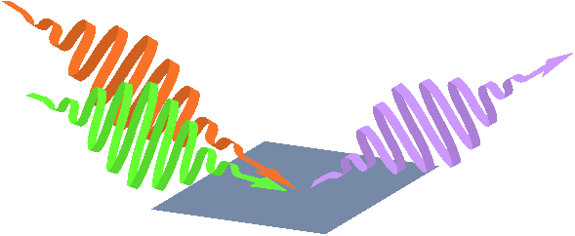

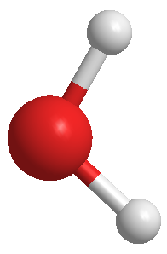





Aqueous interfaces as seen by different vibrational modes of water
Hydrogen bonding and molecular orientation by water bend spectroscopy
ν₂
Alex Benderskii
Department of Chemistry
University of Southern California

Slide 2

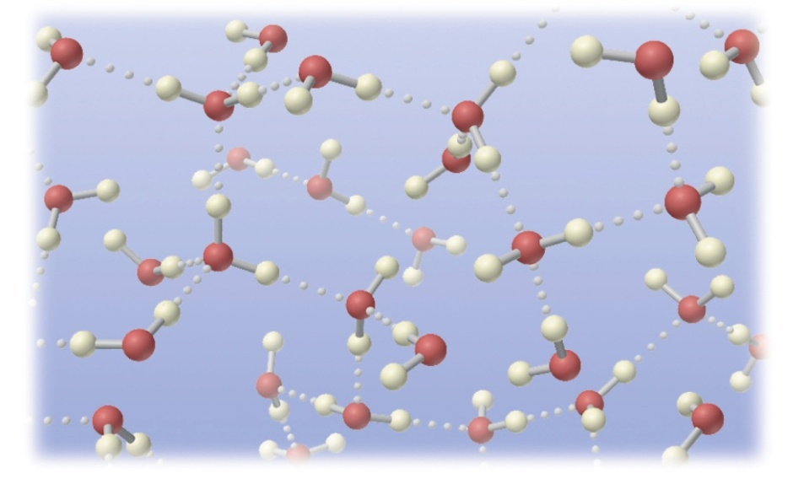
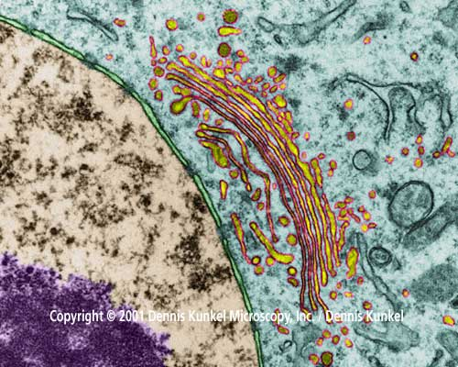

Water H-bonds
at Interfaces
Water H-bond network:
- H₂O liquid at room T
- high density
- high viscosity
- solvation properties
- hydrophobic effect
Aqueous interfaces:
- ‘biological water’
- environmental
interfaces
- electrochemistry
- heterogeneous
catalysis
Notes:
2

Slide 3
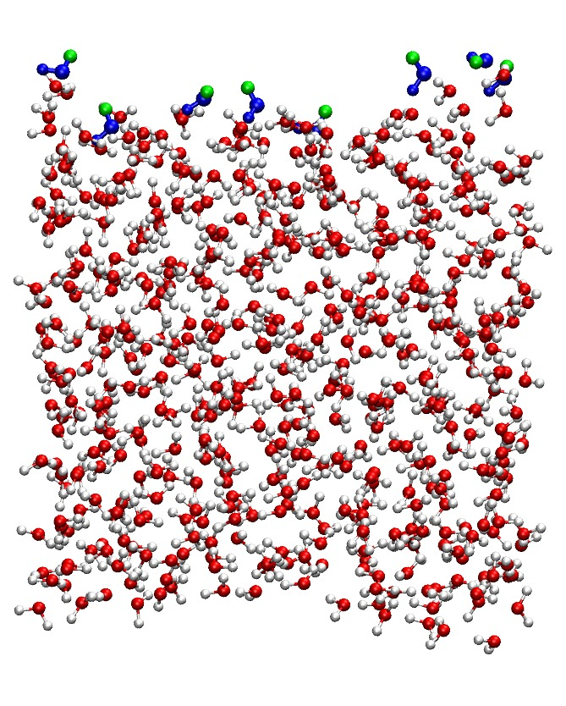
Molecular dynamics and spectroscopy
What do we want to know?
Density
H-bonding (#, strength, geometry)
Molecular orientation
Depth profile
Free energy (z,θ)
(solvation, surface tension, viscosity, etc.)
0
z
MD: Pieniazek, Skinner

Slide 4
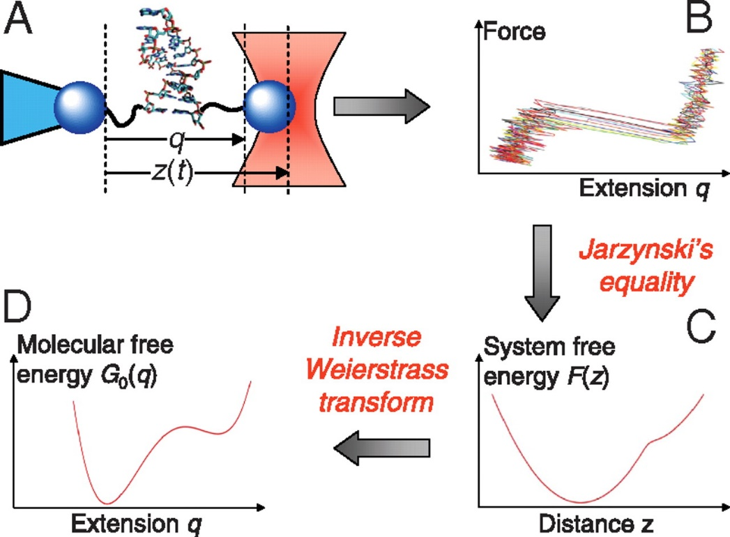
Molecular orientation
at interfaces
Single-molecule pulling experiment and its analysis
+ + + + + + + + + +
θ
G. Hummer, A. Szabo PNAS 2010, 107, 21441-21446
θ
A
B
E-field

Slide 5
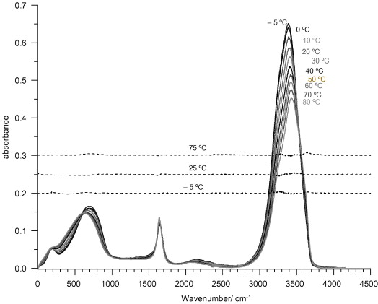
Vibrational spectrum of liquid water
Y. Marechal, J. Mol. Struct. 880 (2008) 38-43

Slide 6
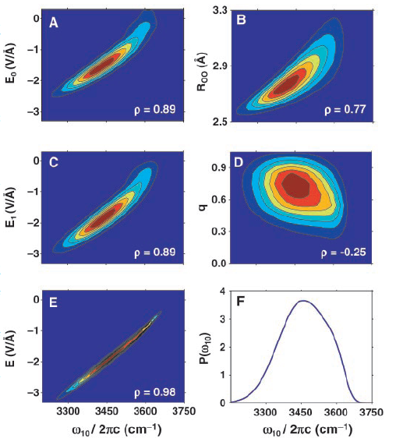
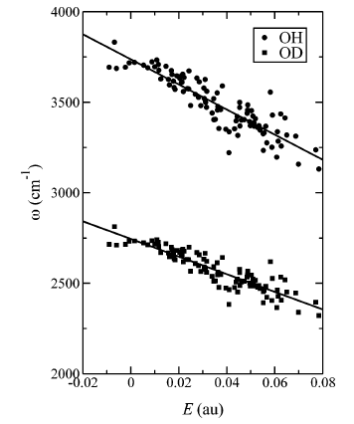
H-bonding: OH stretch frequency maps
Fecko et al. Science 301, 1698 (2003)
Corcelli, Skinner JPCB 109, 6154 (2005)
Tokmakoff, Bakker, Lauebrau, Geisler, Skinner, Hynes, Feyer, Pshenichnikov, Elsaesser, et al.

Slide 7
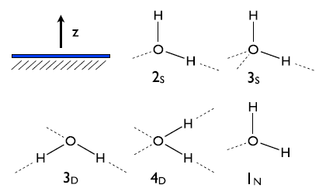
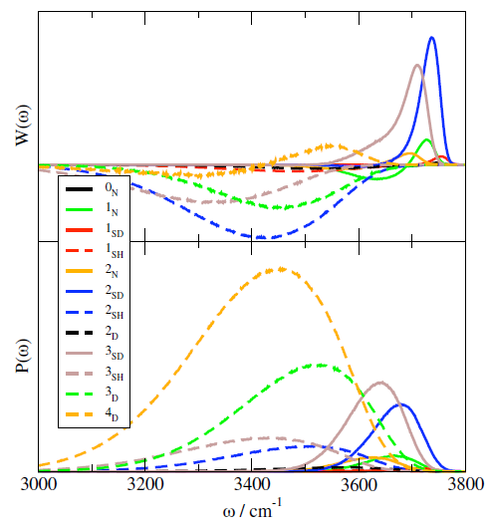
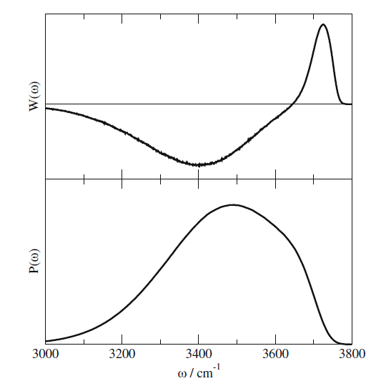
H-bonded classes
Auer, Skinner JCP 129, 214705 (2008),
CPL 470, 13 (2009)
Pieniazek, Tainter, Skinner JCP 135, 044701 (2011)

Slide 8
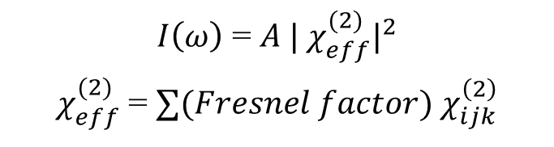
Molecular (?) Orientation at Interfaces
by Vibrational SFG
vis
P
S
P
SFG
ω_{vis}
P
ω_{SFG}
IR
S
S
|v=1⟩
ω_{IR}
|v=0⟩
E_{i}(ω_{SFG}) ∝ P_{i}⁽²⁾ = χ⁽²⁾_{ijk} (ω₁,ω₂) E_{j}(ω₁)E_{k}(ω₂)
Molecular origin of χ ⁽²⁾ :
χ ⁽²⁾_{ijk} = N_{s} ⟨R_{iλ}R_{jμ}R_{kν}⟩_{θ,ϕ,ψ} β_{λμν} ⁽²⁾(ω)
$I\left(ω\right)$ = $A | χ_{eff}^{(2)}|^{2}$
$χ_{eff}^{(2)}$ = $∑(Fresnel factor) χ_{ijk}^{\left(2\right)}$
Surface coverage
Molecular orientation
Spectroscopic selectivity
H.-F. Wang, et al. Int. Rev. Phys. Chem. 24, 191-256 (2005)

Slide 9
Molecular (?) Orientation at Interfaces
Vibrational SFG
Intra- and intermolecular vibrational
coupling (OH-stretch)
ω_{vis}
ω_{SFG}
|v=1⟩
ω_{IR}
|v=0⟩

Slide 10
Vibrational spectrum of liquid water
HOH bend
Small transition dipole - No excitonic effects in
  line shapes
  orientation
Less pronounced non-Condon effects
Y. Marechal, J. Mol. Struct. 880 (2008) 38-43

Slide 11
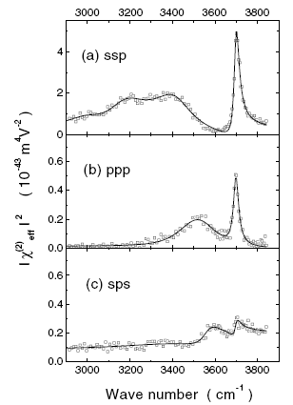
Vibrational spectrum of liquid water
surface
A.
SSP
PPP
Vinaykin, Benderskii
JPCL 3, 3348 (2012)
Du, Superfine, Shen PRL 70, 2313 (1993)
PRL 86, 4799 (2001)
Y. Marechal, J. Mol. Struct. 880 (2008) 38-43

Slide 12
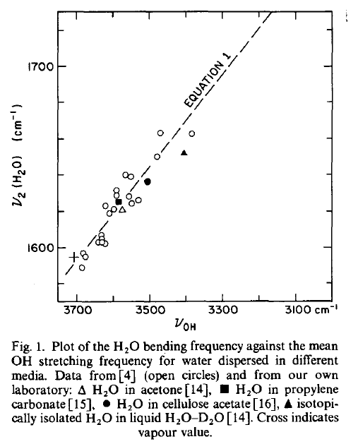
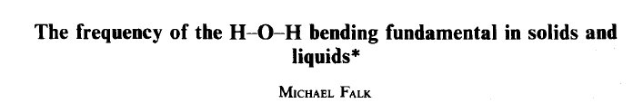
Water bend as a probe of H-bonds
H-bond strength
ν_{OH}
ν₂ (δ_{HOH})
(or is it, really?)

Slide 13
How to turn OH-stretch into a bend spectrum
OH-stretch
HOH bend
1
Wei, Shen PRL 86, 4799 (2001)
2
Nihonyanagi et al. JACS 133, 16875 (2011)
1600
1650
1700
1750
ν₂ (cm⁻¹)
ν₂ =1590-0.26(3705-ν_{OH})

Slide 14
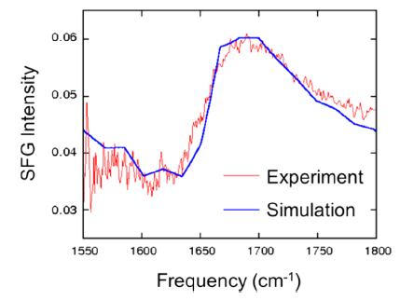
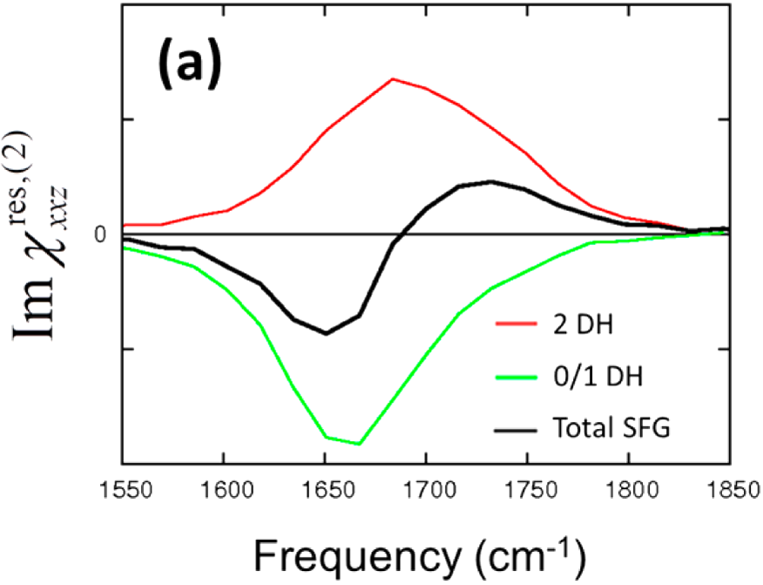
SFG spectrum of water bend at the A/W interface
Gas phase
A.
SSP
SSP
PPP
B.
x3
x3
C.
Nagata, Hsieh, Hasegawa, Voll, Backus, Bonn JPCL 4, 1872 (2013)
Vinaykin, Benderskii JPCL 3, 3348 (2012)

Slide 15
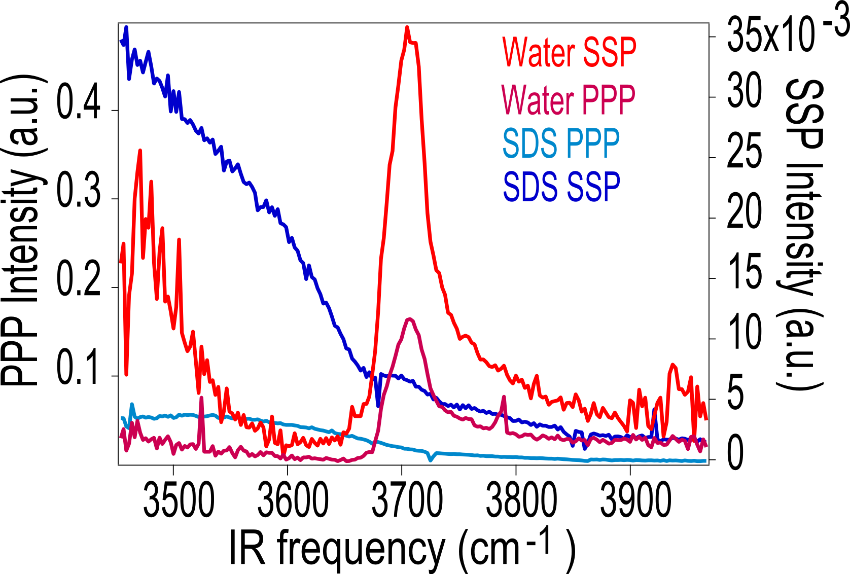
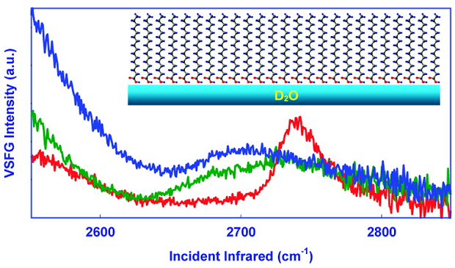
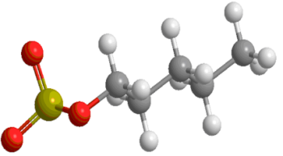

Surfactants suppress free OH species
Air/water interface
(1mM)
SDS at air/water interface
-
-
G.Ma et al.. JACS 2007,129,14057

Slide 16
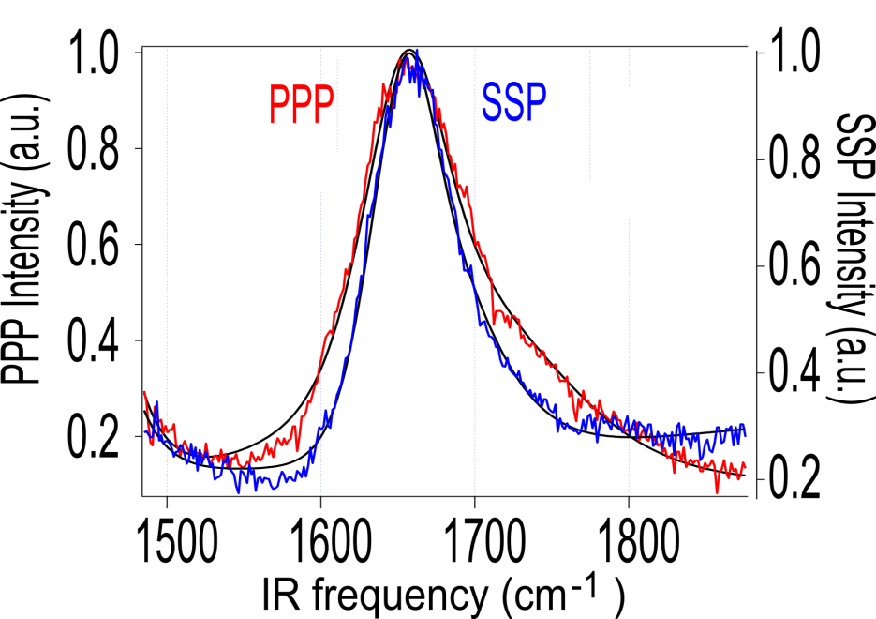
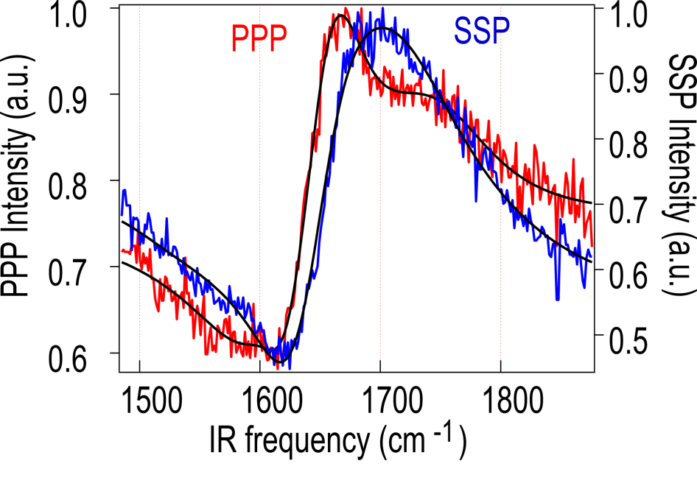
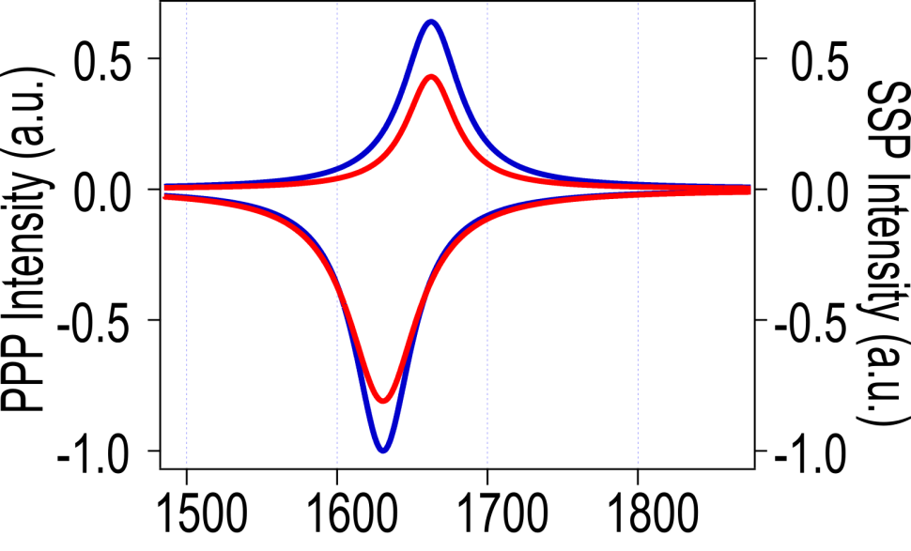
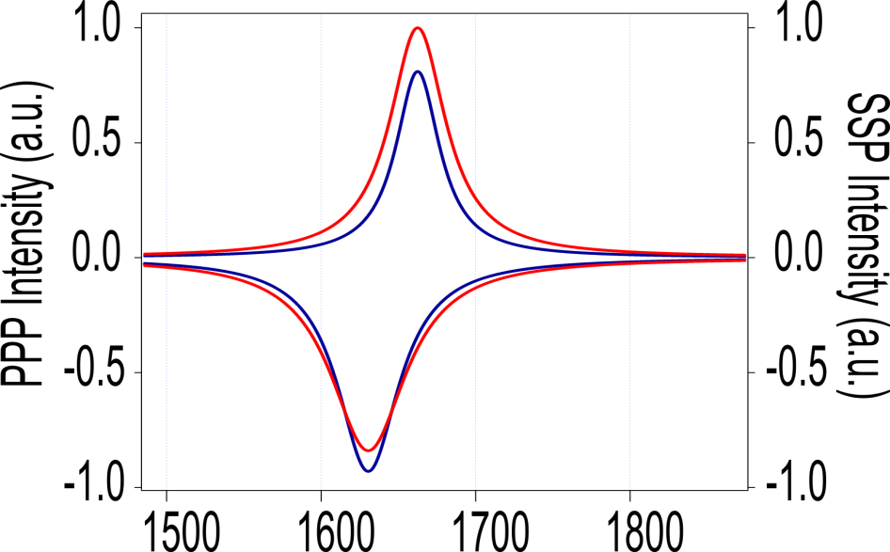
Air/Water
SDS Solution (1mM)
B₂
B₂
B₁
B₁
(SSP)
(SSP)
(PPP)
(PPP)

Slide 17
Water bend spectroscopic maps
Centered ~ 0 cm⁻¹.
Range from ~
−20 cm⁻¹ to +20 cm⁻¹
“+” means H down
“-” means H up

Slide 18
Stretch vs. bend frequency anti-correlation

Slide 19
SFG spectrum of water bend at the A/W interface
Calculated spectra
Contributions
Y. Ni, J.L. Skinner, J. Chem. Phys. 143, 014502 (2015)

Slide 20
SFG orientational analysis: water bend
vis
P
S
z
P
SFG
IR
P
θ
S
S
x
y
a
χ ⁽²⁾_{ijk} = N_{s} ⟨R_{iλ}R_{jμ}R_{kν}⟩_{θ,ϕ,ψ} β_{λμν} ⁽²⁾(ω)
c
b
Molecular orientation
Zhuang, Miranda, Kim, Shen PRB 59, 12632 (1999)
Wang, et al. Int. Rev. Phys. Chem. 24, 191-256 (2005)
from
Ni, Skinner JCP 143, 014502 (2015)

Slide 21
SFG orientational analysis: water bend
“Free OH”
“H-bonded”
1630 cm⁻¹
1660 cm⁻¹

Slide 22
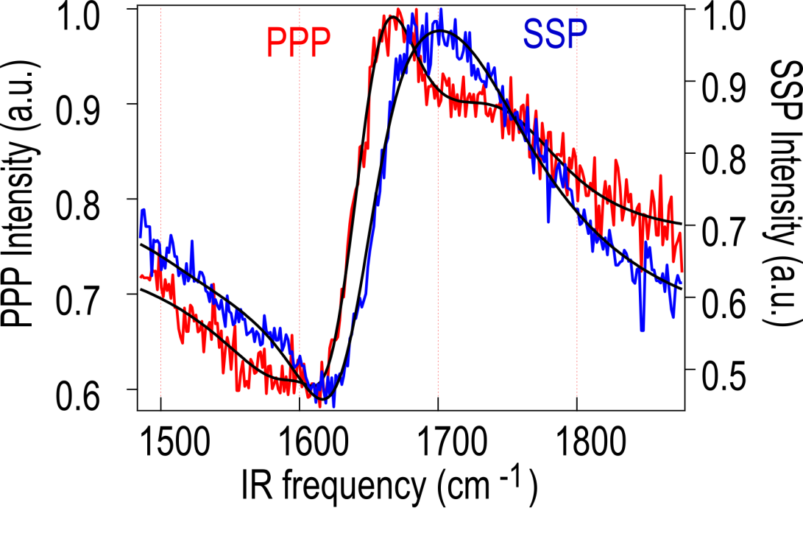
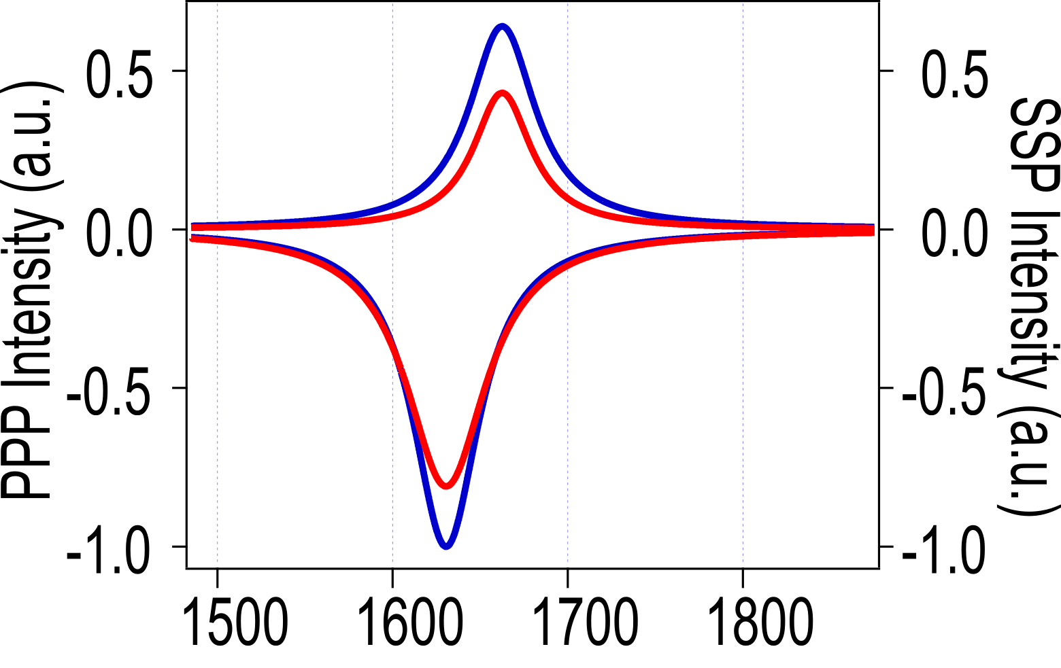
SFG spectrum of water bend at the A/W interface
Two Lorentzian fit
 | ω₁ (cm⁻¹) | ω₂ (cm⁻¹)
SSP | 1630.5 b₁=-0.399 | 1660.5 b₂=0.256
PPP | 1630.5 b₁=-0.323 | 1662.5 b₂=0.171
b₂
“Free OH”
“H-bonded”
b₁

Slide 23
Air/water interface
SFG orientational analysis of water bend
Free OH
H-bonded
72º
110º

Slide 24
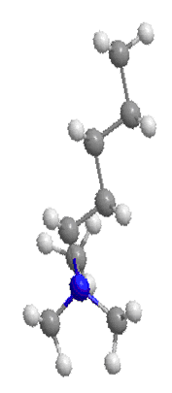



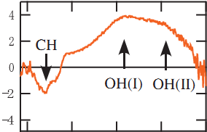

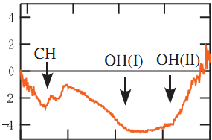

Orientational flip-flop of water molecules
at charged interfaces
-
-
+
+
SDS at air/water interface
CTAB at air/water interface
SDS
CTAB
Nihonyanagi, Yamaguchi, Tahara JCP 2009,130, 204704

Slide 25
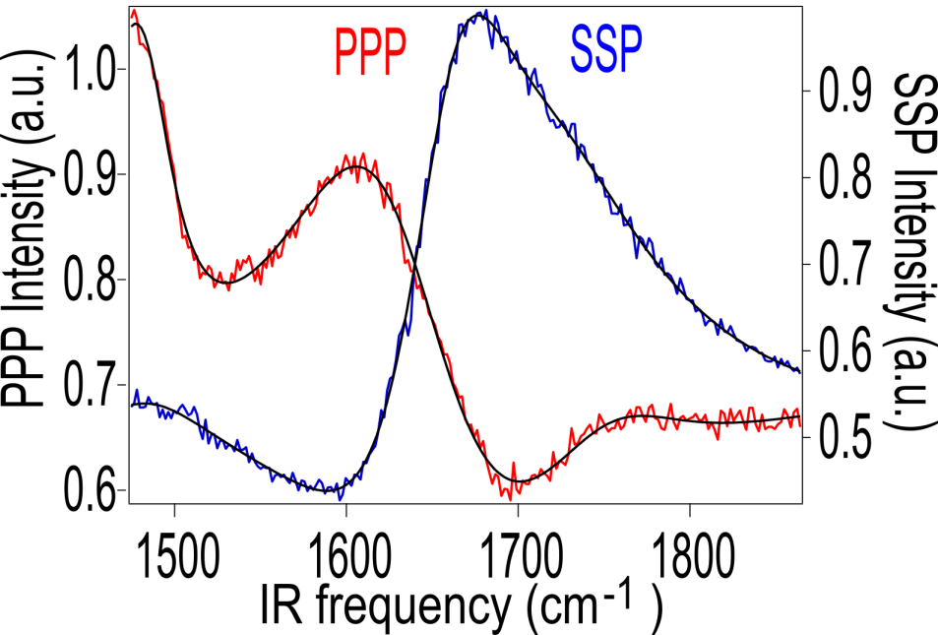
SDS at air/water interface
CTAB at air/water interface
-
-
+
+

Slide 26
Air/Water
SDS at air/water interface

Slide 27
SFG orientational analysis: water bend
“Free OH”
“H-bonded”
1630 cm⁻¹
1660 cm⁻¹
SDS
A/W
A/W

Slide 28
Air/Water
SDS at air/water interface
-
-

Slide 29
Air/Water
CTAB at air/water interface

Slide 30
SFG orientational analysis: water bend
“Free OH”
“H-bonded”
1630 cm⁻¹
1660 cm⁻¹
CTAB
A/W
A/W
CTAB

Slide 31
Air/Water
CTAB at air/water interface
?
+
+
+
+

Slide 32
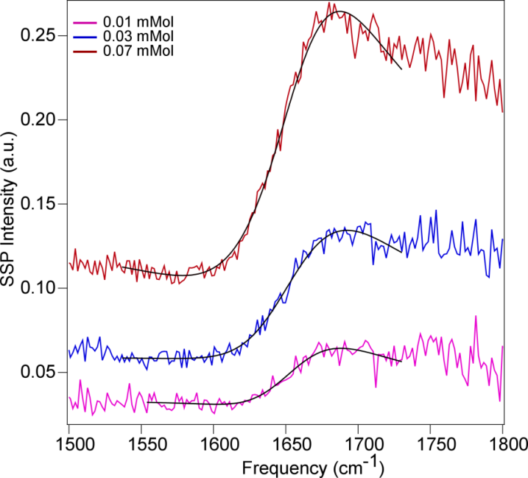
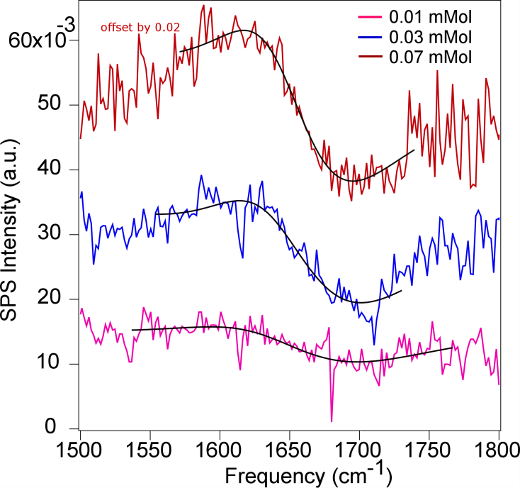
Water orientation vs. surface charge
CTAB at air/water interface
+ + + + + + + + + +
θ
θ
E-field
PPP
SSP
SPS

Slide 33
SFG orientational analysis: water bend
z
θ
x
y

Slide 34
Water orientation vs. surface charge
CTAB at air/water interface
+
+

Slide 35
“Free OH”
+
+

Slide 36
+
+
“H-bonded”

Slide 37

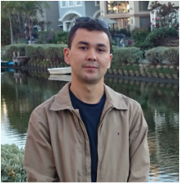
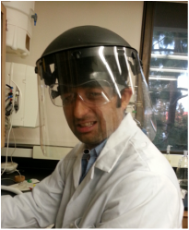





Acknowledgments
Chayan Dutta
Muhammet Mammetkuliyev
Angelo Montenegro
Funding
NSF
Purnim Dhar
Dhritiman Bhattacharyya
Past group members:
Mikhail Vinaykin
Sergey Malyk
Fadel Shalhout
David Valley
Igor Stiopkin
Collaborators:
S. Cronin & group
USC EE
US AFOSR
Theory: water spectroscopy
J. L. Skinner & group
U. Wisconsin-Madison
US ARO
Notes:
37

Slide 39
OH stretch:
non-Condon effects
HOH bend:
Condon approximation
Corcelli, Skinner JPC A 109, 6154 (2005)
Ni, Skinner JCP 143, 014502 (2015)

Slide 40
How to turn OH-stretch into a bend spectrum
OH-stretch
HOH bend
1
Wei, Shen PRL 86, 4799 (2001)
2
Nihonyanagi et al. JACS 133, 16875 (2011)
H-bonded
3
Free OH
1600
1650
1700
1750
1600
1650
1700
1750
ν₂ (cm⁻¹)
ν₂ (cm⁻¹)
ν₂ =1590-0.26(3705-ν_{OH})

Slide 41
CTAB at air/water interface
SSP, PPP, and SPS

Slide 42
SFG spectrum of water bend at the A/W interface
Two Lorentzian fit
 | ω₁ (cm⁻¹) | ω₂ (cm⁻¹)
SSP | 1630.5 b₁=-0.399 | 1660.5 b₂=0.256
PPP | 1630.5 b₁=-0.323 | 1662.5 b₂=0.171
b₂
“Free OH”
“H-bonded”
b₁

Slide 43
SFG spectrum of water bend at the A/W interface
Gas phase
Bulk
A.
SSP
PPP
Two Lorentzian fit
 | ω₁ (cm⁻¹) | ω₂ (cm⁻¹)
SSP | 1655 b₁=1.6 | 1752 b₂=0.3
PPP | 1642 b₁=2.1 | 1728 b₂=0.7
B.
x3
Gas phase: 1595 cm⁻¹
Bulk water: 1645 cm⁻¹
x3
C.
Vinaykin, Benderskii JPCL 3, 3348 (2012)

Slide 44
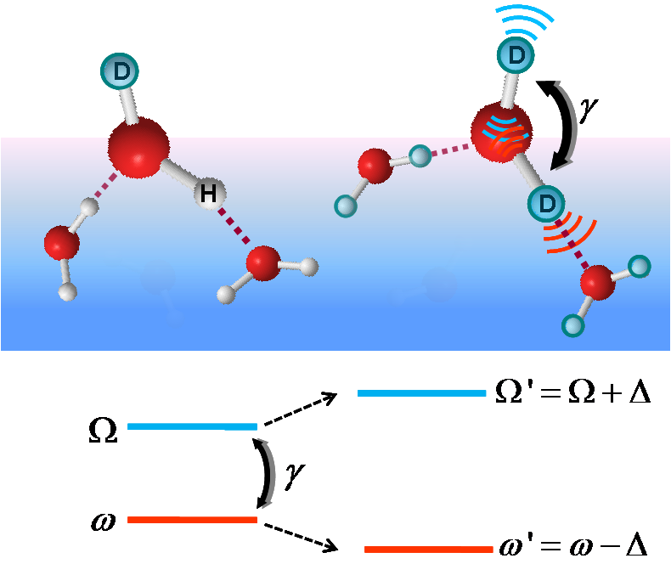
OH-stretch spectrum of water surface
Experiment (SSP)
HOD
DOD
Theory (SSP)
Stiopkin et al. Nature 474, 192 (2011)

Slide 45
SDS - Air/water - CTAB

Slide 46
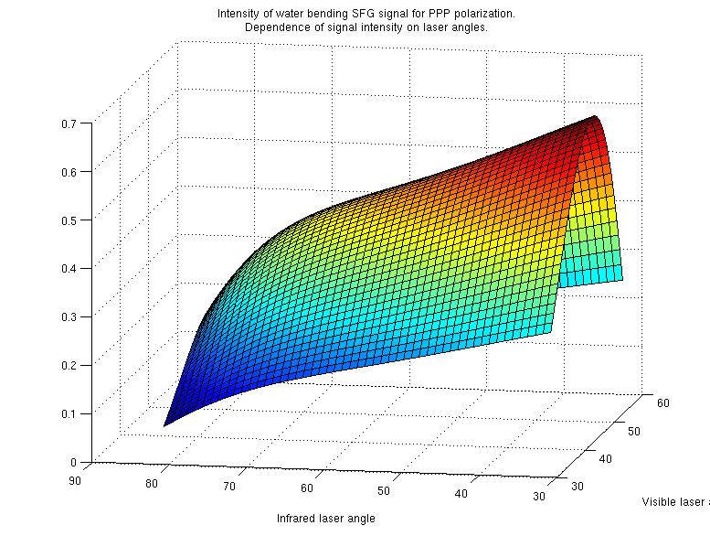
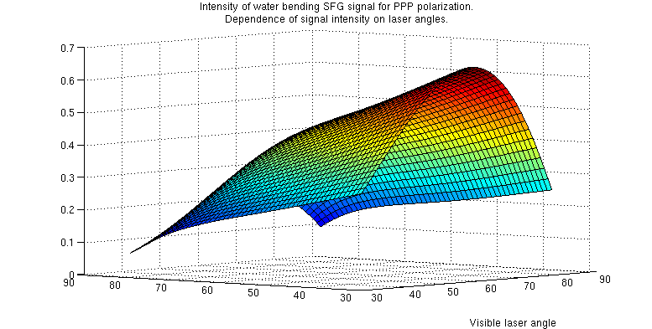
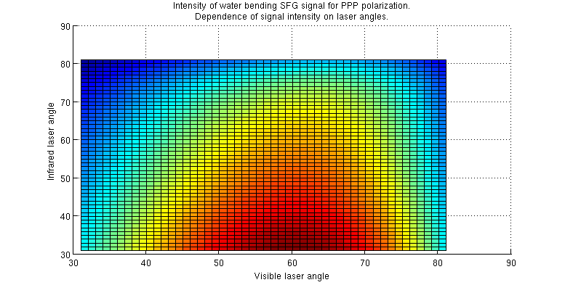
Optimal experimental geometry
for water bend, PPP

Slide 47
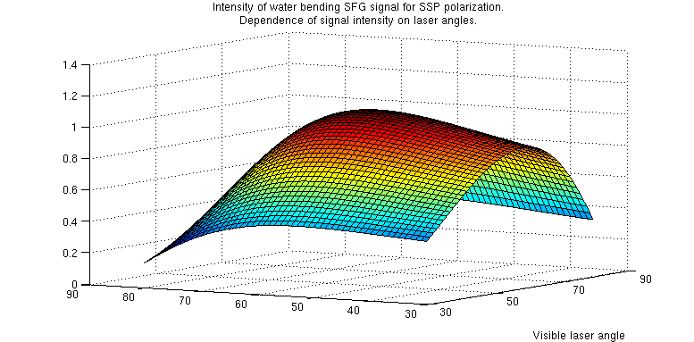
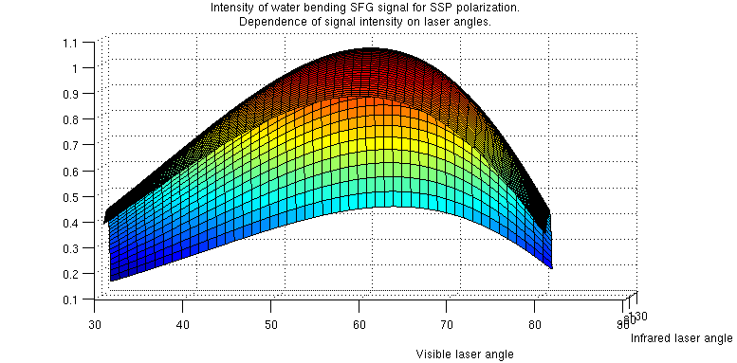
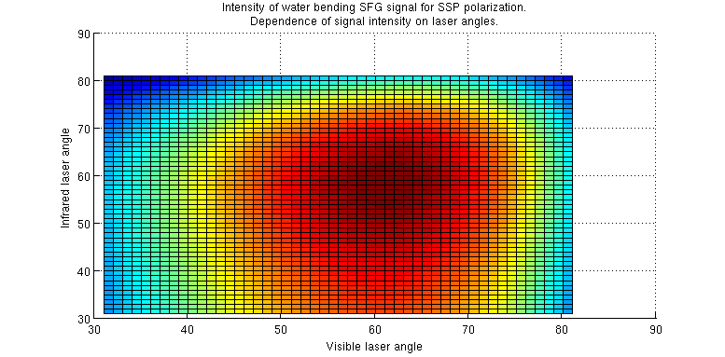
Optimal experimental geometry
for water bend, SSP

Slide 48
Only β_{aac}/ β_{ccc} changed
Solid lines : original values
Dashed lines: β_{aac}/ β_{ccc} increased by 2
Circles: β_{aac}/ β_{ccc} decreased by 2

Slide 49
Only β_{bcc}/ β_{ccc} changed
Solid lines : original values
Dashed lines: β_{bcc}/ β_{ccc} increased by 2
Circles: β_{bcc}/ β_{ccc} decreased by 2

Slide 50
Both β_{aac}/ β_{ccc} and β_{bcc}/ β_{ccc} changed
Solid lines : original values
Dashed lines: values increased by 2
Circles: values decreased by 2

Slide 51
Water bend spectroscopy at the A/W interface
Current summary
Complementary probe of H-boding to OH-stretch
Weak non-Condon effects
No intra-molecular coupling
Inter-molecular coupling may be problematic/interesting
Potentially good probe of molecular orientation
b₂
Future
Orientational analysis, SPS A/W
HD-SFG
Intermolecular coupling mechanism
Temperature dependence
Surface modification, electrostatics
b₁

Slide 52
OH-stretch spectroscopy of water surface
Tian and Shen, JACS 2009, 131, 2790–2791
Nihonyanagi, Ishiyama, Lee, Yamaguchi, Bonn, Morita, Tahara, JACS 133, 16875 (2011)
Excellent probe of H-boding strength
Depth profiling via free OH
Orientation problematic:
Intra- and inter-molecular (excitonic) coupling
Non-Condon effects
Pieniazek, Tainter, Skinner JCP 135, 044701 (2011)

Slide 53
PPP
0º C
20º C
SSP
0º C
20º C
Vinaykin, Benderskii JPCL 3, 3348 (2012)

Slide 54
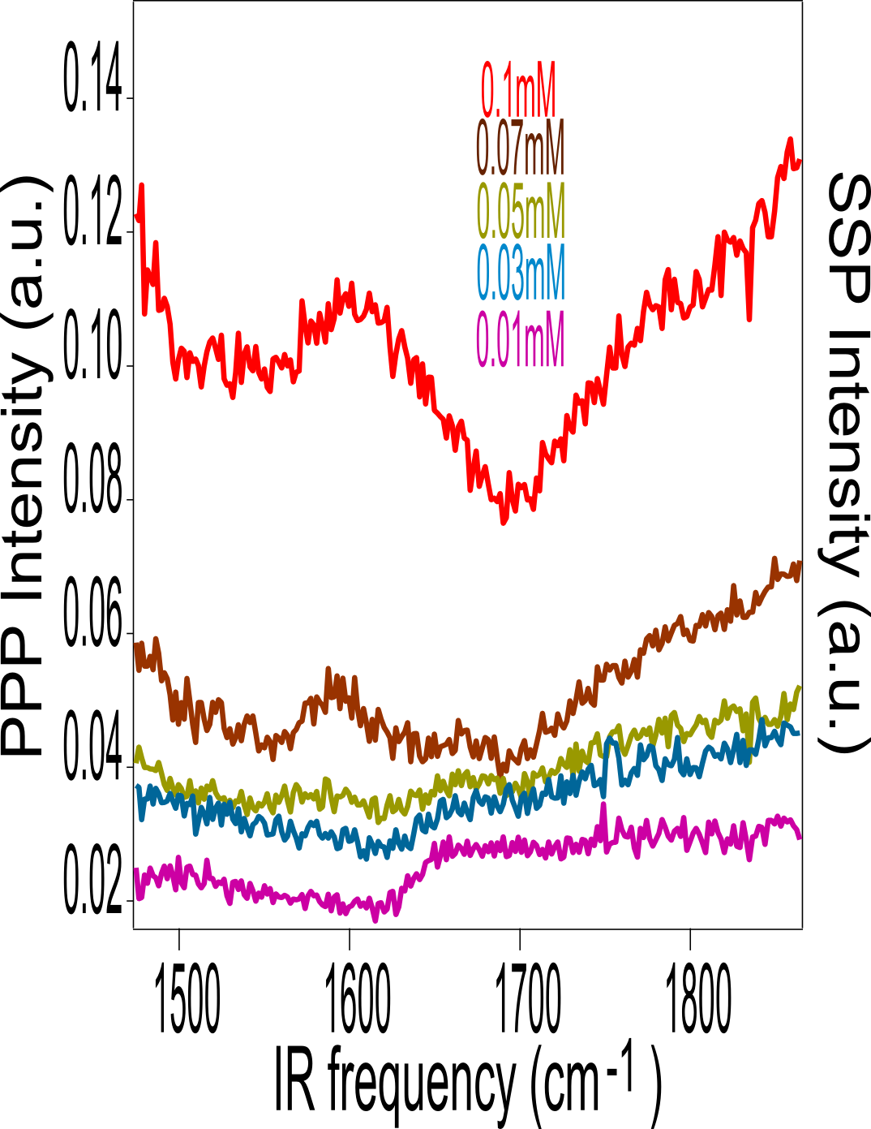
Nonresonant background vs. surface charge
CTAB at air/water interface
SDS - Air/water - CTAB

Slide 55

Water: T-dependence

Slide 56
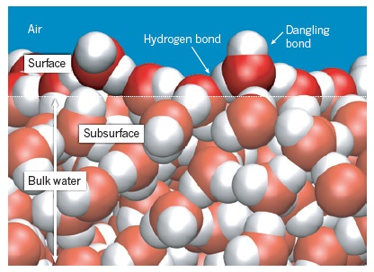
Vibrational spectrum of water surface (SFG)
Experiment (SSP)
HOD
DOD
Theory (SSP)
Stiopkin, Weeraman, Pieniazek, Shalhout, Skinner, Benderskii Nature 474, 192 (2011)

Slide 57
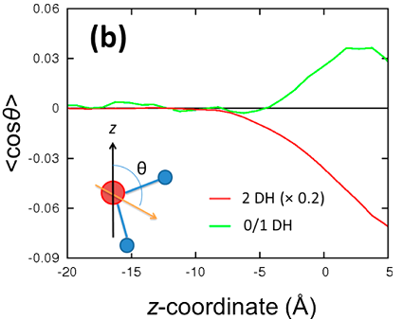
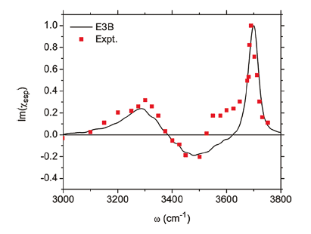
SFG spectrum of water bend at the A/W interface
Sign vs. orientation
SSP
Skinner et al. Acc. Chem. Res. 45, 93 (2012)
Nagata, Hsieh, Hasegawa, Voll, Backus, Bonn JPCL 4, 1872 (2013)

Slide 58
Molecular dynamics and spectroscopy
Information content: too much and too little?
Density
H-bonding
Molecular orientation
Depth dependence
0
z
MD: Pieniazek, Skinner

Slide 59
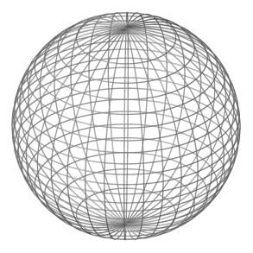
Molecular orientation at surfaces/interfaces
Orientational anisotropy
Equilibrium orientational distribution
Orientational dynamics
Bulk
Interface

Slide 60
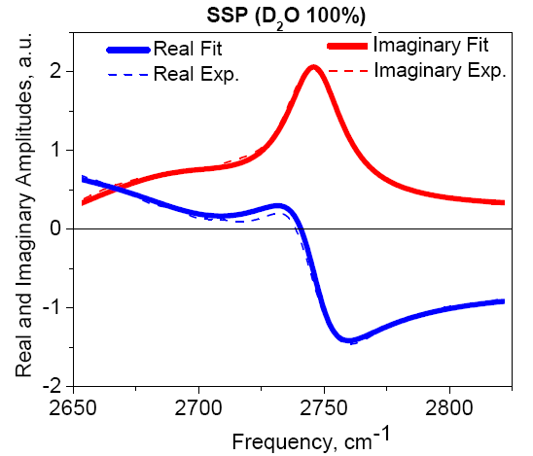
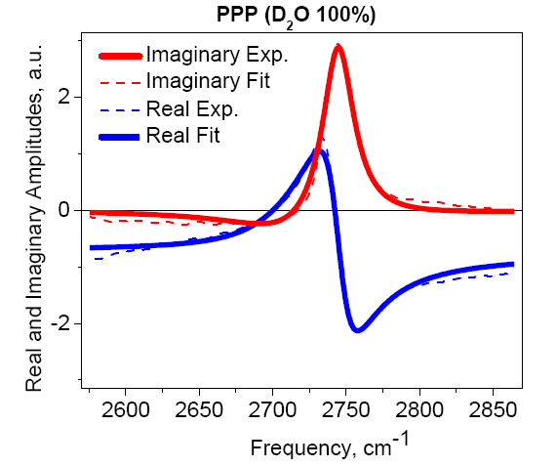
The 2680 cm⁻¹ feature

Slide 61
SFG spectrum of water bend at the A/W interface
Gas phase
Bulk
‘Free OH’ bend ?
‘H-bonded’ bend ?
Vinaykin, Benderskii JPCL 3, 3348 (2012)

Slide 62
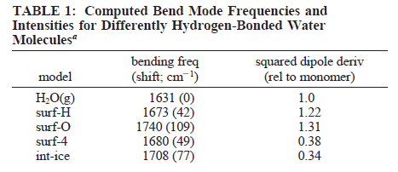
IR spectra of ice cluster surfaces
Hernandez, Uras, Devlin JCP 1998, 108, 4525
Devlin, Sadlej, Buch JPC A 2001, 105, 974-983

Slide 63

Vibrational modes of water
Main vibrations of water isotopologues
Gas | v₁, cm⁻¹ | v₂, cm⁻¹ | v₃, cm⁻¹
H₂¹⁶O | 3657.1 | 1594.7 | 3755.9
H₂¹⁷O | 3653.2 | 1591.3 | 3748.3
H₂¹⁸O | 3649.7 | 1588.3 | 3741.6
HD¹⁶O | 2723.7 | 1403.5 | 3707.5
D₂¹⁶O | 2671.7 | 1178.4 | 2787.7
HT¹⁶O | 2299.8 | 1332.5 | 3716.6
T₂¹⁶O | 2237.2 | 995.4 | 2366.6

Slide 64
Water bend at the A/W interface: T-dependence
“Free OH”:
PPP
SSP
+20ºC : ν₂ = 1656 cm⁻¹, Γ=37 cm⁻¹
0ºC : ν₂ = 1661 cm⁻¹, Γ=44 cm⁻¹
PPP
+20ºC : ν₂ = 1642 cm⁻¹, Γ=39 cm⁻¹
0ºC : ν₂ = 1644 cm⁻¹, Γ=38 cm⁻¹
0º C
20º C
SSP
0º C
Bulk water:
ν₂ band narrowing with increasing T is observed in bulk water (IR and Raman)
Small frequency shift observed as well (IR) 1650 (-4ºC), 1639 (20ºC), 1637 (80ºC)
20º C
ν₂ life time (bulk H₂O): 170 fs at 23ºC (= 31 cm⁻¹)
250 fs at 76ºC
(Elsaesser et al., 2005, 2007)

Slide 65


J.P. Devlin, J. Sadlej, V. Buch J. Phys. Chem. A 2001, 105, 974-983

