Slide 1

Benzimidazolequinoxalines: Novel Fluorophores with Tuneable Sensitivity to Solvent Effects
T.I. Burganov, S.A. Katsyuba, N.A. Zhukova, V.A. Mamedov, Ch. Bannwarth, S. Grimme
Moscow, 2016

Slide 2
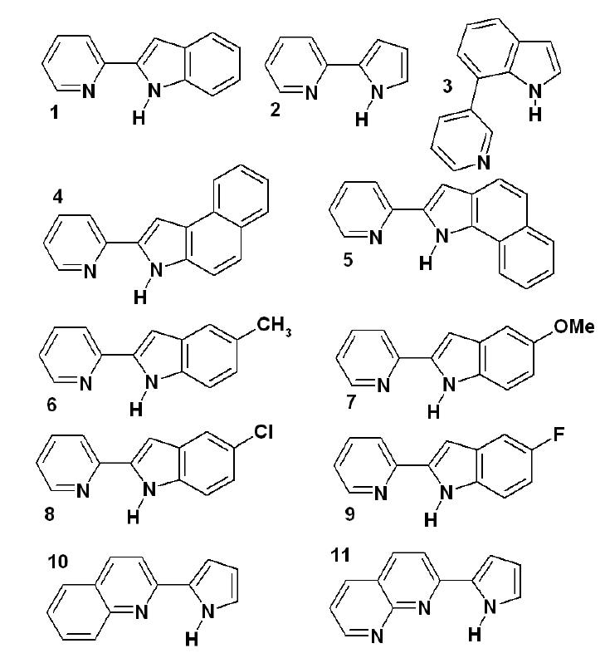
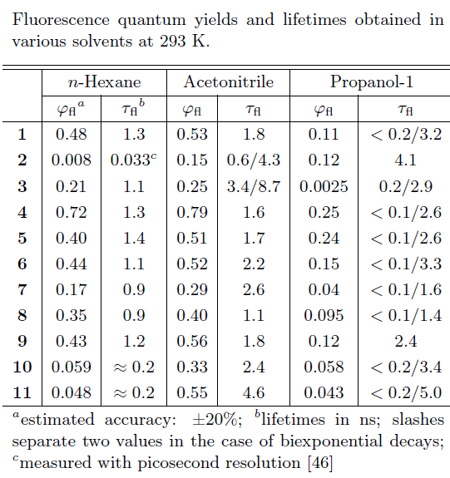
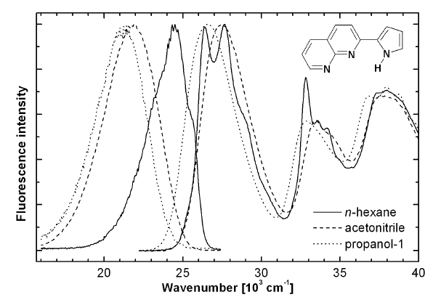
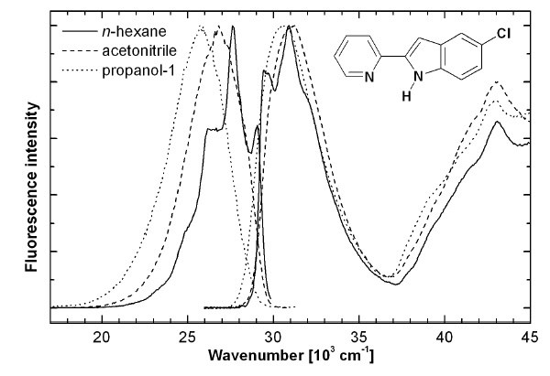
Bifunctional azaaromatic compounds
M. Kijak, et.al ACT. PHYS. POL. A, 2007, 112, S105-S120

Slide 3
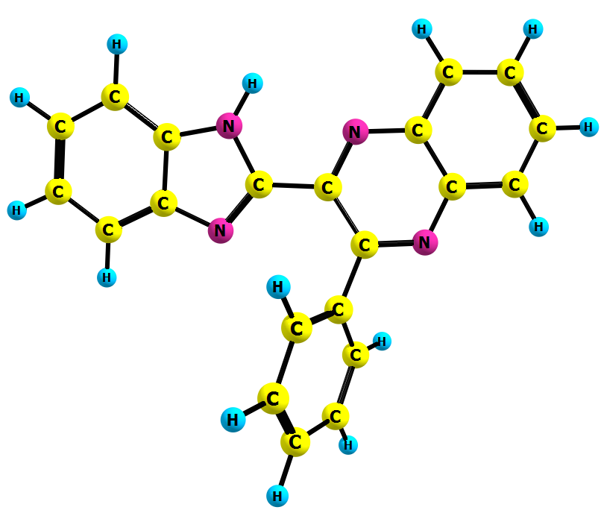
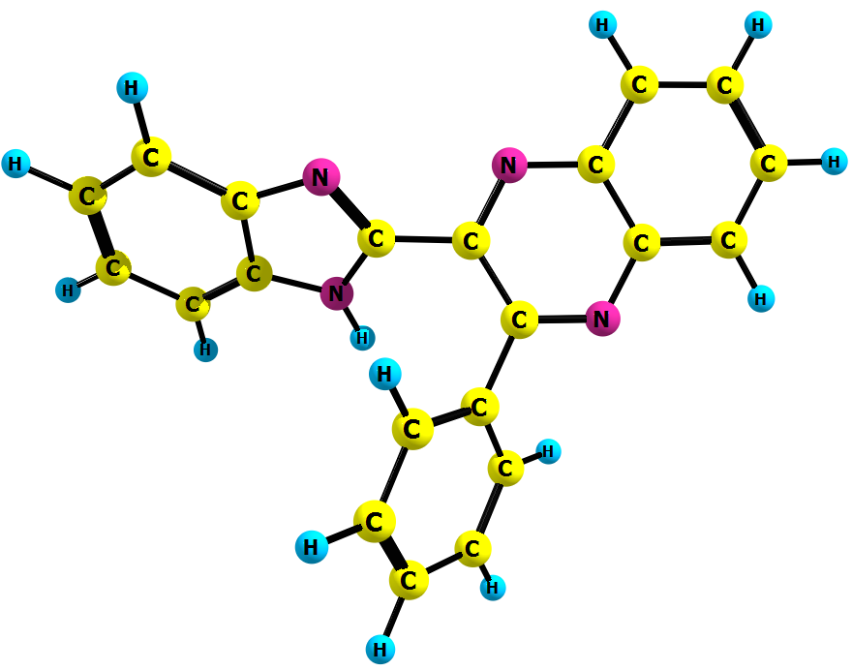
Syn- and anti-conformers of bifunctional azaaromatic compounds
(N-H) 100.7 pm
(N-H) 100.6 pm
Δν(NH_{syn-anti} )= 10 cm⁻¹
ΔI(NH_{syn-anti}) = 21 cm⁻¹
General formula

Slide 4
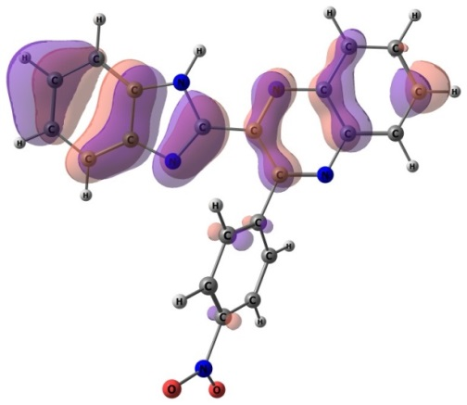
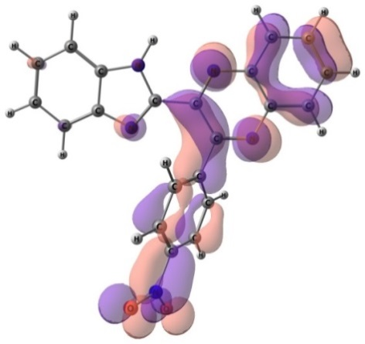
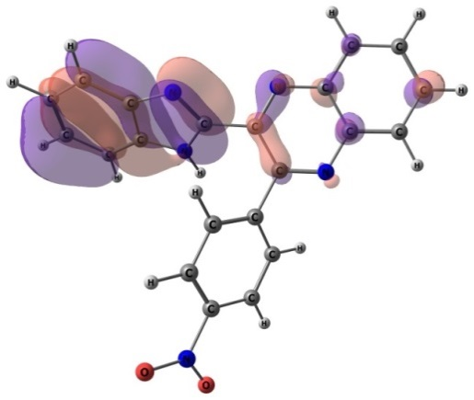
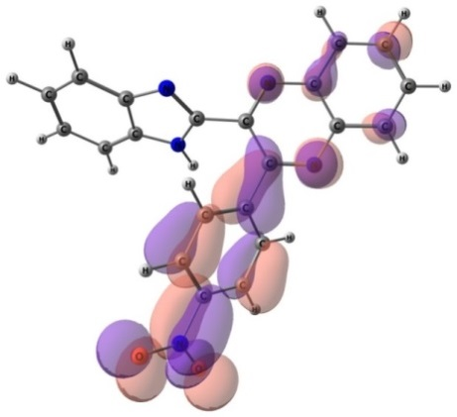
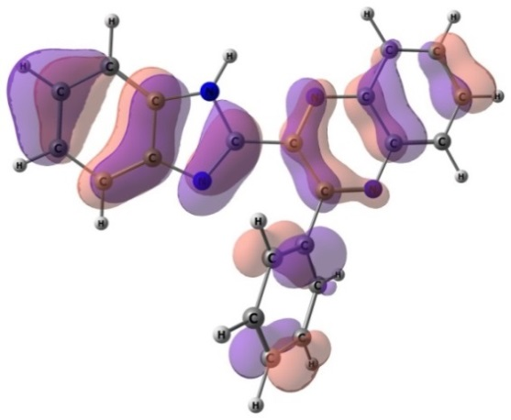
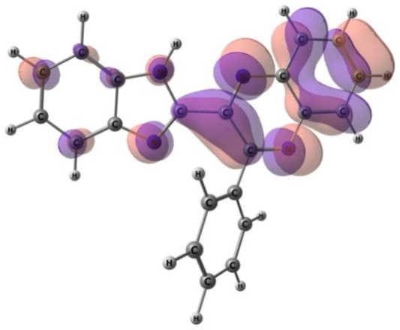
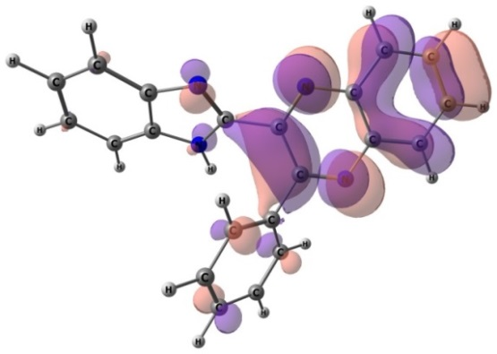
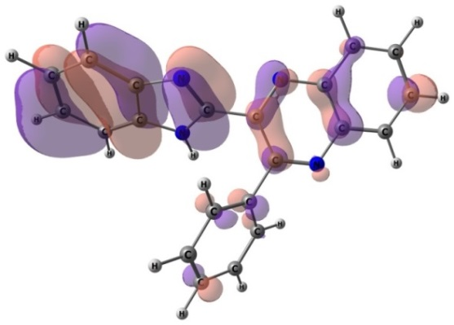
Conformational behavior of anti and syn forms
HOMO syn
LUMO syn
HOMO anti
LUMO anti
HOMO syn
LUMO syn
HOMO anti
LUMO anti

Slide 5
UV/vis absorption spectra of anti and syn forms

Slide 6
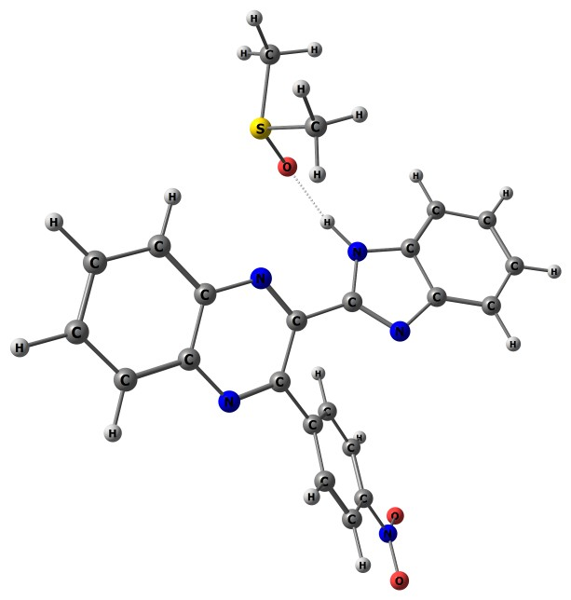
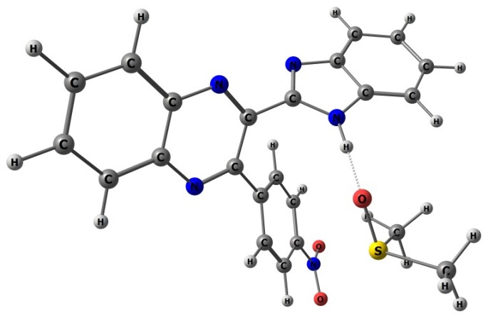
Conformational behavior of anti and syn forms
compound | S₀ (gas phase) |  | S₀ (DMSO) | S₁ (gas) | S₁ (DMSO)
 | ΔE | ΔG | ΔE | ΔE | ΔE
1 | 3.2 | 3.2 | 1.0 | 3.6 | -1.0
1-Me | -0.3 | 0.2 | - | -0.4
2 | 4.7 | 4.7 | 1.6 | -ª | -4.1
3 | 3.7 | 3.7 | - | 4.4
4 | 3.8 | 3.8 | 0.9 | 4.2 | -1.0
5 | 3.3 | 3.4 | - | 4.0
6 | 4.2 | 4.1 | 2.8 | 5.8 | 0.1
Complexes 1 with DMSO (1:1)

Slide 7
UV/vis absorption spectra of anti and syn forms

Slide 8
Fluorescence spectra of the studied compounds

Slide 9
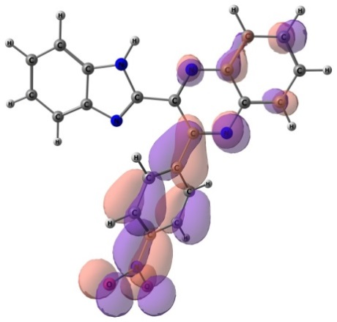
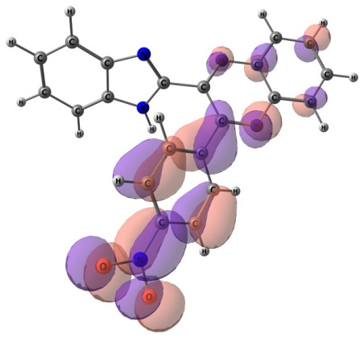
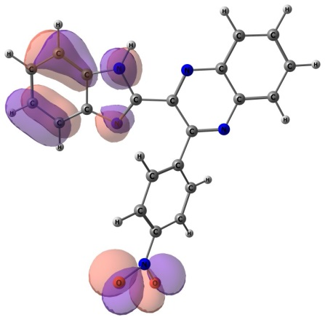
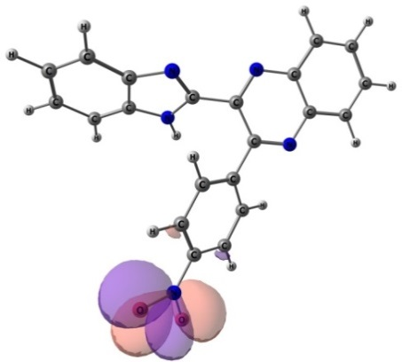
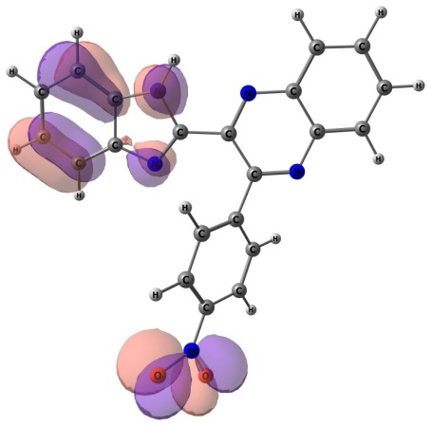
Fluorescence spectra of the studied compounds
syn
anti
LUMO
HOMO-2
HOMO-3

Slide 10
Compound | Type | Experiment |  |  | Calculations
 |  | DCE solution | DMF solution | DMSO solution | syn | anti
1 | abs | 352 | 352 | 352 | 368 | 355
 | emi | 446 | 465 | 470 | 438 | 448
1-Me | abs | 373 | 367 | 367 | 367 | 359
 | emi | 440 | 460 | 470 | 467 | 473
2 | abs | 371 | 367 | 367 | 371 | 387
 | emi | 493 | -- | -- | -- | --
3 | abs | 375 | 370 | 370 | 373 | 355
 | emi | 444 | 462 | 468 | 440 | 450
4 | abs | 375 | 371 | 371 | 373 | 358
 | emi | 446 | 468 | 470 | 442 | 454
5 | abs | 383 | 383 | 380 | 382 | 377
 | emi | 473 | 492 | 501 | 466 | 483
6 | abs | 396 | 391 | 391 | 412 | 406
 | emi | 519 | -- | -- | 513 | 551

Slide 11
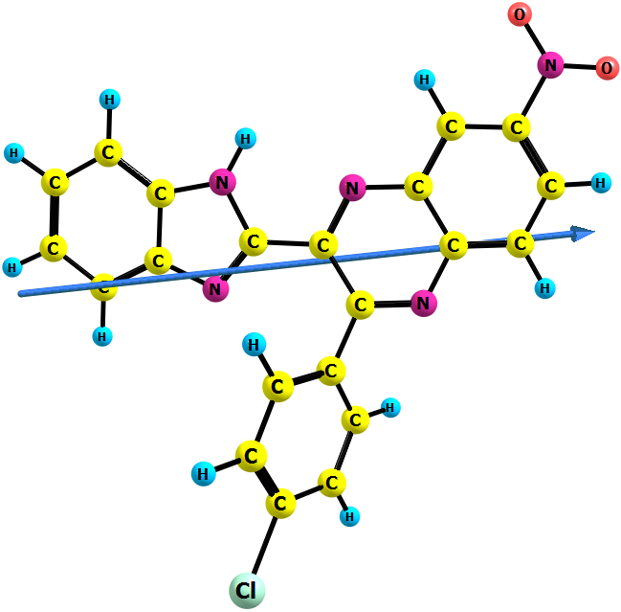
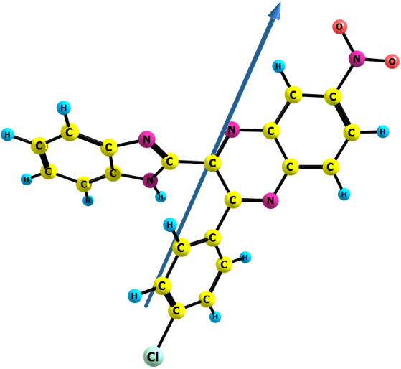
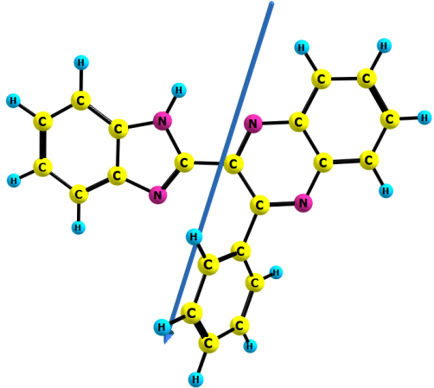
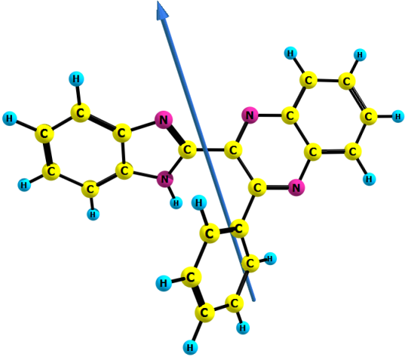
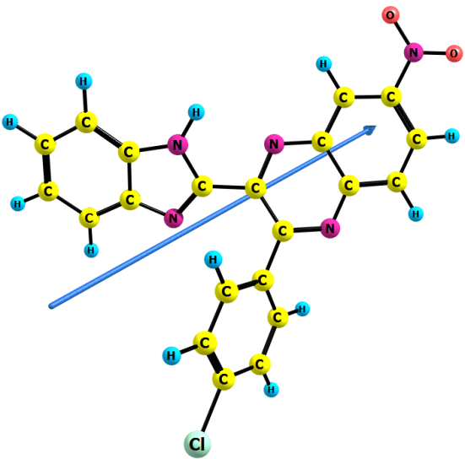
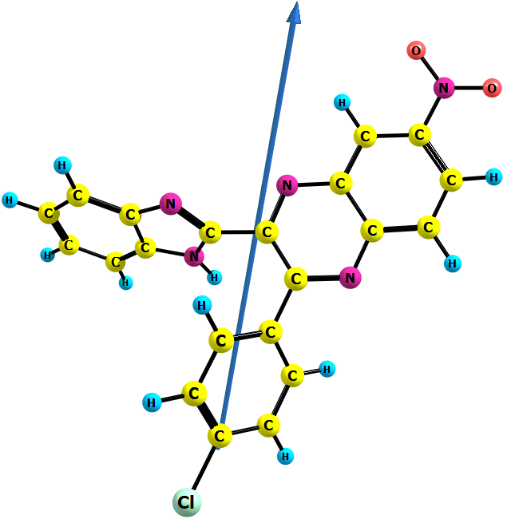
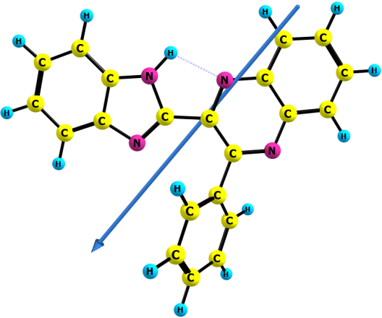
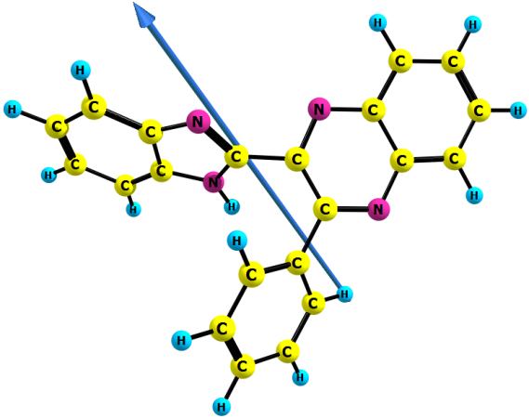
Dipole moments of some studied compounds
syn
anti
syn
anti
S₀
2.80 D
S₀
3.37 D
2.43 D
6.12 D
S₁
S₁
14.23 D
18.49 D
21.97 D
12.04 D

Slide 12
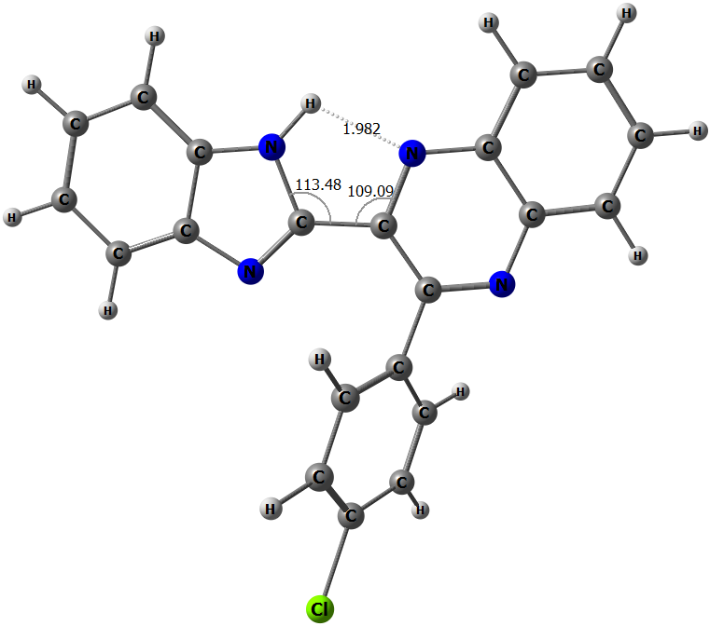
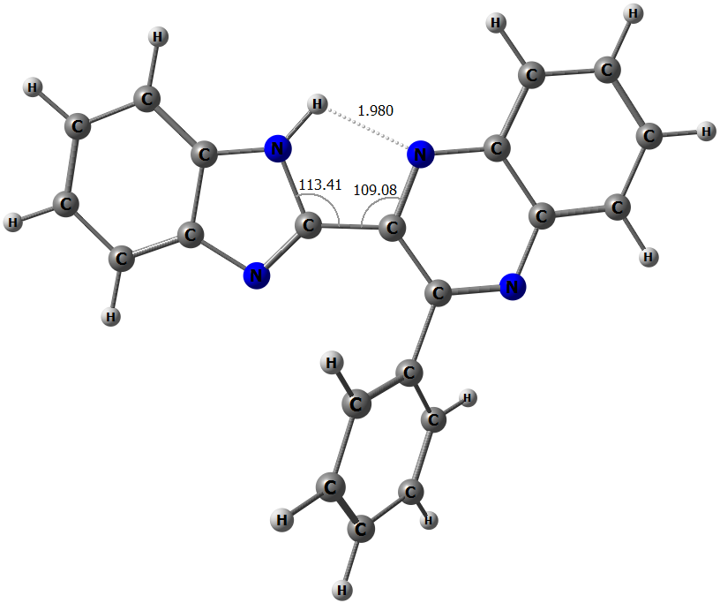
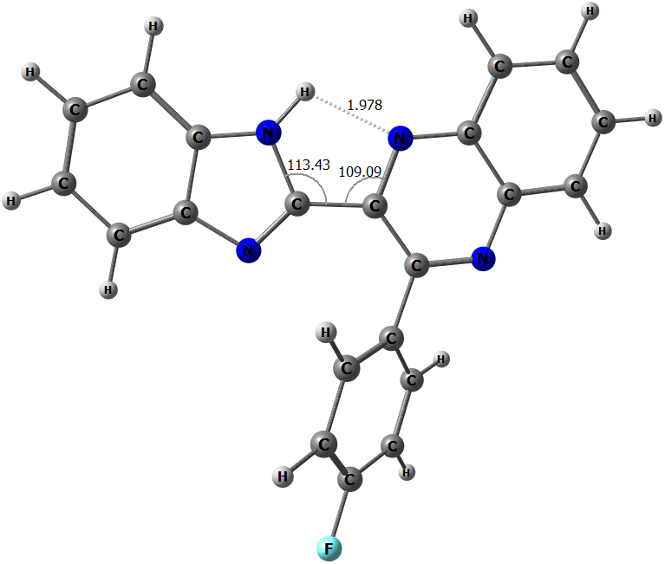
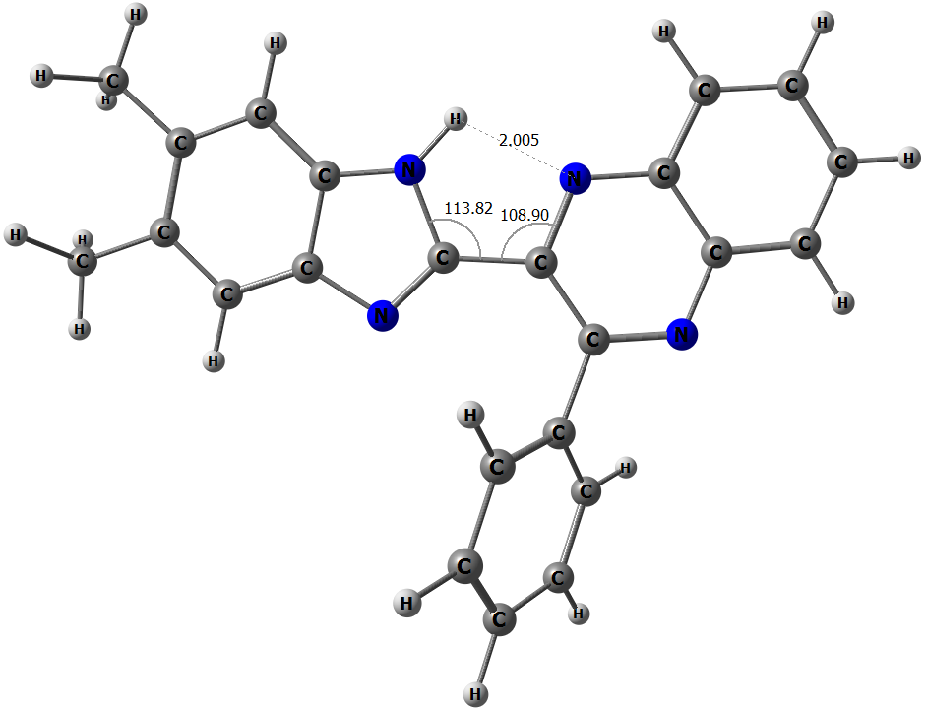
Hydrogen bond energy for first singlet excited state (S¹)
E(HB)=-0.5Vb
E(HB)=9.04 kcal/mol
E(HB)=-0.5Vb
E(HB) = 9.09 kcal/mol
E(HB)=269Gb
E(HB)=7.97 kcal/mol
E(HB)=269Gb
E(HB)=8.00 kcal/mol
E(HB)=-0.5Vb
E(HB)=9.11 kcal/mol
E(HB)=-0.5Vb
E(HB)=8.62 kcal/mol
E(HB)=269Gb
E(HB)=8.01 kcal/mol
E(HB)=269Gb
E(HB)=7.70 kcal/mol

Slide 13
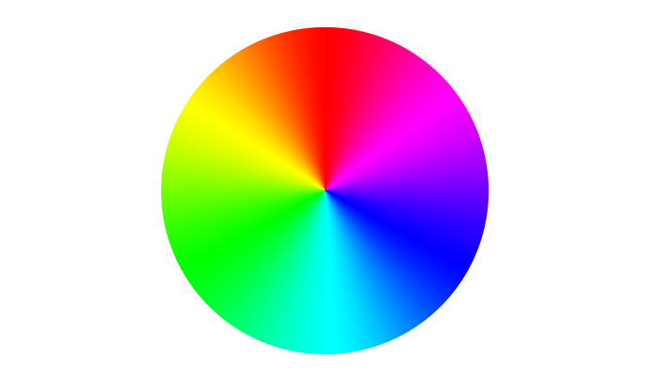
Thank you for kind attention

Slide 14
compound | Calculationsª |  | Experiment^{b}
 | λ_{abs}, nm (f) | λ_{emi}, nm (f) | λ_{abs}, nm (log ε) |  |  | λ_{emi}, nm (φ_{rel})
 |  |  | DCE^{c} | DMF^{d} | DMSO^{e} | DCE^{c} | DMF^{d} | DMSO^{e}
1 | 368 (0.351) | 438 (0.111) | 373 (4.24) | 367 (4.15) | 367 (4.10) | 440 (0.055) | 460 (0.13) | 470 (0.11)
1-Me | 367 (0.220) | 467 (0.059) | 352 (4.03) | 352 (4.01) | 352 (4.02) | 446 (0.025) | 465 (0.33) | 470 (0,04)
2 | 371 (0.278) | -^{f} | 371 (4.24) | 367 (4.20) | 367 (4.18) | 490 | - | -
3 | 373 (0.321) | 454 (0.133) | 375 (4.20) | 370 (4.13) | 370 (4.18) | 444 (0.031) | 462 (0.16) | 468 (0.12)
4 | 373 (0.320) | 442 (0.103) | 375 (4.24) | 371 (4.15) | 371 (4.18) | 446 (0.048) | 468 (0.20) | 470 (0.18)
5 | 382 (0.429) | 466 (0.129) | 383 (4.25) | 383 (4.20) | 380 (4.20) | 473 (0.064) | 492 (0.29) | 501 (0.25)
6 | 412 (0.262) | 513 (0.133) | 396 (4.16) | 391 (4.12) | 391 (4.09) | 519 | - | -

Slide 15
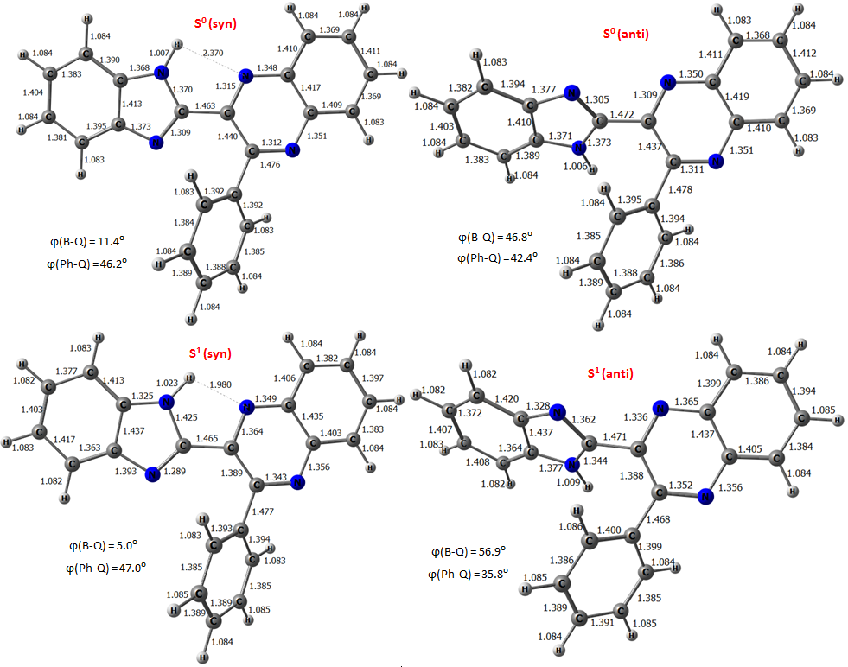
Calculated ground and singlet excited state geometries
Compound 1

Slide 16
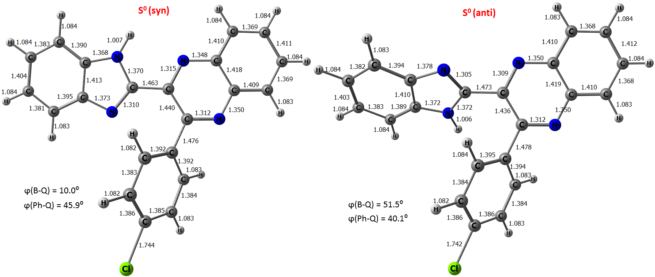
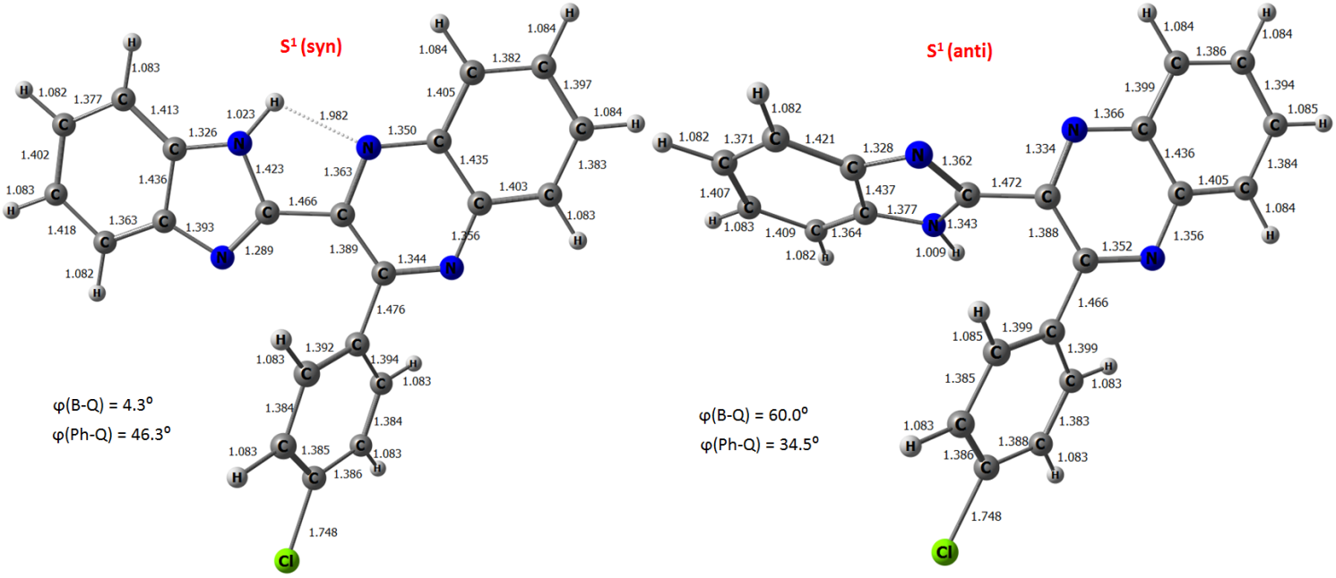
Calculated ground and singlet excited state geometries
Compound 4

Slide 17
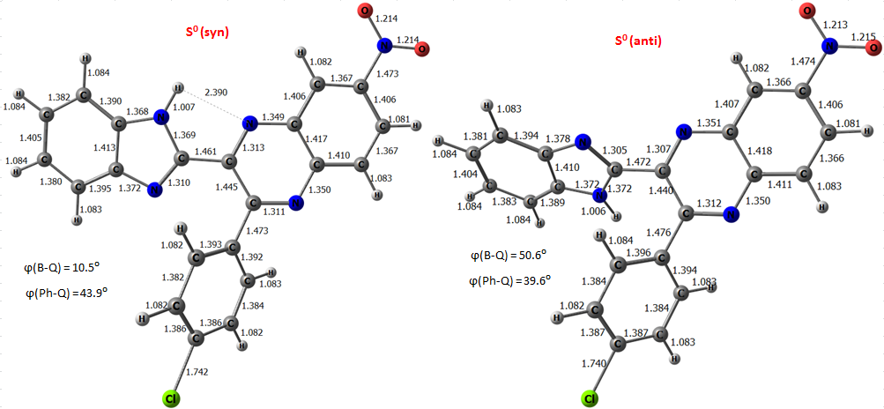
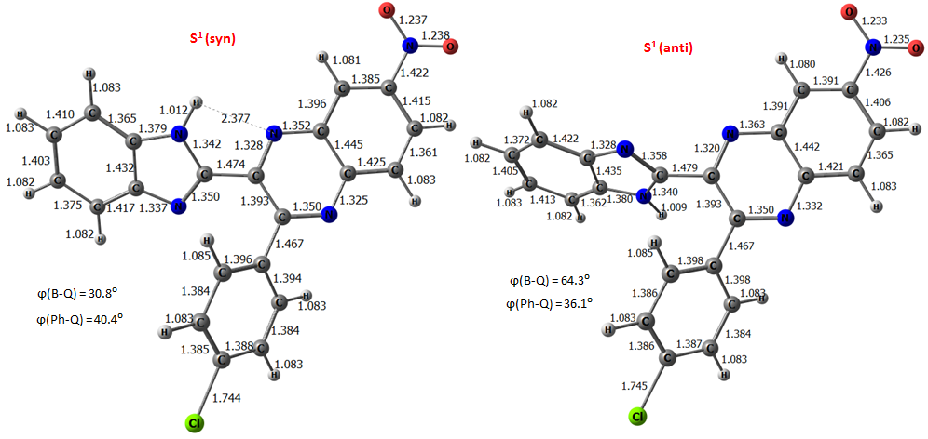
Calculated ground and singlet excited state geometries
Compound 6

Slide 18
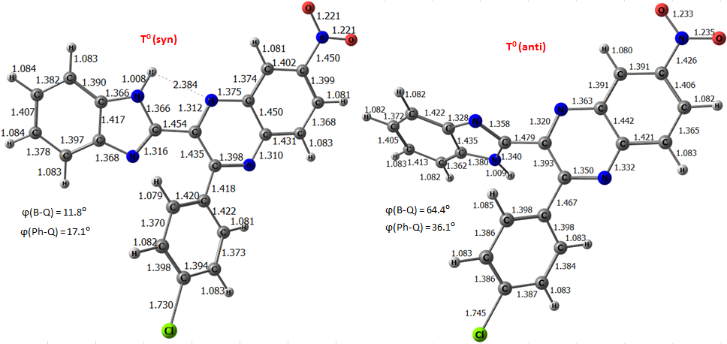
Calculated triplet state geometries
Compound 6

Slide 19
Hydrogen bond energy for first singlet excited state (S¹)
Compound | Rho | Vb | E(HB)=-0.5Vb | kcal/mol | Gb | E(HB)=0.429Gb | kcal/mol
 | 0.032484 | -0.02896 | 0.014478437 | 9.09 | 0.02970837 | 0.012744891 | 8.00
 | 0.031033 | -0.02747 | 0.013736629 | 8.62 | 0.028614463 | 0.012275605 | 7.70
 | 0.032365 | -0.02883 | 0.01441321 | 9.04 | 0.029605797 | 0.012700887 | 7.97
 | 0.032582 | -0.02905 | 0.014525343 | 9.11 | 0.029768069 | 0.012770502 | 8.01
 | no critical point
 | no converged S1 state

Slide 20
Some geometrical and spectral markers of H-bond
Compound | Conformer | Bond length | 1:1 H-complex with DMSO |  | isolated molecules
 |  |  | State |  | State
 |  |  | S₀ | S₁ | S₀ | S₁
1 | syn | NH | 1.0282 | 1.0746 | 1.0072 | 1.0234
 |  | ΔNH | 0.0211 | 0.0512
 |  | H···O | 1.7649 | 1.5230
 |  | SO | 1.5292 | 1.5528
 | anti | NH | 1.0291 | 1.0845 | 1.0059 | 1.0091
 |  | ΔNH | 0.0232 | 0.0754
 |  | H···O | 1.7340 | 1.4996
 |  | SO | 1.5303 | 1.5540
 |  | ΔΝΗ_{syn−anti} | - | - | 0.0012 | 0.0143
 |  | ΔνNH_{syn-anti} |  |  | -10
 |  | ΔI(νNH)_{syn-anti} |  |  | 21
2 | syn | NH | 1.0292 | 1.0865 | 1.0072 | -
 |  | ΔNH | 0.0221
 |  | H···O | 1.7542 | 1.4842
 |  | SO | 1.5293 | 1.5519
 | anti | NH | 1.0281 | 1.1057 | 1.0057 | -
 |  | ΔNH | 0.0224
 |  | H···O | 1.7440 | 1.4419
 |  | SO | 1.5301 | 1.5627
 |  | ΔΝΗ_{syn−anti} | - | - | 0.0015
 |  | ΔνNH_{syn-anti} |  |  | -14
 |  | ΔI(νNH)_{syn-anti} |  |  | 25
Compound | Conformer | Bond length | 1:1 H-complex with DMSO |  | isolated molecules
 |  |  | State |  | State
 |  |  | S₀ | S₁ | S₀ | S₁
4 | syn | NH | 1.0285 | 1.0752 | 1.0072 | 1.0235
 |  | ΔNH | 0.0213 | 0.0517
 |  | H···O | 1.7626 | 1.5203
 |  | SO | 1.5293 | 1.5528
 | anti | NH | 1.0285 | 1.0850 | 1.0057 | 1.0089
 |  | ΔNH | 0.0228 | 0.0762
 |  | H···O | 1.7415 | 1.4963
 |  | SO | 1.5303 | 1.5539
 |  | ΔΝΗ_{syn−anti} | - | - | 0.0015 | 0.0146
 |  | ΔνNH_{syn-anti} |  |  | -14
 |  | ΔI(νNH)_{syn-anti} |  |  | 24
6 | syn | NH | 1.0310 | 1.0849 | 1.0072 | 1.0120
 |  | ΔNH | 0.0238 | 0.0730
 |  | H···O | 1.7380 | 1.4881
 |  | SO | 1.5303 | 1.5539
 | anti | NH | 1.0228 | 1.0871 | 1.0058 | 1.0089
 |  | ΔNH | 0.0171 | 0.0783
 |  | H···O | 1.8170 | 1.4832
 |  | SO | 1.5307 | 1.5531
 |  | ΔΝΗ_{syn−anti} | - | - | 0.0014 | 0.0031
 |  | ΔνNH_{syn-anti} |  |  | -13
 |  | ΔI(νNH)_{syn-anti} |  |  | 23

Slide 21
Compound | conformer | Dipole moments
 |  | S₀ | S₁
1 | syn | 2.80 | 12.04
 | anti | 3.37 | 14.23
1-Me | syn | 3.15 | 14.25
 | anti | 3.73 | 15.18
2 | syn | 8.47 | -*
 | anti | 5.13 | -*
3 | syn | 4.45 | 12.23
 | anti | 2.97 | 14.23
4 | syn | 4.80 | 12.51
 | anti | 2.97 | 13.78
5 | syn | 2.79 | 14.56
 | anti | 3.17 | 17.81
6 | syn | 2.43 | 18.49
 | anti | 6.12 | 21.97
Vector representation of dipole moments for 1
S₀
S₁

