Slide 1


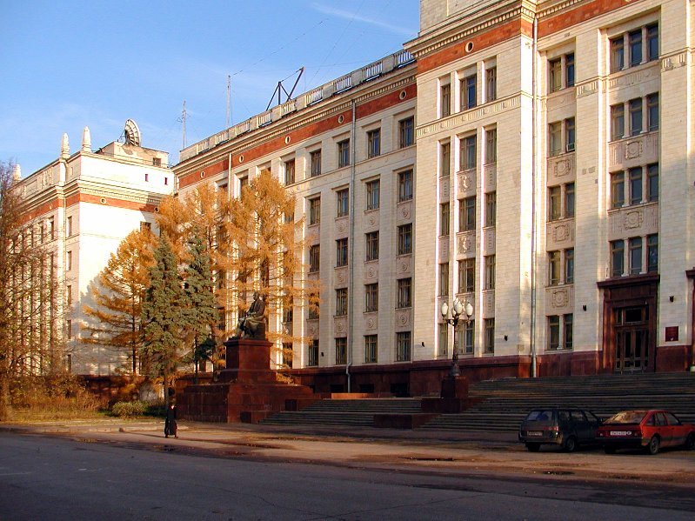
The atomic, charge and electronic structure of small Ar cluster ions – an ab initio study
J.G. Korobova, A.E Ieshkin, V.S. Chernysh
Moscow State University, Physical Department
e-mail: korobovajg@yandex.ru
5-th School-Conference on Atomistic Simulation of Functional Materials

Slide 2
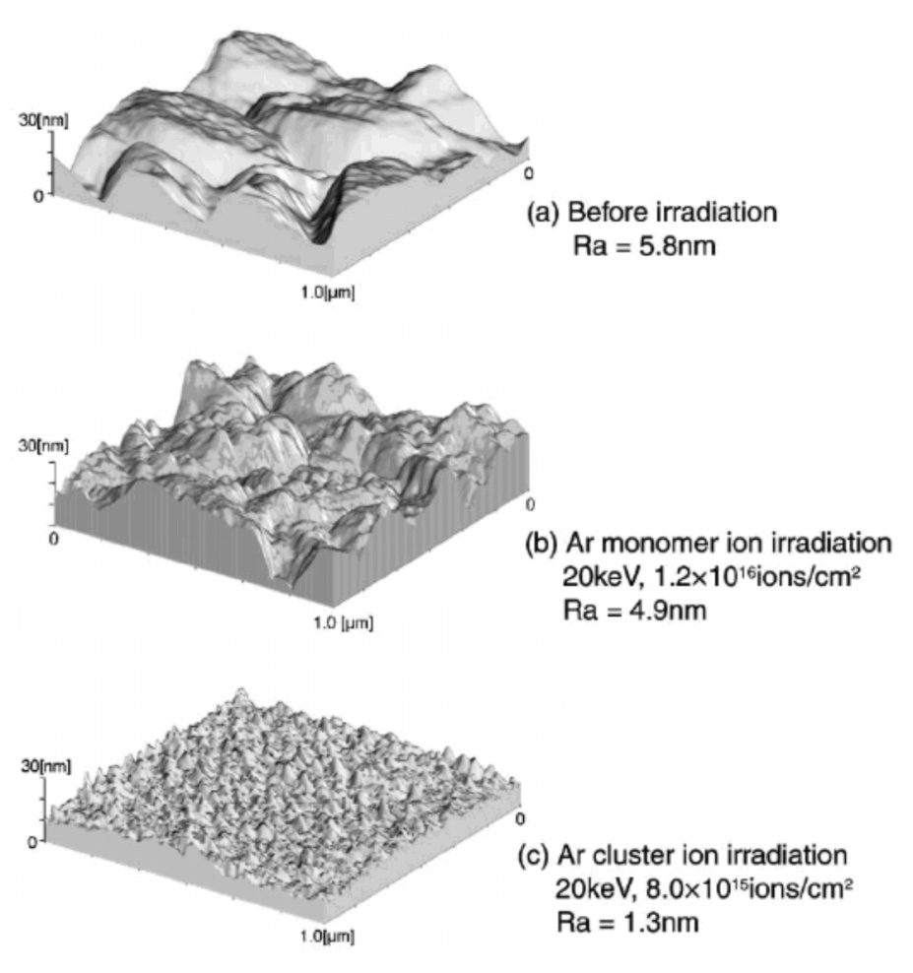
Motivation. Why cluster ions?
Micro
Meso
Macro
Micro
clusters
Large
clusters
monomer
Small
clusters
Nanoclusters
Atom
dimer
trimer
Bulk region
1
10
10²
10³
10⁴
10⁵
Atoms
cluster ion assisted deposition of films
Ion implantation
5-th School-Conference on Atomistic Simulation of Functional Materials

Slide 3
Objective
Cluster ion atomic and charge structure affects the interaction between cluster ion and irradiated surface
FCC structure
Isosahedrical structure
Aim: to obtain charge distribution in Ar⁺ cluster ions
Considered cluster sizes:
Ar₁₃
Ar₁₉
Ar₅₅
Ar₁₃₅
Methodology:
DFT – supercell approach,
Plane wave basis set
Local Density Approximation (LDA)
Spin-orbital coupling
5-th School-Conference on Atomistic Simulation of Functional Materials

Slide 4
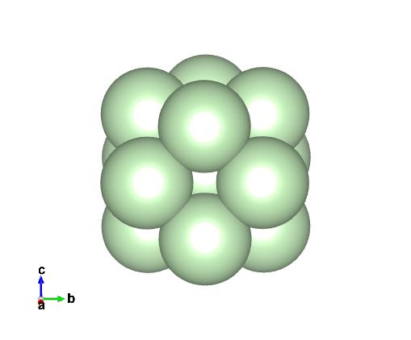
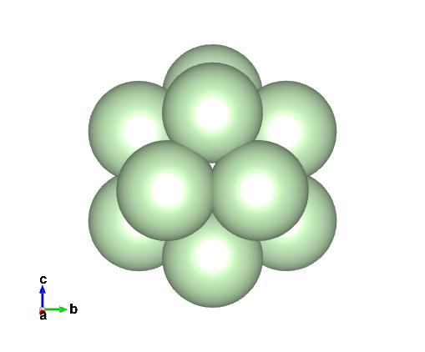
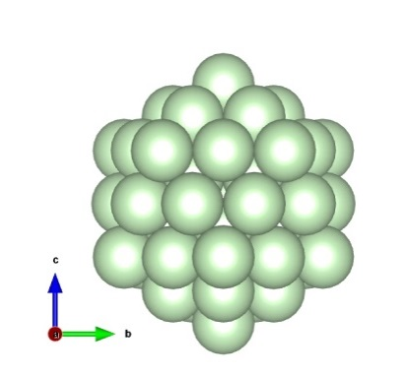
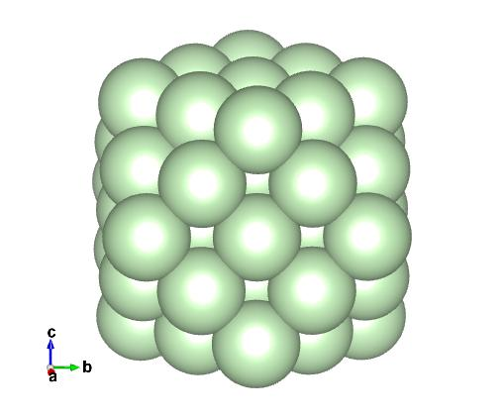
Neutral Ar clusters
Atomic structure and stability
fcc
isp
Isosahedrical structure is more preferable
Ar₁₃
Cluster | E^{fcc} – E^{isp}, meV
13 | 61.04807
19 | 38.10684
55 | 164.867
135 | -
Ar₅₅
5-th School-Conference on Atomistic Simulation of Functional Materials

Slide 5
Ar⁺ cluster ions
Atomic structure and stability
Isosahedrical structure is still more preferable
Neutral cluster is more stable
Cluster ion is more close packed
Cluster ion has magnetic moment
Cluster | Minimal interatomic distance, Å
 | Ar⁰ | Ar⁺
Ar₁₃ fcc | 3.46 | 3.38
Ar₁₃ isp | 3.38 | 3.30
Ar₁₉ fcc | 3.48 | 3.47
Ar₁₉ isp | 3.35 | 3.33
Ar₅₅ fcc | 3.72 | 3.44
Ar₅₅ isp | 3.32 | 3.30
Ar₁₃₅ fcc | 3.48 | 3.46; 3.44
Cluster | E(Ar⁺) – E(Ar⁰), meV |  | μ(Ar⁺), μ_{B}
 | Fcc | isp | fcc | isp
13 | 11.4 | 11.4 | 0.85 | 0.85
19 | 10.6 | 10.7 | 0.86 | 0.87
55 | 10.4 | 10.4 | 0.86 | 0.87
135 | 9.8 21.3 |  | 0.86 1.73
5-th School-Conference on Atomistic Simulation of Functional Materials

Slide 6
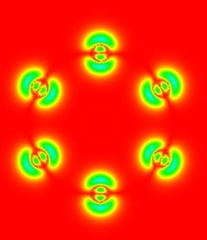
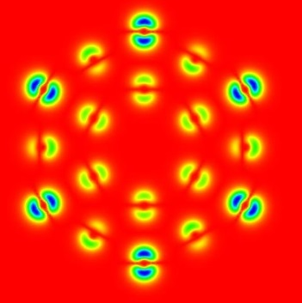
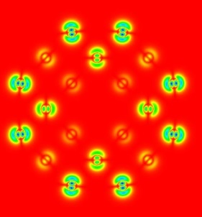
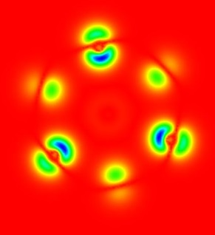

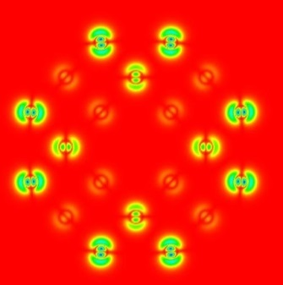
Ar⁺ cluster ions
Distribution of charge difference between Ar⁰ and Ar⁺
Ar₁₃
(111)
Ar₅₅
Ar₁₃₅
(001)
Ar⁺
fcc
Ar⁺²
isp
5-th School-Conference on Atomistic Simulation of Functional Materials

Slide 7
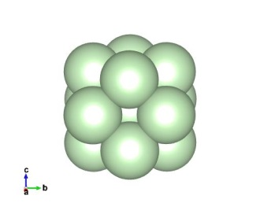
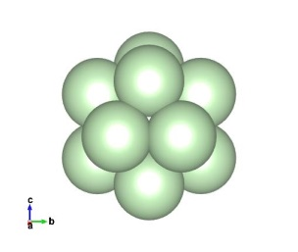
Ar⁺ cluster ions
Electronic structure
fcc
Ar₁₃
isp
5-th School-Conference on Atomistic Simulation of Functional Materials

