Slide 1
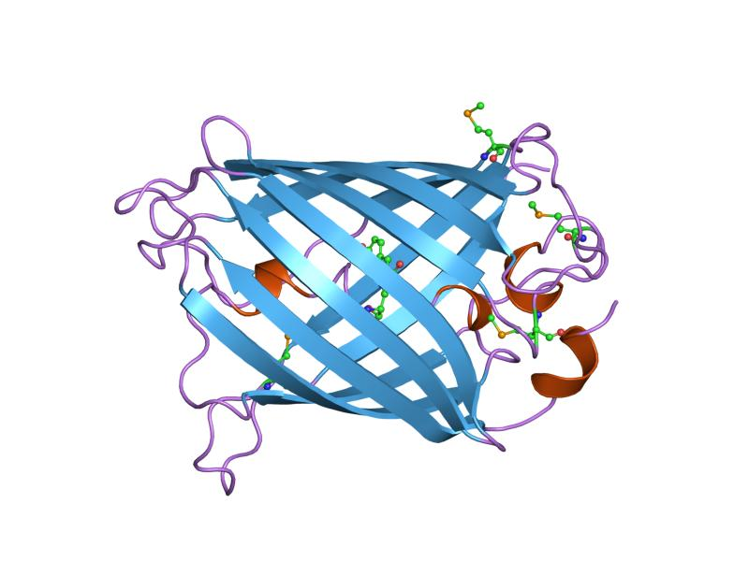
Effective Fragment Potential method: extension to flexible systems
Lyudmila V. Slipchenko
Department of Chemistry, Purdue University
Methodology: Effective Fragment Potential method (EFP)
Polarizable embedding: how and why
New uses for old models: going to biology and materials

Slide 2
Outline
Theory:
  Effective Fragment Potential (EFP) method and
  QM / EFP for the electronic excited states
Chemistry:
  excited state proton transfer in CHCM photoacid
Theory again:
  EFP method for biological systems: BioEFP
Notes:
Change!

Slide 3
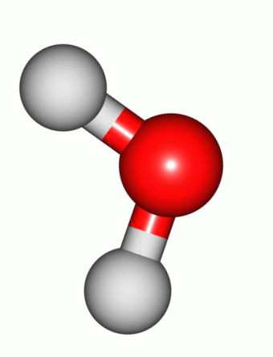
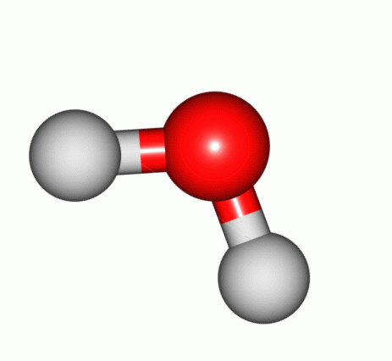
Electrostatic energy in EFP
Quantum-chemical model
ρ₁
ρ₂
Classical model
(q,μ,Θ,Ω)
(q,μ,Θ,Ω)
(q,μ,Θ,Ω)
(q,μ,Θ,Ω)
(q,μ,Θ,Ω)
(q,μ,Θ,Ω)
multipole expansion at
each atom and bond mid-point

Slide 4
Electrostatic energy in EFP
Quantum-chemical model
ρ₁
ρ₂
Charge-penetration energy:
E_{ch-pen} =
E^{ES}_{QM} - E^{ES}_{classical}
Classical model
(q,μ,Θ,Ω)
(q,μ,Θ,Ω)
(q,μ,Θ,Ω)
(q,μ,Θ,Ω)
(q,μ,Θ,Ω)
(q,μ,Θ,Ω)

Slide 5
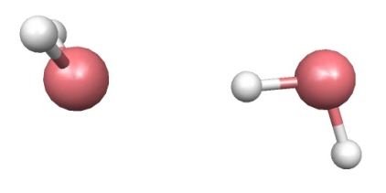
Correcting for charge-penetration energy: electrostatic screening
Notes:
Quantum instead of Morokuma

Slide 6
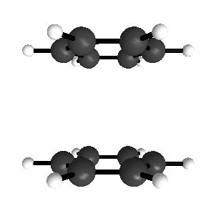
Charge-penetration: benzene dimer
Sinnokrot and Sherrill, JPC A, 108 (46), 10200 (2004);
Slipchenko, Gordon, JCC 28, 276 (2006)

Slide 7
Effective Fragment Potential method
Perturbation theory applied to non-interacting fragments
E_{interaction} = E_{coulomb}
+ E_{polarization}
+ E_{dispersion}
+ E_{exchange-repulsion}
+ E_{charge-transfer}
long-range perturbation theory
short-range perturbation theory
EFP
E_{int}
distributed approach
used for all terms
EFP
QM
E_{int}
EFP
Day et al, J. Chem. Phys. 1996, 105, 1968-1986;
Gordon et al, . Phys. Chem. A 2001, 105, 293-307;
Gordon et al, Ann. Rep. Comp. Chem., 2007, 3, 177-193;
Ghosh et al, J. Phys. Chem. A 2010, 114, 12739-12754
E_{int}
EFP
EFP
Notes:
sophisticated

Slide 8
EFP set-up
Preparation of EFP fragment parameters
general fragment: MAKEFP run (GAMESS)
  a set of ab initio calculations on each unique fragment
  Coulomb: set of point multipoles (DMA)
  Polarization: static polarizability tensors at LMO (coupled HF)
  Dispersion: dynamic polarizability tensors at LMO (TDHF)
  Exchange-repulsion: wave function & Fock matrix (HF)
precomputed EFP fragments from library
https://github.com/makefp/EFP_potentials
online tools for computing EFP parameters
efpdb.org and bioefp.org
2. EFP calculation (energy, optimization, MD, MC, …)
  EFP-EFP interactions by (semi)-classical formulas
  QM-EFP interactions as 1-electron terms in QM Hamiltonian
Notes:
do specific?

Slide 9
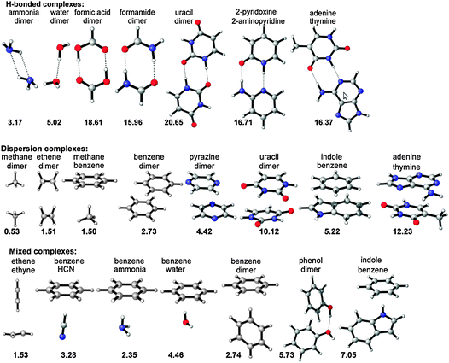
S22 dataset of intermolecular interactions

Slide 10
S22: performance of popular methods
MAD, kcal/mol
 | HB | disp | mixed | overall
HF | 3.29 | 7.24 | 3.15 | 4.56
B3LYP | 1.77 | 6.22 | 2.64 | 3.54
PBE | 1.13 | 4.53 | 1.66 | 2.44
M06 | 0.89 | 0.99 | 0.67 | 0.85
M06-2X | 0.73 | 0.36 | 0.32 | 0.47
ωB97X-D | 0.27 | 0.30 | 0.42 | 0.33
MP2 | 0.24 | 1.69 | 0.61 | 0.88
SCS-MP2 | 1.54 | 0.55 | 0.37 | 0.80
SCS-CCSD | 0.40 | 0.23 | 0.08 | 0.24
Amber | 4.64 | 0.98 | 0.89 | 2.12
OPLSAA | 4.45 | 1.07 | 0.56 | 1.98
MMFF94 | 3.61 | 0.73 | 0.60 | 1.61
EFP | 1.82 | 0.57 | 0.35 | 0.89
10% error | 1.38 | 0.48 | 0.39 | 0.74
J. Chem Theory Comp., 8 (8), 2835–2843 (2012)

Slide 11


S22: performance of force fields
energies in kcal/mol
Paton et al, J. Chem. Inf. Model. 2009, 49, 944–955
Dr. Dmytro Kosenkov
Joanna Flick

Slide 12
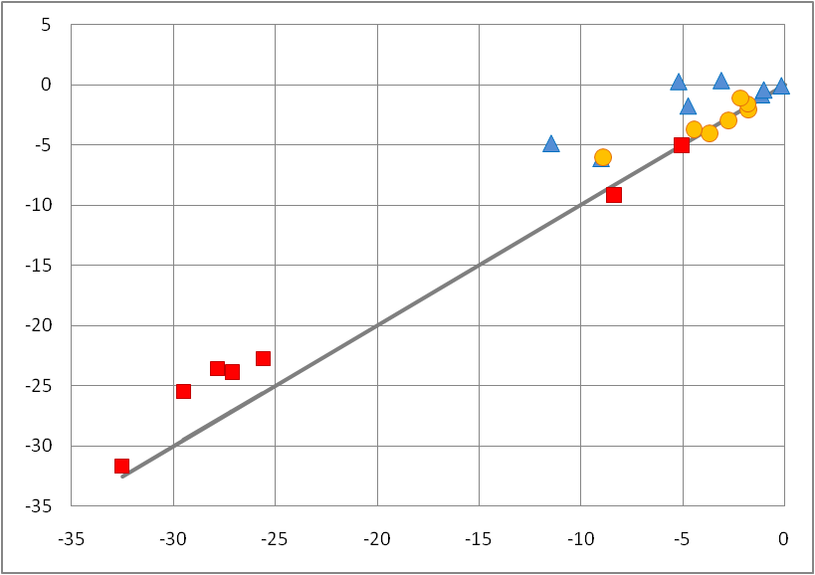
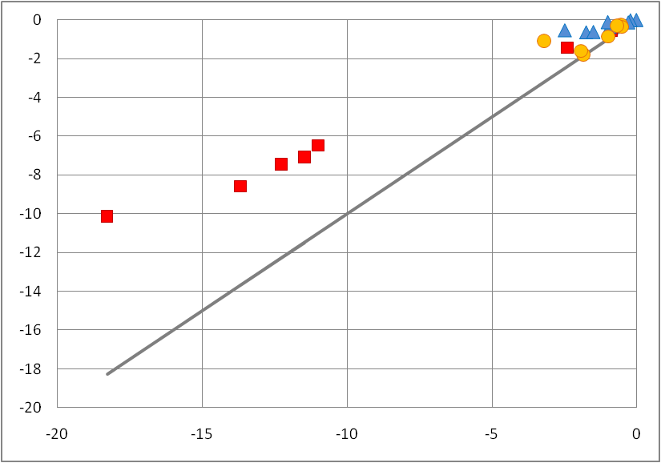
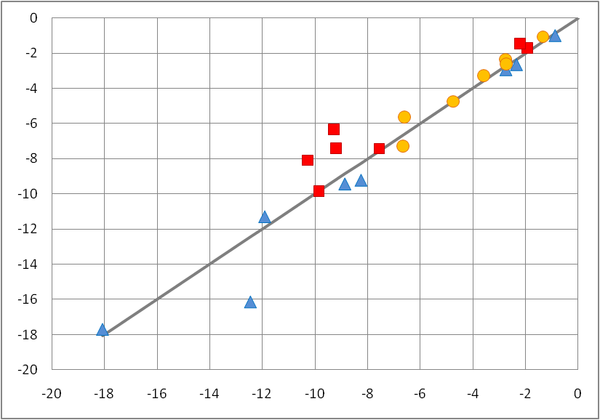
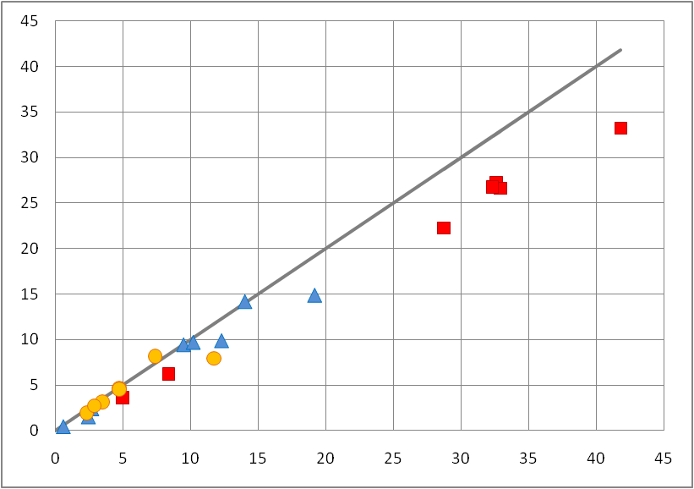
EFP vs SAPT
electrostatic
induction
charge-penetration
energy
charge-penetration & missing charge-transfer
dispersion
exchange-repulsion
good!
H-bonded
dispersion-dominated
missing correlation
mixed
J. Chem Theory Comp., 8 (8), 2835–2843 (2012)

Slide 13
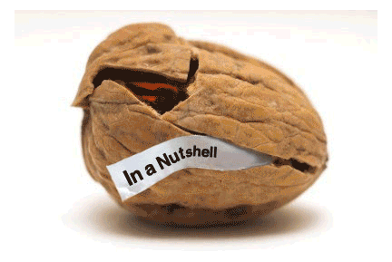
EFP in a nutshell
rigid-geometry fragment-based polarizable force field
all EFP force field parameters are obtained from a separate ab initio calculation: no fitted parameters
provides physical insight into intermolecular interaction
accuracy: 11-12% relative error in interaction energies (similar to MP2, better than many DFT functionals, superior to classical force fields)
accuracy can be further improved
Notes:
11

Slide 14


Electrostatic interactions
DMA in 6-31+G* (non-aromatic) or 6-31G* (aromatic)
Overlap-based damping
in spherical Gaussian approximation:
Kairys and Jensen, CPL 315, 140 (1999);
Slipchenko and Gordon, Mol. Phys., 107, 999 (2009)

Slide 15
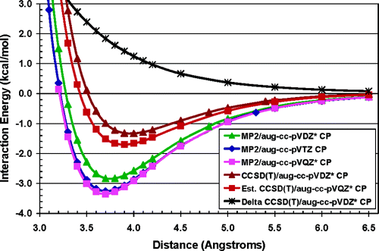
Benzene dimer: sandwich
EFP
CCSD(T)
MP2

Slide 16
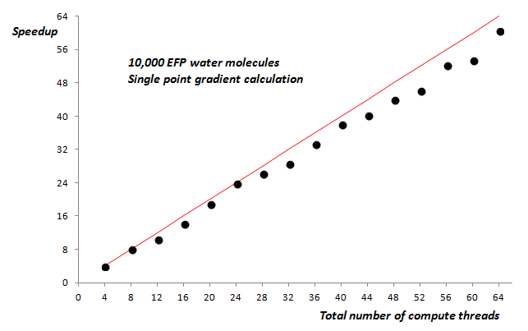
LIBEFP: stand-alone EFP implementation
written in standard C99
uses native EFP data format generated by GAMESS
2-clause BSD license
uses BLAS wherever possible for better performance
available as a shared or static library
parallelization across multiple nodes using hybrid MPI/OpenMP
Dr. Ilya Kaliman
http://www.libefp.org/
Kaliman and Slipchenko, JCC 34, 2284 (2013)

Slide 17
LIBEFP
LIBEFP
EFP-only
system
Q-Chem
various QM/EFP methods
EFPMD
PSI4
distributed with LIBEFP code
single point energy and analytical gradient calculation
geometry optimization using efficient LBFGS optimizer
molecular dynamics in NVE, NVT, and NPT ensembles
seminumerical Hessian and normal mode analysis
simulation of periodic systems
NWChem
GAMESS
Your favorite package

Slide 18

QM / EFP: toward full embedding
EFP
solute
solvent
EFP
QM
E_{int}
EFP
coupling term
E_{int}
EFP
EFP
one-electron terms
in quantum Hamiltonian:
polarizable embedding
additive contribution to QM/EFP energy
Annu. Rev. Phys. Chem., 64, 553-78 (2013);
Notes:
Add more refs

Slide 19
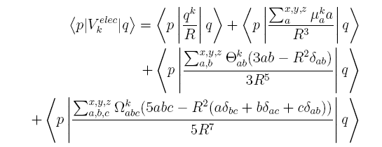
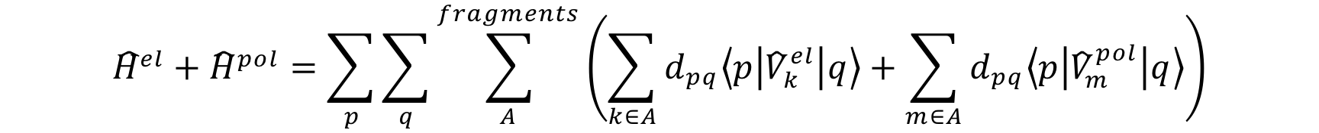

QM/EFP: polarizable embedding

Slide 20
Polarizable embedding
QM region
EFP region
static multipoles
Ψ
nuclei
induced dipoles
total field
Induced dipole
polarizability tensors
F^{total} = Σ (F^{mult} + F^{ind}) + F^{ai} + F^{ai-nuc}
E^{pol} = -½ Σ μ (F^{mult} + F^{ai-nuc}) + ½ Σ μ F^{ai}

Slide 21
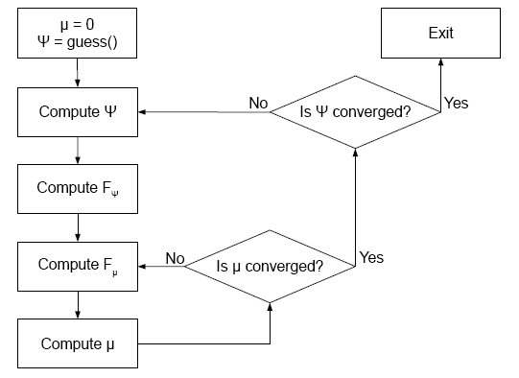
Polarization within SCF cycle
wave function
self-consistent cycle
polarization
self-consistent cycle

Slide 22
QM/EFP for the electronic excited states
Generally, each excited state has different electron density & charge distribution
different response from environment
Polarization correction to the excitation energy due to polarizable environment (using one-electron excited state density):
ΔE^{pol} = E^{pol,ai}(μ^{ex}) – E^{pol,gr}(μgr) - Σ (μ^{ex} – μgr)F^{ai,ex}
leading correction to the interaction between μ^{ex} and Ψ ^{ex}
Thompson & Schenter, JPC 99, 6374 (1995)

Slide 23
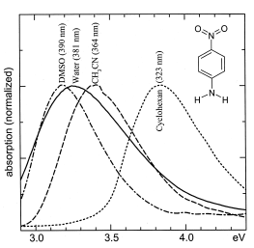
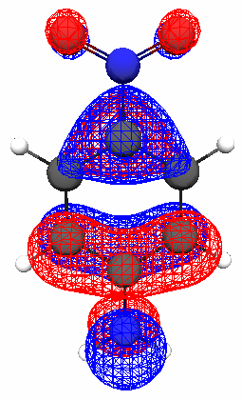
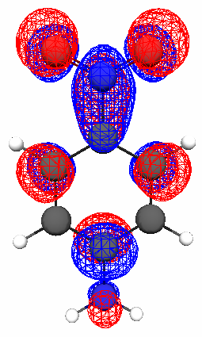
Solvatochromism in para-nitroaniline
Para-nitroaniline (pNA) – a chromophore with bright low-lying charge-transfer state
absorption spectrum
-
charge-transfer π->π* transition
+
μgr = 6.2 D
μ^{ex} = 15.3 D
Kovalenko, Schanz, Farztdinov, Hennig, Ernsting, CPL 323, 312 (2000)

Slide 24
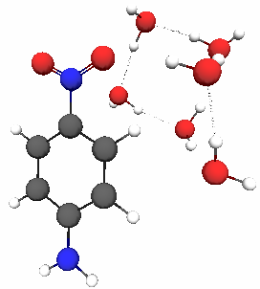
Composition of solvatochromic shift
EOM-CCSD / EFP
Solvatochromic shift, eV
indirect polarization: -0.043 eV
direct polarization: -0.019 eV
indirect Coulomb: -0.177 eV
EOM-CCSD
discrepancy: -0.024 eV
Indirect terms: orbital relaxation of the solute in the electrostatic field of the solvent
Direct polarization: repolarization of the environment as a response to a change of the electronic wave function in the excited state

Slide 25
QM / EFP for the electronic excited states
Electrostatic and polarization environmental response is calculated for the excited states
One-particle excited state density is needed;
the cost of QM/EFP calculation is ~ the cost of QM properties calculation
Any number of the excited states can be treated simultaneously
Implemented for excited state methods which have one-particle properties:
  CI family (CIS, CIS(D), CISD)
  TD-DFT
  EOM-CCSD, including SF and IP variants

Slide 26
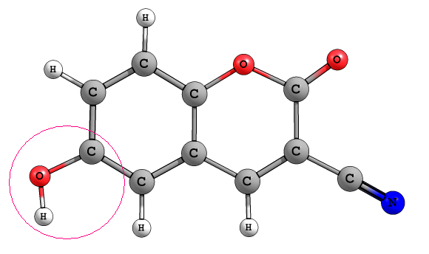
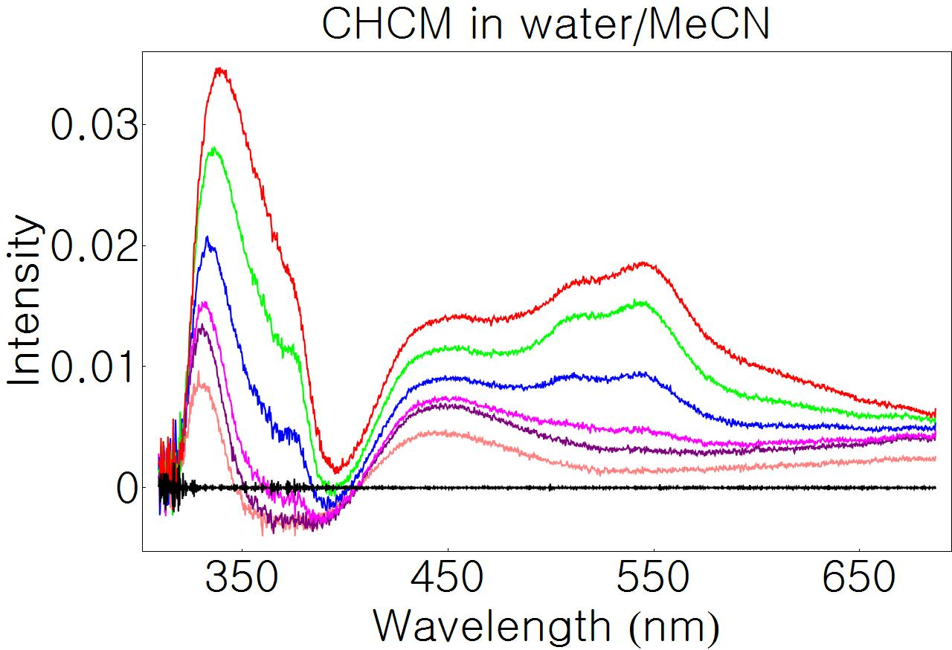
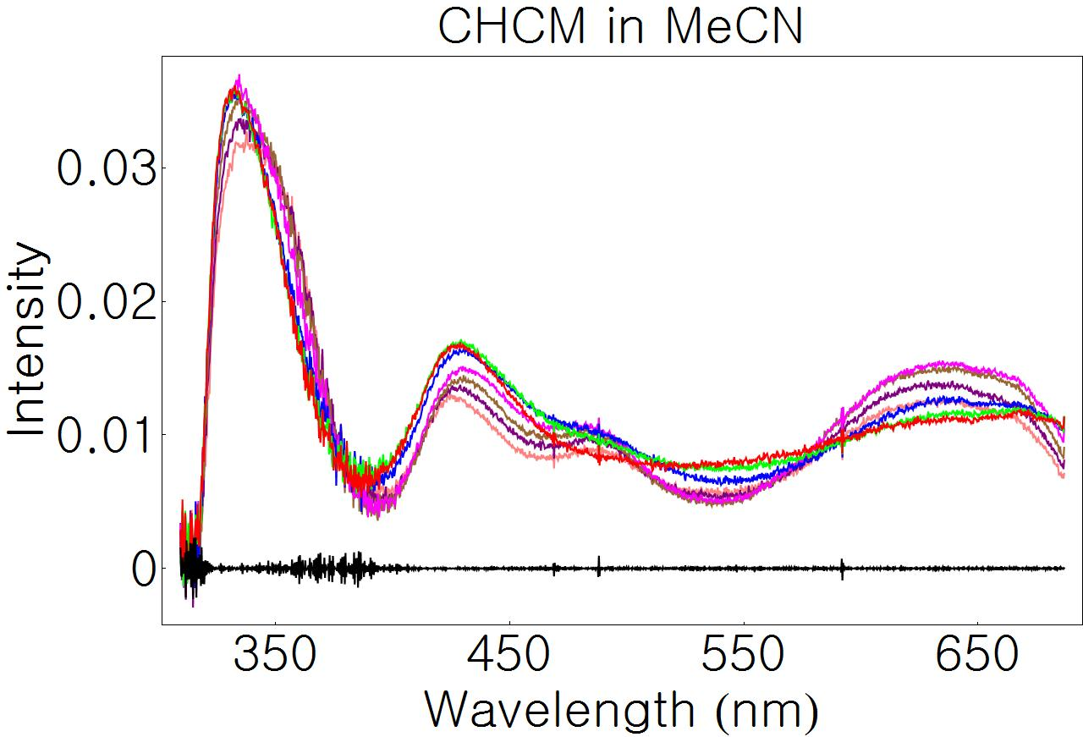
Excited state dynamics in photoacids
7 ps
900 ps
3-cyano-6-hydroxycoumarin (CHCM)
Dr. Kyril Solntsev, Georgia Tech
Dr. Oliver Poizat, Université de Lille, France
Transient absorption spectra:
No significant time dependence in spectra in aprotic MeCN solvent
Excited state anion signal appears and decays in presence of water

Slide 27
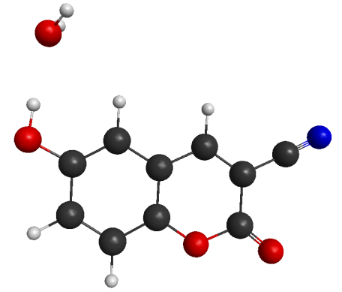
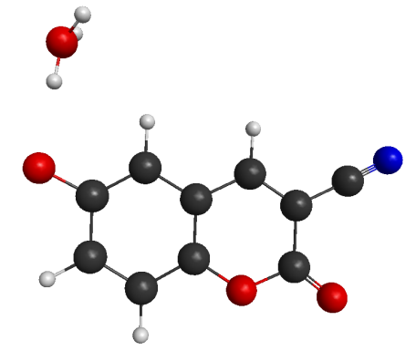
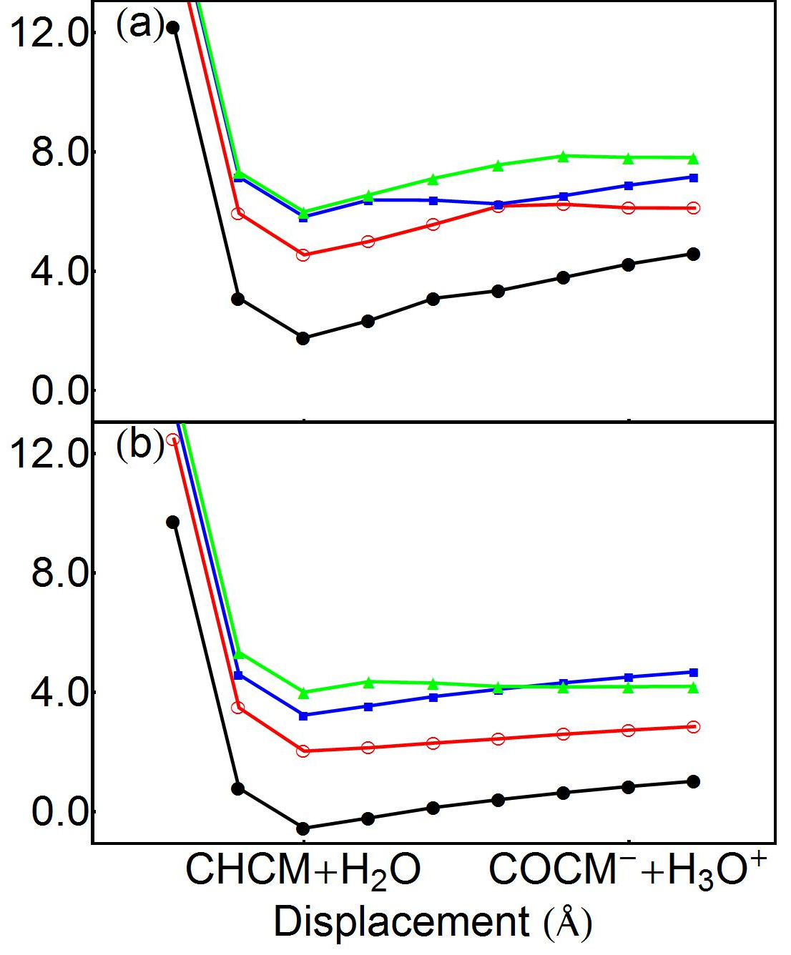
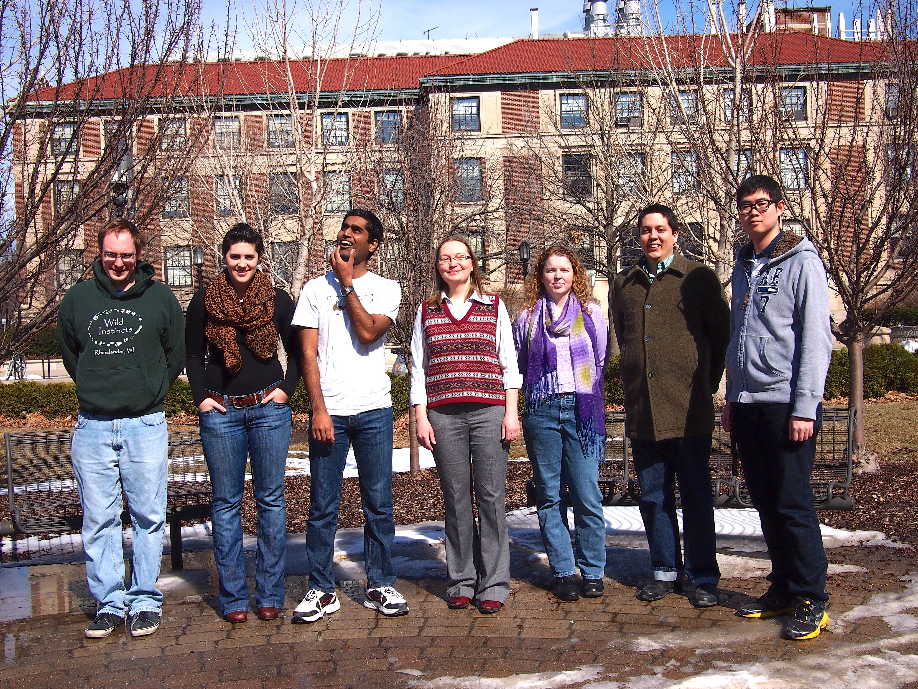
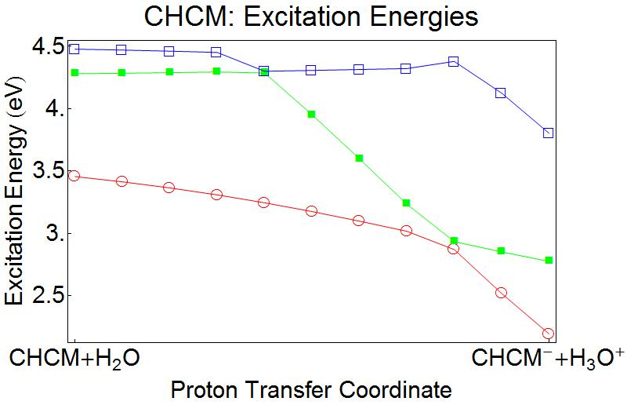
Excited state proton transfer in CHCM
gas phase
Energy, eV
π->σ*
π->π*
water solvent (PCM)
Ben Nebgen
SungMin Hong
TD-DFT(PBE0)/6-31+G*

Slide 28
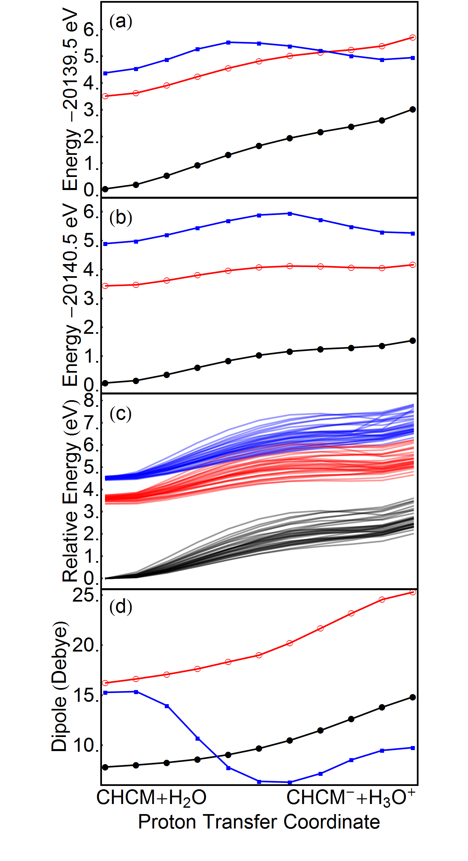
Linear displacement model
Dipole moment
gas phase
Energy, eV
π->σ*
PCM water
QM/EFP

Slide 29
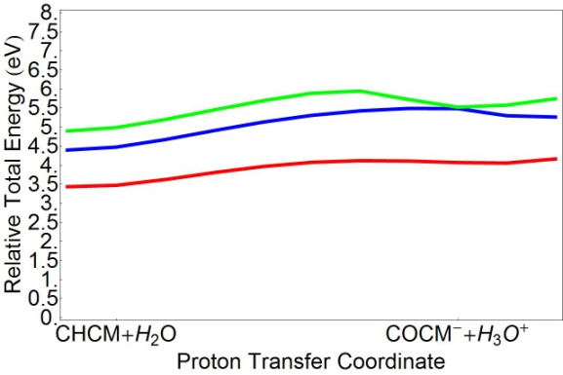
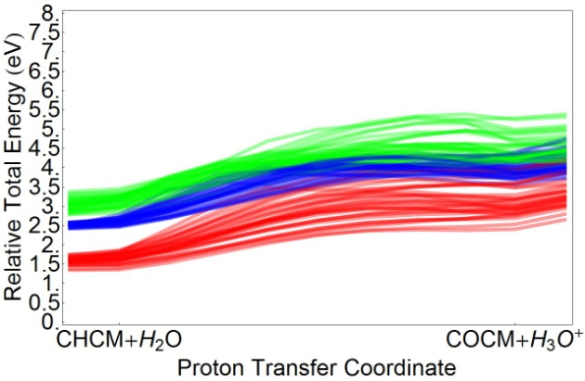
PT is solvent: PCM vs EFP
PCM
Neutral complex:
CHCM + H₂O
Weak solvent effects
Good agreement between implicit and explicit description of solvent
Implicit solvent is OK
Zwitterionic complex:
COCM⁻ + H₃O⁺
Strong solvent effects
Large discrepancy between implicit and explicit description of solvent
Explicit solvent is needed!
QM/EFP
Proton transfer coordinate

Slide 30
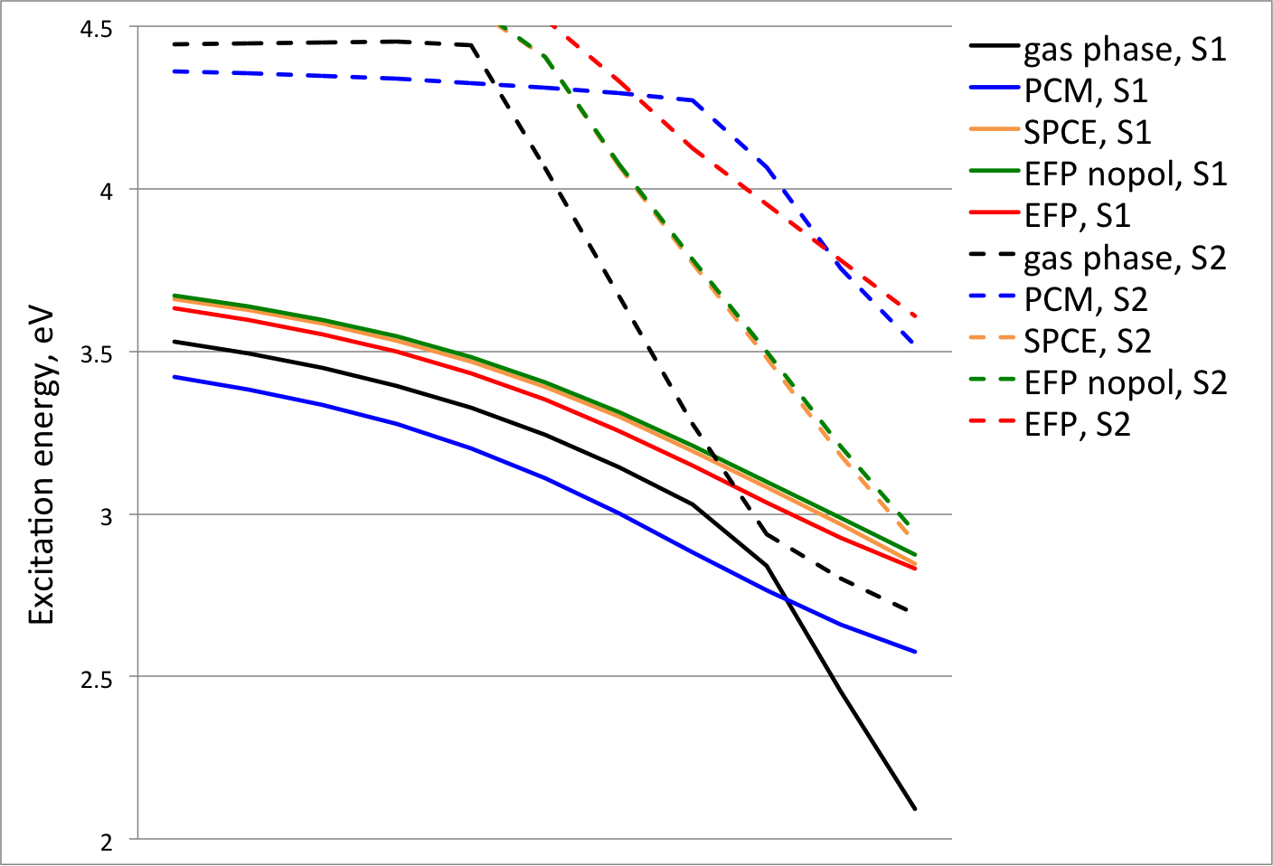
ESPT in CHCM: solvent effects
π->σ*
π->π*
Polarization is essential for describing charge-transfer states in aqueous solvent

Slide 31

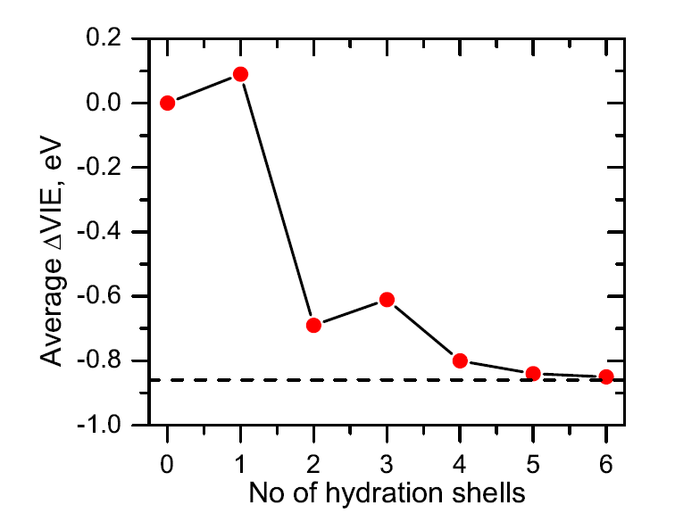
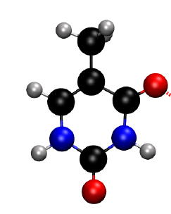
Vertical ionization energy of hydrated thymine
due to microhydrates!
Dr. Debashree Ghosh (USC)
electron acceptor,
increases VIE
EOM-IP-CCSD/EFP
electron donor,
decreases VIE
Ghosh, Isayev, Slipchenko, Krylov,
JPCA 115, 6028 (2011)
Notes:
When the water molecule is
h-bonded to the NH groups of thymine, it acts as the electron donor
and, therefore, reduces the VIE. Likewise, water that is hydrogen-
bonded to the carbonyl groups acts as the electron acceptor, thereby
increasing the VIE.

Slide 32
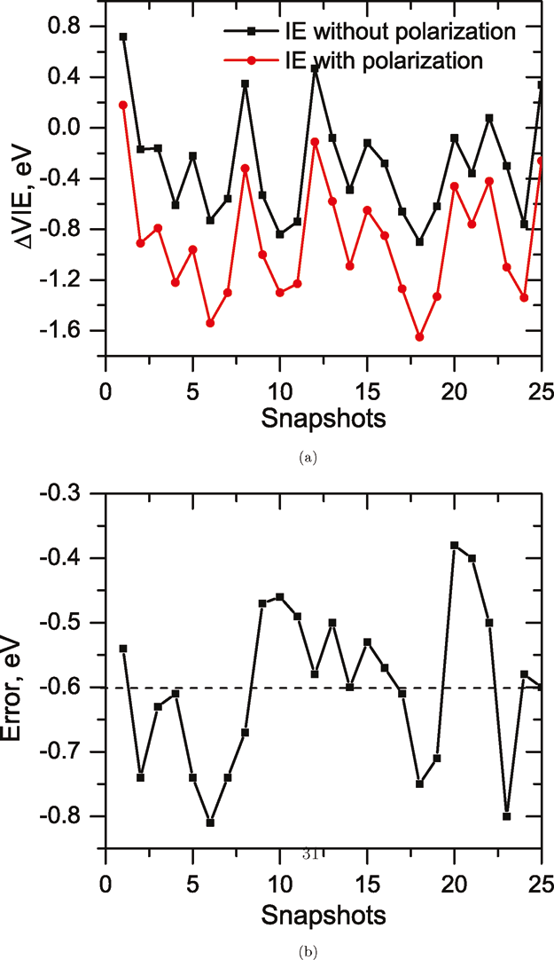
Vertical ionization energy of hydrated thymine
Polarization of environment is extremely important in describing ionization energies in water solvent!

Slide 33

Moving to biology
Is polarization important in photo-biological and photovoltaic applications?
Is accurate electrostatics needed there?
Challenge:
extend QM/EFP to biological macromolecules
Green Fluorescent Protein
Pradeep Gurunathan
Gurunathan, Acharya, Ghosh, Kosenkov, Kaliman, Shao, Krylov, and Slipchenko,
J. Phys. Chem. B, 2016, 120 (27), 6562

Slide 34
BioEFP: extending EFP to biology
Original EFP
rigid-geometry fragment-based polarizable force field
EFP parameters are obtained from ab initio calculations on a gas phase fragment
describes intermolecular interactions
EFP
EFP
QM
E_{int}
EFP
E_{int}
EFP
EFP
BioEFP
split macromolecule into fragments
prepare parameters for each fragment
develop mechanism to describe covalent interactions between neighboring fragments
watch out for polarization madness
EFP
EFP
EFP
QM
EFP
EFP

Slide 35
Polypeptide: how to cut into fragments?
Small fragments
(Nemukhin group)
Main goal: reaction mechanisms
Fragment-fragment interactions: classical FF
QM-fragment interactions: electrostatic embedding, fitted ex-rep
Fragment parameters: predetermined, stored in library
Fragment-fragment and QM-fragment gradients are relatively straightforward
Large fragments
(Slipchenko group)
Main goal: accurate description of protein effects on photochemistry
Fragment-fragment interactions: EFP terms + bonded terms from classical FF
QM-fragment interactions: electrostatic + polarization embedding
Fragment parameters: recomputed for each structure
Gradients are more complicated

Slide 36
Preparing parameters for bio-fragments
O
||
O
||
−C_{a}H−C−NH−C_{a}H− −C−NH−C_{a}H−
|
R
|
R
|
R
O
||
cap with H
O
||
−C_{a}H−C−NH−C_{a}H−H
H−C−NH−C_{a}H−
|
R
|
R
compute EFP parameters
|
R
remove caps
O
||
O
||
−C_{a}H−C−NH−C_{a}H
redistribute residual charge
C−NH−C_{a}H−
|
R
|
R
|
R

Slide 37
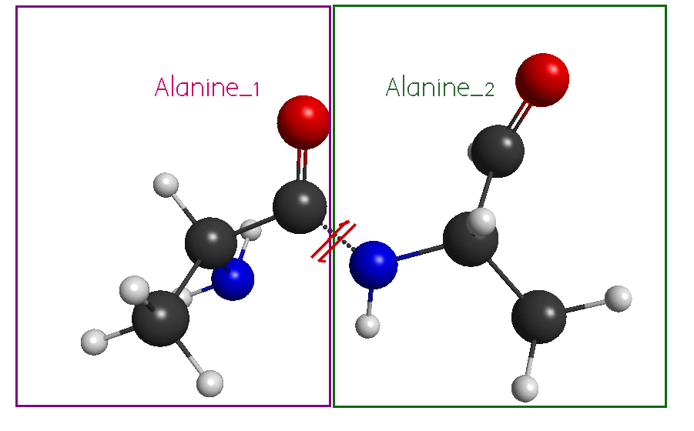
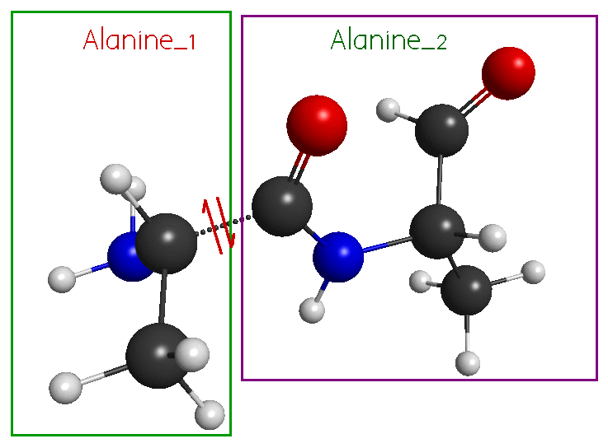
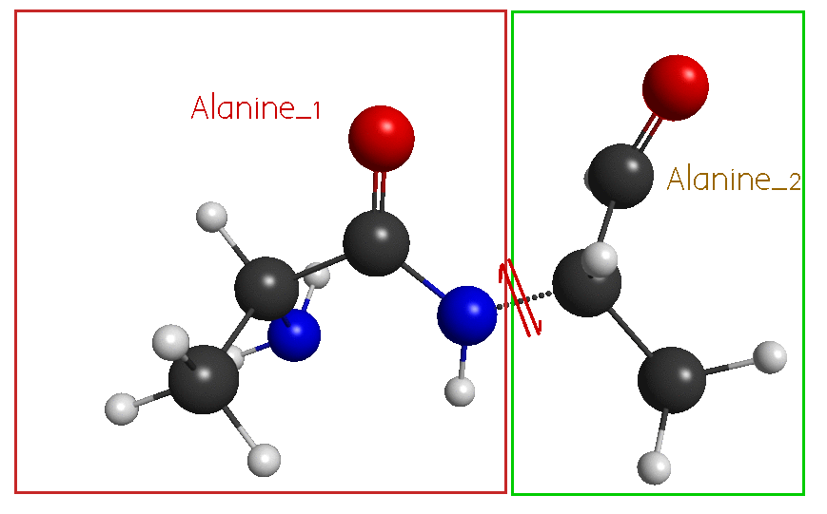
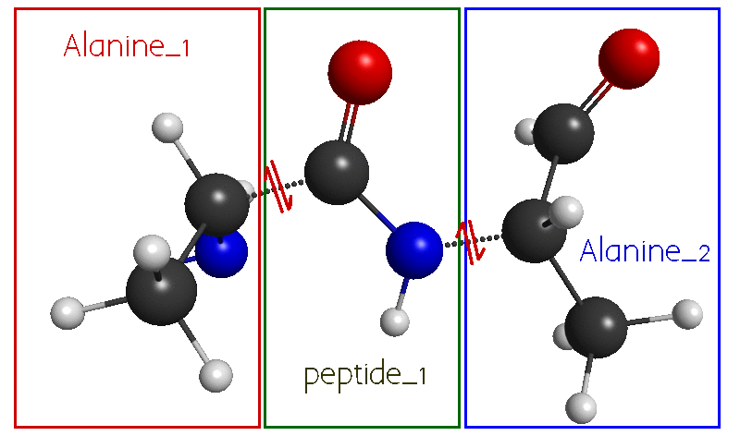
Polypeptide: how to cut into fragments?
peptide bond
Cα-C bond
Cα-N bond
two fragments per aminoacid
suitable for frozen-fragment MD
Cα-C and Cα-N bond

Slide 38
Test system:
GFP chromophore in natural environment
full QM: reference
protonation site
GFP chromophore with
VAL93, GLN94, GLU95, ARG96 peptide
Vertical ionization energies
in deprotonated (anionic) and protonated forms

Slide 39
Test system:
GFP chromophore in natural environment
EFP-superfragment
QM
GFP chromophore +
VAL93, GLN94, GLU95, ARG96 peptide
Vertical ionization energies
in deprotonated (anionic) and protonated forms

Slide 40
Test system:
GFP chromophore in natural environment
EFP-fragments
QM
GFP chromophore +
VAL93, GLN94, GLU95, ARG96 peptide
Vertical ionization energies
in deprotonated (anionic) and protonated forms

Slide 41
Vertical ionization energies
VIE, eV | Full QM | Super-fragment | fragmentation
 |  |  | Ca-C | Ca-N | peptide | Ca-C Ca-N
Deprotonated form
standard EFP | 4.015 | 3.959 | 3.966 | 3.942 | 3.955 | 3.952
damped pol |  |  | 3.985 | 3.958 | 3.955 | 3.974
no polarization |  | 3.763 | 3.889 | 3.876 | 3.870 | 3.882
no elec damp |  | 3.916 | 3.925 | 3.900 | 3.913 | 3.911
Protonated form
standard EFP | 9.699 | 9.661 | 9.669 | 9.796 | 9.680 | 9.650
damped pol |  |  | 9.686 | 9.803 | 9.670 | 9.667
no polarization |  | 9.585 | 9.657 | 9.776 | 9.649 | 9.638
no elec damping |  | 9.627 | 9.637 | 9.764 | 9.648 | 3.911
wB97x-d/6-31G*

Slide 42
Vertical ionization energies
VIE, eV | Full QM | Super-fragment | fragmentation
 |  |  | Ca-C | Ca-N | peptide | Ca-C Ca-N
Deprotonated form
standard EFP | 4.015 | 3.959 | 3.966 | 3.942 | 3.955 | 3.952
damped pol |  |  | 3.985 | 3.958 | 3.955 | 3.974
no polarization |  | 3.763 | 3.889 | 3.876 | 3.870 | 3.882
no elec damp |  | 3.916 | 3.925 | 3.900 | 3.913 | 3.911
Protonated form
standard EFP | 9.699 | 9.661 | 9.669 | 9.796 | 9.680 | 9.650
damped pol |  |  | 9.686 | 9.803 | 9.670 | 9.667
no polarization |  | 9.585 | 9.657 | 9.776 | 9.649 | 9.638
no elec damping |  | 9.627 | 9.637 | 9.764 | 9.648 | 3.911
wB97x-d/6-31G*

Slide 43
Vertical ionization energies
VIE, eV | Full QM | Super-fragment | fragmentation
 |  |  | Ca-C | Ca-N | peptide | Ca-C Ca-N
Deprotonated form
standard EFP | 4.015 | 3.959 | 3.966 | 3.942 | 3.955 | 3.952
damped pol |  |  | 3.985 | 3.958 | 3.955 | 3.974
no polarization |  | 3.763 | 3.889 | 3.876 | 3.870 | 3.882
no elec damp |  | 3.916 | 3.925 | 3.900 | 3.913 | 3.911
Protonated form
standard EFP | 9.699 | 9.661 | 9.669 | 9.796 | 9.680 | 9.650
damped pol |  |  | 9.686 | 9.803 | 9.670 | 9.667
no polarization |  | 9.585 | 9.657 | 9.776 | 9.649 | 9.638
no elec damping |  | 9.627 | 9.637 | 9.764 | 9.648 | 3.911
wB97x-d/6-31G*

Slide 44
Vertical ionization energies
VIE, eV | Full QM | Super-fragment | fragmentation
 |  |  | Ca-C | Ca-N | peptide | Ca-C Ca-N
Deprotonated form
standard EFP | 4.015 | 3.959 | 3.966 | 3.942 | 3.955 | 3.952
damped pol |  |  | 3.985 | 3.958 | 3.955 | 3.974
no polarization |  | 3.763 | 3.889 | 3.876 | 3.870 | 3.882
no elec damp |  | 3.916 | 3.925 | 3.900 | 3.913 | 3.911
Protonated form
standard EFP | 9.699 | 9.661 | 9.669 | 9.796 | 9.680 | 9.650
damped pol |  |  | 9.686 | 9.803 | 9.670 | 9.667
no polarization |  | 9.585 | 9.657 | 9.776 | 9.649 | 9.638
no elec damping |  | 9.627 | 9.637 | 9.764 | 9.648 | 3.911
wB97x-d/6-31G*

Slide 45
Performance of BioEFP for VIE
Error of QM/EFP wrt full QM: <0.1 eV
Contribution of polarization: 0.X eV
Error due to fragment-fragment polarization damping: 0.01-0.02 eV
Contribution of electrostatic damping: 0.0X eV, increases in larger basis sets
Error due to fragmentation of protein into fragments: 0.01-0.02 eV
Fragmentation along Cα-C bond or along (Cα-C & Cα-N bonds) works the best
Fragmentation does not spoil the accuracy of QM/EFP

Slide 46
BioEFP: tech details
BioEFP provides a parameter-free description of protein effects on photochemical events
Automatic preparation of the system ( bioefp.org ):
  PDB file ->
  geometries of fragments ->
  calculation of fragment parameters (jobs submitted to GAMESS) ->
  removing extra points ->
  generating input file for QM/BioEFP
Computational cost:
- cost of QM calculation on a chromophore
- generating EFP parameters (e.g., for GFP protein: ~2 days at 20 cores)
Geometry can be relaxed:
  MD of frozen-geometry fragments covalently linked by classical potentials is implemented

Slide 47

Extension to flexible fragments
Goal:
create algorithm that allows changes of internal fragment geometries
Why:
minimize time for computing potentials for effective fragments
ensure smooth potential energy surface in EFP calculations
Options:
Recompute fragment parameters for each unique fragment geometry
or
Adjust parameters for new geometries, based on some “standard” fragment
Nikita Dubinets, spring 2016

Slide 48
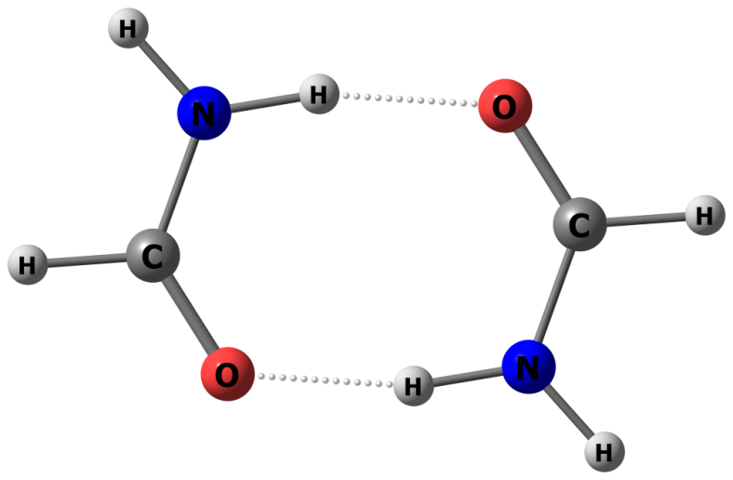
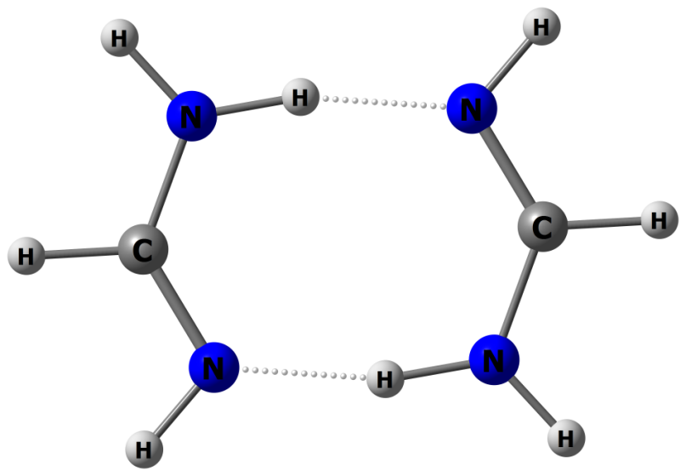
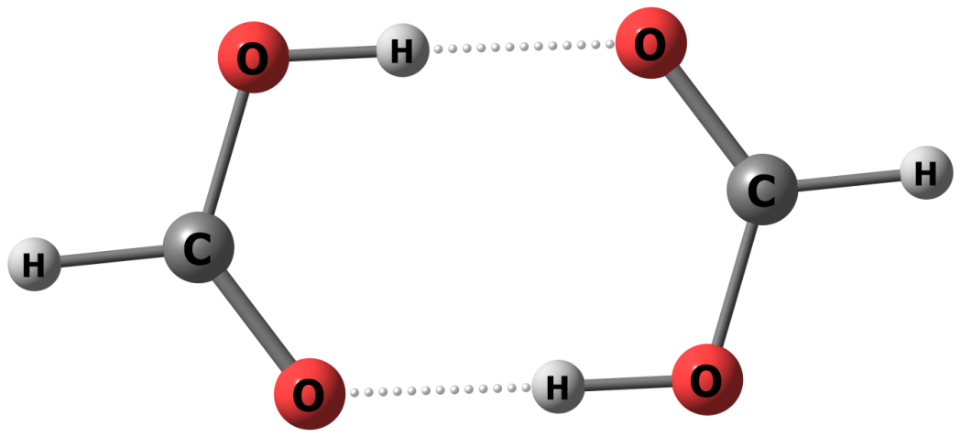
Flexible fragments
Test set:
FaOO dimer
(formic acid)
FaON dimer
(formamide)
FaNN dimer
(formamidine)
Schemes:
“optimized” parameters and geometries
“gas-phase” parameters and geometries
“gas-phase” parameters and geometries, mixed basis set
“shifted” parameters on optimized geometries

Slide 49
Interaction energies
FaNN dimer

Slide 50
FaNN dimer: summary
binding energy
interaction energy @ 3.5A
Equil. distance
MAD

Slide 51
Energy components

Slide 52
Conclusions
EFP is first-principles based polarizable force field
LIBEFP is a stand-alone EFP implementation ready for interfacing with ab initio software
BioEFP: extension of EFP to biological systems and polymers
QM/EFP and QM/BioEFP methods:
  polarizable embedding for the electronic structure calculations
  essential for description of electronic states with strong charge-transfer character and ionization potentials in aqueous environment
  a role of polarization in biological systems will be scrutinized (work in progress)
  extension to flexible fragments is developed and tested

Slide 53
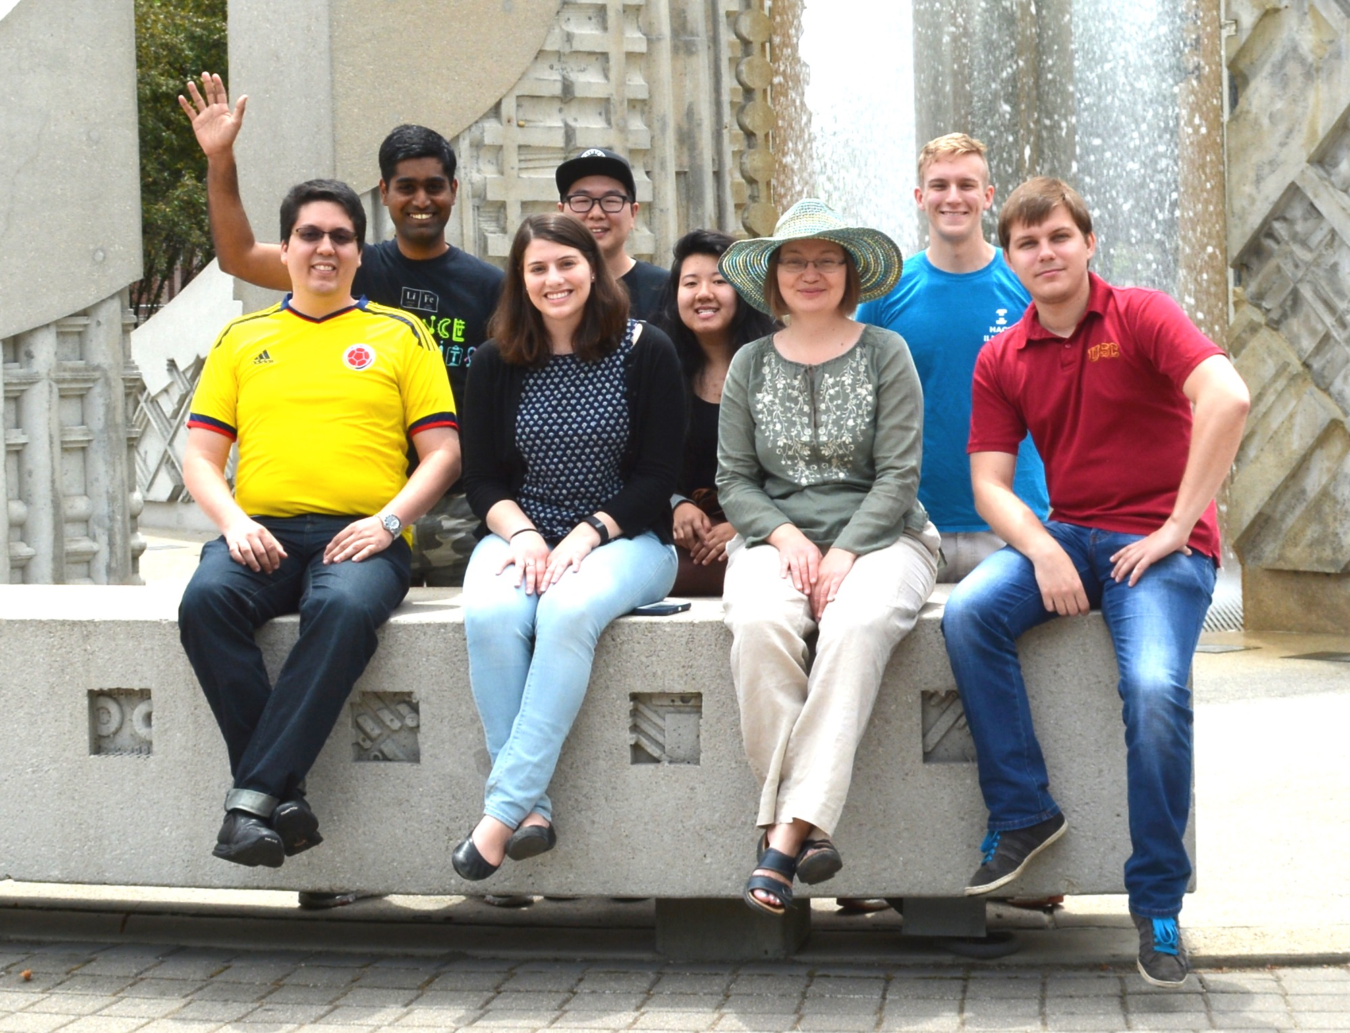
Acknowledgements
Group members:
Pradeep Gurunathan
Carlos Borca
Yen Bui
Yongbin Kim
Claudia Viquez Rojas
Jen Werner
Will Pierce
Group alumni:
Dr. Ilya Kaliman
Dr. Dmytro Kosenkov
Dr. Ben Nebgen
Dr. Mandy Green
Dr. Mike Hands
Fr. Frank Emmert
SungMin Hong
Joanna Flick
$$$:
NSF Theory
NSF SSI
NSF AIR-TT
Collaborators:
Anna Krylov (USC)
Debashree Ghosh (NCL Pune)
Atanu Acharya (USC)
Software:
Q-Chem
GAMESS
PSI4
LibEFP

