Slide 1


THEORETICAL INVESTIGATION OF TRANSITION METAL BASED QUASI-TWO-DIMENSIONAL STRUCTURES
7-th School-Conference on Atomistic Simulation of Functional Materials (ASFM 2018)
Authors:
Konstantin V. Larionov
Dmitry G. Kvashnin
Pavel B. Sorokin
Photochemistry Center,
September 12–13, 2018

Slide 2
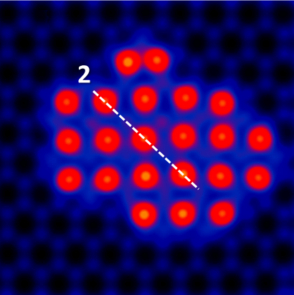
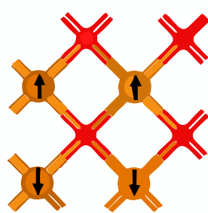
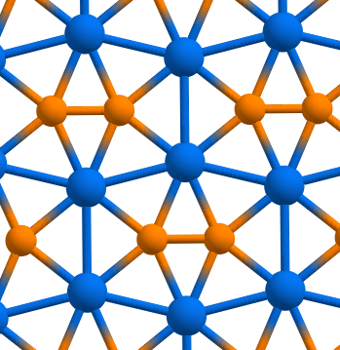
Outline
A very small introduction
Theoretically-experimental investigation of 2D copper oxide (CuO) with uncommon square lattice structure
Prediction of a new 2D phase of iron oxide (FeO) and investigation of its heterojunctions with graphene
Prediction of a new 2D phase of cobalt oxide (CoC) and investigation of its properties
Some conclusion remarks

Slide 3


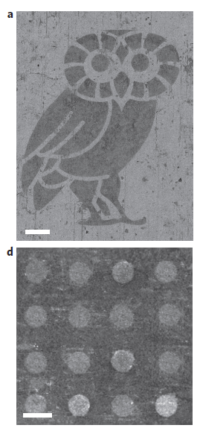
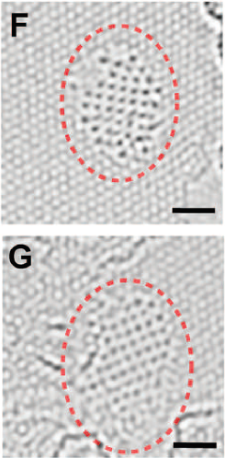
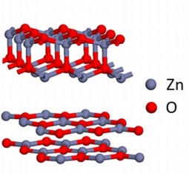

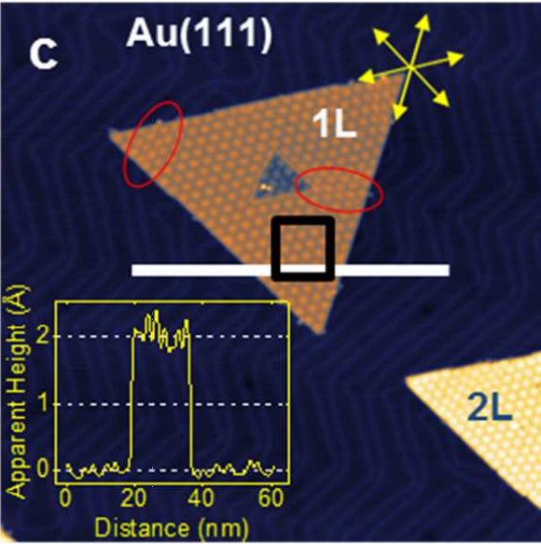
Двумерные гетеросоединения на основе графена
Two-dimensional materials
a
c
e
d
f
b
Liu Z. et al.
In-plane heterostructures of graphene and hexagonal boron nitride with controlled domain sizes // Nature Nanotechnology. 2013.
Zhao J. et al.
Free-Standing Single-Atom-Thick Iron Membranes Suspended in Graphene Pores // Science. 2014.
Lee J. et al.
Tunable Lattice Constant and Band Gap of Single- and Few-Layer ZnO // The Journal of Physical Chemistry Letters. 2016.

Slide 4
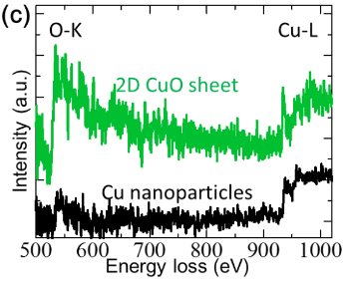
Experimental observation of 2D CuO on graphene
1 nm
2-Cu
1-Cu
1-G
None
ADF-STEM image of the Cu cluster and atoms on graphene sheet.
Beam-shower technique as room temperature was used to prevent both contamination and aggregation of Cu atoms.
Sharp threshold peaks indicate a partial emptying of the Cu 3d band caused by the chemical bond with oxygen.
Kano E. et al. One-Atom-Thick 2D Copper Oxide Clusters on Graphene. Nanoscale 2017, 9 (11), 3980–3985.

Slide 5
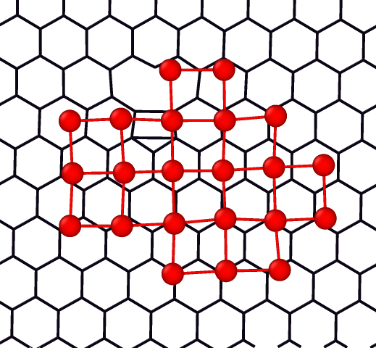
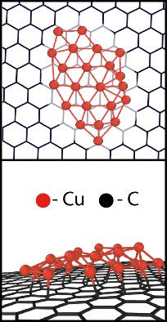
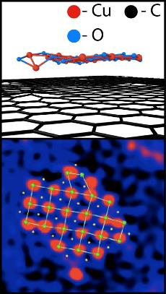
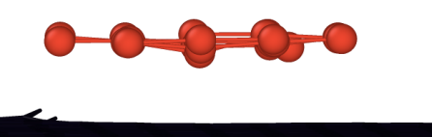
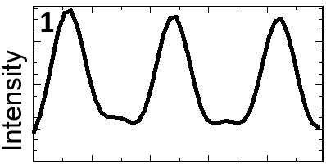
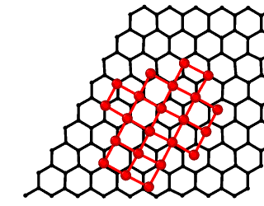
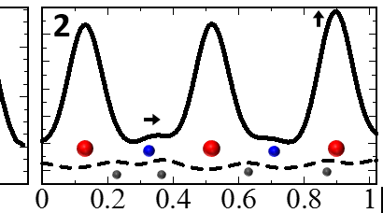
Modeling of Cu-based cluster on graphene
Based on experimental results, the model of 2D Cu cluster on graphene surface with the same size was constructed.
The oxygen impurity atoms placed in the centers of Cu rectangles play the major role in the stabilization of orthogonal lattice of 2D Cu.
Exp.
1
Simul.
With the absence of oxygen impurities the 2D Cu cluster tends to curve, form 3D structure and bind with the graphene surface.
STEM image simulation totally confirmed the experimental observations

Slide 6
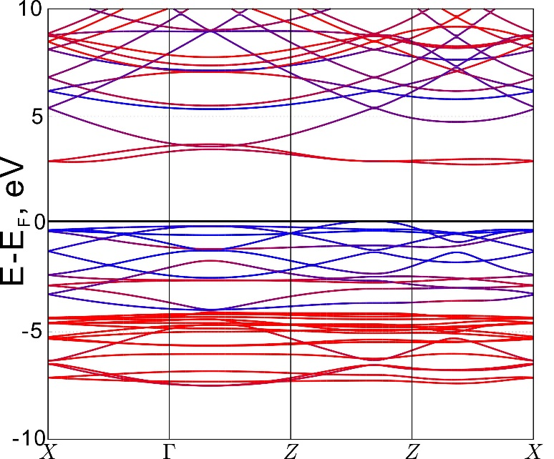
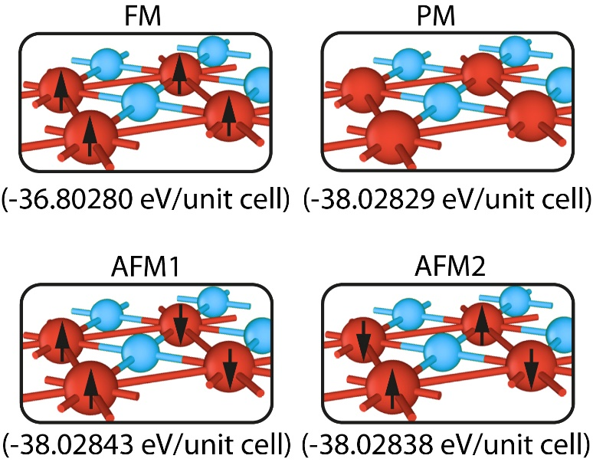
Electronic and magnetic properties of 2D CuO
2D CuO is a wide gap semiconductor with E_{g} = 2.5 eV, while bulk CuO has a band gap about 1.5 eV.
Y
Unlike the bulk phase of Cu and CuO which have a paramagnetic (PM) ground state, the 2D CuO has a weak antiferromagnetic (AFM) ground state with the energy difference between PM and AFM about ~ –0.18 meV/atom.
Kano E. et al. One-Atom-Thick 2D Copper Oxide Clusters on Graphene. Nanoscale 2017, 9 (11), 3980–3985.

Slide 7
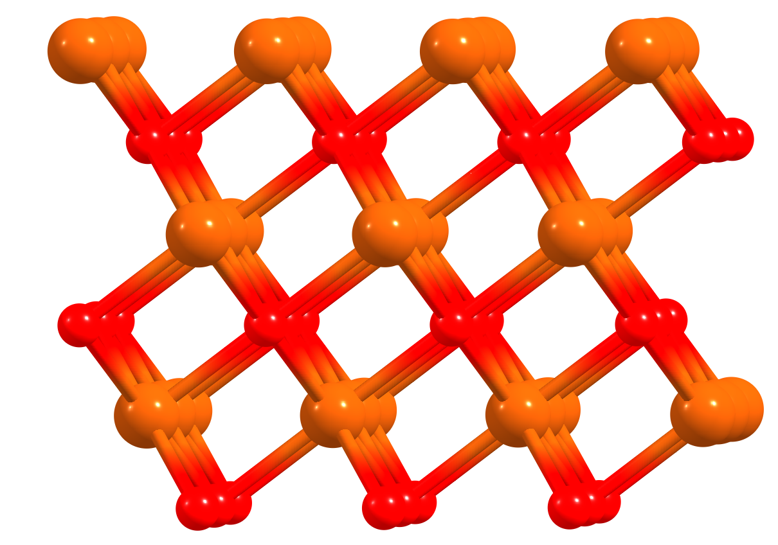
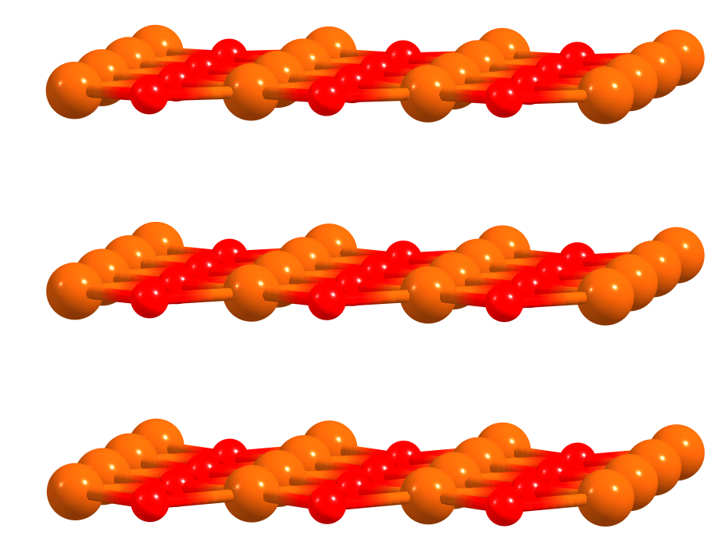
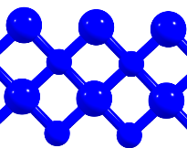
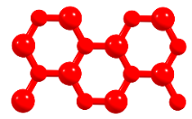
“Ionic graphitization” effect in ultrathin FeO films
Rocksalt FeO film (111)
Stack of 2D FeO (001)
d
3.1 Å
~ 0.1 eV/FeO
1.0
0.5
0.0
-0.5
ΔE, eV/FeO
-14.2
-1.0
E, eV/FeO
-1.5
-14.3
Step
1
2
3
4
-2.0
1
2
3
4
5
6
7
8
9
10
11
12
Number of layers, N

Slide 8
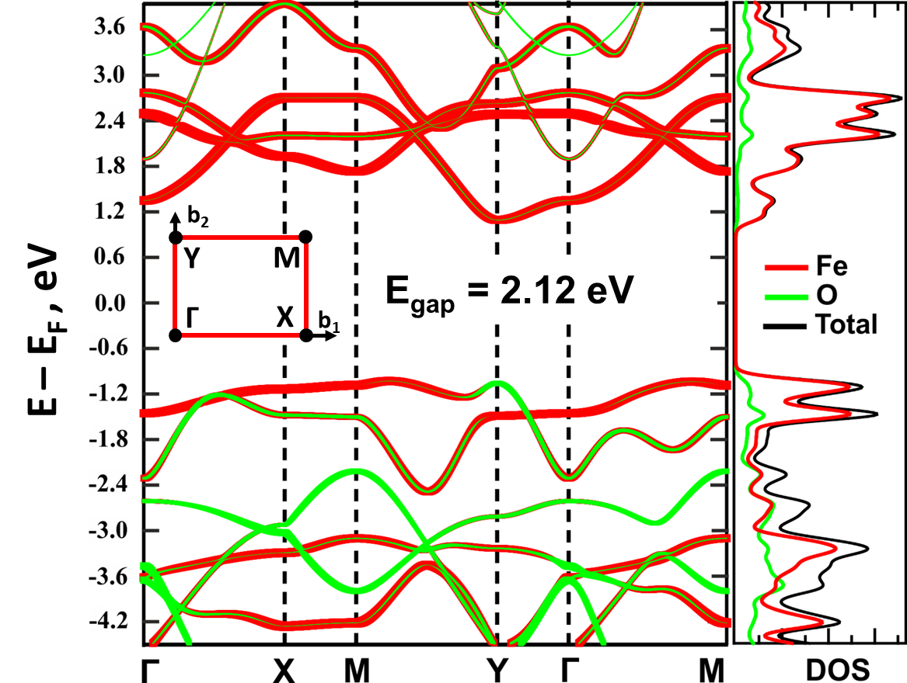
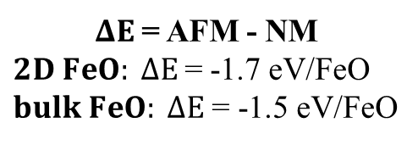
Properties of 2D FeO
АFM2
FM
NM
E = -14.33 eV/FeO
E = -14.22 eV/FeO
E = -12.57 eV/FeO
d₁ = 2.80 Å
$ΔE$ = AFM - NM
$2D FeO: ΔE$= -1.7 eV/FeO
$bulk FeO: ΔE$ = -1.5 eV/FeO
d₂ = 2.76 Å
Elastic constant | C (N/m)
FeO(ZZ₁), C₁₁ | 150
FeO(ZZ₂), C₂₂ | 137
FeO, C₁₂ | 57
FeO, C₆₆ | 27
Graphene, C₁₁ = 367 N/m
MoS₂, C₁₁ = 140 N/m
Larionov K. et al. The Journal of Physical Chemistry C 2018, 122 (30), 17389–17394.

Slide 9
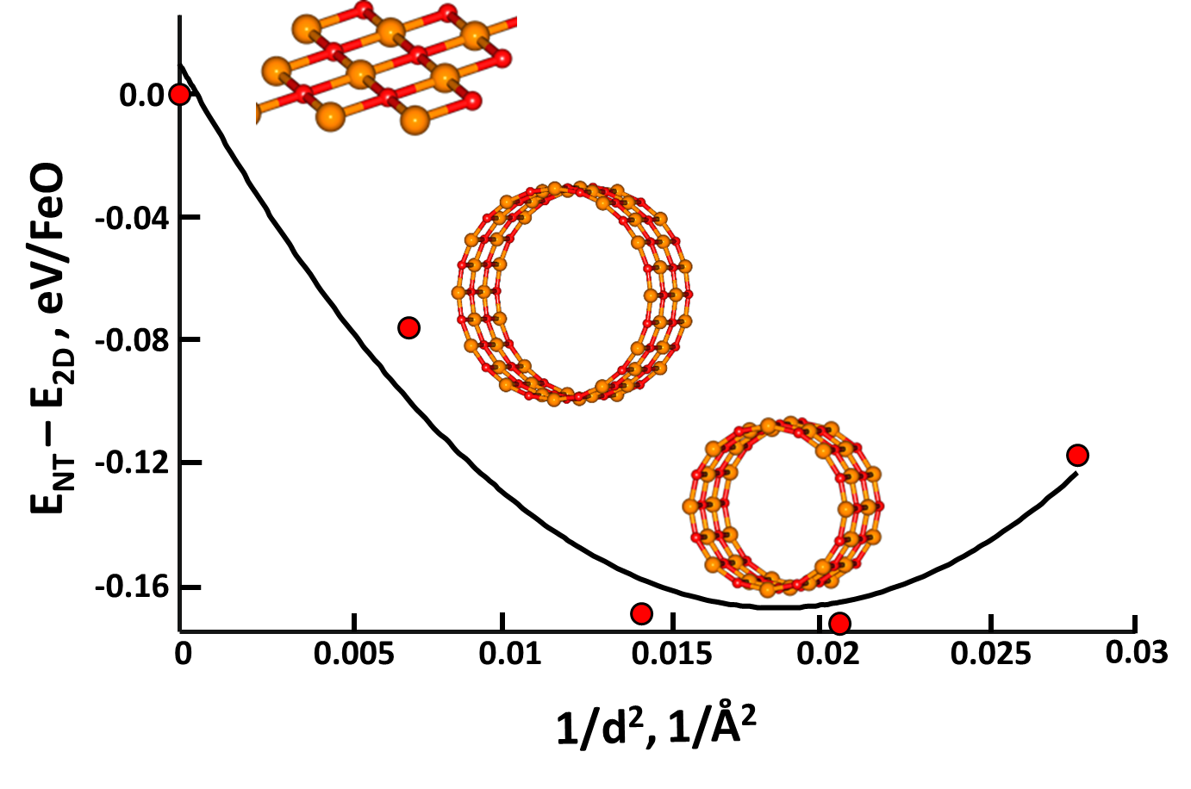
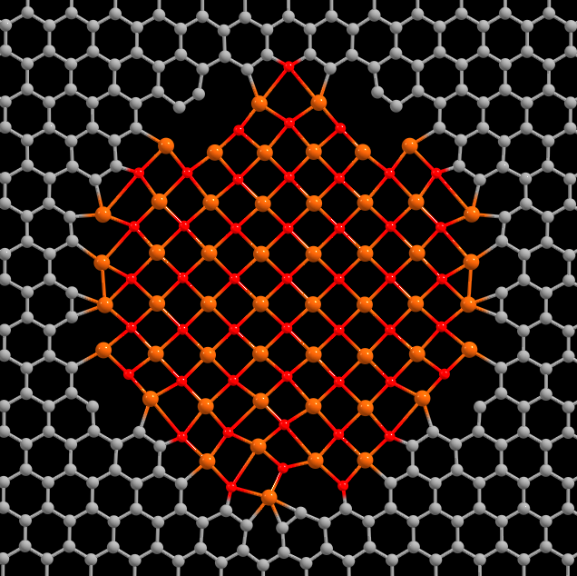

2D FeO stability
$$\text{U} \text{=} \frac{\text{D}}{\text{2}{\text{r}}^{\text{2}}}$$
Larionov K. et al. The Journal of Physical Chemistry C 2018, 122 (30), 17389–17394.

Slide 10
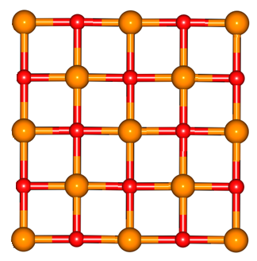
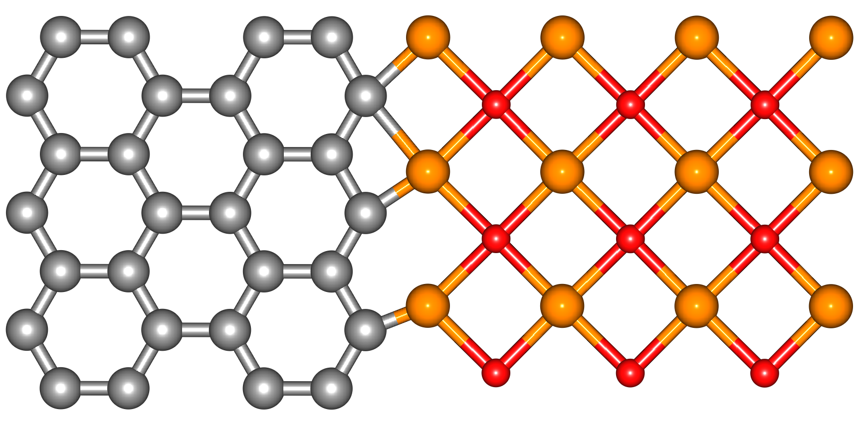
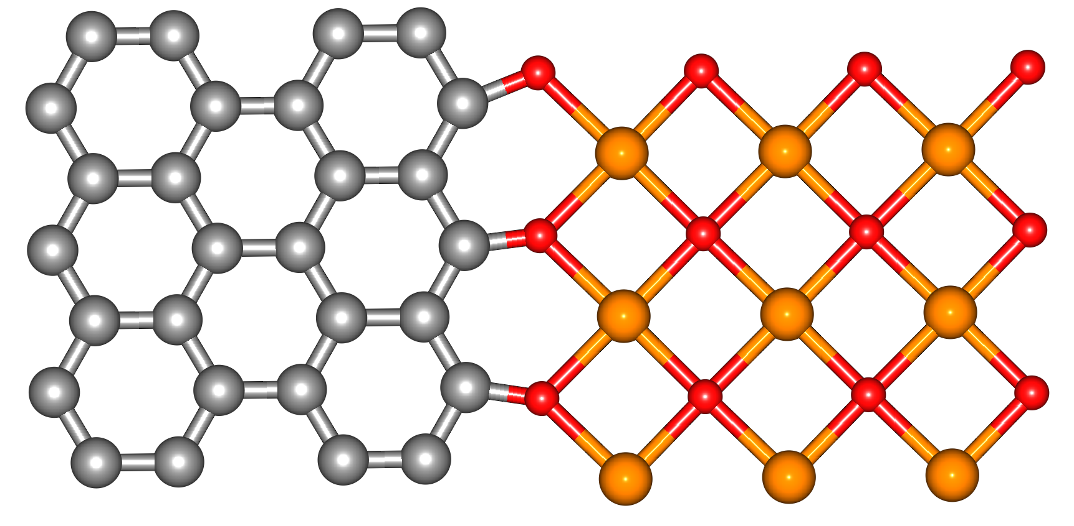
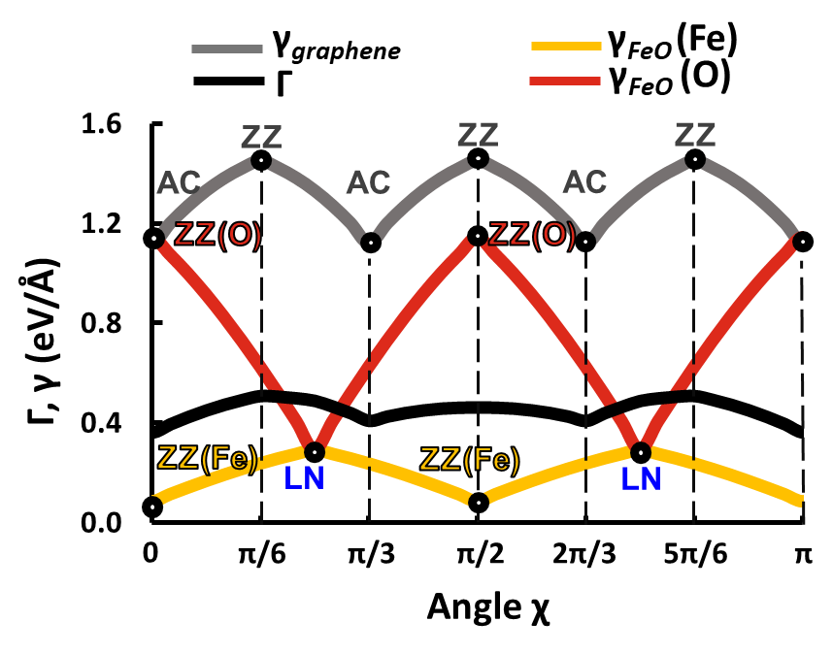
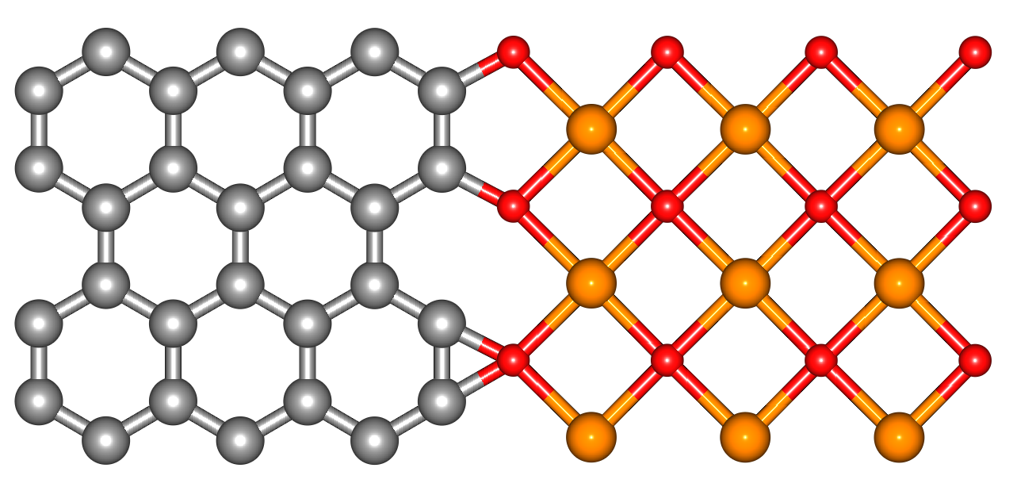
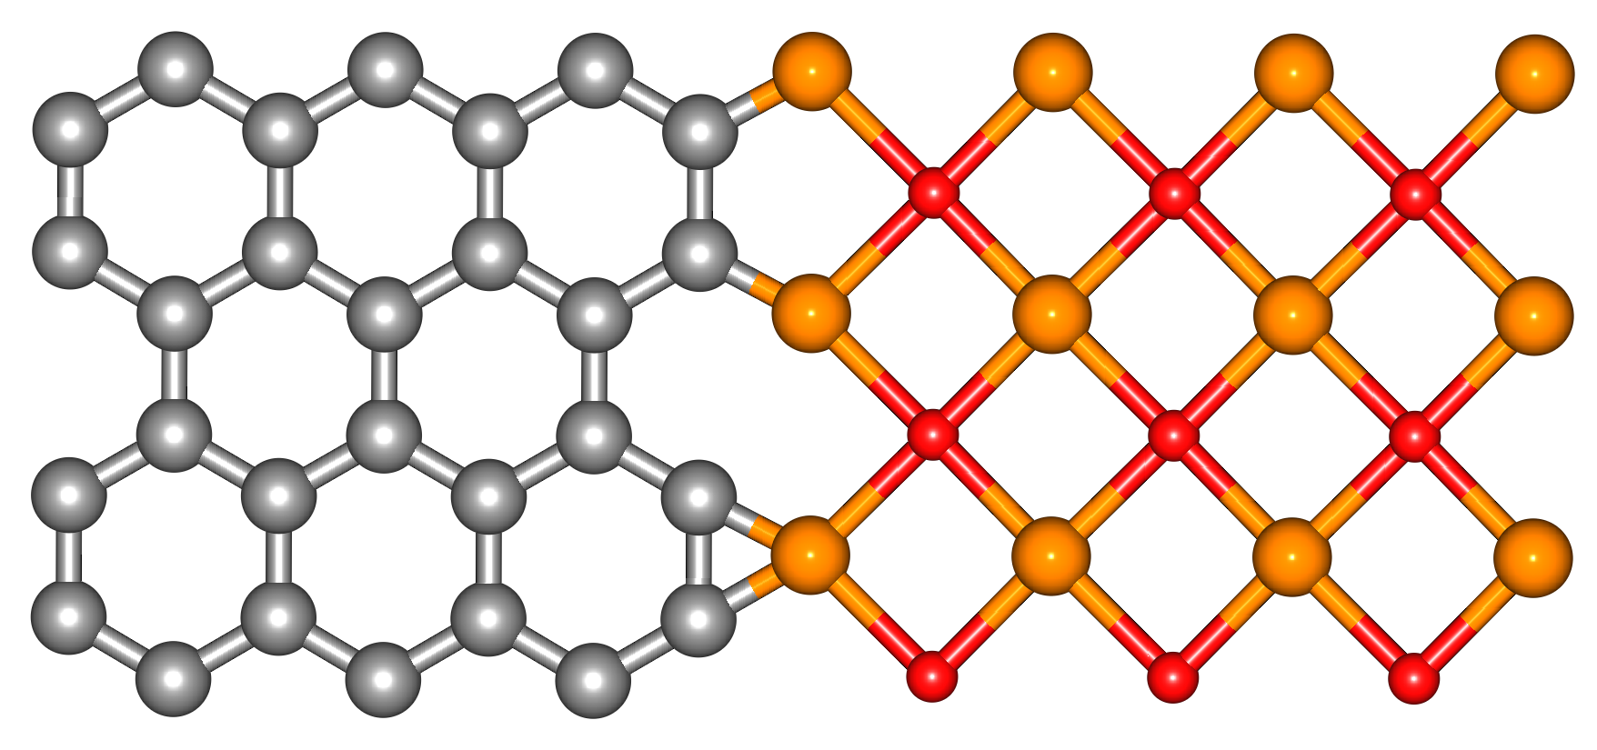
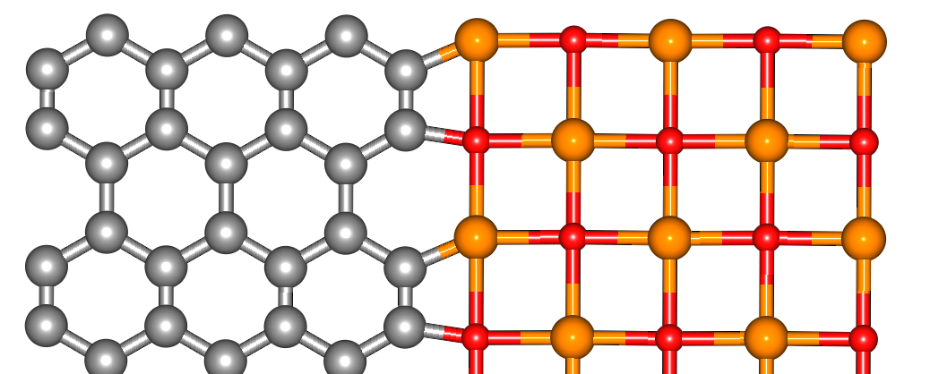
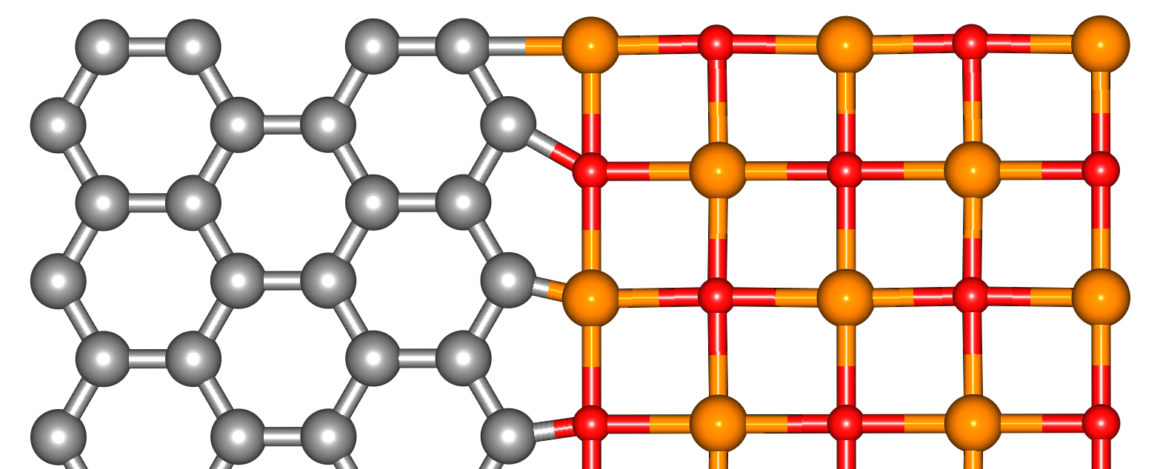



Investigation of 2D FeO/graphene interface
$\text{Γ}\left(\text{χ}\right)\text{ = }{\text{γ}}_{\text{graphene}}\left(\text{χ}\right){\text{+} \text{γ}}_{\text{FeO}}\left(\text{χ}\right)\text{ + }{\text{E}}_{\text{bind}}$ [1]
ЗАГОЛОВОК СЛАЙДА
zigzag (ZZ)
${\text{γ}}_{\text{graphene}}\left(\text{χ}\right) \text{= 2}{\text{γ}}_{\text{ZZ}}\text{sin}\left(\text{χ}\right) \text{+ 2}{\text{γ}}_{\text{AC}}\text{sin}\text{(}\frac{\text{π}}{\text{6}} – \text{χ}\text{)}$ [2]
$${\text{γ}}_{\text{FeO}}\left(\text{χ}\right) \text{= }\sqrt{\text{2}} {\text{γ}}_{\text{ZZ}}\text{sin}\left(\text{χ}\right) \text{+ }\sqrt{\text{2}} {\text{γ}}_{\text{LN}}\text{sin}\left(\frac{\text{π}}{\text{4}} \text{– }\text{χ}\right)$$
linear (LN)
ZZ+ZZ(Fe)
ZZ+ZZ(O)
AC+ZZ(Fe)
AC+ZZ(O)
AC+LN
ZZ+LN
[1] Liu et al. Nano Lett. 2011
[2] Liu et al. Physical Review Letters 2010

Slide 11
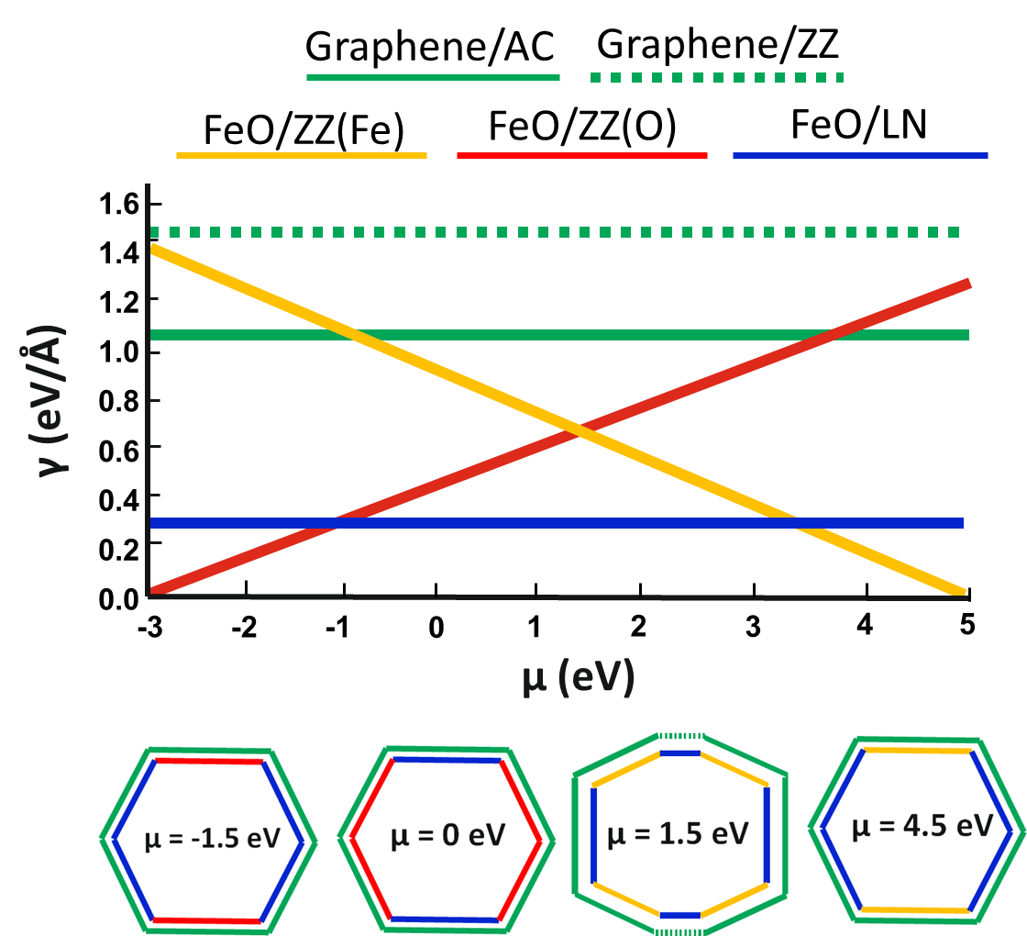
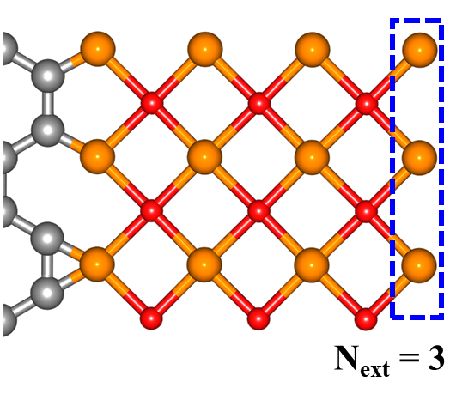
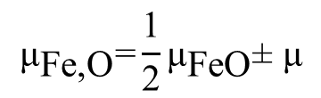
Determination of equilibrium shape of FeO film in graphene pore
Concentrations of iron and oxygen atoms are not equal in case of ZZ edge. Thus, one should take into account a difference of their chemical potentials:
$${\text{μ}}_{\text{Fe}\text{,}\text{O}}\text{=}\frac{\text{1}}{\text{2}}{\text{μ}}_{\text{FeO}}\text{± }\text{μ}$$
Larionov K. et al. The Journal of Physical Chemistry C 2018, 122 (30), 17389–17394.

Slide 12
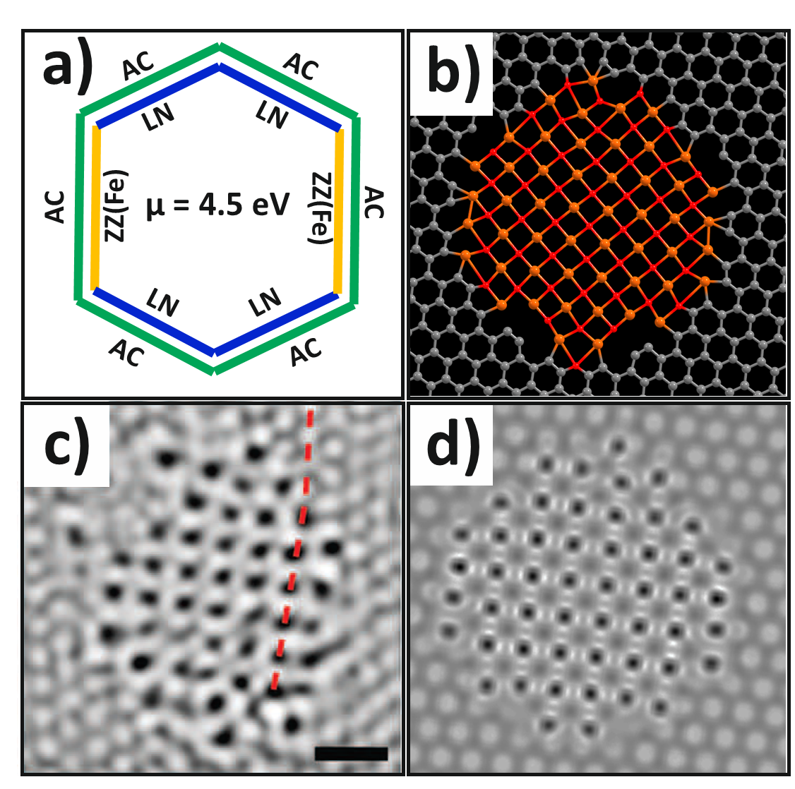
Simulation of 2D FeO film in graphene nanopore
a, b, d) Larionov K. et al. The Journal of Physical Chemistry C 2018, 122 (30), 17389–17394.
c) Zhao J. et al. Science 2014, 343 (6176), 1228–1232.

Slide 13
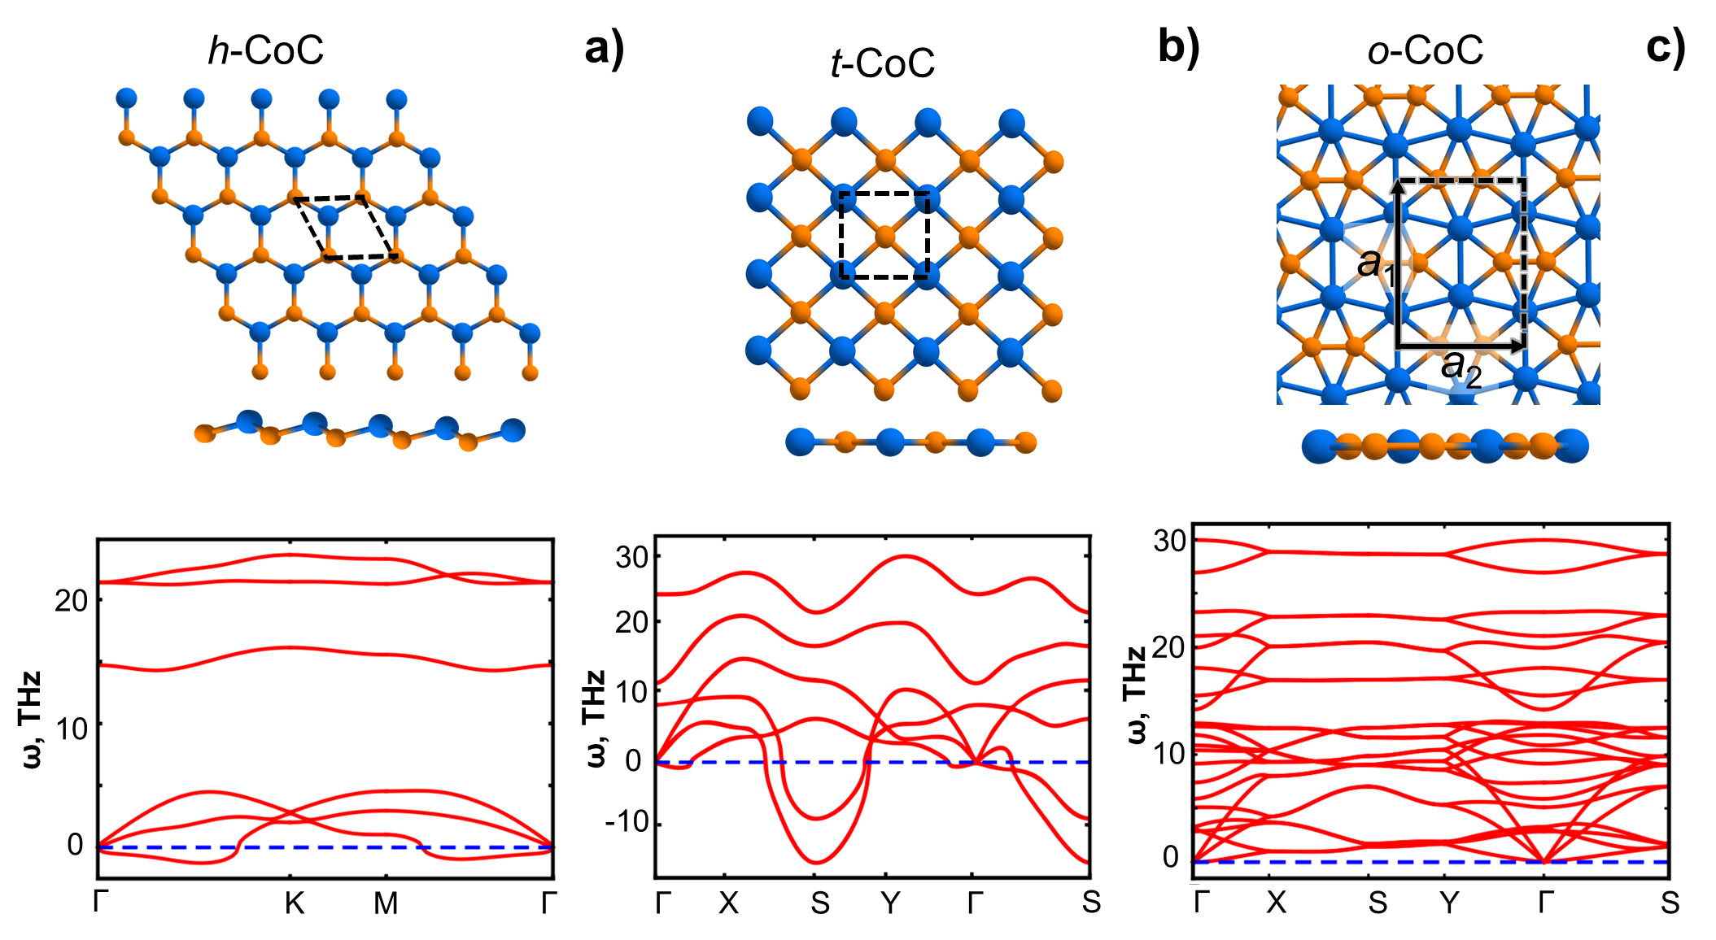

2D CoC of different lattice type
Larionov K. et al. Study of the New Two-Dimensional Compound CoC. JETP Letters 2018, 108 (1), 13–17

Slide 14
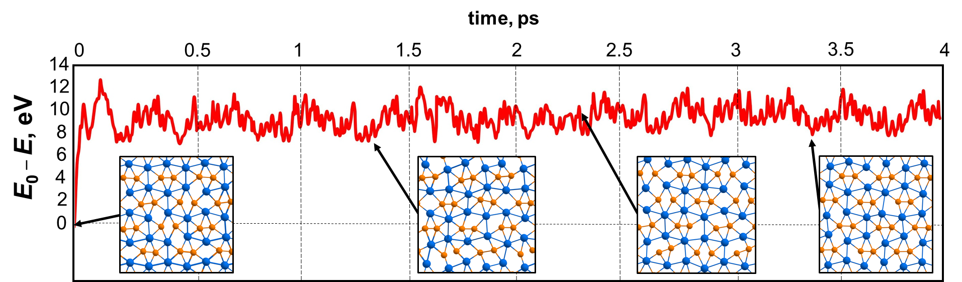
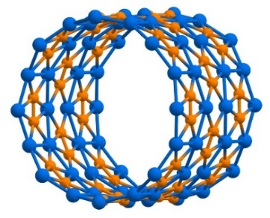
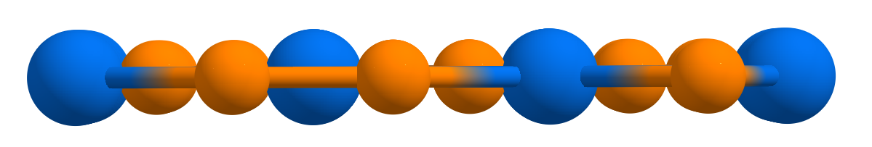
MD and bending analysis of o-CoC stability

Slide 15
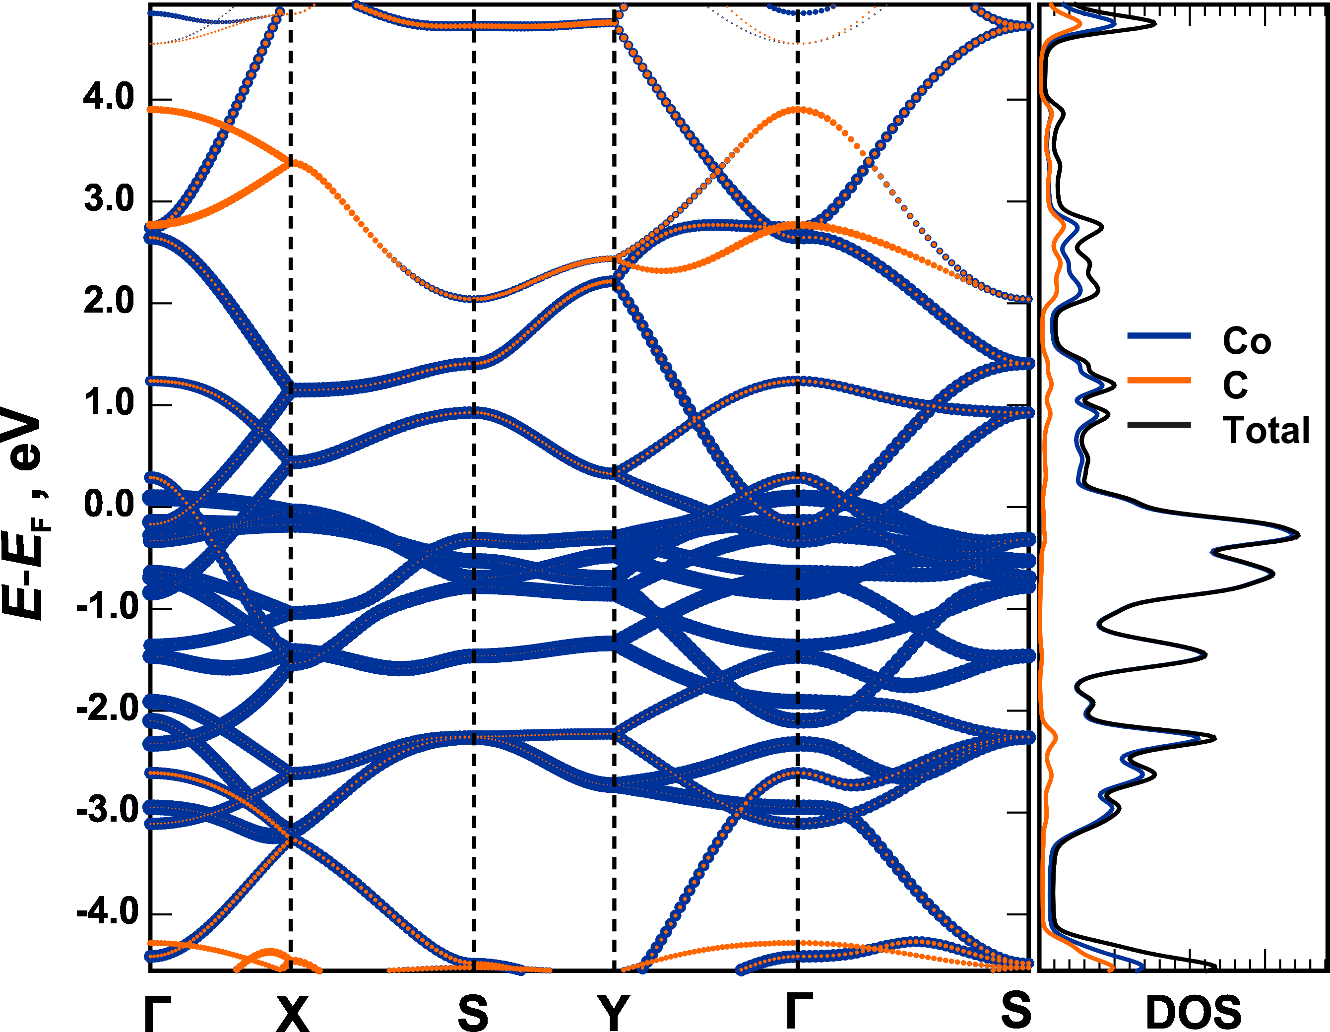
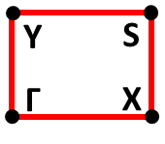
Electronic and mechanical properties of o-CoC
C₁₁ (N/m) | 229
C₁₂ (N/m) | 71
C₂₂ (N/m) | 241
C₆₆ (N/m) | 68
ν₁₂ | 0.31
ν₂₁ | 0.29
D₁ (eV) | 1.23
D₂ (eV) | 1.63
Graphene, C₁₁ = 367 N/m
MoS₂, C₁₁ = 140 N/m
Graphene, D = 1.46 eV
Larionov K. et al. Study of the New Two-Dimensional Compound CoC. JETP Letters 2018, 108 (1), 13–17

Slide 16



Conclusion
2D CuO
  Orthorhombic structure
  Semiconducting and antiferromagnetic properties
  Experimentally observed
  2D FeO
  Orthorhombic structure
  Semiconducting and strong antiferromagnetic properties
Seems to be experimentally observed
  2D CoC
  Orthorhombic structure
  Metallic and prospective mechanical properties
  No evidence of experimental observation. Yet.
  So, to be continued…

Slide 17
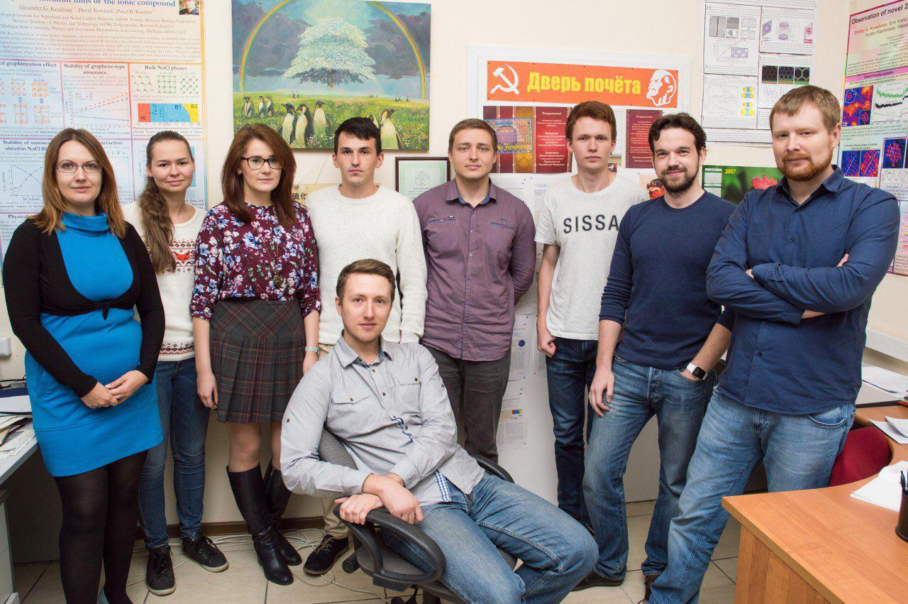

Acknowledgments
Pavel B. Sorokin Dmitry G. Kvashnin Zakhar I. Popov
Research Laboratory “Inorganic Nanomaterials”, NUST MISIS, Moscow
Research Laboratory of Theoretical Modeling of New Materials, TISNCM, Troitsk, Moscow
Head of theoretical group: Dr. habil. Pavel B. Sorokin
Join us via www.facebook.com/SorokinTheorGroup/

Slide 18

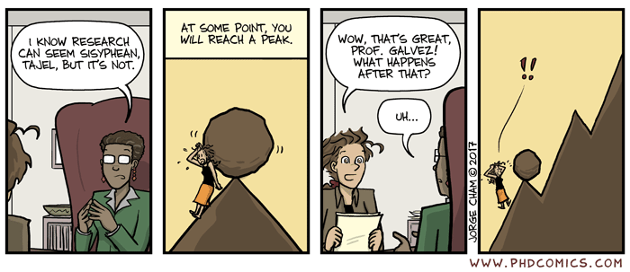
!

Slide 19
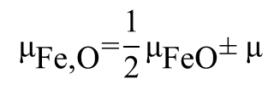
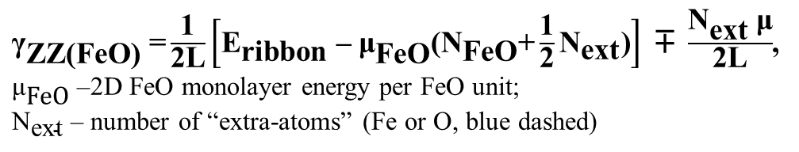
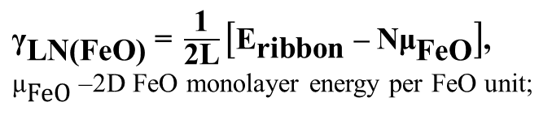
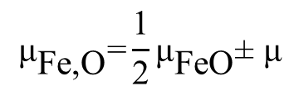
Determination of equilibrium shape of FeO film in graphene pore
${\text{γ}}_{\text{ZZ}\text{(}\text{FeO}\text{)}}\text{ =}\frac{\text{1}}{\text{2}\text{L}}\left[{\text{E}}_{\text{ribbon}}\text{ – }{\text{μ}}_{\text{FeO}}\text{(}{\text{N}}_{\text{FeO}}\text{+}\frac{\text{1}}{\text{2}}{\text{N}}_{\text{ext}}\text{)}\right]\text{ ∓ }\frac{{\text{N}}_{\text{ext}} \text{μ}}{\text{2}\text{L}}$,
${\text{μ}}_{\text{FeO}}$ –2D FeO monolayer energy per FeO unit;
${\text{N}}_{\text{ext}}$ – number of “extra-atoms” (Fe or O, blue dashed)
$${\text{μ}}_{\text{Fe}\text{,}\text{O}}\text{=}\frac{\text{1}}{\text{2}}{\text{μ}}_{\text{FeO}}\text{± }\text{μ}$$
$${\text{μ}}_{\text{Fe}\text{,}\text{O}}\text{=}\frac{\text{1}}{\text{2}}{\text{μ}}_{\text{FeO}}\text{± }\text{μ}$$
${\text{γ}}_{\text{LN}\text{(}\text{FeO}\text{)}}\text{ = }\frac{\text{1}}{\text{2}\text{L}}\left[{\text{E}}_{\text{ribbon}}\text{ – }\text{N}{\text{μ}}_{\text{FeO}}\right]$,
${\text{μ}}_{\text{FeO}}$ –2D FeO monolayer energy per FeO unit;

Slide 20
Ссылки на свои статьи
Тезисно выводы по каждому слайду
Анимации к слайдам. Да побольше ☺
Анимации к MD и FeO(hex -> square)
Благодарности
Нормальный Outline
  Systematic investigation of two-dimensional transition metal oxides and carbides as well as hetererostructures based on them is of great interest because of their high promising electronic and magnetic properties appearing at the low dimension.

Slide 21

Fan, D.; Lu, S.; Hu, X. Two-Dimensional Iron Monocarbide with Planar Hypercoordinate Iron and Carbon.
arXiv:1802.03673 [cond-mat.mtrl-sci]

Slide 22
Summary
2D-CuO
  Formation of CuO monolayers with square lattice was predicted and found to be in agreement with STEM/EELS experiments
  Semiconducting and weak antiferromagnetic properties of 2D-CuO were shown
  2D-FeO
“Ionic graphitization” of ultrathin rocksalt FeO films into stack of monolayers with orthorhombic lattice type and strong antiferromagnetic ordering was shown
2D-FeO/graphene interface energy and its shape under external conditions were described analytically
Possibility of experimental observation of 2D-FeO was proposed
  2D-CoC
  New 2D phase of CoC with orthorhombic lattice was proposed and its prospective stability was shown
  Mechanical and electronic properties analysis of o-CoC was carried out

