Slide 1
7-th School-Conference on Atomistic
Simulation of Functional Materials
(ASFM 2018)
Novel push-pull quinoxalinone-based chromophores with high sensitivity of emission and absorption
to small structural modifications
T.I. Burganov,*¹
S.A. Katsyuba,¹ T.P. Gerasimova,¹ S.M. Sharipova,¹ A.A. Kalinin,¹ A. Monari,² X. Assfeld.²
¹ Arbuzov Institute of Organic and Physical Chemistry, FRC Kazan Scientific Center of RAS, Kazan, Russia
² University of Lorraine, Laboratory of theoretical chemistry and physics, CS 25233, Nancy, France
* e-mail: timk90@mail.rua
Moscow 2018

Slide 2
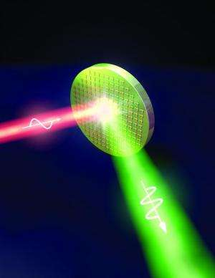
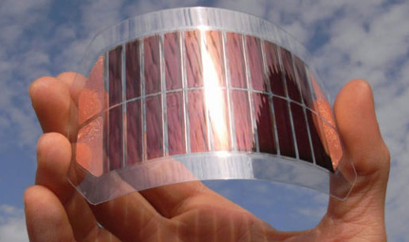
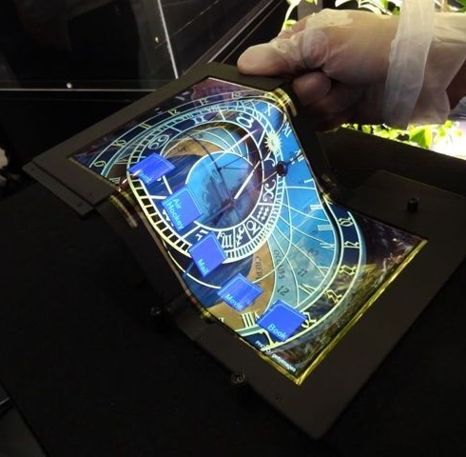
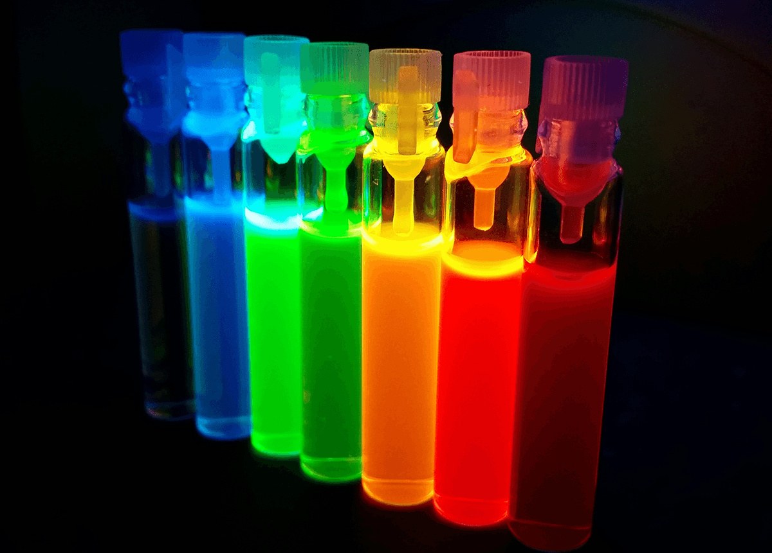
Applications of push-pull systems
Organic light-emitting diodes (OLEDs)
Nonlinear optics
(NLO - materials)
Organic solar cells (DSSCs/BHJ)
Luminescent sensors
Donor – π – Acceptor
systems
D
π
А

Slide 3
Considered quinoxalinone-based D/A-π-A compounds
D
π
А
A
π
А
3

Slide 4
Experimental photophysical
properties
4

Slide 5
Positive solvatochromic
behavior
Compound 1
 | dioxane | Ethyl Acetate | CH₂Cl₂ | Acetone | CH₃CN | DMSO
λ_{max}, nm | 354 | 354 | 362 | 359 | 359 | 367
eV | 3.50 | 3.50 | 3.43 | 3.45 | 3.45 | 3.38
ε | 26500 | 23454 | 46000 | 41589 | 44000 | 30432
λ_{emi}, nm | 523 | 550 | 590 | 598 | 610 | 616
eV | 2.37 | 2.25 | 2.10 | 2.07 | 2.03 | 2.01
φ | 0.13 | 0.05 | 0.023 | 0.003 | <0.01 | <0.01
Stokes shifts
Δλ_{emi}, nm | 169 | 196 | 228 | 239 | 251 | 249
eV | 1.13 | 1.25 | 1.32 | 1.38 | 1.42 | 1.37
Δν,cm⁻¹ | 9128 | 10067 | 10675 | 11133 | 11462 | 11014
Absorption
Emission
5

Slide 6
Calculated electronic transitions on optimized S₀
with PBE0/def2-TZVP
ΔG_{B-A} < 0.2 kcal/mol
6

Slide 7
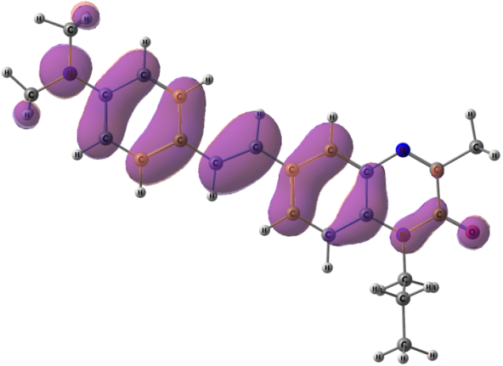
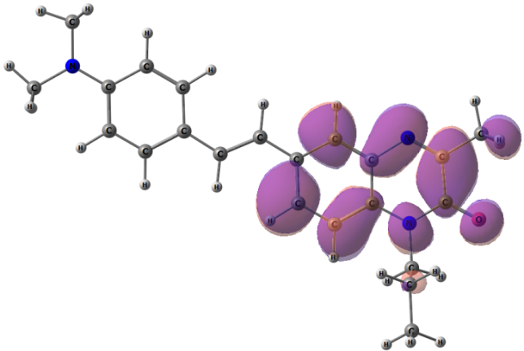
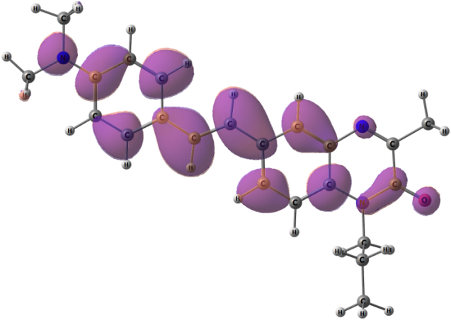
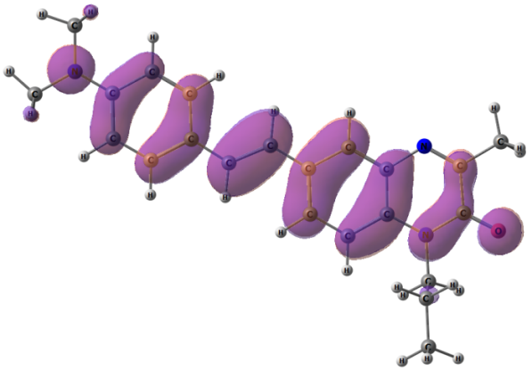
Calculated NTO for the first electronic transitions on optimized S₀
with PBE0/def2-TZVP
Occupied NTO
Virtual NTO
Partialy
ICT
1st
ϕ_{S =} 0.71
Local
π→π*
2^{d}
ϕ_{S =} 0.91
7
ICT – intramolecular charge transfer

Slide 8
Calculated electronic transitions on optimized S₀
with PBE0/def2-TZVP
Calculated and Experimental Absorption
Experiment |  | Calculations
λ_{max}, nm/eV | λ_{emi}, nm/eV | S₀→S_{n}, nm/eV (f) | S₁→S₀, nm/eV (f) | Nature of S₀→S₁ (ϕ_{S}) | μ(S₀), D | ΔE (ΔG) kcal/mol
DIOX 362/ 3.43 DCM 363/ 3.43 | DIOX 523/ 2.37 DCM 590/ 2.10 | GAS S₀→S₁ 406/ 3.05 (0.03) S₀→S₂ 357/ 3.47 (1.48) | GAS 507/ 2.45 (0.049) DCM(PCM) 550/ 2.26 (0.143) | Local with partial CT (0.71) S₀→S₂ Local π→π* (0.91) | 5.93 | 0.14 (0.13)
Calculated and Experimental Emission
8

Slide 9
Experimental photophysical properties
9

Slide 10
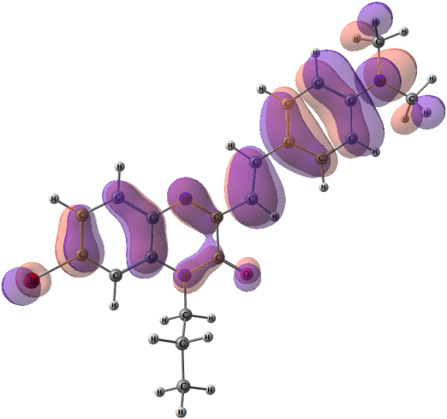
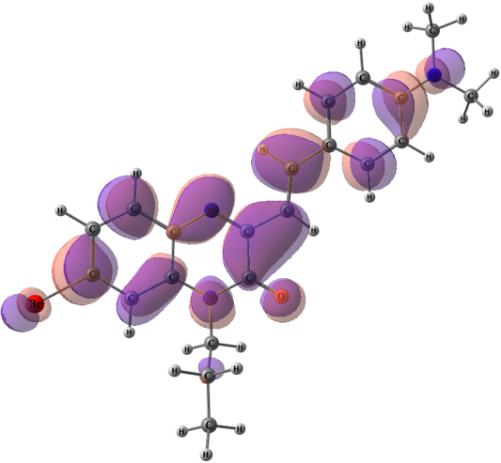
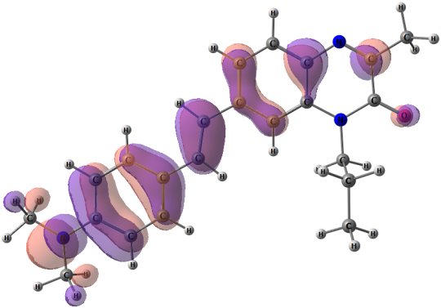
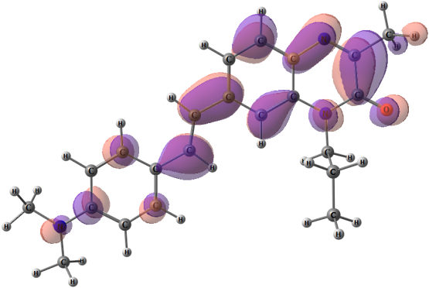
NTO for the first electronic transitions of 2 and 3
Occupied NTO
Virtual NTO
Partial ICT
More local
than 1
1st
ϕ_{S =} 0.72
Partial ICT
More local
than 1
1st
ϕ_{S =} 0.68
10
ICT – intramolecular charge transfer

Slide 11
 | Experiment |  | Calculations
 | λ_{max}, nm/eV | λ_{emi}, nm/eV | S₀→S₁, nm/eV (f) ^{[d]} | S₁→S₀, nm/eV (f) ^{[d]} | Assignment for S₀→S₁ (ϕ_{S}) | μ(S₀)D | ΔE, (ΔG) kcal/mol
1 | DCM 362/ 3.43 | DCM 590/ 2.10 | 406/3.05 (0.03) S₀→S₂ 357/3.47 (1.48) | DCM 550/ 2.26 (0.143) | Local with partial CT (0.71) S₀→S₂ π→π* (0.91) | 5.93 | 0.14 (0.13)
2 | DIOX 442/ 2.81 DCM 447/ 2.77 | DIOX 530/ 2.34 DCM 560/ 2.21 | GAS 433/ 2.86 (1.17) | GAS 478/ 2.60 (1.627) DCM(PCM) 564/ 2.20 (1.533) | Local with partial CT π→π* (0.72) | 1.95 | 0.76 (1.07)
3 | DIOX 397/ 3.08 DCM 403/ 2.22 | DIOX 497/ 2.49 DCM 558/ 2.21 | GAS 409/ 3.03 (1.07) | GAS 448/ 2.76 (1.16) DCM(PCM) 532/ 2.33 (1.556) | Local with partial CT π→π* (0.68) | 7.70 | 0.06 (0.08)
11

Slide 12

 | Experiment In DCM |  | Calculations with TDDFT (PBE0/def2-TZVP) gas/PCM(DCM)
 | λ_{max}, nm/ eV | λ_{emi}, nm/ eV | S₀→S₁, nm/eV (f) ^{[d]} | S₁→S₀, nm/eV (f) /PCM in bold | ΔE^{[c]}, (ΔG) kcal/ mol
2 | 447/ 2.77 | 560/2.21 | 433/2.86 (1.17) | 478/2.60 (1.627) 564/2.20 (1.533) | 0.76 (1.07)
4 | 462/2.68 | 580/2.14 | 431/2.88 (1.27) | 469/2.64 (1.19) 550/2.26 (1.740) | 0.81 (1.08)
Occupied NTO
Virtual NTO
12

Slide 13
Linear correlation between E_{T}(30) values and the experimental positions of λ_{emi}
13

Slide 14
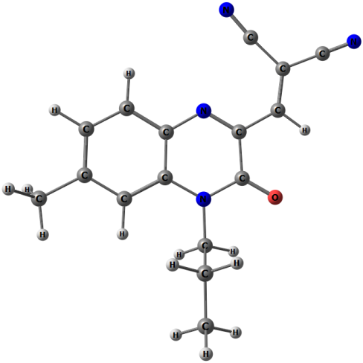
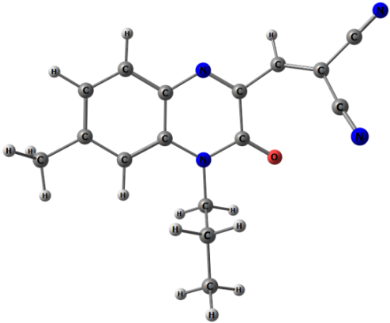
 | Experiment In DCM |  | Calculations with TDDFT (PBE0/def2-TZVP) gas/PCM(DCM)
 | λ_{max}, nm/ eV | λ_{emi}, nm/ eV | S₀→S₁, nm/eV (f) ^{[d]} | S₁→S₀, nm/eV (f) /PCM in bold | ΔE^{[c]}, (ΔG) kcal/ mol
1 | 362/ 3.43 | 590/ 2.10 | 406/ 3.05 (0.03) S₀→S₂ 357/ 3.47 (1.48) | 507/ 2.45 (0.049) 550/ 2.26 (0.143) | 0.14 (0.13)
5 | DIOX 441/ 2.81 DCM 452/ 2.74 | DIOX 526/ 2.36 DCM 537/ 2.31 | GAS 431/ 2.88 (0.26) | GAS 501/ 2.48 (0.1726) DCM(PCM) 555/2.24 (0.3638) | 4.35 (3.69)
Rotamer A
(major)
Rotamer B
(minor)
ΔG_{A-B} =
3.7 kcal/mol
14

Slide 15
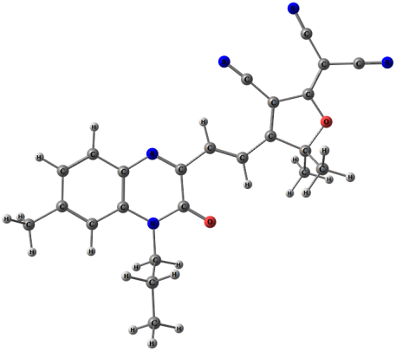
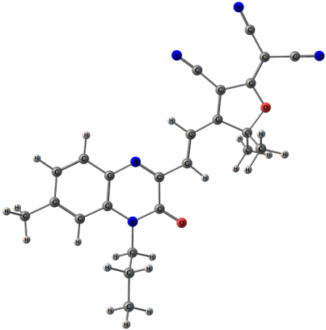
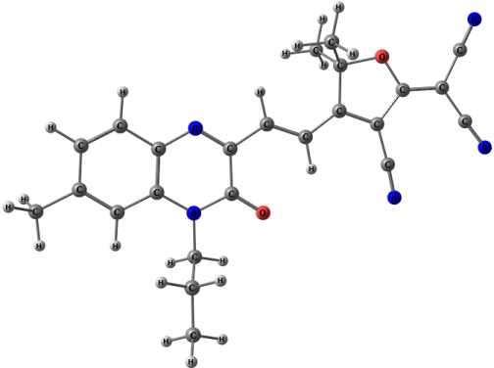
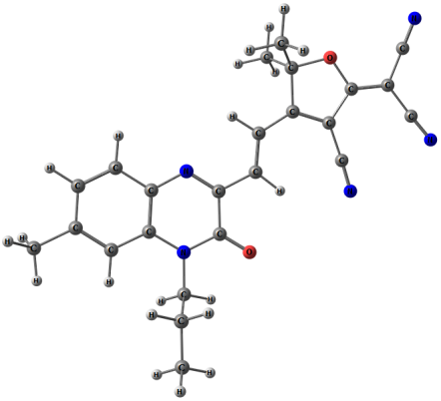
 | Experiment In DCM |  | Calculations with TDDFT (PBE0/def2-TZVP) gas/PCM(DCM)
 | λ_{max}, nm/ eV | λ_{emi}, nm/ eV | S₀→S₁, nm/eV (f) ^{[d]} | S₁→S₀, nm/eV (f) /PCM in bold | ΔE^{[c]}, (ΔG) kcal/ mol
1 | 362/3.43 | 590/2.10 | 406/ 3.05 (0.03) S₀→S₂ 357/ 3.47 (1.48) | 507/ 2.45 (0.049) 550/ 2.26 (0.143) | 0.14 (0.13)
5 | 450/2.76 | 526/2.36 | 431/ 2.88 (0.26) | 501/ 2.48 (0.1726) 555/ 2.24 (0.3638) | 4.35 (3.69)
6 | DIOX 462/ 2.68 DCM 469/2.64 | DIOX 590/ 2.10 DCM 606/2.05 | GAS 490/ 2.53 (0.87) | GAS 574/ 2.16 (0.9222) DCM(PCM) 633/ 1.96 (1.3160) | 1.33 (1.51)
rotamer A
(1.0 kcal/mol)
rotamer B
(0 kcal/mol)
rotamer C
(1.3 kcal/mol)
rotamer D
(2.2 kcal/mol)
15

Slide 16
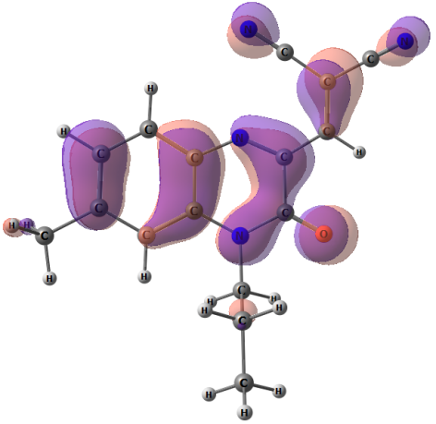
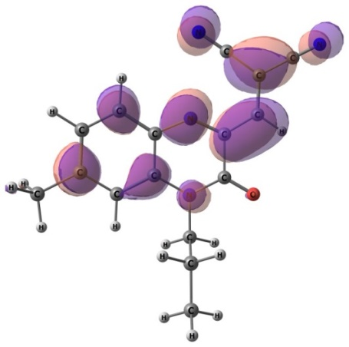
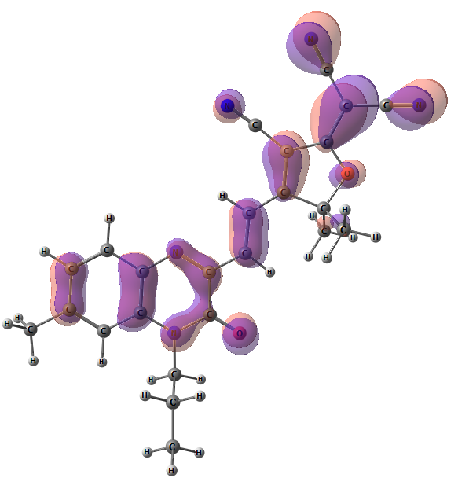
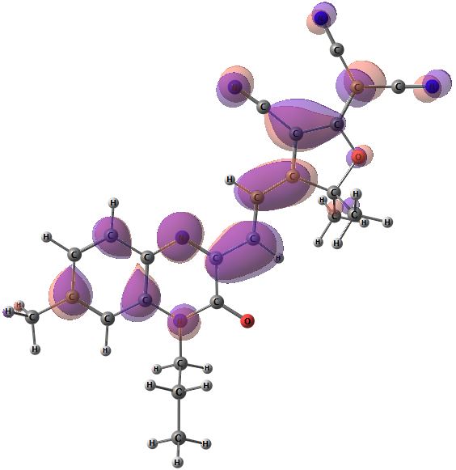
NTO for the first electronic transitions of 5 and 6
Occupied NTO
Virtual NTO
Purely
local π→π*
1st
ϕ_{S =} 0.71
Purely
local π→π*
1st
ϕ_{S =} 0.79
16

Slide 17
Conclusions
The capacity of a series of novel push-pull quinoxalinone based chromophores to absorb and emit radiation in the broad range of visible spectrum is demonstrated. Their absorption and emission are shown to depend dramatically on quite moderate structural modification of the molecules.
Quantum-chemical calculations within TDDFT approach using cost-effective PBE0/def2-TZVP method with PCM model reasonably reproduce main spectral features and trends along with solvatochromic behavior.
Seemingly gigantic Stokes Shift of 1 has been explained on the basis of the calculations
The moderate charge-transfer character established for all the systems using NTO and detachment/attachment density matrices is shown to be non the main factor affecting the photophysical properties
No dependence of the photophysical characteristics of the chromophores on the conformation of the DMAS group is found.
For more details:
Burganov T. I., et al, Physical Chemistry Chemical Physics., 2018, 20, 21515-21527. https://pubs.rsc.org/en/content/articlelanding/2018/cp/c8cp03780a#!divAbstract
17

Slide 18



Acknowledgements
The reported study was funded by RFBR according to the research project
№ 18-33-00128 mol_a
TB gratefully acknowledges researcher-mobility funding program of the government of the Republic of Tatarstan “Algarysh-2017”
(grant №12440 24.05.17)
Special thanks are due to Prof. L. Zakharova and Dr. D. Gabdrakhmanov for their kind assistance in fluorimetric measurements.
18

Slide 19
Thank you for your kind attention

Slide 20
20

Slide 21
 | 1 | 2 | 3 | 4 | 5 | 6
 | 1,4-dioxane
λ_{max}, nm | 354 | 442 | 397 | 457 | 441 | 462
eV | 3.50 | 2.81 | 3.12 | 2.71 | 2.81 | 2.68
ε | 26500 | 31000 | 33000 | 26000 | 9500 | 19600
λ_{emi}, nm | 523 | 530 | 497 | 556 | 525 | 590
eV | 2.37 | 2.34 | 2.49 | 2.23 | 2.36 | 2.10
φ | 0.13 | 0.11 | 0.81 | 0.16 | 0.05 | <0.01
 | Ethyl Acetate
λ_{max}, nm | 354 | 439 | 394 | 453 | 445 | 460
eV | 3.50 | 2.82 | 3.15 | 2.74 | 2.79 | 2.70
ε | 23454 | 25850 | 30482 | 27816 | 12500 | 25000
λ_{emi}, nm | 550 | 544 | 527 | 569 | 538 | 610
eV | 2.25 | 2.28 | 2.35 | 2.18 | 2.30 | 2.03
φ | 0.05 | 0.12 | 0.80 | 0.20 | 0.08 | 0.03
 | CH₂Cl₂
λ_{max}, nm | 362 | 446 | 403 | 464 | 452 | 469
eV | 3.43 | 2.78 | 3.08 | 2.67 | 2.74 | 2.64
ε | 46000 | 39000 | 25500 | 24000 | 11000 | 10600
λ_{emi}, nm | 590 | 561 | 558 | 581 | 537 | 606
eV | 2.10 | 2.21 | 2.22 | 2.13 | 2.31 | 2.05
φ | 0.023 | 0.15 | 0.62 | 0.17 | 0.05 | 0.04
1 | 2 | 3 | 4 | 5 | 6
Acetone
359 | 441 | 397 | 455 | 448 | 466
3.45 | 2.81 | 3.12 | 2.72 | 2.77 | 2.66
41589 | 28730 | 36336 | 32186 | 8600 | 11300
598 | 572 | 583 | 599 | 560 | 635
2.07 | 2.17 | 2.13 | 2.07 | 2.21 | 1.95
0.003 | 0.17 | 0.53 | 0.23 | 0.08 | 0.02
CH₃CN
359 | 439 | 397 | 453 | 450 | 467
3.45 | 2.82 | 3.12 | 2.74 | 2.76 | 2.65
44000 | 26000 | 33000 | 32500 | 10500 | 9200
610 | 588 | 609 | 611 | 561 | 635
2.03 | 2.11 | 2.04 | 2.03 | 2.21 | 1.95
<0.01 | 0.16 | 0.03 | 0.13 | 0.06 | 0.03
DMSO
367 | 454 | 407 | 466 | 452 | 470
3.38 | 2.73 | 3.05 | 2.66 | 2.74 | 2.64
30432 | 30993 | 32459 | 31062 | 9800 | 18500
616 | 602 | 619 | 624 | 580 | 655
2.01 | 2.06 | 2.00 | 1.99 | 2.14 | 1.89
<0.01 | 0.28 | 0.11 | 0.19 | 0.02 | 0.03

Slide 22
 | 1 | 2 |  | 3 | 4 | 5 | 6
Stokes shifts
 | 1,4-dioxane
Δλ_{emi}, nm | 169 | 88 | 100 |  | 99 | 84 | 128
eV | 1.13 | 0.47 | 0.63 |  | 0.48 | 0.45 | 0.58
Δν,cm⁻¹ | 9128 | 3757 | 5068 |  | 3896 | 3628 | 4696
 | Ethyl Acetate
Δλ_{emi}, nm | 196 | 105 | 133 |  | 116 | 93 | 150
/eV | 1.25 | 0.55 | 0.79 |  | 0.56 | 0.48 | 0.66
Δν,cm⁻¹ | 10067 | 4397 | 6405 |  | 4500 | 3885 | 5346
 | CH₂Cl₂
Δλ_{emi}, nm | 228 | 115 | 155 |  | 117 | 85 | 137
/eV | 1.32 | 0.57 | 0.85 |  | 0.54 | 0.43 | 0.60
Δν,cm⁻¹ | 10675 | 4596 | 6893 |  | 4340 | 3502 | 4820
 | Acetone
Δλ_{emi}, nm | 239 | 131 | 186 |  | 144 | 112 | 169
/eV | 1.38 | 0.64 | 1.00 |  | 0.66 | 0.55 | 0.71
Δν,cm⁻¹ | 11133 | 5193 | 8036 |  | 5284 | 4500 | 5700
 | CH₃CN
Δλ_{emi}, nm | 251 | 149 | 212 |  | 158 | 111 | 168
/eV | 1.42 | 0.72 | 1.09 |  | 0.71 | 0.55 | 0.70
Δν,cm⁻¹ | 11462 | 5772 | 8769 |  | 5709 | 4397 | 5665
 | DMSO
Δλ_{emi}, nm | 249 | 148 | 212 |  | 158 | 128 | 185
/eV | 1.37 | 0.67 | 1.04 |  | 0.67 | 0.61 | 0.75
Δν,cm⁻¹ | 11014 | 5415 | 8415 |  | 5434 | 4883 | 6010
22

