Slide 1




Electronic excitations of cytosine in water: how to describe solvent effects?
Nikita Dubinets
Moscow 2018

Slide 2
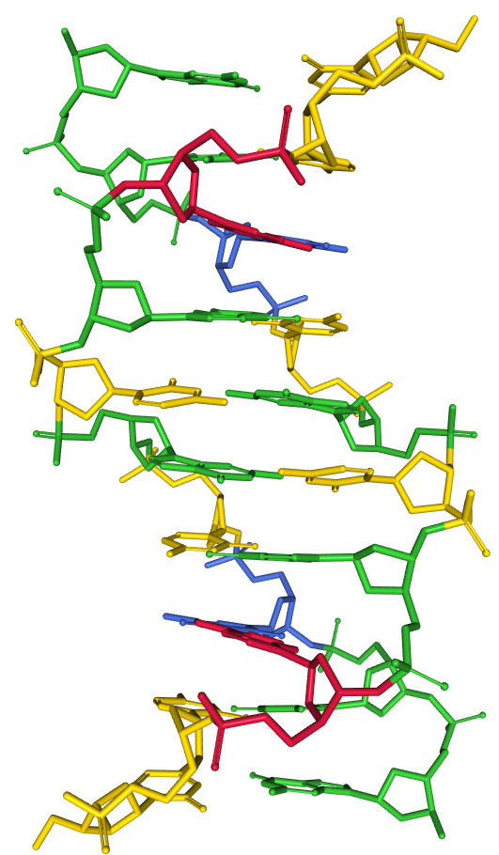
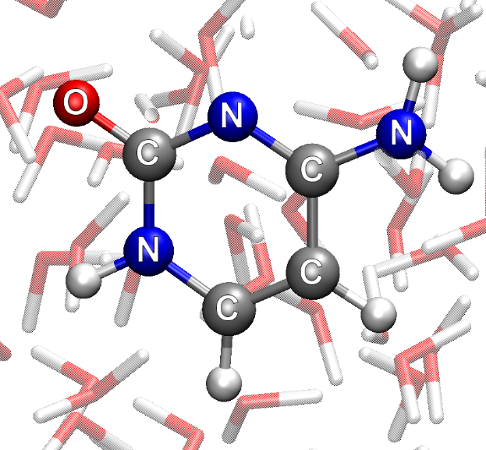
INTRODUCTION
Effective Fragment Potential Method for H‑Bonding: How To Obtain Parameters for Nonrigid Fragments
J. Phys. Chem. A 2017, 121, 5301−5312
pyEFP: Automatic Decomposition of the Complex Molecular Systems into Rigid Polarizable Fragments
Journal of Computational Chemistry 2018, 39, 807–814

Slide 3
“GAS PHASE” EXC. ENER.
REF* |  | cc-pVDZ | EOM-CCSD |  | CIS(D) |  | TD-DFT/PBE0 |  | TDDFT/wB97xD
 |  |  | Exc. E. eV | Oscil. str. | Exc. E. eV | Oscil. str. | Exc. E. eV | Oscil. str. | Exc. E. eV | Oscil. str.
4.66 | 0.052 | 1A’ | 5.061 | 0.056 | 6.152 | 0.166 | 4.982 | 0.045 | 5.226 | 0.071
4.87 | 0.002 | 1A” | 5.482 | 0.001 | 6.902 | 0.002 | 4.914 | 0.000 | 5.253 | 0.001
5.26 | 0.002 | 2A” | 6.074 | 0.000 | 7.231 | 0.001 | 5.805 | 0.000 | 6.014 | 0.000
5.53 | 0.005 | 4A” | 7.039 | 0.000 | 7.886 | 0.001 | 6.614 | 0.000 | 7.198 | 0.000
5.61 | 0.138 | 2A’ | 6.068 | 0.166 | 7.607 | 0.353 | 5.798 | 0.090 | 6.147 | 0.110
5.83 | 0.000 | 3A" | 6.360 | 0.000 |  |  | 5.352 | 0.001 | 5.253 | 0.001
*CC2/aug-cc-pVDZ // Timo Fleig. Stefan Knecht. Christof Hattig; J. Phys. Chem. A 2007. 111. 5482-5491

Slide 4
“GAS PHASE” EXC. ENER.
REF* |  | aug-cc-pVDZ | EOM-CCSD |  | CIS(D) |  | TD-DFT/PBE0 |  | TDDFT/wB97xD
 |  |  | Exc. E. eV | Oscil. str. | Exc. E. eV | Oscil. str. | Exc. E. eV | Oscil. str. | Exc. E. eV | Oscil. str.
4.66 | 0.052 | 1A’ |  |  | 5.963 | 0.169 | 4.881 | 0.054 | 5.104 | 0.079
4.87 | 0.002 | 1A” | 5.406 | -0.003 | 6.874 | 0.002 | 4.917 | 0.001 | 5.252 | 0.002
5.26 | 0.002 | 2A” |  |  |  |  | 5.733 | 0.000 | 5.993 | 0.000
5.53 | 0.005 | 4A” | 5.571 | -0.004 | 6.285 | 0.012 | 5.434 | 0.005 | 5.902 | 0.006
5.61 | 0.138 | 2A’ |  |  |  |  | 5.651 | 0.086 | 5.973 | 0.116
5.83 | 0.000 | 3A" | 6.268 | 0.000 |  |  | 5.350 | 0.001 | 5.861 | 0.000
*CC2/aug-cc-pVDZ // Timo Fleig. Stefan Knecht. Christof Hattig; J. Phys. Chem. A 2007. 111. 5482-5491

Slide 5
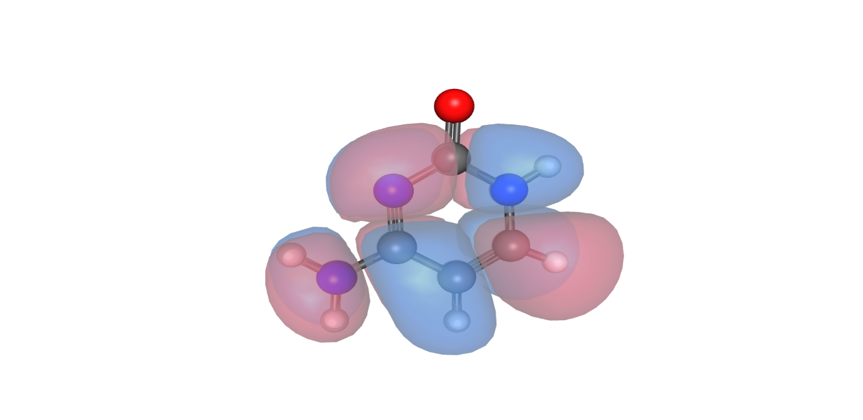
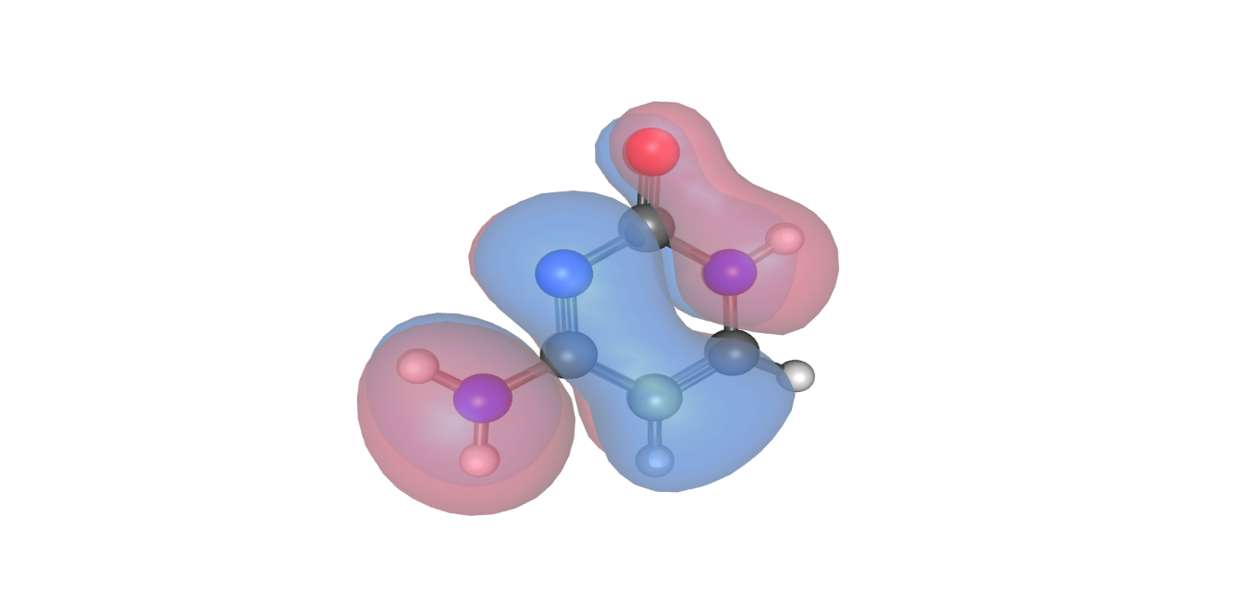
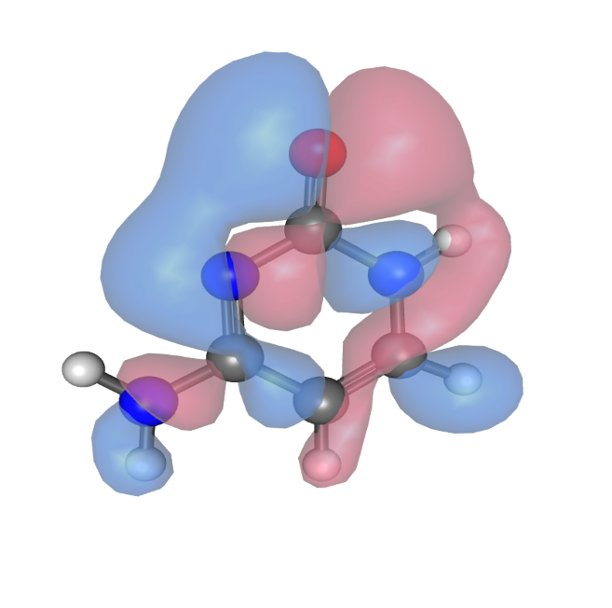

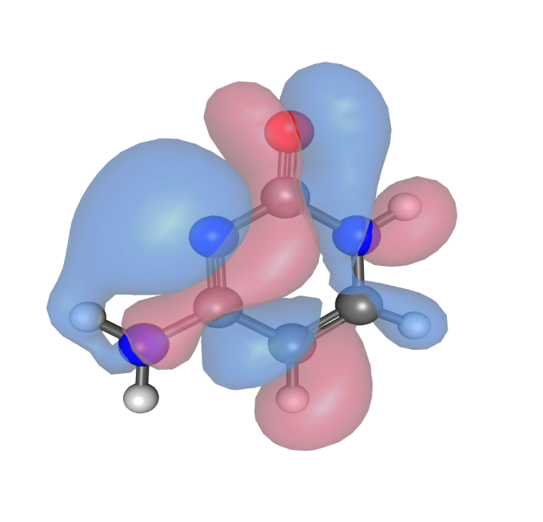
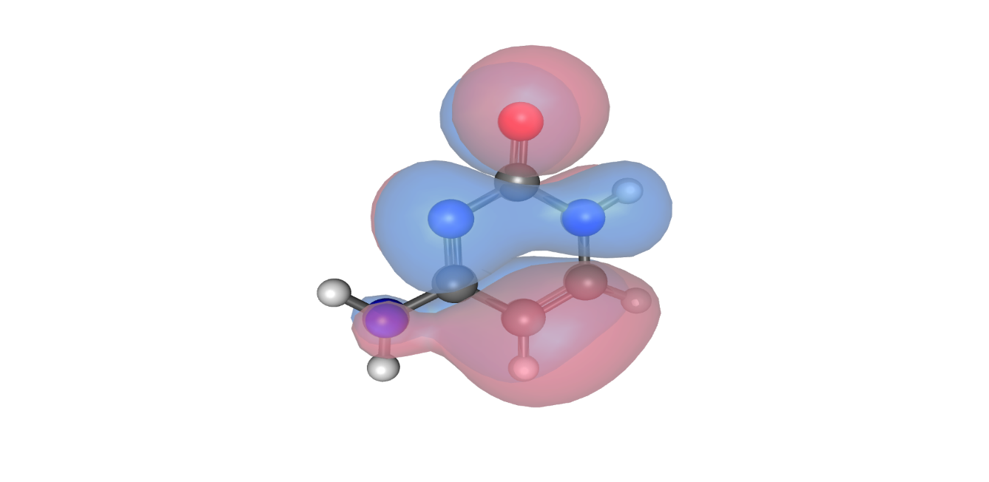
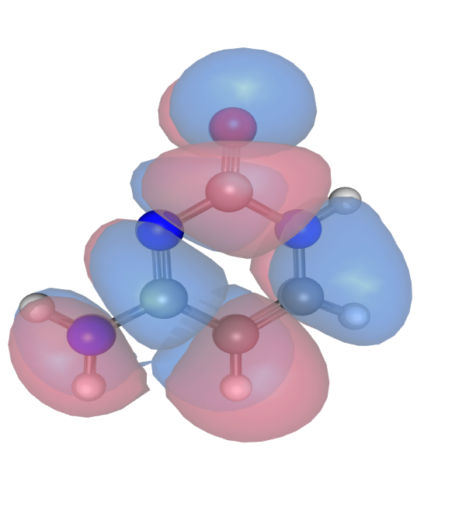
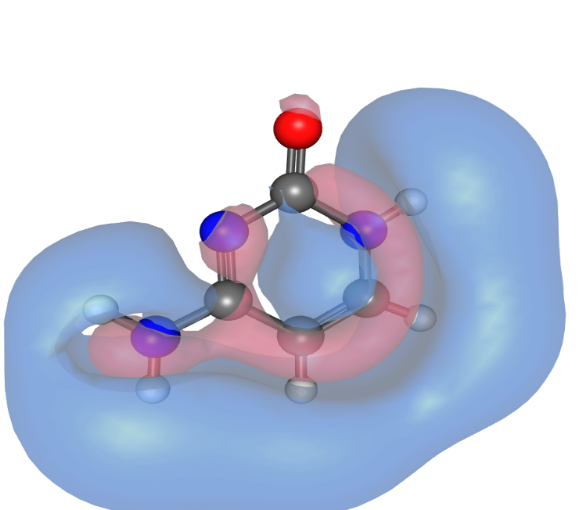
MOLECULAR ORBITALS
29→1 1A’ π→π* | 27→1 1A” n→π* | 27→2 2A” n→π* | 29→3 4A” π→Ryd | 28→1 2A’ π→π* | 26→1 3A” n→π*

Slide 6
TIME & DEVIATION
cc-pVDZ, min |  | aug-cc-pVDZ, min
EOM-CCSD | 216 | EOM-CCSD | 753
CIS(D) | 14 | CIS(D) | 100
TD-DFT/ PBE0 | 1 | TD-DFT/ PBE0 | 6
TDDFT/ wB97xD | 2 | TDDFT/ wB97xD | 13
cc-pVDZ, eV |  | aug-cc-pVDZ, eV
EOM-CCSD | 0.721 | EOM-CCSD | 0.338
CIS(D) | 1.970 | CIS(D) | 1.354
TD-DFT/ PBE0 | 0.443 | TD-DFT/ PBE0 | 0.226
TDDFT/ wB97xD | 0.747 | TDDFT/ wB97xD | 0.387

Slide 7
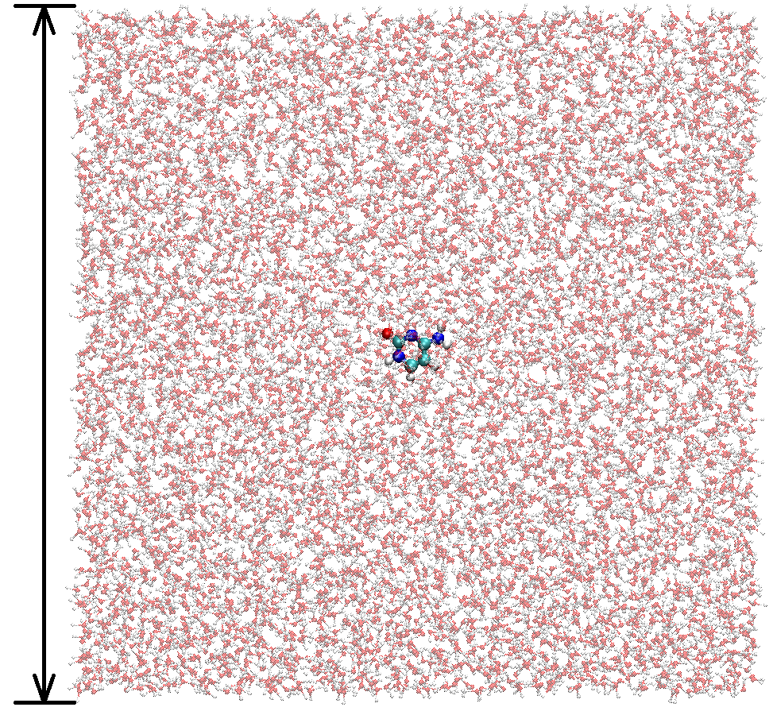
MD DETAILS
Energy minimization
Steepest descent algorithm
NVT
Nsteps = 50000
NPT
Nsteps = 1000000
Time step = 2 fs
T ≈ 300K
Berendsen thermostat
Time step = 2 fs
P ≈ 1.05 bar
Parrinello-Rahman barostat
Initial density:
≈ 982 kg/m³
Number waters:
7090
60 Å
Force field:
OPLS-aa
Number snapshots:
100

Slide 8
QM DETAILS
QM/EFP
TD-DFT/PBE0
QM/MM
TD-DFT/PBE0
FMO
TD-DFT/PBE0
Electrostatic: Yes
cc-pVDZ
cc-pVDZ
Electrostatic: Yes
Exchange-Repulsion: No
Dispersion: No
cc-pVDZ
FMO1
60 Å
Number waters:
7090
Number snapshots:
100

Slide 9
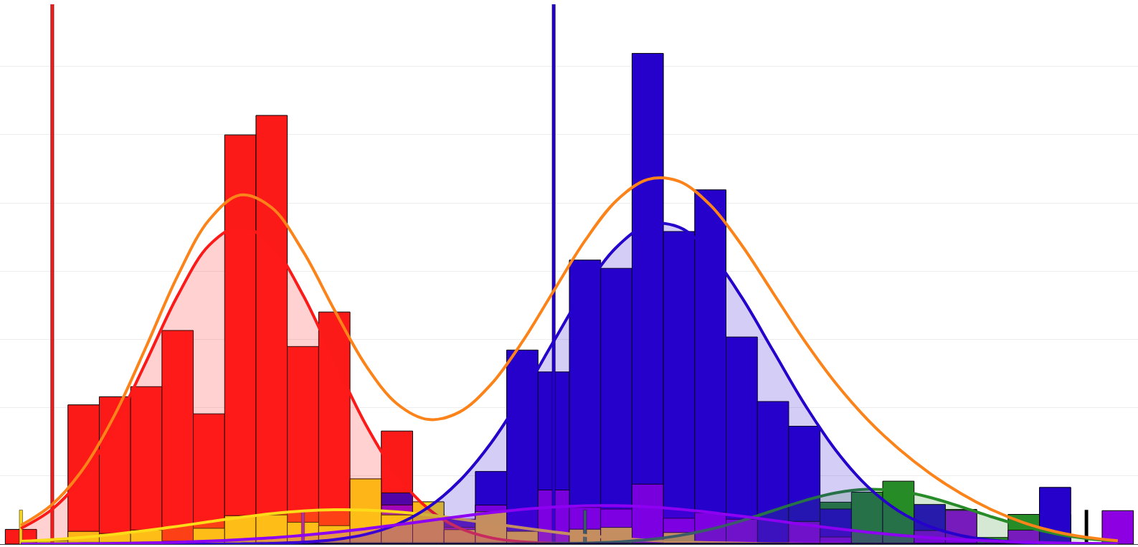

QM/EFP
0.014
1A’
0.012
1A’’
2A’’
0.01
2A’
3A’’
0.008
4A’’
SUM
0.006
0.004
0.002
0
5
5.25
5.5
5.75
6
6.25
6.5

Slide 10
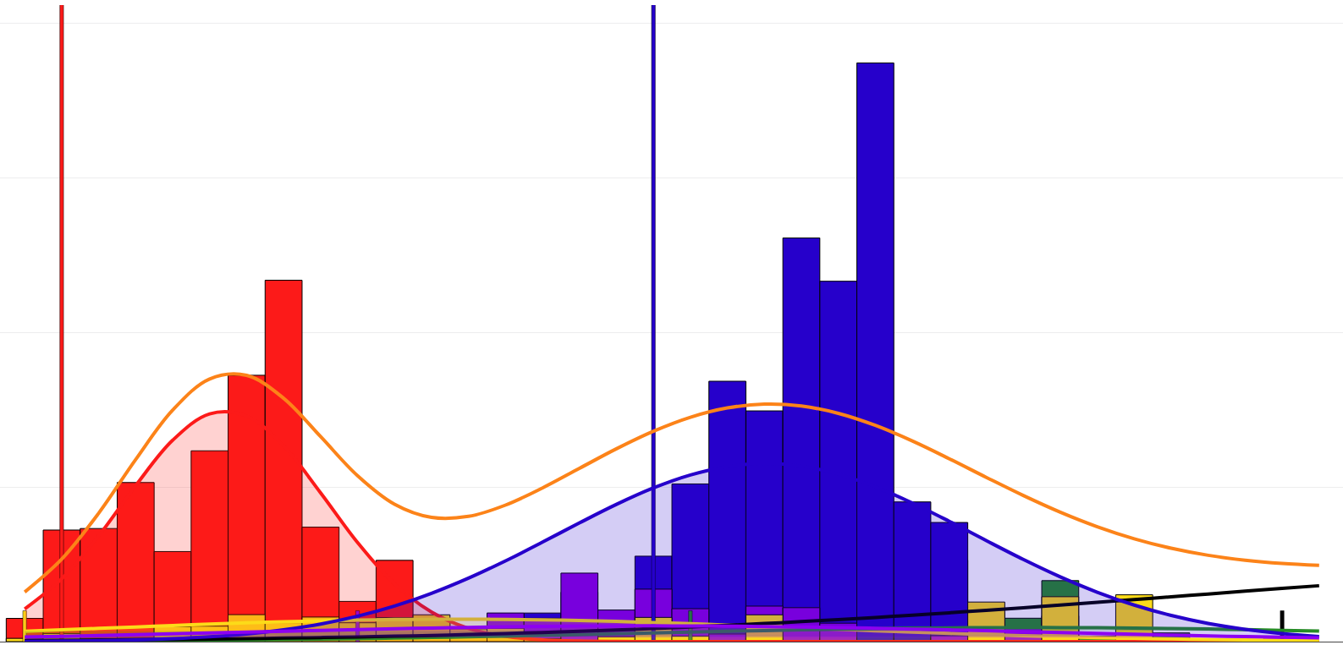
QM/MM
0.02
1A’
0.015
1A’’
2A’’
2A’
3A’’
0.01
4A’’
SUM
0.005
0
5
5.25
5.5
5.75
6
6.25
6.5

Slide 11
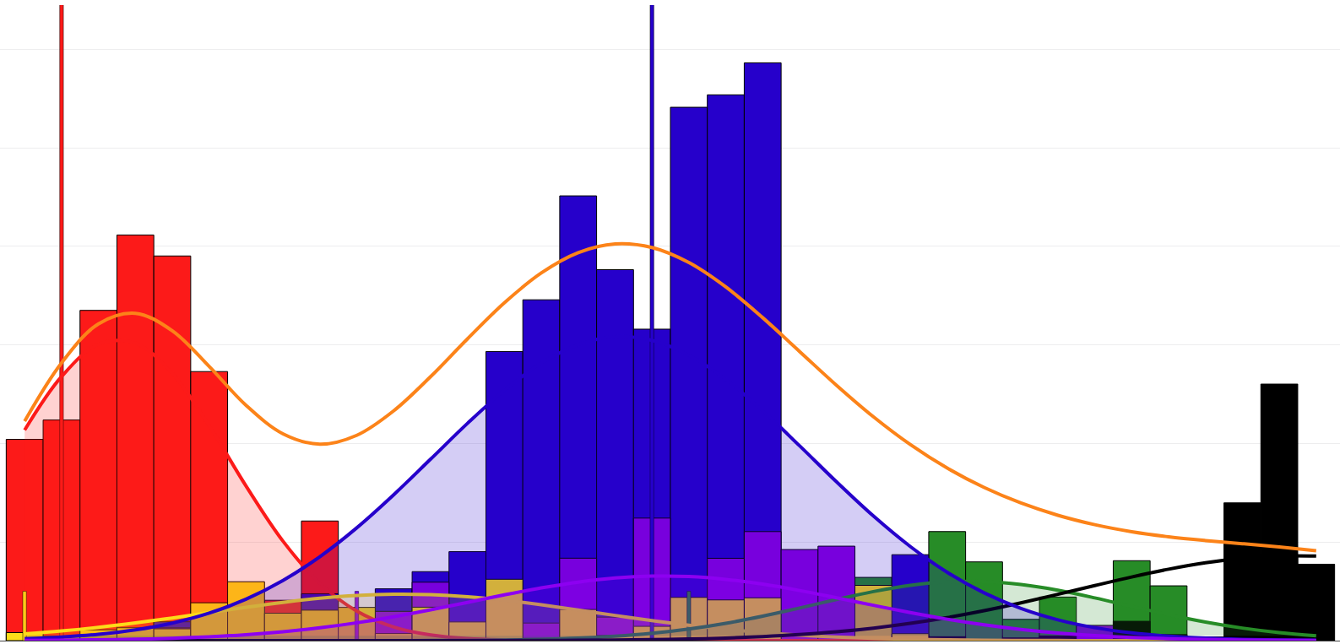
FMO
0.012
1A’
0.01
1A’’
2A’’
0.008
2A’
3A’’
0.006
4A’’
SUM
0.004
0.002
0
5
5.25
5.5
5.75
6
6.25
6.5

Slide 12
SHIFTS & FWHM
 |  | 1A’ | 1A” | 2A” | 4A” | 2A’ | 3A"
QM/EFP | Shift | 0.268 | 0.502 | 0.454 | 0.697 | 0.123 | 0.475
 | FWHM | 0.337 | 0.546 | 0.378 | 0.341 | 0.419 | 0.653
 | MAX | 0.013 | 0.002 | 0.002 | 0.000 | 0.014 | 0.002
QM/MM | Shift | 0.189 | 0.570 | 0.452 | 0.698 | 0.104 | 0.388
 | FWHM | 0.324 | 1.107 | 1.217 | 1.955 | 0.659 | 1.262
 | MAX | 0.012 | 0.002 | 0.003 | 0.001 | 0.019 | 0.002
FMO | Shift | 0.045 | 0.498 | 0.375 | 0.008 | 0.089 | 0.413
 | FWHM | 0.353 | 0.613 | 0.495 | 0.689 | 0.601 | 0.610
 | MAX | 0.008 | 0.001 | 0.002 | 0.005 | 0.012 | 0.002

Slide 13
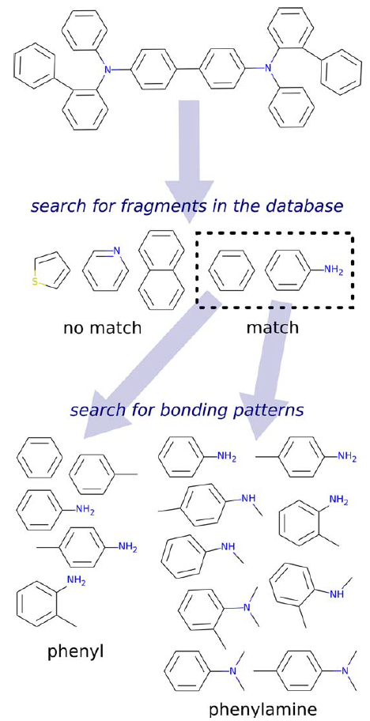
b-DNA FRAGMENTATION
SUG
CYT
PO₄

Slide 14
b-DNA FRAGMENTATION
SUG
CYT
CYT+SUG+PO₄
PO₄

Slide 15
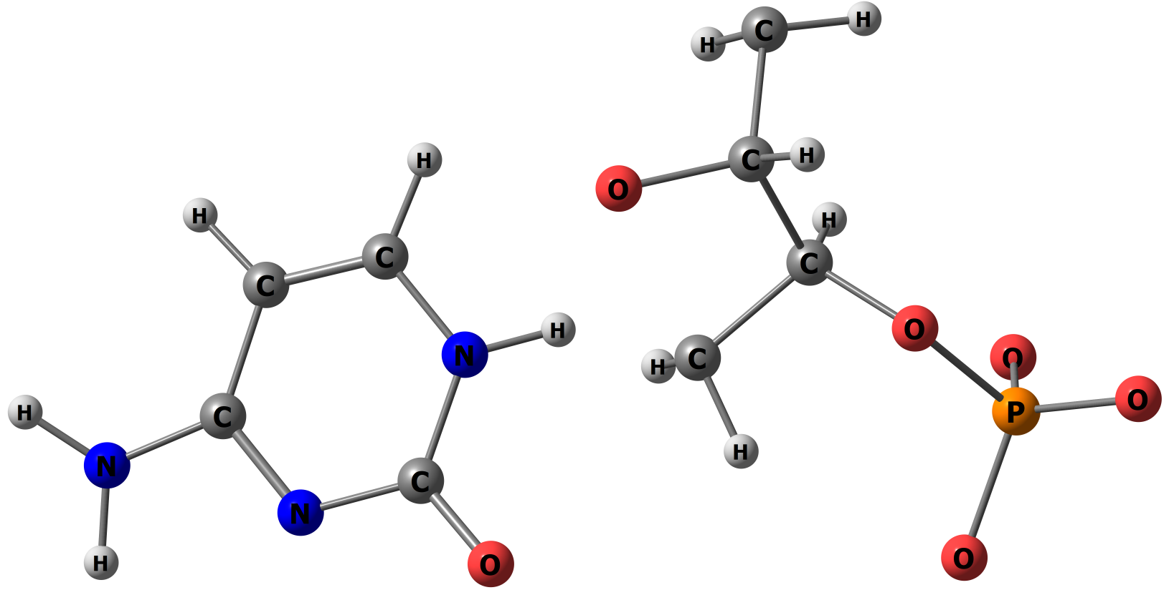
QM/EFP AREA
H
QM
C

Slide 16
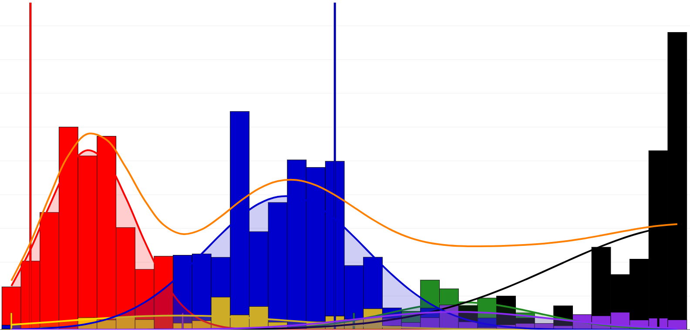
QM/EFP
0.018
0.016
1A’
0.014
1A’’
0.012
2A’’
2A’
0.01
3A’’
4A’’
0.008
SUM
0.006
0.004
0.002
0
5
5.25
5.5
5.75
6
6.25
6.5

Slide 17
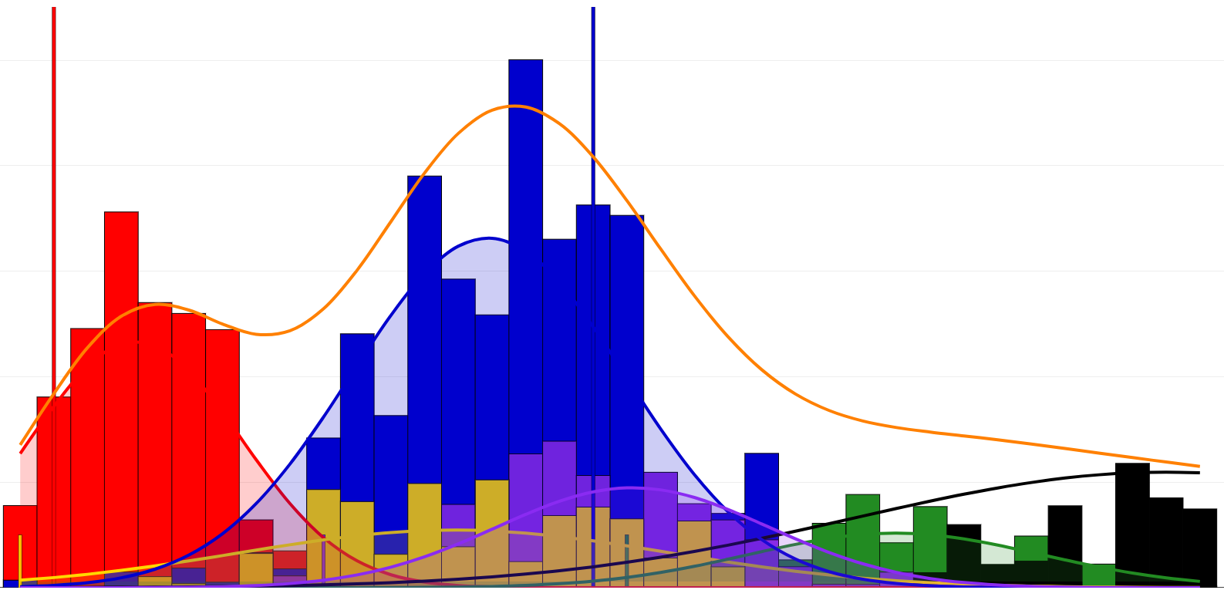
QM/MM
0.01
0.008
1A’
1A’’
2A’’
2A’
0.006
3A’’
4A’’
SUM
0.004
0.002
0
5
5.25
5.5
5.75
6
6.25
6.5

Slide 18
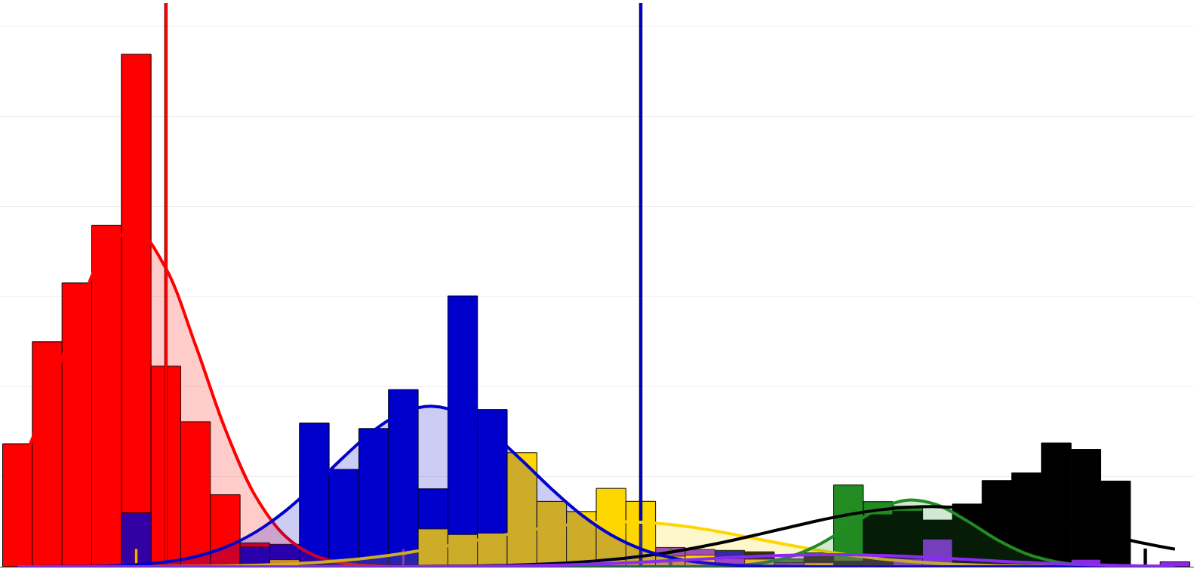
FMO
0.03
0.025
1A’
1A’’
2A’’
0.02
2A’
3A’’
0.015
4A’’
SUM
0.01
0.005
0
5
5.25
5.5
5.75
6
6.25
6.5

Slide 19
SHIFTS & FWHM
 |  | 1A’ | 1A” | 2A” | 4A” | 2A’ | 3A"
QM/EFP (60 frag) | Shift | 0.123 | 0.426 | 0.282 | 0.085 | 0.176 | 0.718
 | FWHM | 0.287 | 0.719 | 0.461 | 0.869 | 0.492 | 0.600
 | MAX | 0.012 | 0.002 | 0.003 | 0.018 | 0.013 | 0.001
QM/MM (60 frag) | Shift | 0.090 | 0.631 | 0.393 | 0.015 | 0.204 | 0.457
 | FWHM | 0.367 | 0.751 | 0.512 | 1.081 | 0.480 | 0.475
 | MAX | 0.007 | 0.002 | 0.002 | 0.002 | 0.010 | 0.003
FMO (20 frag) | Shift | 0.091 | 0.802 | 0.403 | 0.375 | 0.401 | 0.718
 | FWHM | 0.279 | 0.554 | 0.250 | 0.615 | 0.397 | 0.539
 | MAX | 0.028 | 0.006 | 0.005 | 0.007 | 0.015 | 0.002

Slide 20
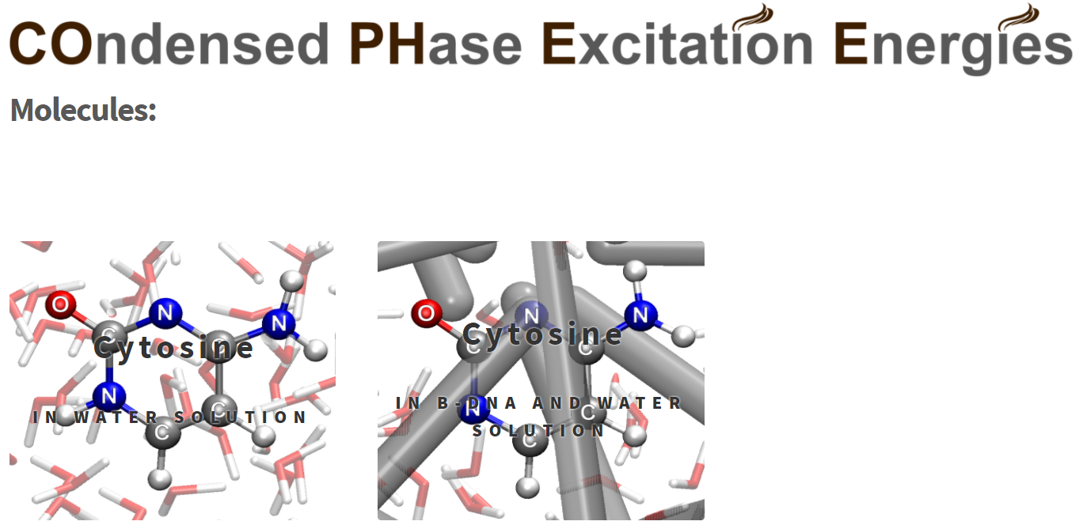
COPHEE.INFO

