Slide 1
A.E. Arbuzov Institute of Organic and Physical Chemistry, FRC Kazan Scientific Center of RAS
A fresh look on the nature of dual-emission of the octahedral Cu₄I₄ clusters
T.P. Gerasimova, A.V. Shamsieva, I.D. Strelnik, I.E. Kolesnikov, S.A. Katsyuba, E.I. Musina, A.A. Karasik
7-th School-Conference on Atomistic Simulation of Functional Materials (ASFM 2018)
September 12-13, 2018

Slide 2
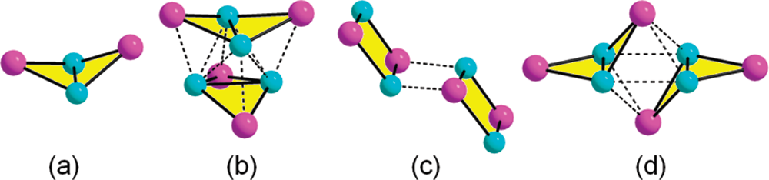
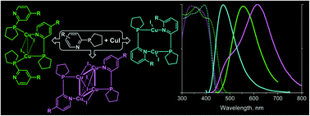
Zh. Liu, P.I. Djurovich, M.T. Whited, M.E. Thompson , Cu₄I₄ Clusters Supported by P∧N-type Ligands: New Structures with Tunable Emission Colors, Inorg. Chem., 2012, 51, 230−236.
E.I. Musina, A.V. Shamsieva, I.D. Strelnik, T.P. Gerasimova, D.B. Krivolapov, I.E. Kolesnikov, E.V. Grachova, S.P. Tunik, C. Bannwarth, S. Grimme, S.A. Katsyuba, A.A. Karasik, O.G. Sinyashin, Synthesis of novel pyridyl containing phospholanes and their polynuclear luminescent copper(I) complexes Dalton Trans., 2016,45, 2250-2260

Slide 3
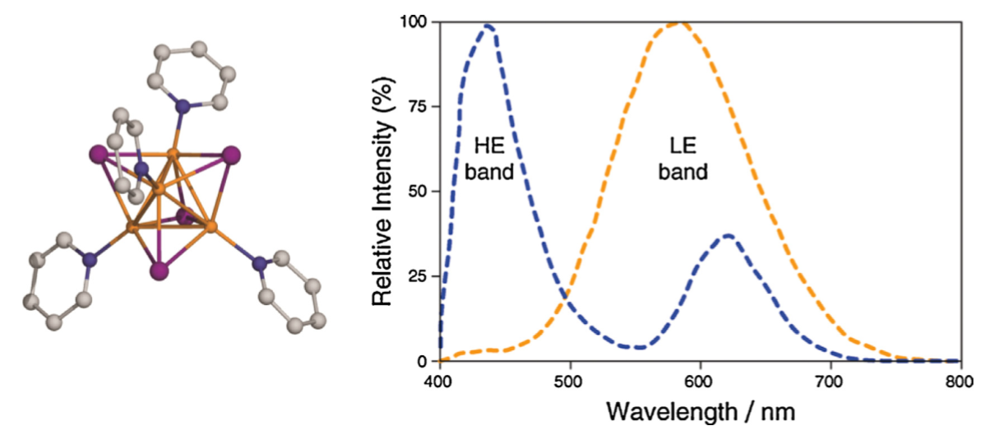
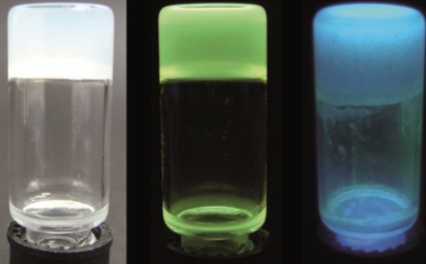
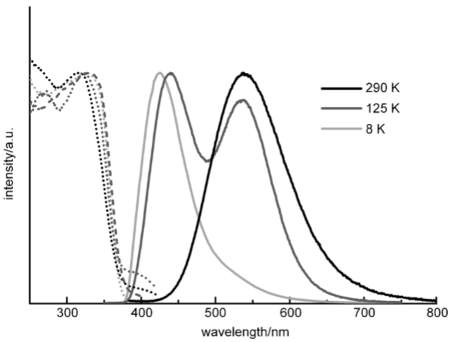
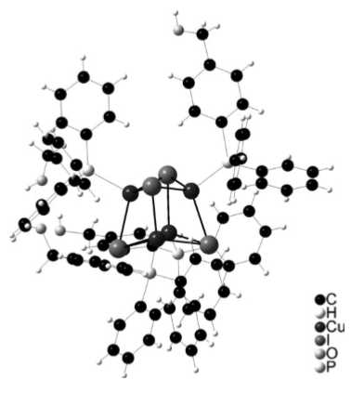
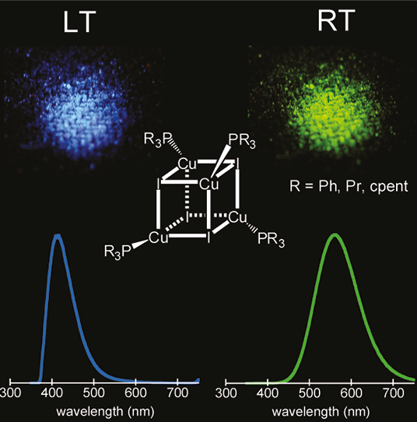
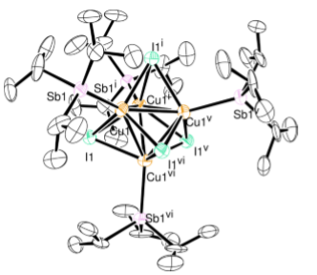
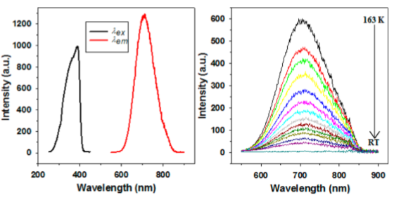
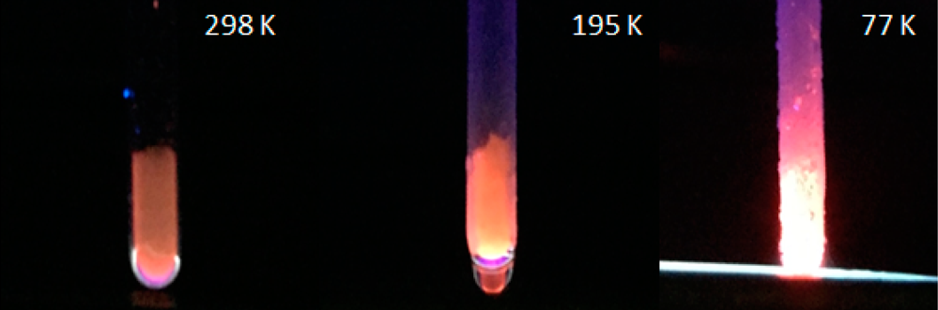
RT
LT
F. Parmeggiani, A. Sacchetti, Preparation and Luminescence Thermochromism of Tetranuclear Copper(I)–Pyridine–Iodide Clusters J. Chem. Educ., 2012, 89 (7), 946–949
Q. Benito, A. Fargues, A.G.S. Maron, T. Gacoin, J.P. Boilot, S. Perruchas, F. Camerel Photoactive Hybrid Gelators Based on a Luminescent Inorganic [Cu₄I₄] Cluster Core Chem. Eur. J., 2013, 19, 15831–15835
S. Perruchas, C. Tard, X.F.Le Goﬀ, A. Fargues, A. Garcia, S. Kahlal, J.Y. Saillard, T. Gacoin, J.P. Boilot, Thermochromic Luminescence of Copper Iodide Clusters: The Case of Phosphine Ligands Inorg. Chem. 2011, 50, 10682–10692
W.V. Taylor, U.H. Soto, V.M. Lynch, M.J. Rose, Antimony-Supported Cu₄I₄ Cuboid with Short Cu−Cu Bonds: Structural Premise for Near-Infrared Thermoluminescence Inorg. Chem., 2016, 55 (7), pp 3206–3208

Slide 4
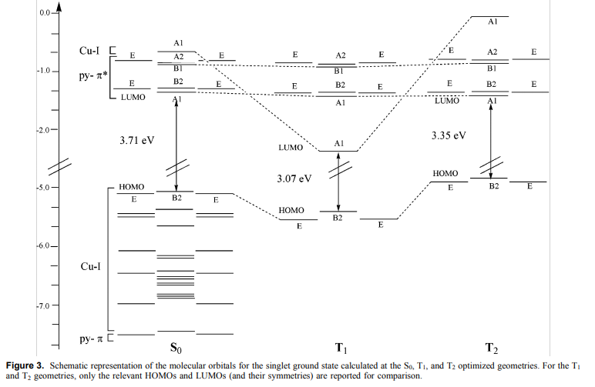
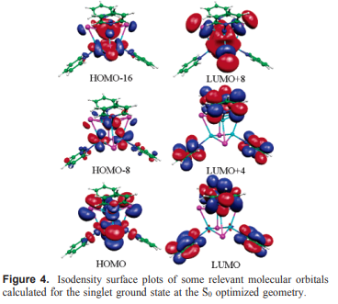
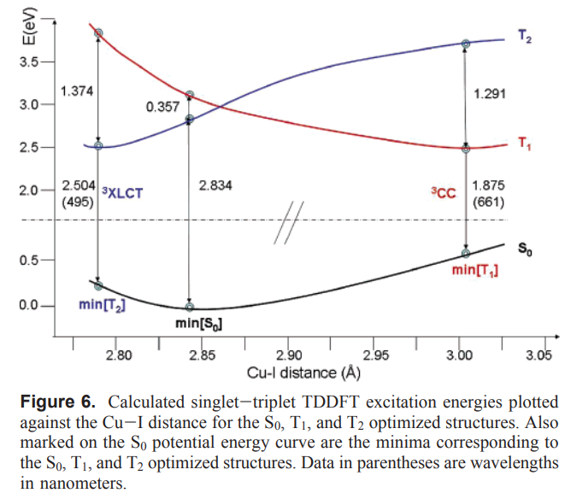
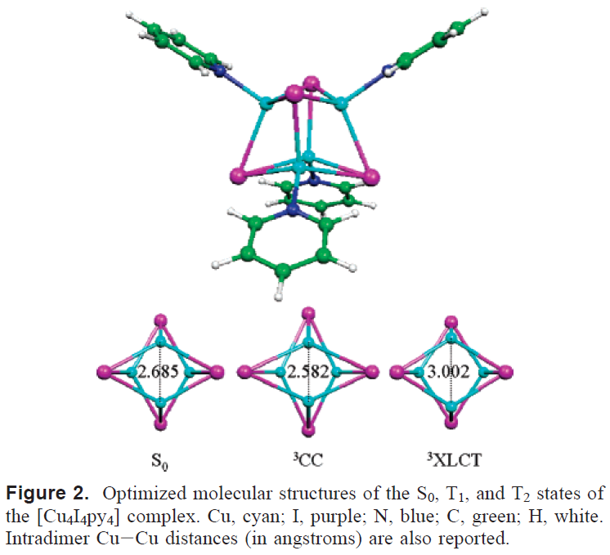
F. De Angelis, S. Fantacci, A. Sgamellotti, E. Cariati, R. Ugo, P.C. Ford, Electronic Transitions Involved in the Absorption Spectrum and Dual Luminescence of Tetranuclear Cubane [Cu₄I₄(pyridine)₄] Cluster: a Density Functional Theory/Time-Dependent Density Functional Theory Investigation, Inorg. Chem. 2006, 45, 10576-10584

Slide 5
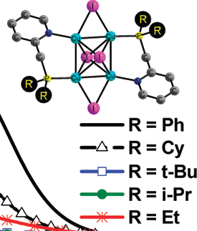
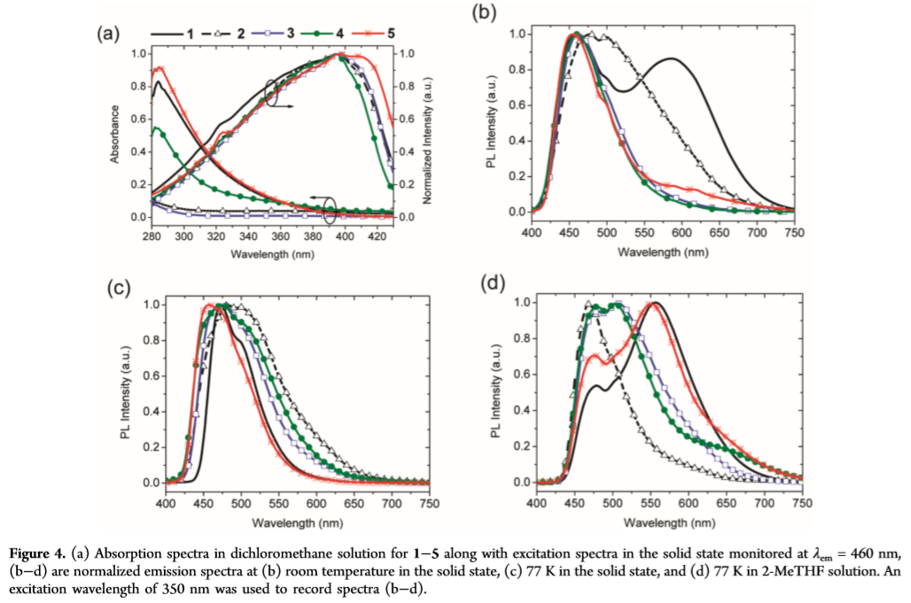
Zh. Liu, P.I. Djurovich, M.T. Whited, M.E. Thompson , Cu₄I₄ Clusters Supported by P∧N-type Ligands: New Structures with Tunable Emission Colors, Inorg. Chem., 2012, 51, 230−236.

Slide 6
E.I. Musina, A.V. Shamsieva, I.D. Strelnik, T.P. Gerasimova, D.B. Krivolapov, I.E. Kolesnikov, E.V. Grachova, S.P. Tunik, C. Bannwarth, S. Grimme, S.A. Katsyuba, A.A. Karasik, O.G. Sinyashin, Synthesis of novel pyridyl containing phospholanes and their polynuclear luminescent copper(I) complexes Dalton Trans., 2016,45, 2250-2260

Slide 7
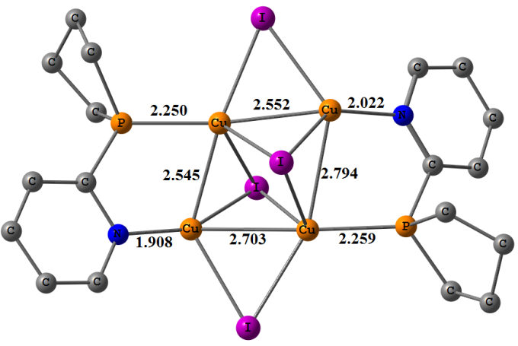
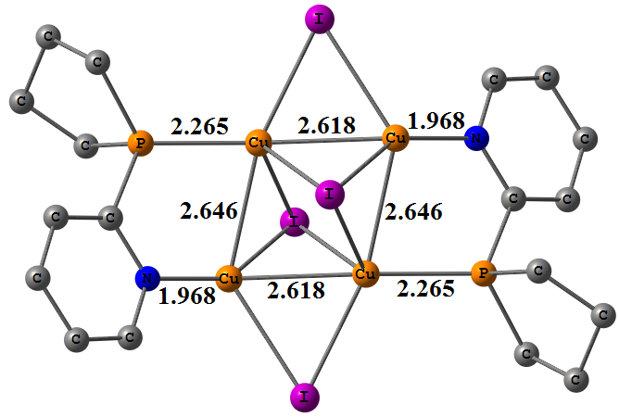
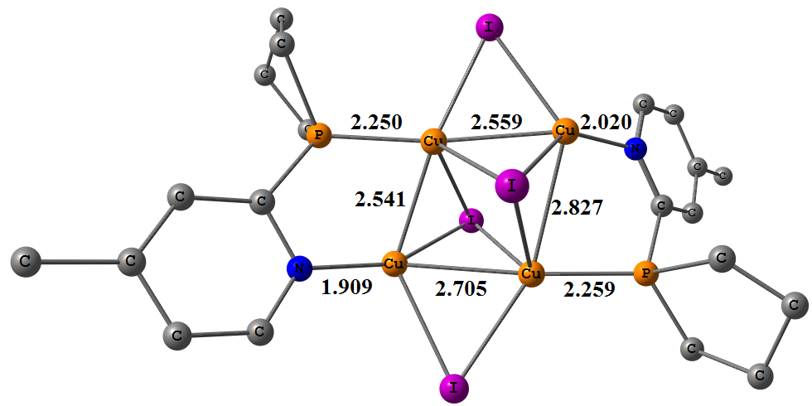
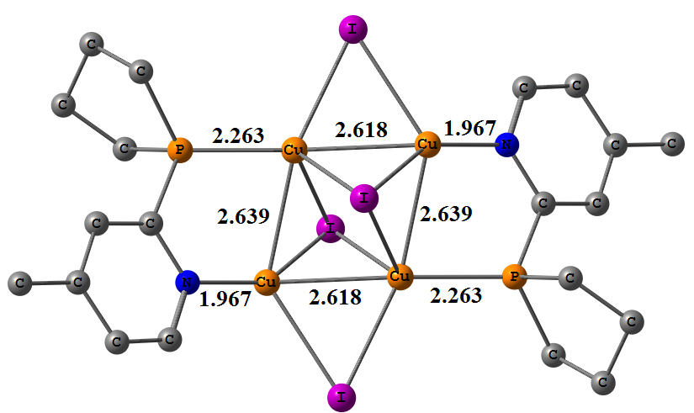
T₁, 0 kcal/mol | T₂, 5.9 kcal/mol
Δ-SCF (PBE0/def-TZVP/D3)
639 nm (exp 621 nm) | 508 nm (exp 505 nm)
TDDFT (cam-B3LYP/def-TZVP/D3)
614 nm | 473 nm
T₁, 0 kcal/mol | T₂, 6.3 kcal/mol
Δ-SCF (PBE0/def-TZVP/D3)
630 nm (exp 615 nm) | 497 nm (exp 490 nm)
TDDFT (cam-B3LYP/def-TZVP/D3)
600 nm | 464 nm

Slide 8
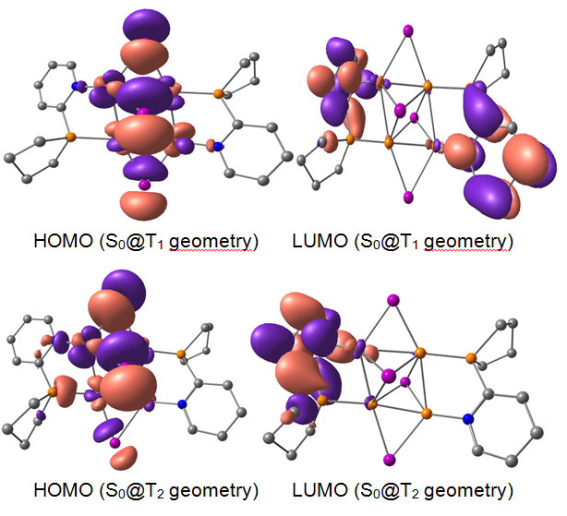
Both bands are of ³(X+M)LCT character!!!

Slide 9
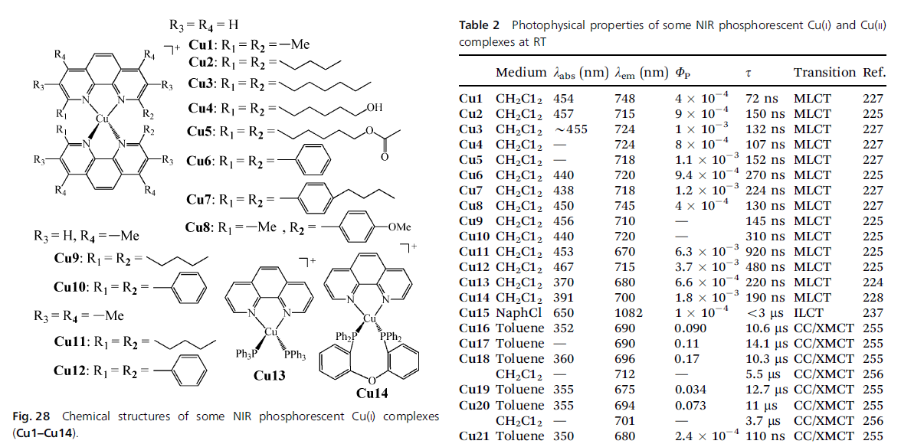
Literature examples
H. Xiang, J. Cheng, X. Ma, X. Zhou, J.J. Chruma Near-infrared phosphorescence: materials and applications Chem. Soc. Rev., 2013, 42, 6128--6185

Slide 10
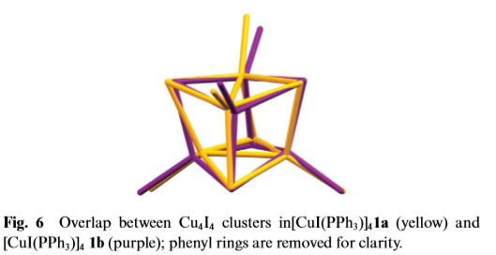
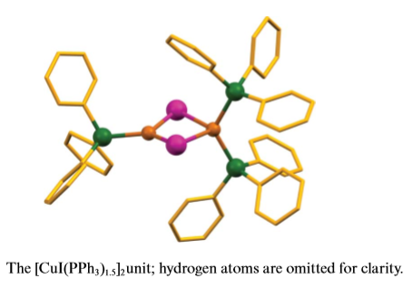
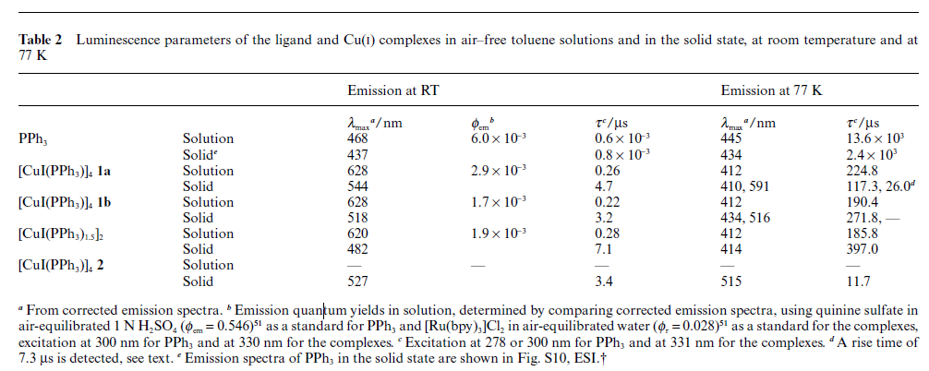
Literature examples
L. Maini, D. Braga, P.P. Mazzeoa, B. Ventura, Polymorph and isomer conversion of complexes based on CuI and PPh₃ easily observed via luminescence, Dalton Trans., 2012, 41, 531–539

Slide 11
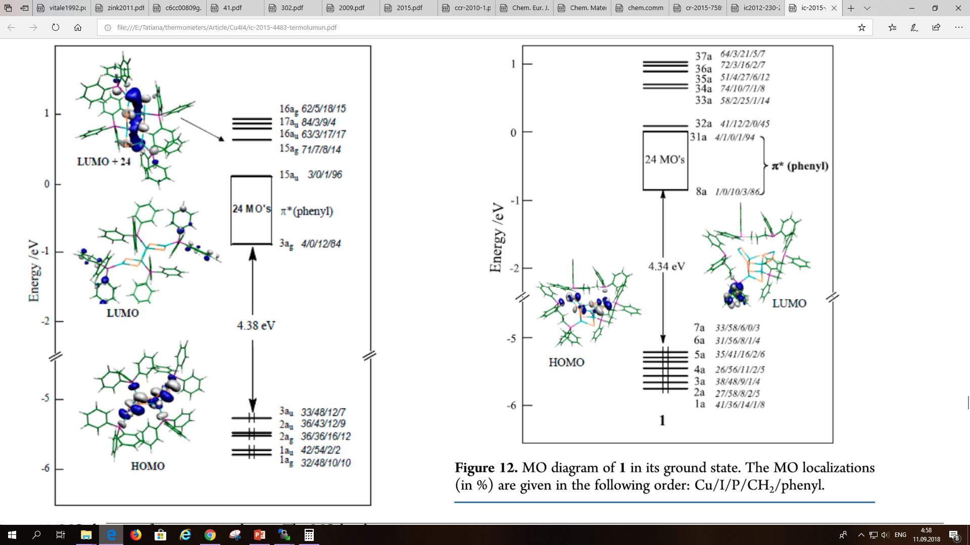

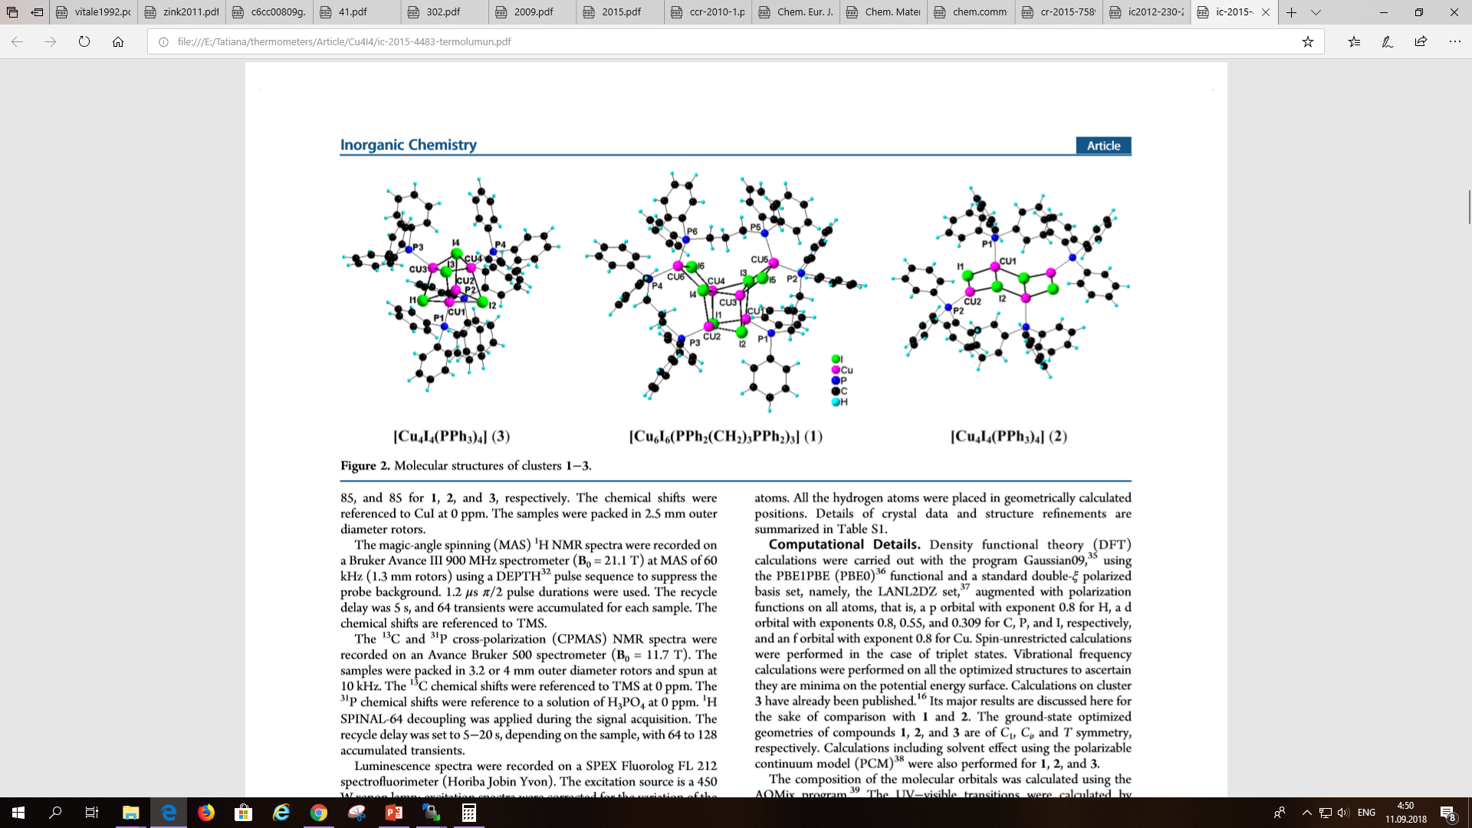
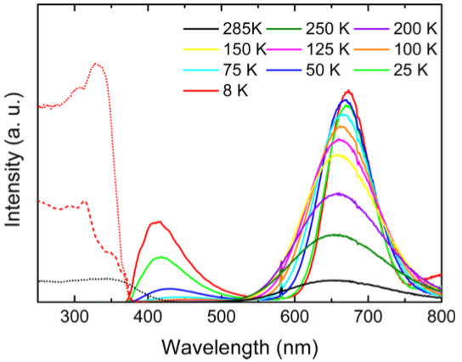
Literature examples
Q. Benito, X.F. Le Goﬀ, G. Nocton, A. Fargues, A. Garcia, A. Berhault, S. Kahlal, J.Y. Saillard, C. Martineau, J. Trébosc, T. Gacoin, J.P. Boilot, S. Perruchas Geometry Flexibility of Copper Iodide Clusters: Variability in Luminescence Thermochromism Inorg. Chem., 2015, 54, 4483−4494

Slide 12
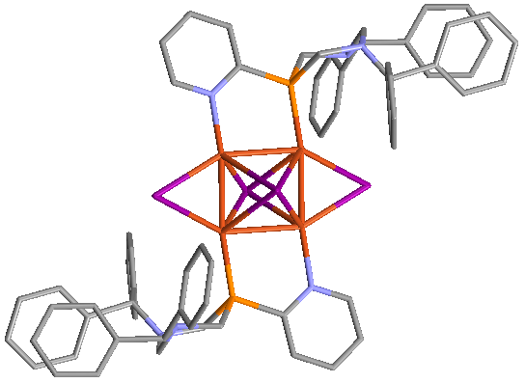
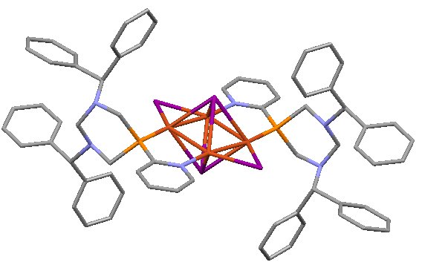
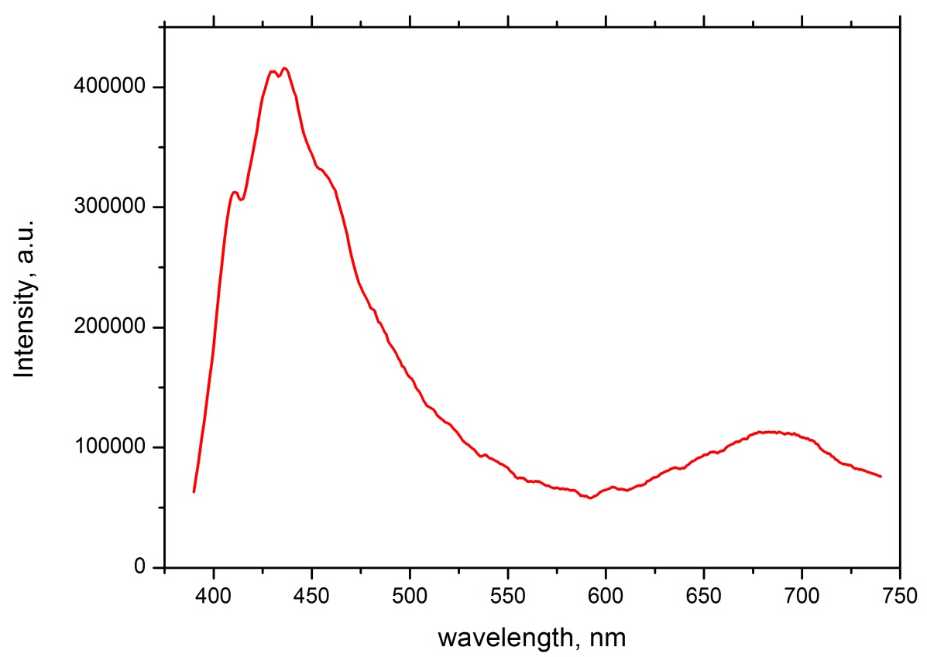
436 nm
685 nm

Slide 13
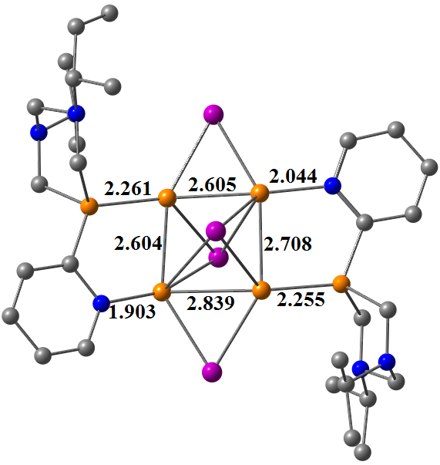
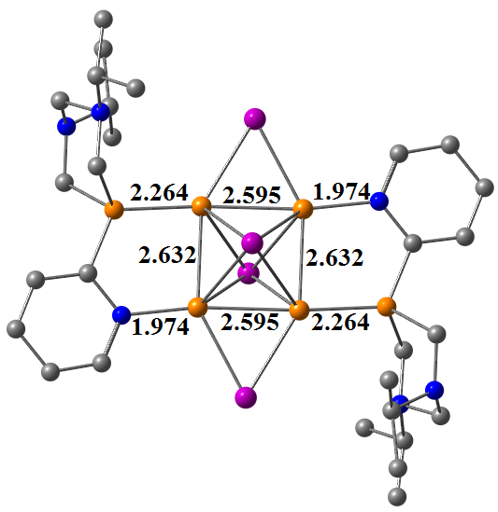
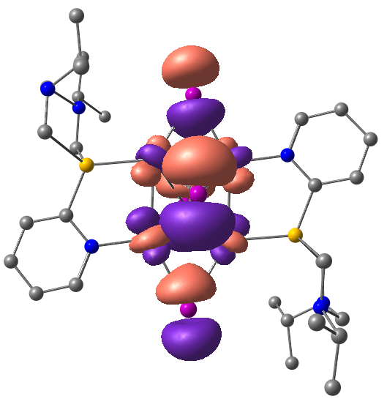
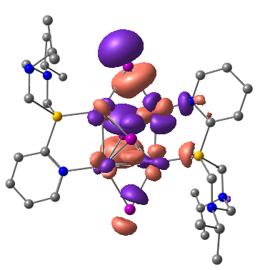
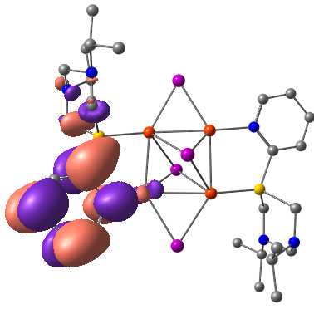
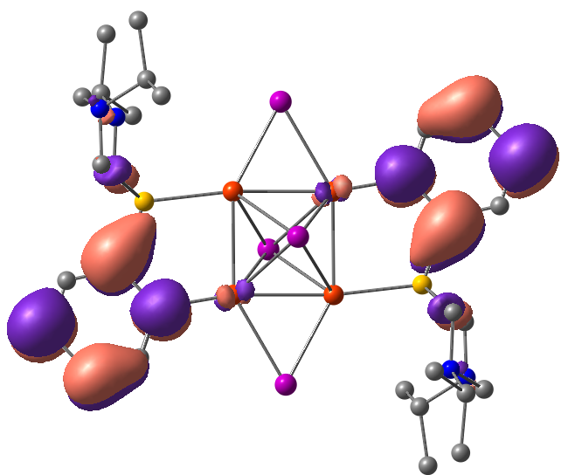
T₁, 0 kcal/mol | T₂, 6.3 kcal/mol
Δ-SCF (PBE0/def-TZVP/D3)
587 nm (exp 685 nm) | 464 nm (exp 436 nm)
HOMO
LUMO
HOMO
LUMO

Slide 14
Conclusions
For the first time both triplet states have been found for interpretation of dual emission of complexes with octahedral Cu₄I₄ core.
The obtained in this work results demonstrate the alternative interpretation of LE band for Cu₄I₄ complexes, which should be taken into account.

Slide 15
Aknowledgements
Authors gratefully acknowledge the Centre for Optical and Laser Materials Research of Saint-Petersburg State University Research Park for registration of emission spectra of solid samples.

Slide 16
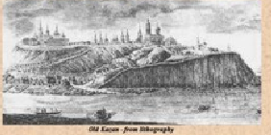
Thank you for your attention

