Slide 1

Atomistic Simulation of Functional Materials» (ASFM-2018 Fall)
Computational search for new
superhard transition metal borides
Alexander Kvashnin
13.09.2018, Moscow

Slide 2
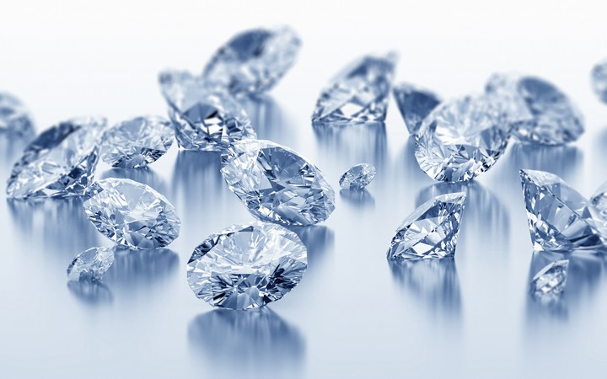
Outline
Introduction + Motivation
Methods
Superhard Cr-based materials
Prediction and synthesis of new WB₅
Study of Mo-B system

Slide 3
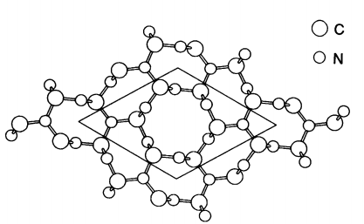
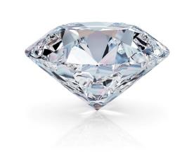
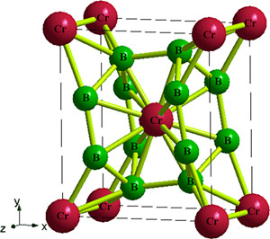
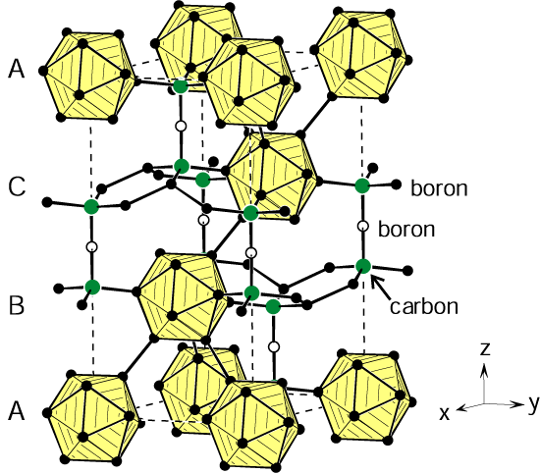
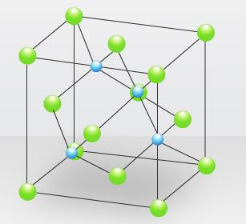
Introduction
Diamond
Transition metal borides and carbides
~92 GPa
~98 GPa
Science 245, 841 (1989)
Phys. Chem. Chem. Phys., 2016,18, 2361
~50 GPa
c-BN
~60 GPa
B₄C
~32 GPa

Slide 4
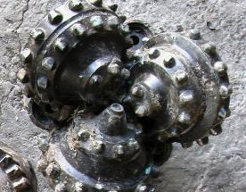
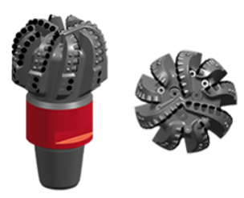
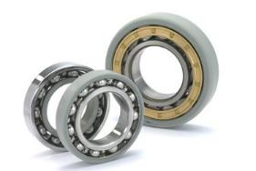
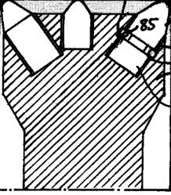
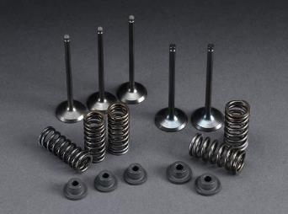
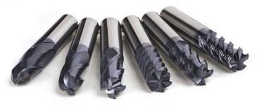
Why it is important?
Ease in synthesis and production
These materials have high melting temperature
High hardness allows them to be used in many other different fields of technology
Possible applications:
Manufacturing industry
Mining industry
PCD, c-BN,
Mixture PCD/BN
Hard alloys of
WC, TiN etc.
Substitution of traditional materials

Slide 5

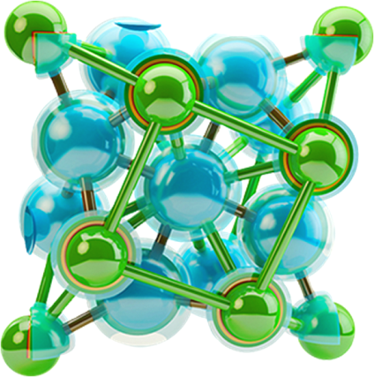

Methods
Computational search for new materials was carried out using the evolutionary crystal structure prediction algorithm USPEX
Geometry relaxation and calculations of mechanical properties were performed at a density functional level of theory using PBE parameterization implemented into VASP package

Slide 6
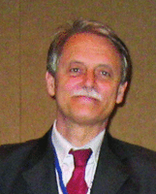
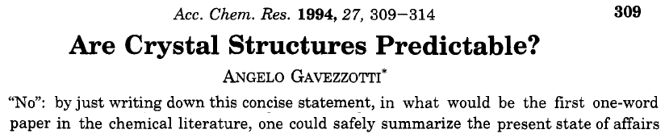
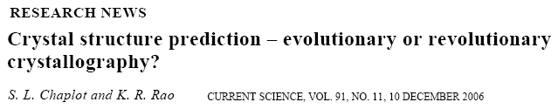
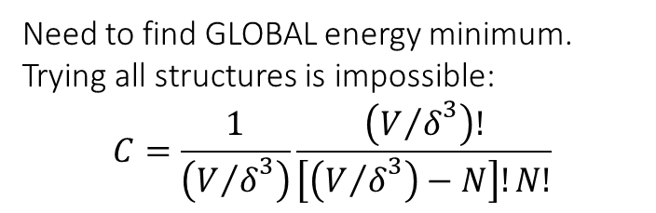
Need to find GLOBAL energy minimum.
Trying all structures is impossible:
$$C=\frac{1}{\left({V/δ}^{3}\right)}\frac{\left({V/δ}^{3}\right)!}{\left[\left({V/δ}^{3}\right)−N\right]!N!}$$
N_{atoms} | Variants | CPU time
1 | 1 | 1 sec.
10 | 10¹¹ | 10³ yrs.
20 | 10²⁵ | 10¹⁷ yrs.
30 | 10³⁹ | 10³¹ yrs.
Overview USPEX
(Oganov & Glass,
J.Chem.Phys. 2006)
Notes:
«Нет», если бы это слово было полным содержанием данной статьи, первой в химической литературе статьи, состоящей из одного слова, то этим можно было бы достаточно надежно охарактеризовать состояние данной области.

Slide 7
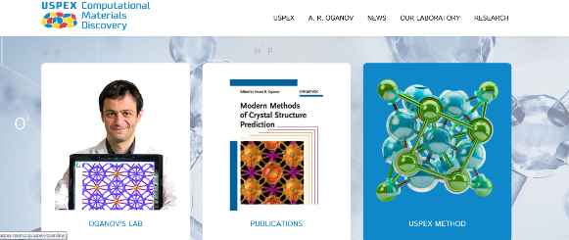
USPEX project
(Universal Structure Prediction: Evolutionary Xtallography)
http://uspex-team.org
The most popular code for computational materials design in the world (>4300 users from 78 countries).
Effort of ~80 man-years.
>400 publications, 5 patents.
Universal:
-prediction of stable structure AND composition, 3D, 2D, 1D, 0D – systems.
-optimization of physical properties,
-prediction of phase transition mechanisms

Slide 8
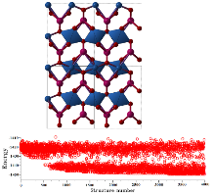
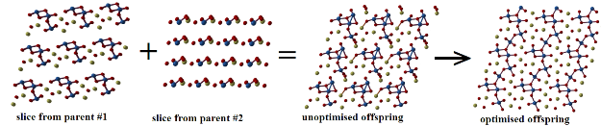
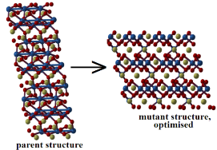
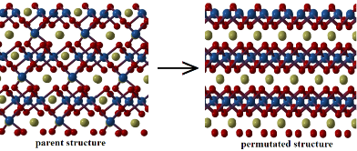
USPEX project
(Universal Structure Prediction: Evolutionary Xtallography)
(Random) initial population
Evaluate structures by relaxed (free) energy
Select lowest-energy structures as parents for new generation
Standard variation operators:
(1) Heredity (crossover)
(3) Permutation
(2) Lattice mutation
+(4) Transmutation +(5) Rotational mutation +(6) Soft-mode mutation +...

Slide 9
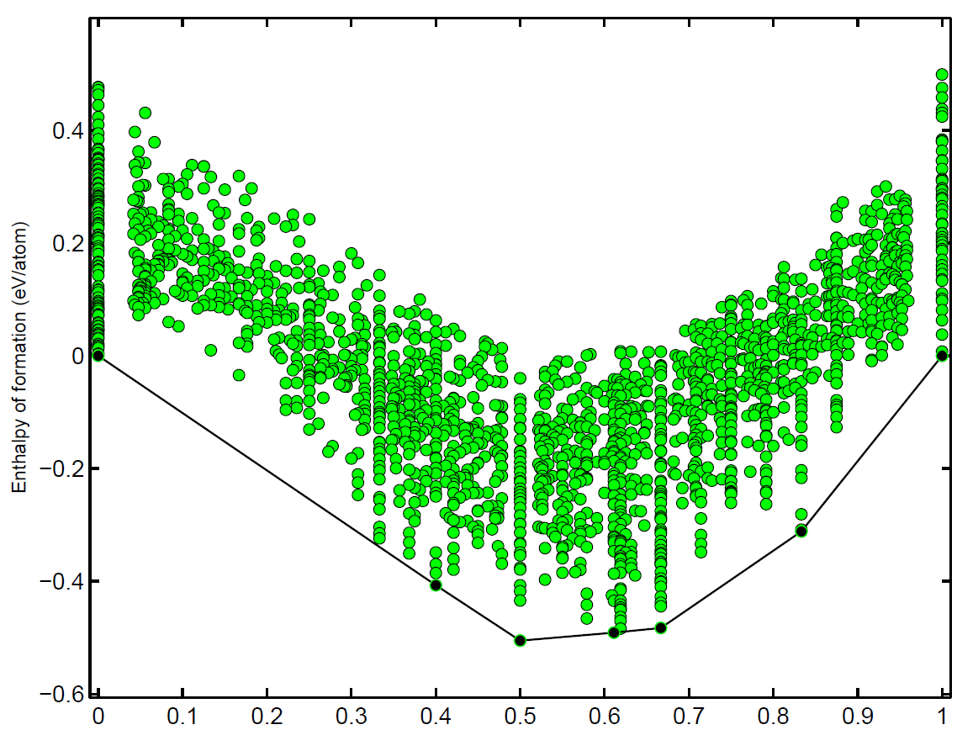
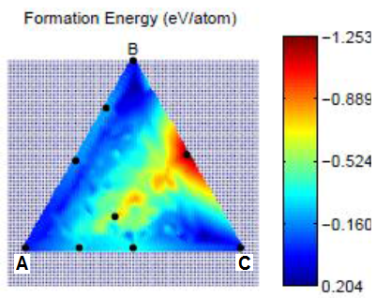
Automatic search for ground states in multicomponent system
Thermodynamic stability in variable-composition systems
Example of a ternary system
Convex Hull
AB₅
AB
A B
Stable structure must be below all the possible decomposition lines !!

Slide 10
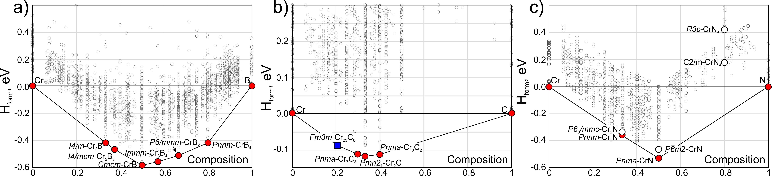
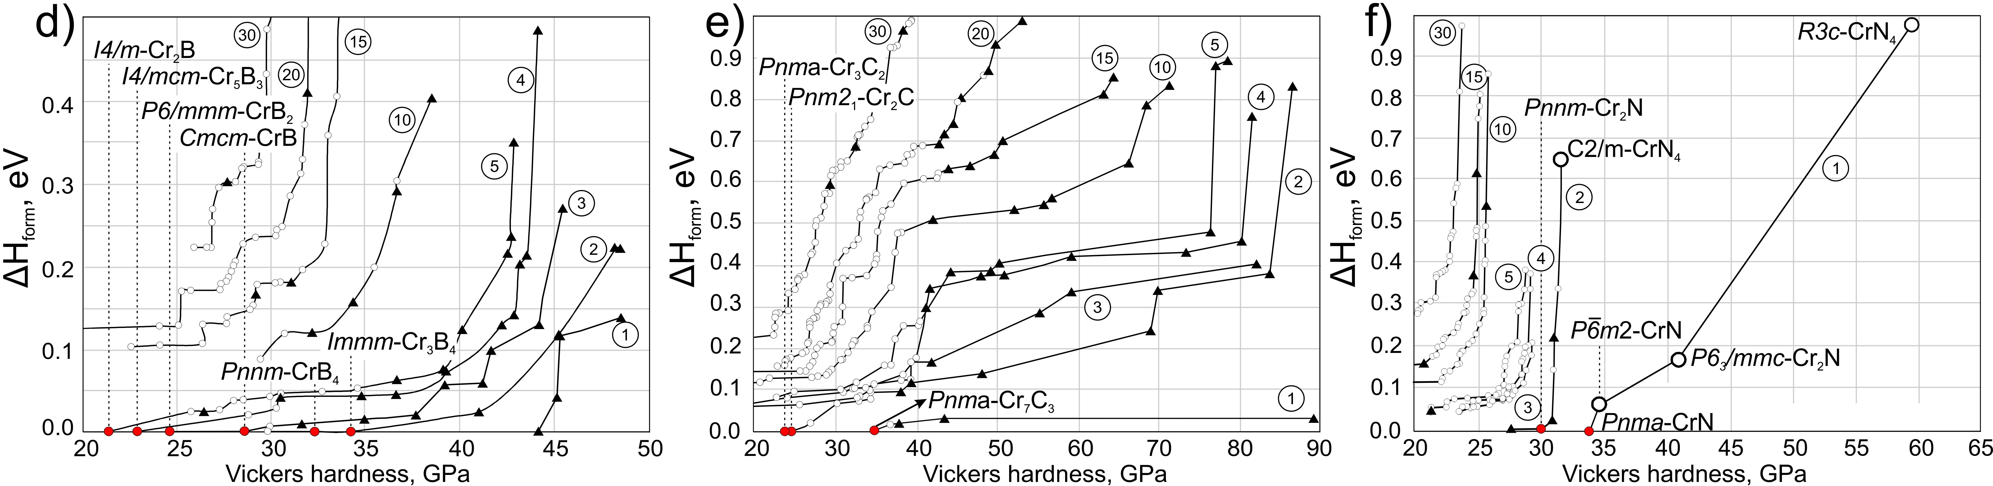
Search for new phases in Cr-B, Cr-C, Cr-N systems

Slide 11
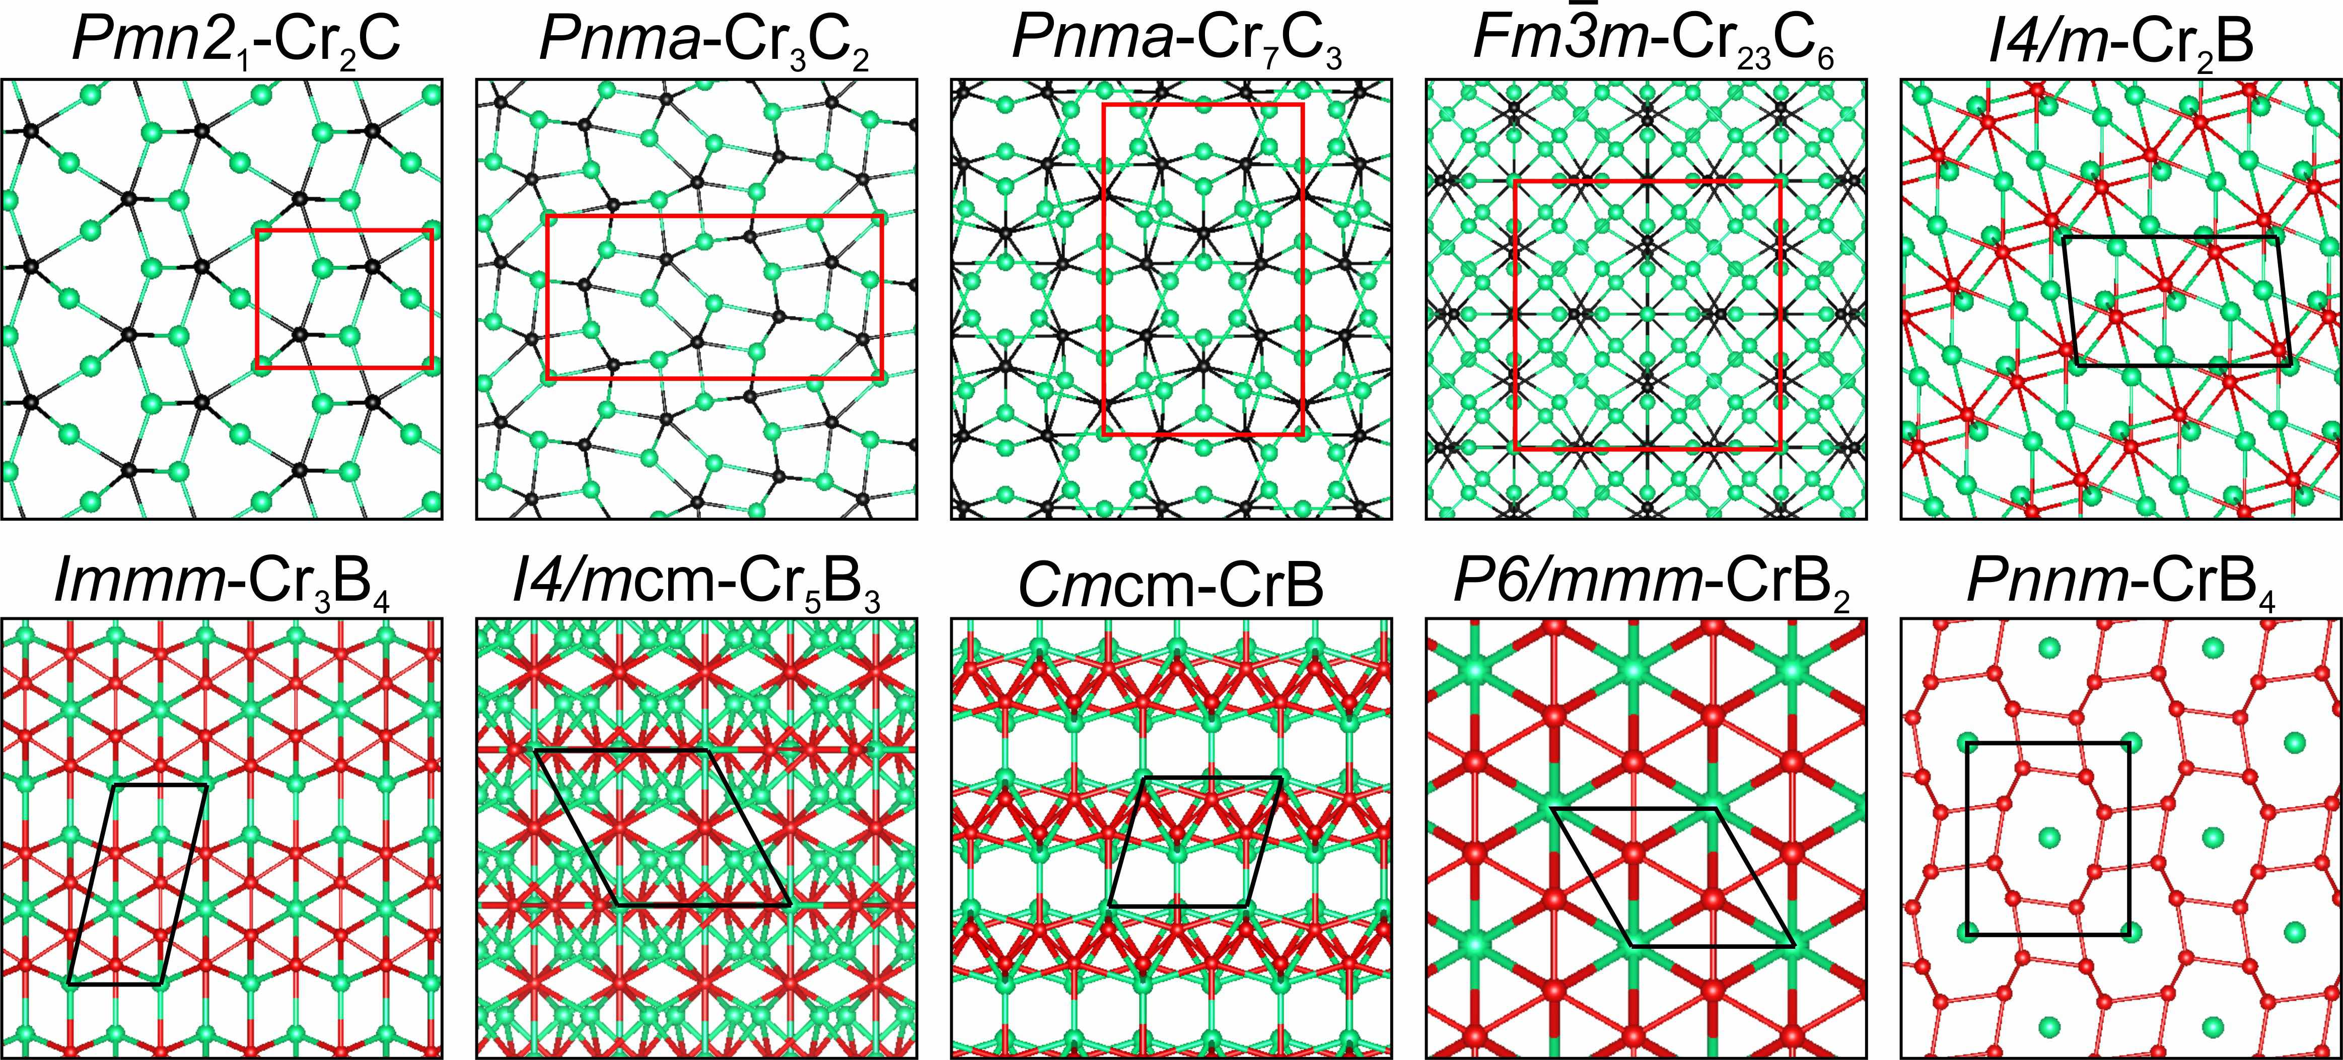
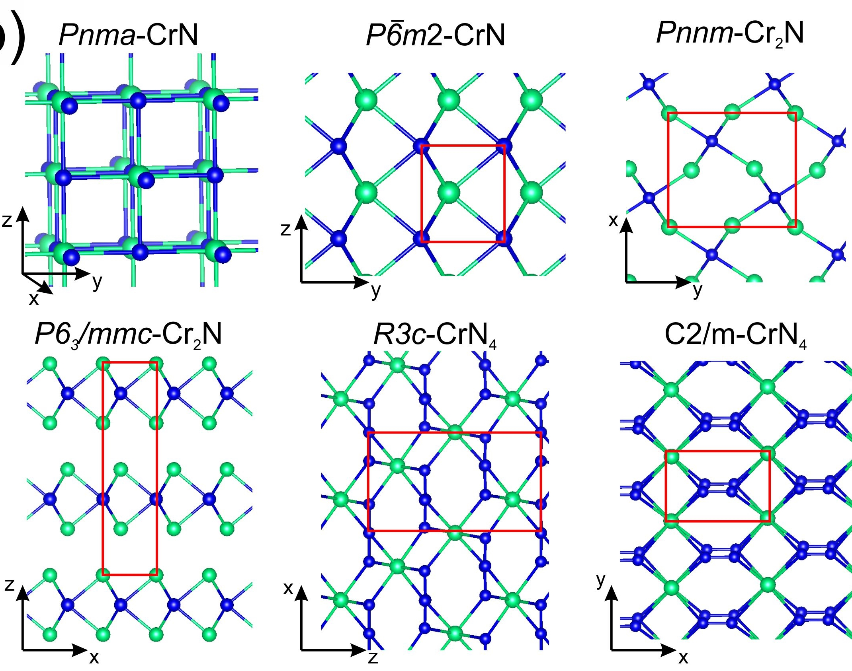
Search for new phases in Cr-B , Cr-C, Cr-N systems
New phase, has not been studied before
Superhard material with H_{v} ~50 GPa
High energy density materials

Slide 12
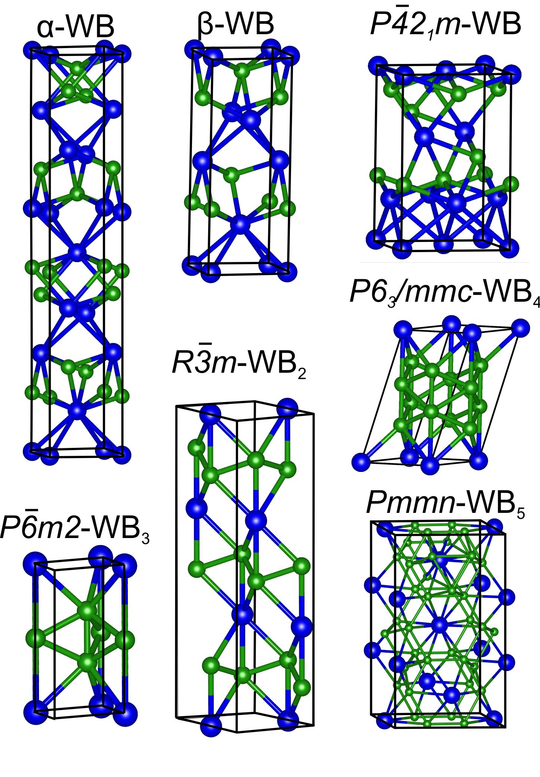
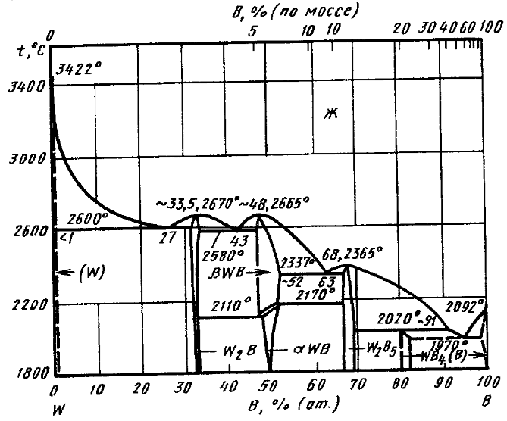
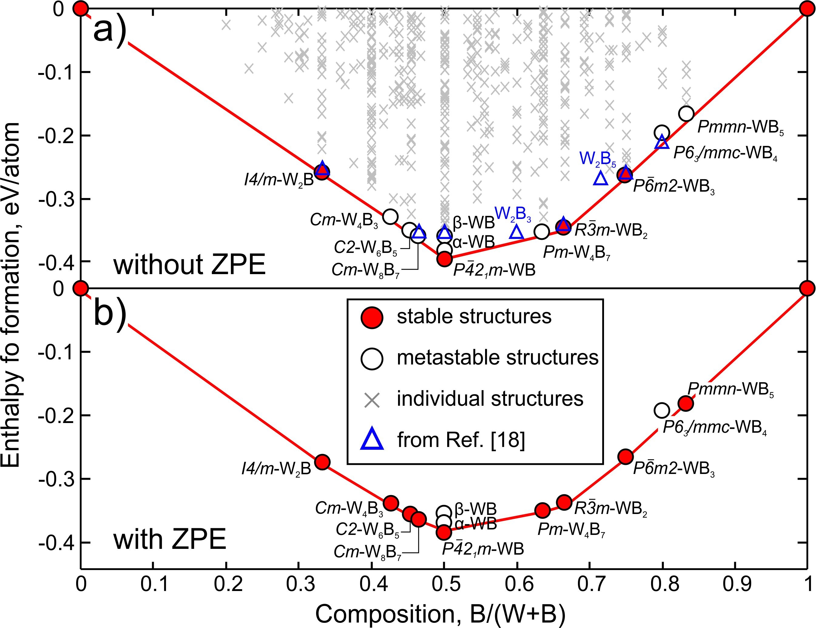
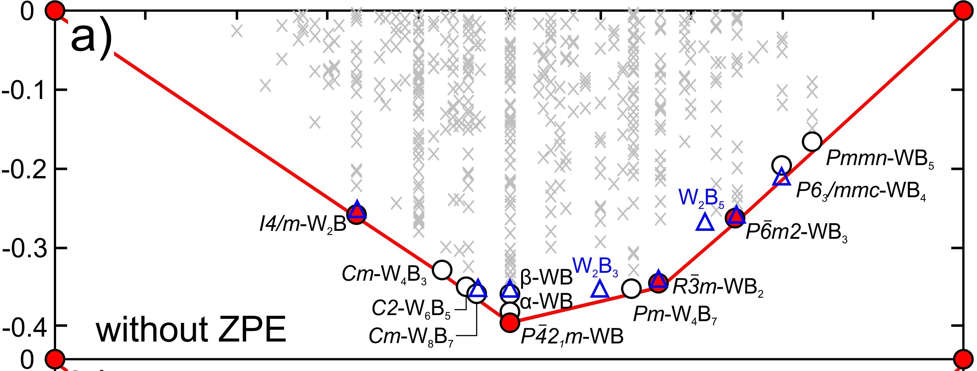
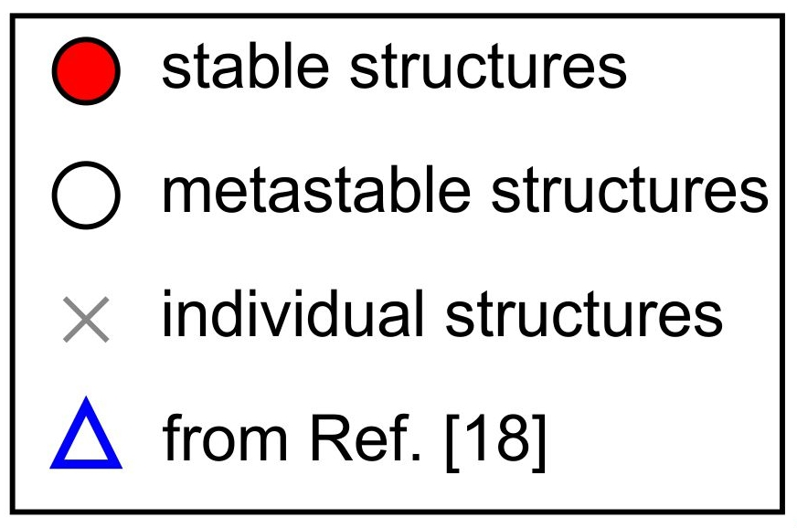
W-B system
Vickers hardness of WB₅ is 45 GPa
A.G. Kvashnin, et al., J. Phys. Chem. Lett., 2018, 9, pp 3470–3477

Slide 13
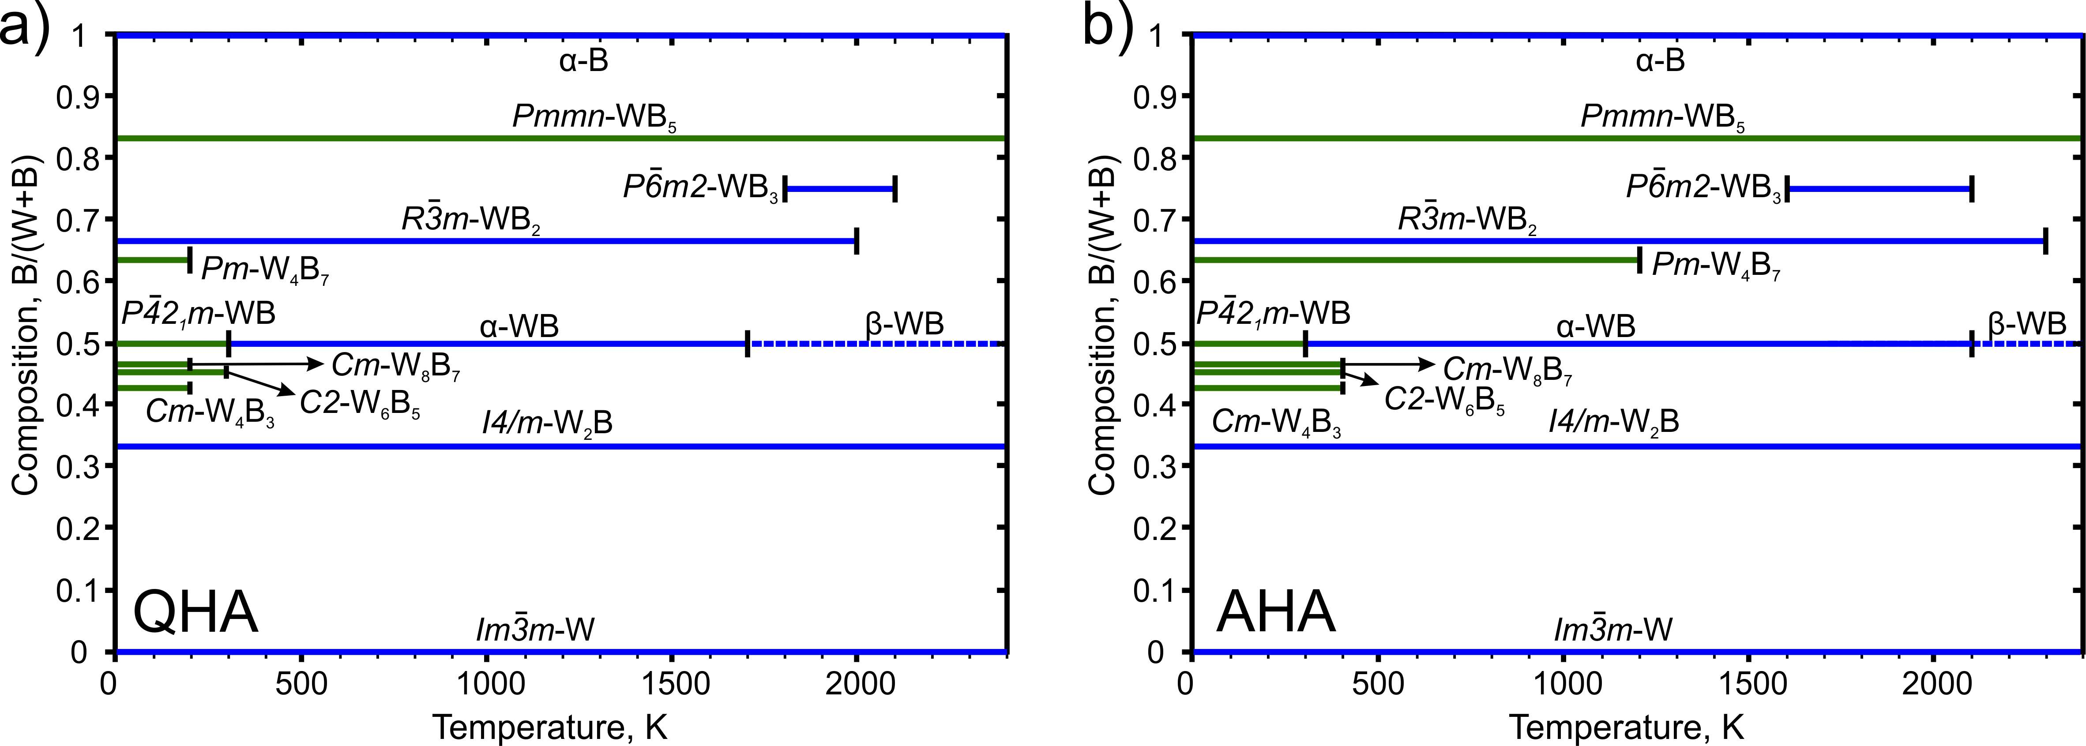
Temperature stability
[x] J. Phase Equilibria 1995, 16 (2), 150–161
[o] Sov. Powder Metall. Met. Ceram. 1974, 13 (1), 1–3
A.G. Kvashnin, et al., J. Phys. Chem. Lett., 2018, 9, pp 3470–3477

Slide 14
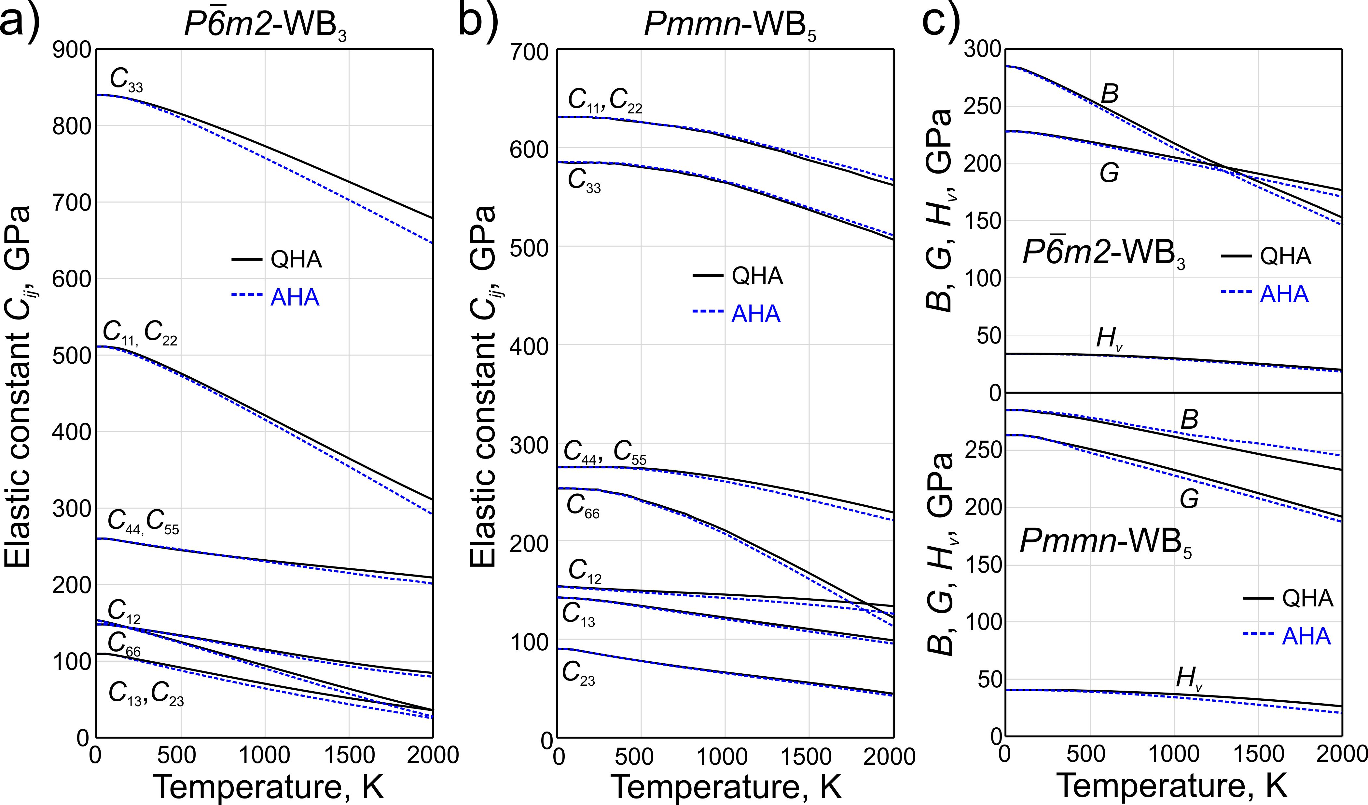
Temperature dependence of mechanical properties
A.G. Kvashnin, et al., J. Phys. Chem. Lett., 2018, 9, pp 3470–3477

Slide 15
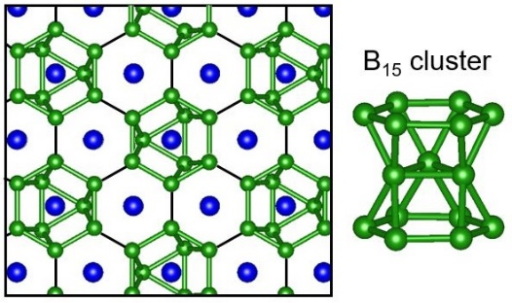
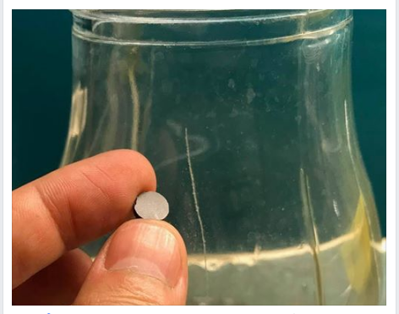
Hardness vs Fracture toughness
Ashby plot may show the material with optimal combination of Vickers hardness and fracture toughness.
WB₅ is new optimal material
A.G. Kvashnin, et al., J. Phys. Chem. Lett., 2018, 9, pp 3470–3477

Slide 16
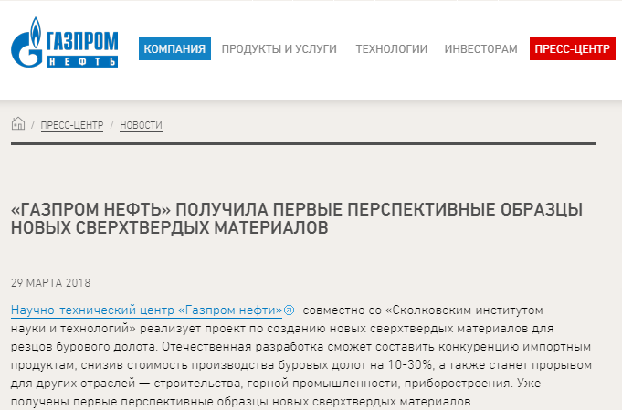
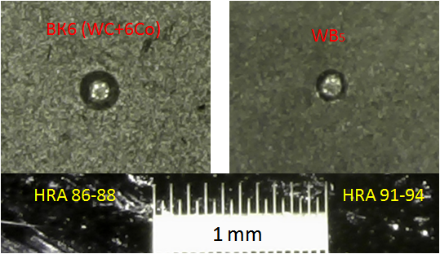
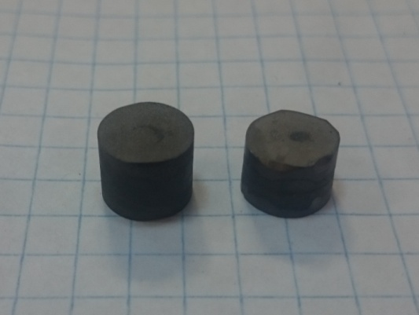
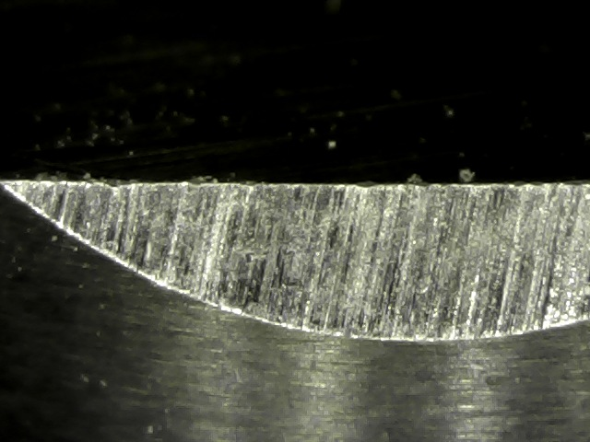
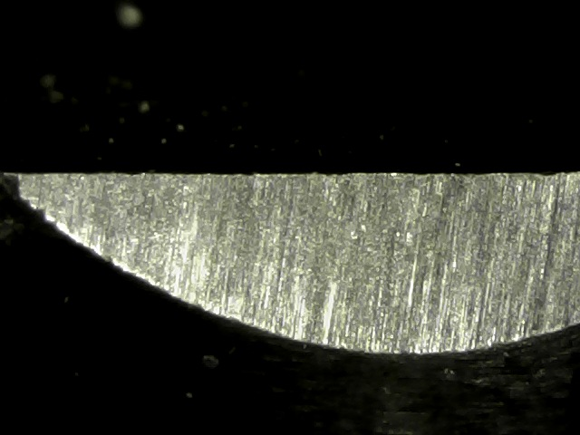
Hardness vs Fracture toughness
Measurements of hardness and fracture toughness
ВК6 (WC+6Co)
WB₅
Samples of new superhard material
ВК6 (WC+6Co)
WB₅

Slide 17
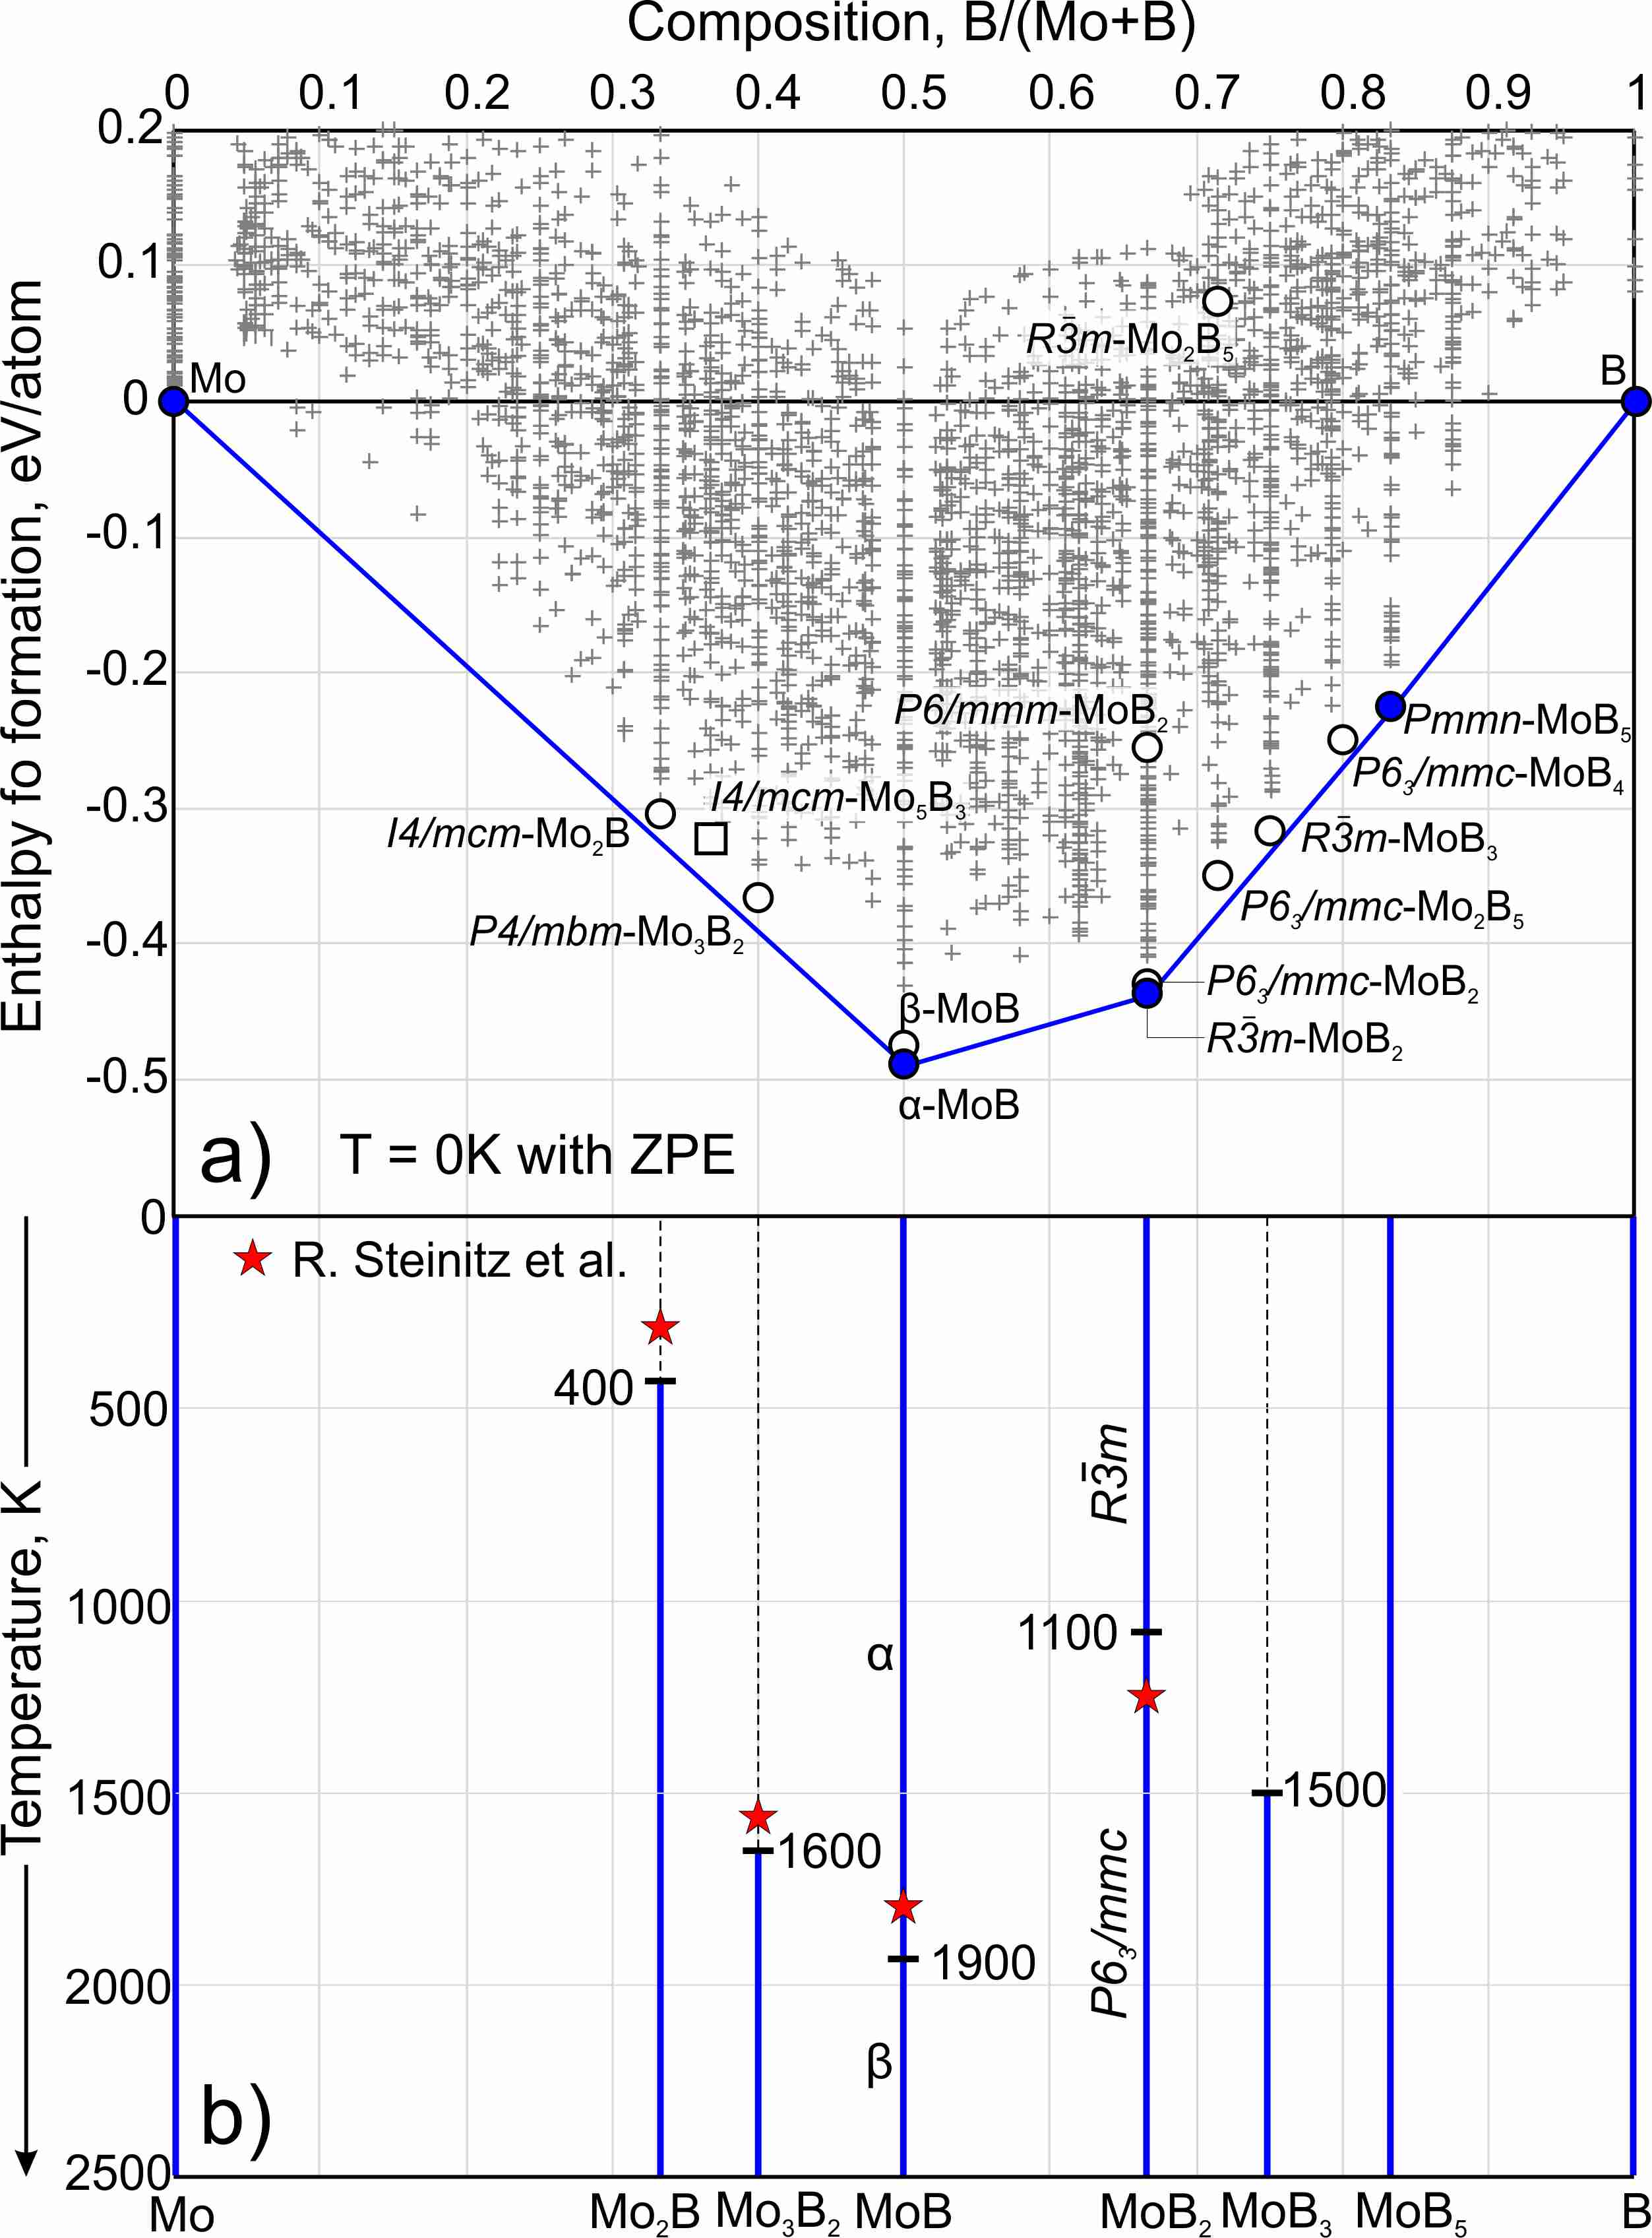
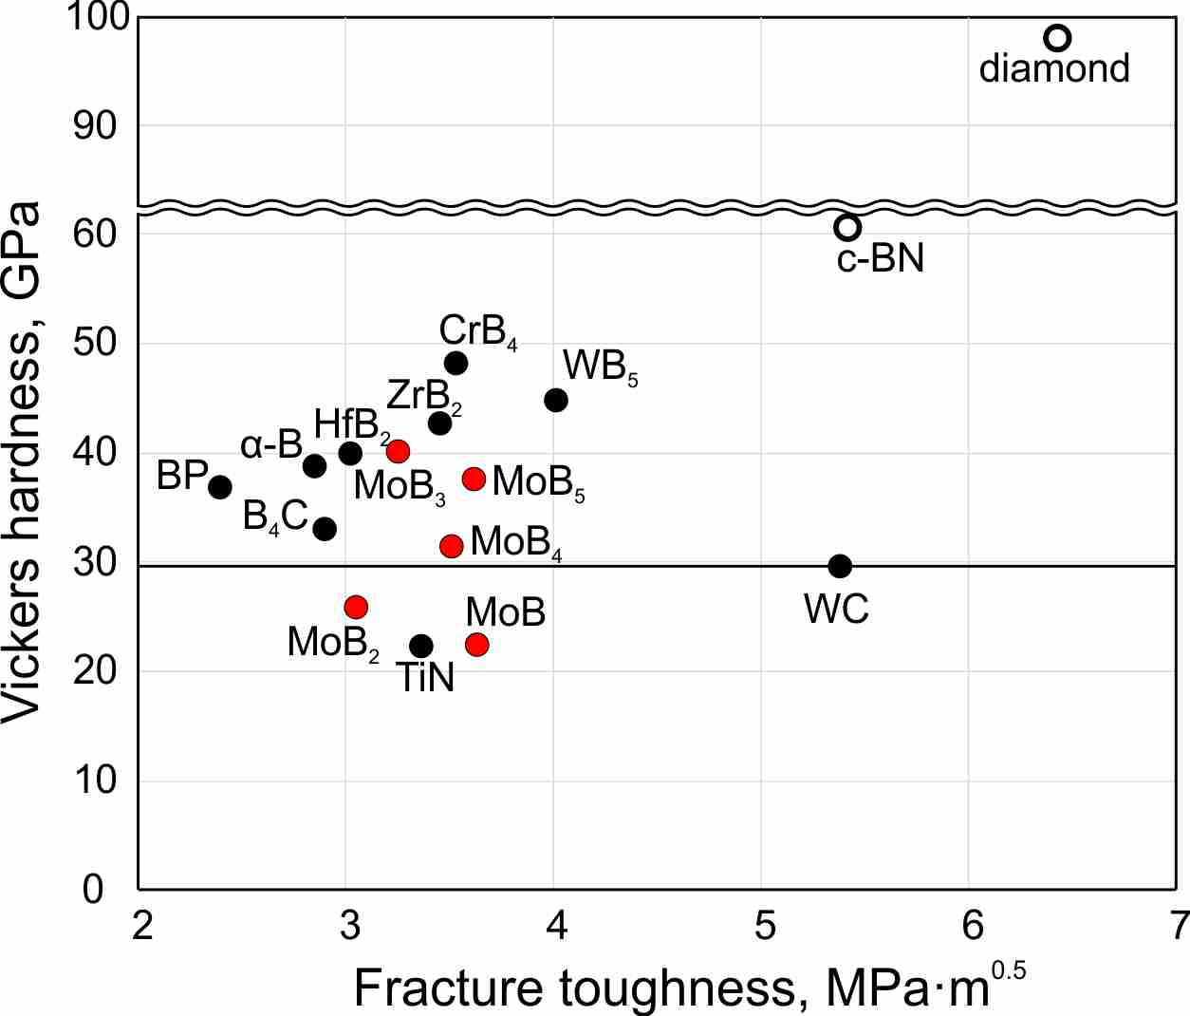
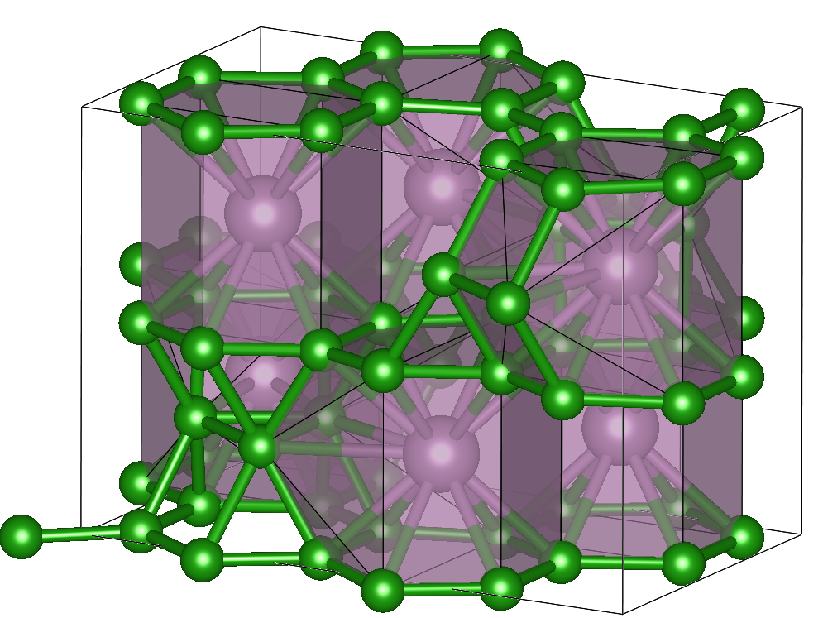
Mo-B system
New MoB₅ is stable in the entire temperature range
MoB₄ is metastable.
MoB₅ has lower hardness compared to WB₅
A.G. Kvashnin, et al., Submitted 2018

Slide 18
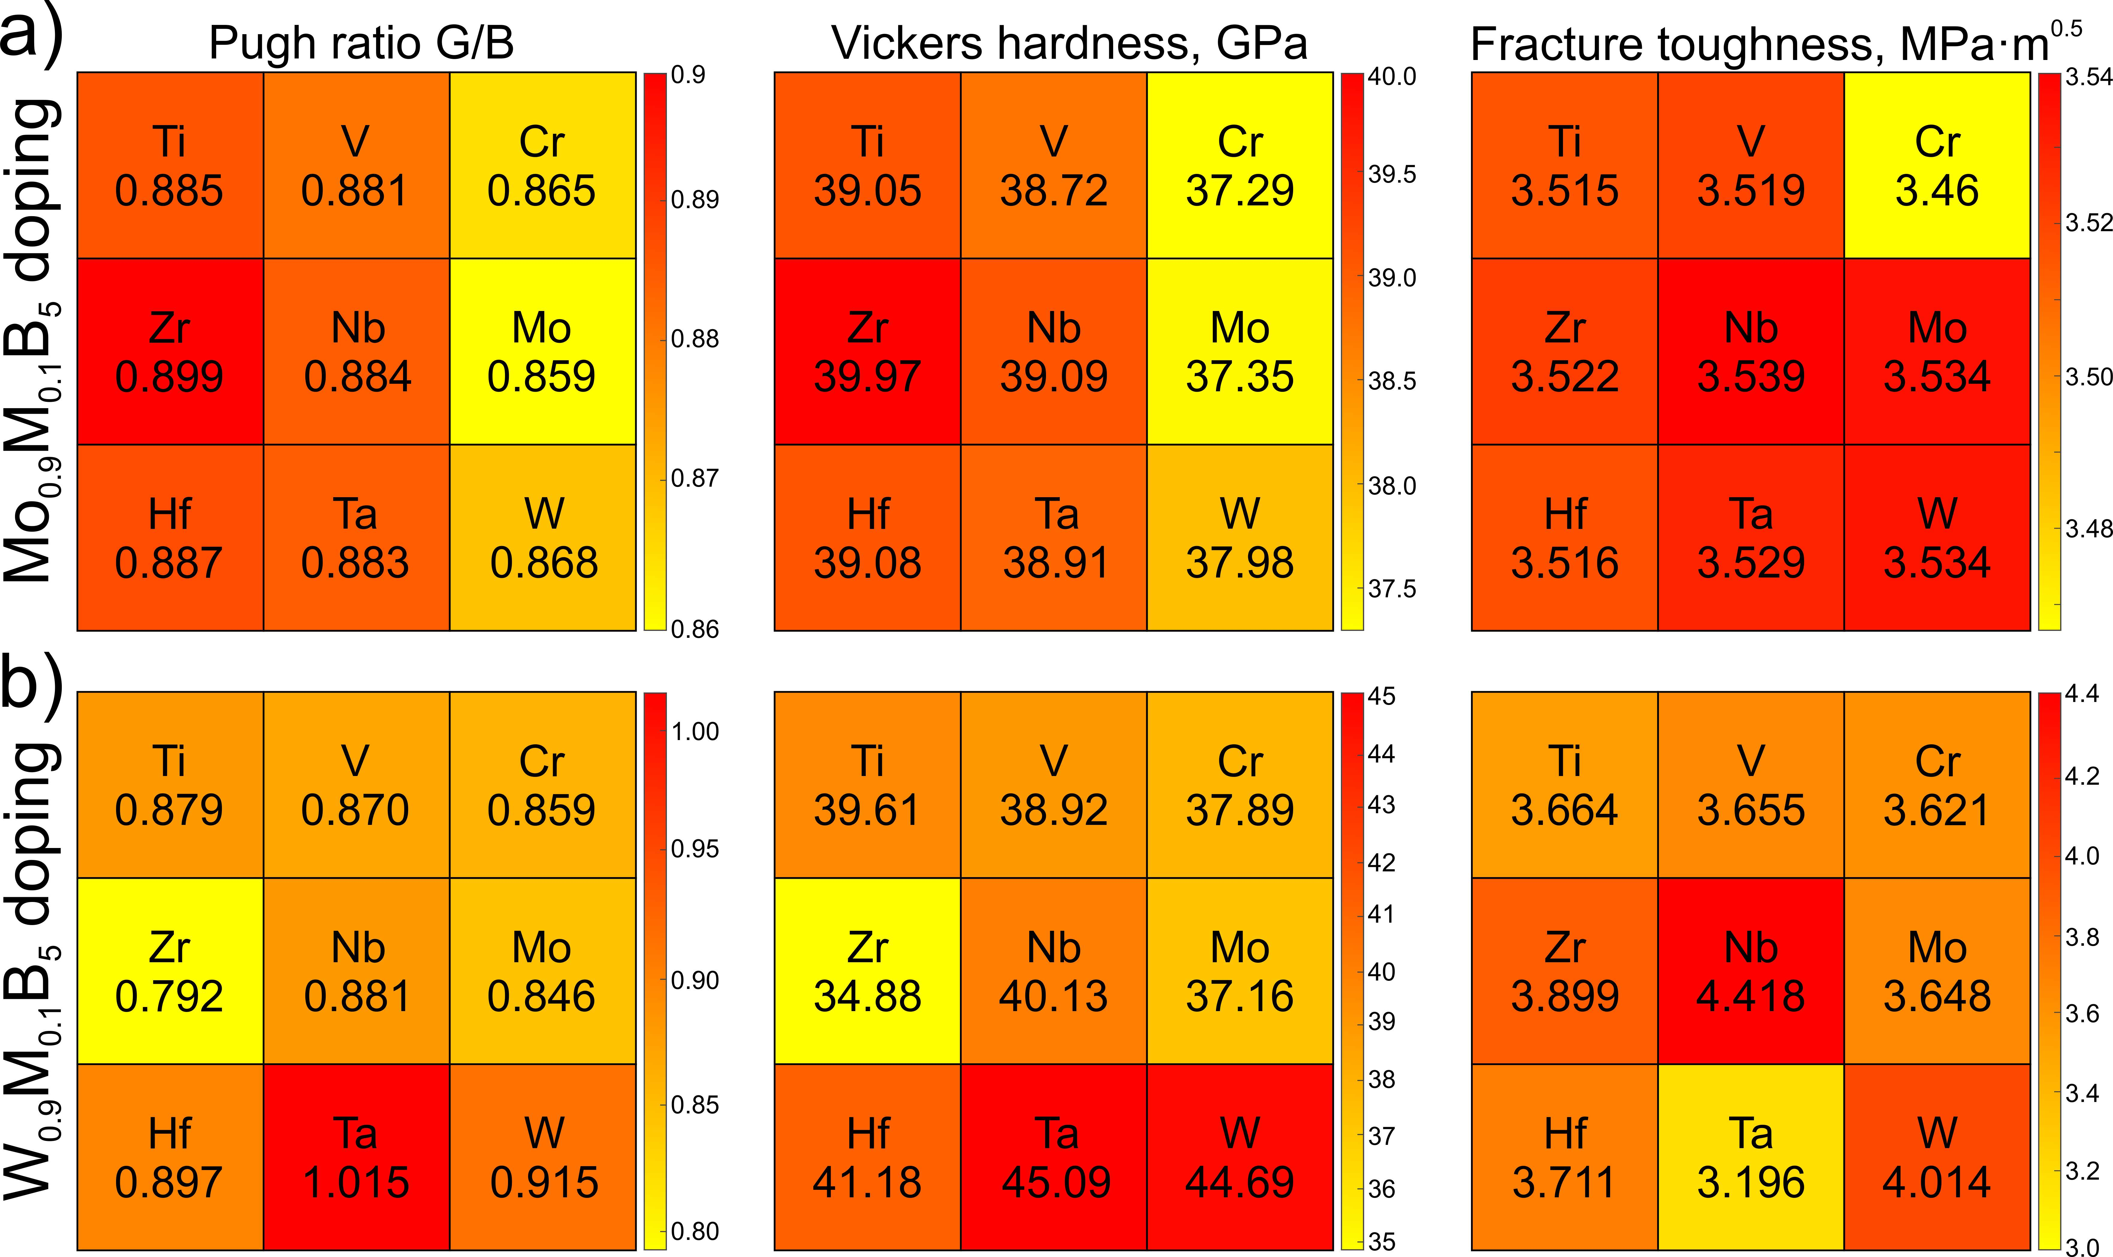
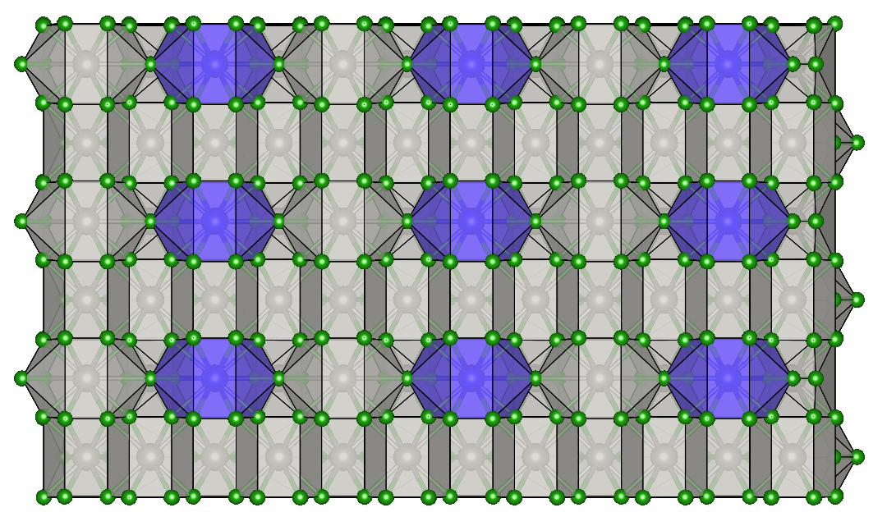
Dependence of mechanical properties on the doping
M1_{0.9}M2_{0.1}B₅
M1 = W,Mo
M2 = Ti,V,Cr,Zr,Nb,Mo,Hf,Ta,W
2×1×1 supercell
M1⟷M2
A.G. Kvashnin, et al., Submitted 2018

Slide 19
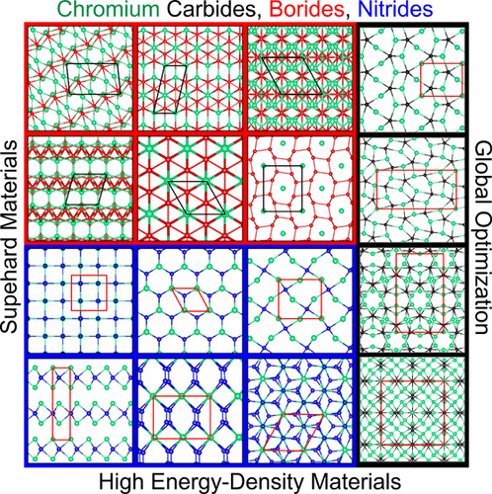
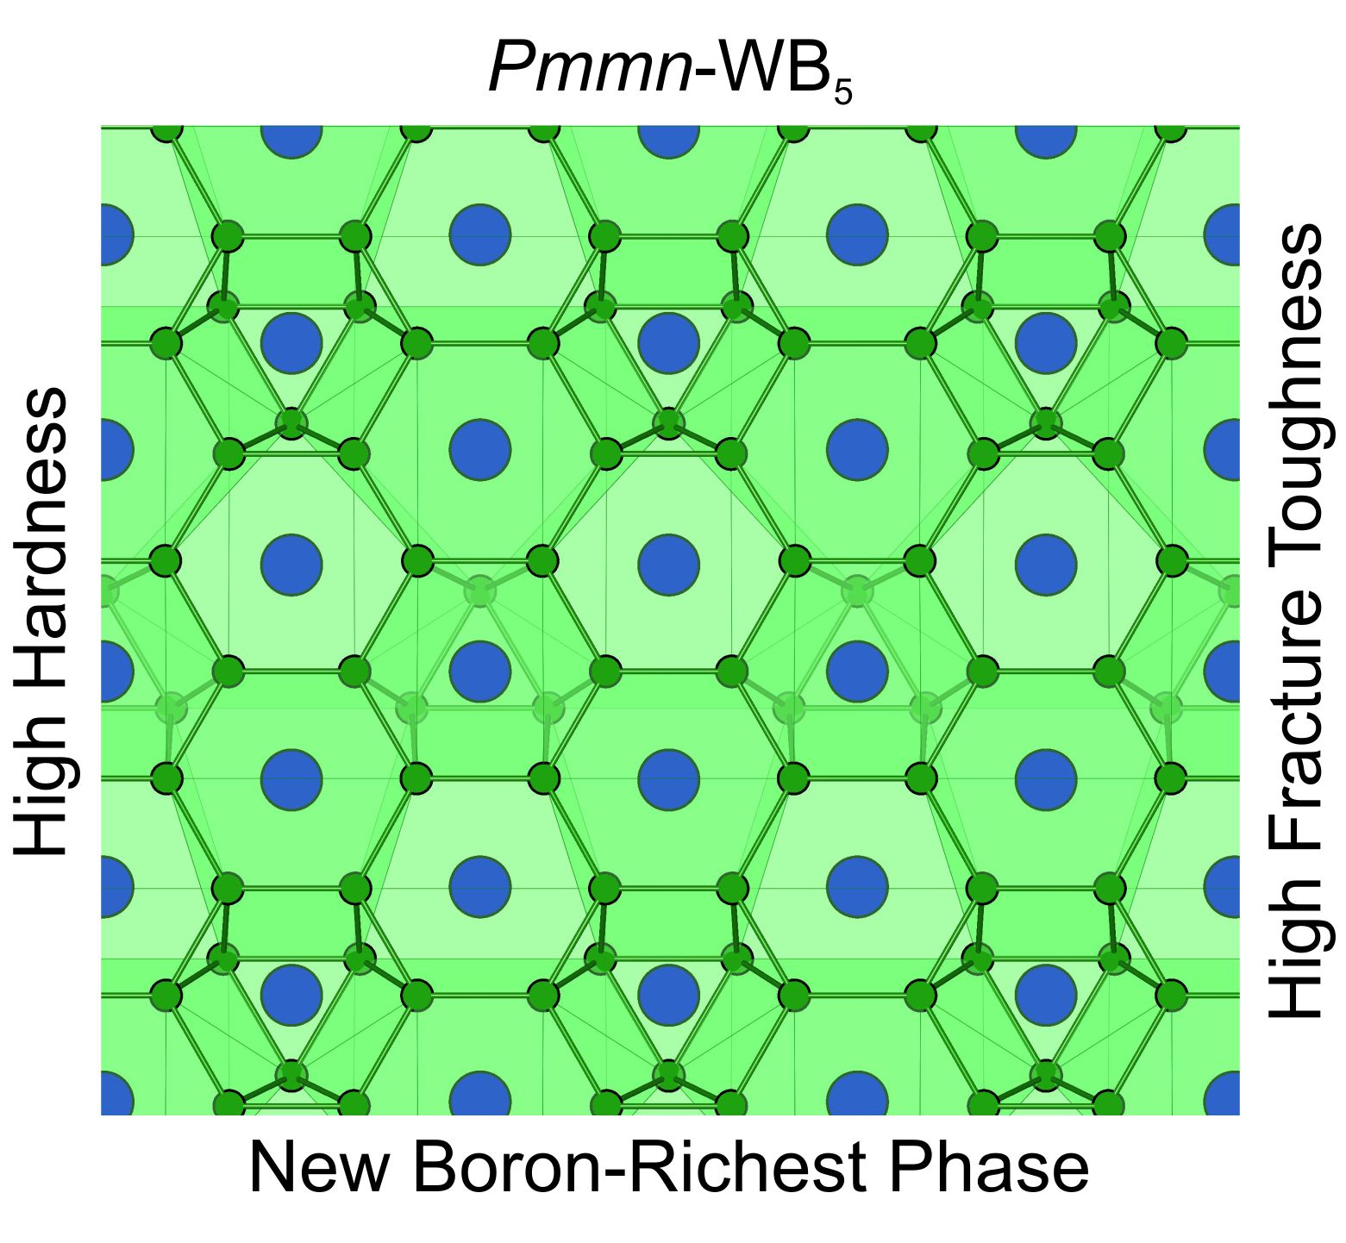
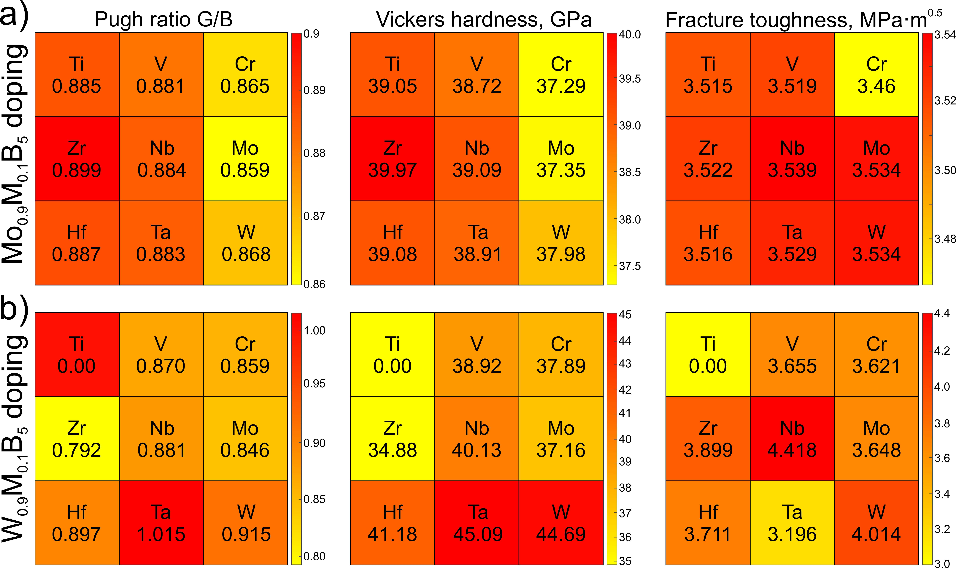
Conclusions
J. Phys. Chem. Lett., 8, 755-764 (2017)
J. Phys. Chem. Lett., 9, 3470-3477 (2018)
Submitted (2018)

Slide 20


Ready for pre-order
New book on the
Computational materials discovery
is published soon
14 Chapters within 3 big Sections:
Methods for materials discovery
Functional materials
Low-dimensional materials

Slide 21










Acknowledgements
A.R. Oganov
H.A. Zakaryan
D.V. Rybkovskiy
A.I. Samtsevich
Yu.A. Kvashnina
C. Xie
Z. Allahyari
Thank you for your kind attention!

Slide 22




Vickers hardness
There are 3 empirical models, which can be applied to estimate the Vickers hardness
Lyakhov-Oganov model (Phys. Rev. B. 84, 092103, 2011)
Gao model (Phys. Rev. Lett. 91, 015502, 2003)
Chen model (Intermetallics, 19, 1275, 2011)
$$H_{v}=2∙{\left(k^{2}∙G\right)}^{0.585}−3$$

Slide 23




Fracture toughness
Fracture toughness could be estimated using the empirical equation developed in our lab [1]
where
[1] H.Niu, S.Niu, A.R. Oganov, PRL, submitted (2018)

Slide 24
Vickers hardness
Cr₂B
Cr₅B₃
CrB
Cr₃B₄
CrB₄
CrB₂
Cr₇C₃
Cr₂C
Cr₃C₂
Cr₂₃C₆
CrN
CrN
Cr₂N
Cr₂N
CrN₄
CrN₄
*CrN₂
Hardness, GPa
Borides
Carbides
Nitrides
*Phys. Rev. B, 93, 214104, 2016

Slide 25
Твердость по Виккерсу
H_{v}, ГПа

Slide 26



Temperature stability. Theory
To take into account the temperature one needs to calculate the Gibbs free energy instead of total energy
T=300 K
where
G, eV
AHA
T=N K
$$F_{A}\left(T,V\right)≈A_{2}T^{2},$$
where
$$A_{2}=\frac{3k_{B}}{Θ_{H}}\left(0.0078〈γ〉−0.0154 \right).$$
G, eV
$$γ_{i}=\frac{B_{0}}{ω_{i}}\frac{dω_{i}}{dp}$$
AHA
A.G. Kvashnin, et al., J. Phys. Chem. Lett., 2018, 9, pp 3470–3477

Slide 27




Temperature dependence of mechanical properties
Elastic constants could be calculated by two different ways:
$$C_{ij}(T)$$
$$C_{ij}=\frac{∂σ_{i}}{∂η_{j}}$$
$$C_{ij}=\frac{1}{V}\frac{∂^{2}E}{∂η_{i}∂η_{j}}$$
E is energy, σ is stress, η is strain.
Instead of E we need to use Gibbs free energy as:
$$B\left(T\right), G\left(T\right)$$
$$H_{v}\left(T\right), K_{IC}\left(T\right)$$
…
where
A.G. Kvashnin, et al., J. Phys. Chem. Lett., 2018, 9, pp 3470–3477

Slide 28







Superconductivity
Allen-Dynes equation (full)
Modified McMillan equation (short)
$$T_{C}=ω_{log}\frac{f_{1}f_{2}}{1.2}\exp\left(\frac{−1.04\left(1+λ\right)}{λ−μ^{∗}−0.62λμ^{∗}}\right) ,$$
$$T_{C}=\frac{ω_{log}}{1.2}\exp\left(\frac{−1.04\left(1+λ\right)}{λ−μ^{∗}−0.62λμ^{∗}}\right)$$
where
$$f_{1}={\left(1+{\left(\frac{λ}{Λ_{1}}\right)}^{\frac{3}{2}}\right)}^{\frac{1}{3}}, f_{2}=1+\frac{λ^{2}}{λ^{2}+Λ_{2}^{2}}∙\left(\frac{ω_{2}}{ω_{log}}−1\right)$$
$$λ=\int_{ω_{min}}^{ω_{max}}{\frac{2∙a^{2}F\left(ω\right)}{ω}dω}$$
$$Λ_{1}=2.46\left(1+3.8μ^{∗}\right), Λ_{2}=1.82\left(1+6.3μ^{∗}\right),$$
$$ω_{2}=\sqrt{\frac{1}{λ}\int_{ω_{min}}^{ω_{max}}{\left[\frac{2∙a^{2}F\left(ω\right)}{ω}\right]ω^{2}dω}}$$
$$ω_{log}=\exp\left(\frac{2}{λ}\int_{ω_{min}}^{ω_{max}}{\frac{dω}{ω}α^{2}F\left(ω\right)\ln\left(ω\right)}\right)$$
Important!
McMillan approximation cannot be apply for EPC parameters λ > 2
For large λ the fill Allen-Dynes equation should be used.

Slide 29

Search for new Cr-N phases
As a result, the CrN, Cr₂N, CrN₄ phases were found. The most intensive study was devoted to the new CrN₄ phases

Slide 30






More attention to Cr-N system
Comparison of experimental XRD pattern with simulations. The Pnnm-Cr₂N phase was remained structurally unresolved until now – but here we finally determine its crystal structure.
Exp. from [3]
CrN₄ phases are in fact high energy-density materials with polymeric nitrogen chains with 2 atoms (С2/m) and flat triangular NN₃-groups (similar to NO₃-groups; R3c-CrN₄ is structurally similar to calcite CaCO₃ and NaNO₃)
[3] M.D. Aguas, A.M. Nartowski, I.P. Parkin, M. MacKenzie, and A.J. Craven, J. Mater. Chem. 8, 1875 (1998).

Slide 31

Stability of Cr-N phases
The stability of Cr-N phases were studied by calculating the P(T) phase diagrams. All phases remain dynamical stability (no imaginary phonon frequencies). CrN₄ phases are metastable due to the positive formation energy. These phases become stable under external pressure more than 5 GPa.

Slide 32





Stability under pressure
Energy density materials
$$CrN_{4}→CrN+\frac{3}{2}N_{2}$$
C2/m-CrN₄ - 1.96 MJ/kg
R3c-CrN₄ - 3.51 MJ/kg
TNT (trinitrotoluene) - 4.6 MJ/kg
Gunpowder 3 MJ/kg
Nitroglycerin 6.6 MJ/kg

