Slide 1


Effects of the surface termination on oxygen reduction rate of cathodes for fuel cells
E. A. Kotomin, R. Merkle,
Yu. Mastrikov, J. Maier

Slide 2

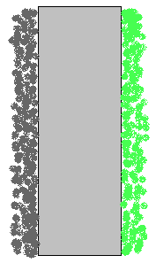
Oxygen/Proton-conducting ceramic fuel cells (PCFC)
SOFC
(Zr,Y)O_{2-x}
PCFC
Ba(Zr,Y)O_{3-x}
H₂O
H₂O
PCFC:
* higher σ_{ion} at low T
* fuel not diluted
by H₂O
O²⁻
H⁺
O₂
H₂
O₂
H₂
H₂O
H₂O
O²⁻
H⁺
O₂
H₂
O₂
H₂
e⁻
e⁻
e⁻
e⁻
≈ 700 °C
300-600 °C
Ba(Zr,Y)O_{3-x}

Slide 3
(La,Sr)MnO3= LSM
one of the first SOFC cathodes
well studied (M.Liu 2007-2010; D.Morgan 2009, 2015; E.Wachsman, Watson 2016
Kuklja et al PCCP 15, 5443 (2013)
Mastrikov et al, J. Phys. Chem. C 114, 3017 (2010);
Wang J.Mat. Res. 27, (2012)
main focus was on MnO2 terminated surface as the most stable, a few studies of Sr doping
However, it was shown that Sr doping makes (La,Sr)O termination more favourable
Piskunov et al PRB 78, 121406 (2008)
Orthorhombic phase stable below 750 K (modeling defects in a cubic phase could make problems)

Slide 4
Ultimate goals of theory:
Atomistic/mechanistic details of oxygen reduction (ORR) at SOFC cathode surface, including O2 adsorption, disociation, O vacancy formation/migration on the surface/bulk; with aim to optimize cathode chemical composition
Challenge: what are the rate-determining reaction stages in oxygen reduction reaction
Advantage of atomistic modeling: effects on terminating plane; charge redistribution.

Slide 5
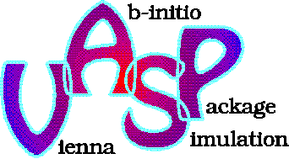
Methods: 1. Solid state physics
Density Functional Theory
Plane Wave basis set
Generalised Gradient Approximation (Hubbard U)
Perdew Wang 91 exchange-correlation functional
Projector Augmented Wave method
Conjugate Gradient method for structure relaxation
Nudged Elastic Bands for energy barriers estimation
Bader charge analysis
Spin-polarized calculations
Slabs 7 – 15 planes with 8x surface unit cell (critically important)
Notes:
5

Slide 6
2. Quantum chemical approach
CRYSTAL 2014 code with LCAO basis set
(re-optimised Comp Mat Sci. 29, 165 (2004)
For light atoms (O), all-electron basis set (BS) for heavy atoms (Sr, Pb,Ti and Zr), the small-core pseudopotentials
Hybrid HF-DFT functionals work very good for band gaps
Bond populations and atomic charge analysis
Well suited for single slabs without repetition along z axis
Ghost basis set on vacant sites
Notes:
6

Slide 7
(La,Sr) (001) terminated surface
Problems: it is polar – oppositely charged
(+/-1e) LaO/MnO2 planes
Stoichiometric slabs reveal macroscopic dipole moment
To avoid macroscopic dipole moment, symmetric but nonstoichiometric slabs are used (on both sides-- LaO or MnO2) with even number of planes
Dependent on the termination, Mn oxidation state (OX) is varied, which affects Vo formation energy
Example: in LSF Vo form.enthalpy changes from 0.7 eV (Fe 4+) to 5 eV (OX < 3).
Our goal- to study these effects on ORR on (La,Sr)O termination (Kotomin et al, ECS Trans. 77 (2017), Mastrikov 2018)

Slide 8
2 (001) slab terminations
LaO (+1) MnO2 (-1)
MnO2 (-1) LaO (+1)
LaO (+1) MnO2 (-1)
MnO2 (-1) LaO (+1)
LaO (+1) MnO2 (-1)
MnO2 (-1) LaO (+1)
LaO (+1) MnO2 (-1)
-- Choice: either non-stoichiometry, or dipole moment

Slide 9
Electronic charge distribution
orthorhombic (001) LMO, Sr 0%, 25%, Sr 50%
7 planes, 8x surface unit cell
bulk LMO: O (-1.27 e), Mn +1.71 e →considerable Mn-O bond covalency
Variation of formal Mn oxidation state:
x_{Sr} bulk (La,Sr)O MnO₂
0 +3.0 +2.67 +3.25
0.25 +3.25 +3.00 +3.44
0.5 +3.50 +3.33 +3.63

Slide 10
Vacancies in different planes
No Sr doping

Slide 11
Two terminations show opposite trends:
ΔE = 1.2 eV transforms into difference in surface [V_{O}..] of 5 orders of magnitude at 1000K
in agreement with D.Morgan (PRB 2015)
for formation energy estimate, use as the
reference the bulk with the same OX!

Slide 12
25% Sr doping
Smaller ΔE_{Vo}..
Different reference energies
in the bulk!
Similar results for 50% Sr

Slide 13
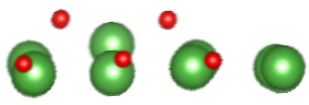
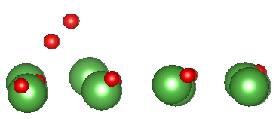
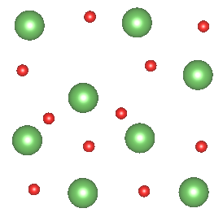
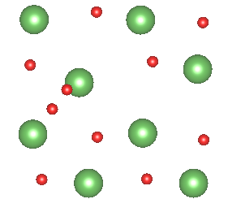
oxygen adsorption sites on AO
atomic:
molecular:
La-O ≈2.2 Å
(bulk ≈2.7 Å)
O-O 1.46 Å
= peroxide
O(2-) adsorption in "hollow" site between 2 La, not ontop of La
Charge -1.2 e is close to bulk, unlike -0.5 e on MnO2 for O(1-)
Ads. energy 4.3 eV is much larger than 1.1 eV on MnO2

Slide 14
O₂ dissociation, V_{O}.. migration
estimated V_{O}.. migration barriers (via subsurface jumps): 1.4-1.3-1.2 eV (Sr 0-25-50%)
Compare with 0.9 eV in bulk and 0.6 eV on MnO₂
Dissociation barriers: 0.2-0.6-0.8 eV (Sr 0-25-50%)
compare ~ 1 eV on LaO La₂NiO₄ (Kilner 2016)
Large enough supercell is critically important
Our adsorbate coverage 12%

Slide 15
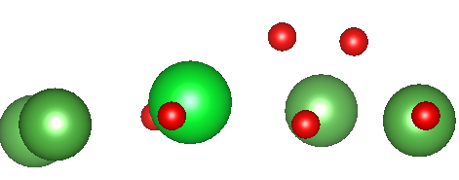
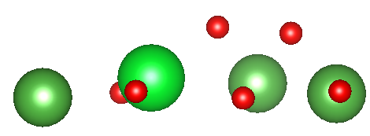
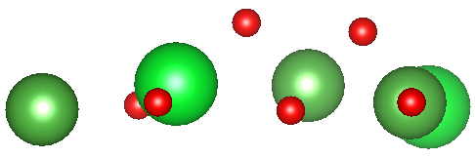
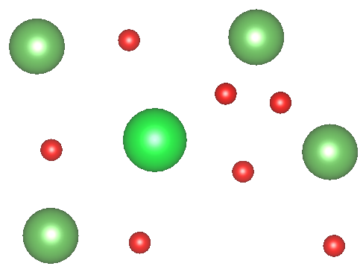
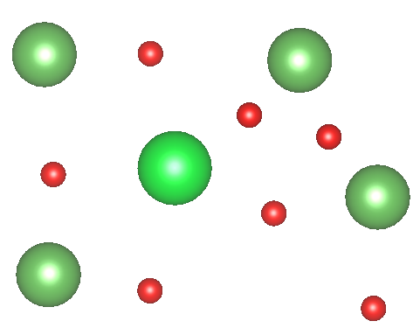
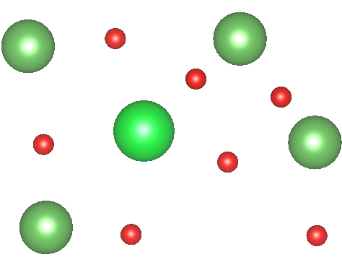
O₂ dissociation on AO
initial state = peroxide
transition state +0.60eV
next frame -0.14eV
1.49 Å
1.90 Å
2.44 Å
2.30
2.35
2.22
2.32
2.14
2.29
2.64
2.47
2.50
2.31
2.37
2.14

Slide 16
LMO- LaO termination, slab with initial Mn oxidation state 2.67+
ΔE
O₂
La La
high O⁻ coverage
surface almost
poisoned by O⁻
very low surface [V_{O}..]
10⁻⁷ relative to MnO₂ termination
with same ox. state at 1000 K
⇒ O incorporation is
rate determining step
O-O 1.46 Å
peroxide
-5.0eV
O⁻
O O
O
La La
La La
-4.3eV
≈1.4eV
⁻O O⁻
O⁻
2×(-0.75eV)
La La La
La La
molecular
adsorption
dissociation
low barrier
encounter of
adsorbed O and V_{O}..
via subsurface
La O²⁻ La
incorporation

Slide 17
La_{0.75}Sr_{0.25}MnO₃ (La,Sr)O termination, slab with initial Mn oxidation state 3.0+
ΔE
O₂
La La
O-O 1.46 Å
peroxide
high O⁻ coverage
surface almost
poisoned by O⁻
very low surface [V_{O}..]
10⁻⁵ relative to MnO₂ termination
with same ox. state at 1000 K
⇒ O incorporation is
rate determining step
-4.0eV
O O
O
O⁻
La La
La La
≈0.6eV
-2.9eV
≈1.3eV
⁻O O⁻
O⁻
La La La
La La
2×(-1.4eV)
molecular
adsorption
dissociation
encounter of
adsorbed O and V_{O}..
via subsurface
La O²⁻ La
incorporation

Slide 18
La_{0.5}Sr_{0.5}MnO₃ (La,Sr)O termination, slab with initial Mn oxidation state 3.3+
moderate O⁻ coverage
about 10-30%
still higher than on MnO₂
still low surface [V_{O}..]
10⁻⁴ relative to MnO₂ termination
with same ox. state at 1000 K
⇒ O incorporation is
rate determining step
ΔE
O₂
O-O 1.38 Å
superoxide
La La
O O
-2.5eV
O
O⁻
La La
La La
≈1.2eV
≈0.8eV
-1.3eV
⁻O O⁻
O⁻
La La La
La La
2×(-2.4eV)
molecular
adsorption
dissociation
encounter of
adsorbed O and V_{O}..
via subsurface
La O²⁻ La
incorporation
dissociation barrier increases
with increasing Sr content,
↔ less negative overall reaction enthalpy,
less electron transfer to ads. O₂

Slide 19
Our goal is modelling of all steps of the ORR in order to find limiting one.
Entropy effects important under realistic operation conditions (1000 K).
MnO2 (001) termination:
Mastrikov et al, J. Phys. Chem. C 114, 3017 (2010); Wang J.Mat. Res. 27, 2012

Slide 20
CONCLUSIONS
Surface termination, surface dipoles and Mn oxidation states (nonstoichiometry) play very important role in slab calculations of polar surfaces
O (O₂) adsorption energy on (La,Sr)O surfaces
much larger than on MnO₂ (1-2 order larger coverg.)
BUT concentrations of V_{O}.. is 4-7 orders smaller
Thus, ORR rate at (La,Sr)O surface is much slower than on MnO₂ termination
could be relevant for many similar polar surfaces

Slide 21
Acknowledgments
Many thanks to:
E. Heifets
R. Evarestov
D.Gryaznov
R.Dovesi

Slide 22
Joint experimental- theoretical study on BSCF-LSCF solid solution solutions
Recent review articles related to SOFC:
L. Wang et al, J.Mater. Res. 27, 2000 (2012)
M. Kuklja et al, PCCP (review) 15, 5443 (2013)
R.Catlow (ed.) Computational Approaches to Energy Materials, Wiley, 2013, Chapter 6.
Yu. Mastrikov et al, PCCP 15, 911 (2013)
D. Fuks et al, J. Mater. Chem. A1, 14320 (2013)

Slide 23
For comparison: LM (Mastrikov, 2010) MnO₂ termination
ΔG
ΔE
O O
O⁻
Mn O Mn
O
+0.7eV
O₂
Mn O Mn
+0.6eV
⁻O O⁻
O⁻
Mn O Mn
Mn O Mn
O Mn
Mn Mn
O O
-1.1eV
Mn O Mn
2×(-1.5eV)
O⁻
-1.6eV
O
+0.6eV
Mn O Mn
Mn O²⁻ Mn
+0.7eV
⁻O O⁻
O⁻
Mn O Mn
O Mn
Mn Mn
2×(-1.5eV)
rate determining:
dissociation
or
encounter of
adsorbed O and V_{O}..
Mn O²⁻ Mn

Slide 24
Effects of LSO surface charge
AO surface charge smaller
than for MnO₂
part of MnO₂ surface dipole
compensated by different
surface rumpling
↔

Slide 25
ΔG
LaMnO₃ LaO termination, slab with initial Mn oxidation state 2.67+
ΔE
O₂
La La
high O⁻ coverage
(but plateau ≈50%?)
surface almost
poisoned by O⁻
very low surface [V_{O}..]
10⁻⁷ relative to BO₂ term.
with same ox state
at 1000 K
⇒ O incorporation is rds
-5.0eV
O⁻
O O
O
La La
La La
O⁻
O O
O
La La
La La
⁻O O⁻
O⁻
La La La
La La
-4.3eV
La O²⁻ La
≈1.4eV
⁻O O⁻
O⁻
2×(-0.75eV)
La La La
La La
molecular
adsorption
dissociation
low barrier
encounter of
adsorbed O and V_{O}..
via subsurface
La O²⁻ La
incorporation

Slide 26
ΔG
La_{0.75}Sr_{0.25}MnO₃ (La,Sr)O termination, slab with initial Mn oxidation state 3.0+
ΔE
O₂
high O⁻ coverage
(but plateau ≈50%?)
surface almost
poisoned by O⁻
very low surface [V_{O}..]
10⁻⁵ relative to BO₂ term.
with same ox state
at 1000 K
⇒ O incorporation is rds
La La
O O
O
O⁻
La La
-4.0eV
La La
O O
O
O⁻
La La
⁻O O⁻
O⁻
La La
La La La
La La
≈0.6eV
-2.9eV
≈1.3eV
La O²⁻ La
⁻O O⁻
O⁻
La La La
La La
2×(-1.4eV)
molecular
adsorption
dissociation
encounter of
adsorbed O and V_{O}..
via subsurface
La O²⁻ La
incorporation

Slide 27
La_{0.5}Sr_{0.5}MnO₃ (La,Sr)O termination, slab with initial Mn oxidation state 3.3+
moderate O⁻ coverage
(still higher than on BO₂)
coverage 10-30%
still low surface [V_{O}..]
10⁻⁴ relative to BO₂ term.
with same ox state
at 1000 K
⇒ O incorporation is rds
ΔG
ΔE
O₂
O O
La La
O⁻
La La
O
La La
⁻O O⁻
O⁻
O O
La La La
La La
-2.5eV
O
O⁻
La La
La La
≈1.2eV
≈0.8eV
-1.3eV
⁻O O⁻
O⁻
La La La
La La
La O²⁻ La
2×(-2.4eV)
molecular
adsorption
dissociation
encounter of
adsorbed O and V_{O}..
via subsurface
La O²⁻ La
dissociation barrier increases
in parallel to less negative
overall reaction enthalpy
from LM to L5S5M
incorporation

Slide 28
Charge redistribution near surfaces
Effective atomic and plane charges, MnO₂ termination
(a) x_{Sr}=0 |  |  |  |  | (b) x_{Sr}=0.50
 | La | Mn | O | plane | La | Sr | Mn | O | plane
T |  | 1.69 | -1.20 | -0.71 |  |  | 1.77 | -1.14 | -0.51
 | 2.09 |  | -1.20 | 0.89 | 2.09 | 1.59 |  | -1.18 | 0.66
 |  | 1.83 | -1.21 | -0.59 |  |  | 1.88 | -1.16 | -0.44
Central | 2.08 |  | -1.25 | 0.83 | 2.09 | 1.57 |  | -1.25 | 0.58
Bulk | 2.09 | 1.78 | -1.25 |  | 2.10 | 1.58 | 1.85 | -1.21
(La,Sr)O termination
(a) x_{Sr}=0 |  |  |  |  | (b) x_{Sr}=0.50
 | La | Mn | O | plane | La | Sr | Mn | O | plane
T | 1.99 |  | -1.34 | 0.64 | 2.00 | 1.57 |  | -1.33 | 0.45
 |  | 1.59 | -1.29 | -0.99 |  |  | 1.78 | -1.24 | -0.70
 | 2.07 |  | -1.30 | 0.77 | 2.09 | 1.58 |  | -1.24 | 0.60
Central |  | 1.69 | -1.27 | -0.85 |  |  | 1.78 | -1.24 | -0.70
bulk | 2.07 | -1.6 | -1.3 |  | 2.09 | 1.59 | 1.79 | -1.24

Slide 29
Charge redistribution
Comparison for the same Mn oxidation state:
surface O ions more negative for AO than MnO₂
(-1.34 vs -1.20 e),
La charge less positive (+1.99 vs +2.09 e)
surface MnO₂ layers more covalent than bulk
(decreased Mn and O charges)

Slide 30
Density of states for different Sr doping
(La,Sr)O
(La,Sr)O termination:
Reference: deep O 2s level
E Fermi decreases with OX (Sr content)
VB top consists of Mn t_{2g}, e_{g} states
overlap with O 2p
Mn ions in 2-, 4-planes close to bulk

Slide 31
DOS vs Sr content
MnO2
MnO2 termination:
Surface Mn t_{2g} is wider and split off
Mn ions in 3 plane close to bulk
Sr doping does not affect splitting

Slide 32
Variation of oxygen exchange rates for MnO2 termination
.
or
Notes:
32

