Slide 1



7th School-Conference
Atomistic Simulations of Functional Materials
Center for Photochemistry of RAS
June 12-13, 2018
Correlations of Particle Motion in Supercooled Liquids
Vasily Pisarev, Elena Kirova, Dmitry Fleita,
Genri Norman

Slide 2
Phases of Substances

Slide 3
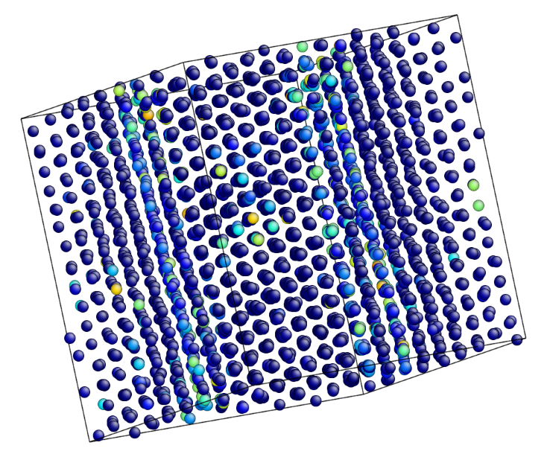
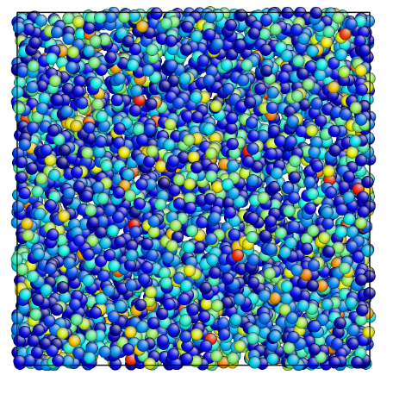
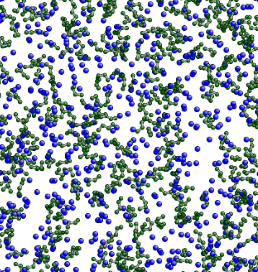
Extended List of “Phases”
Thermodynamically stable phases
Solid
Liquid
Gas

Slide 4
Extended List of “Phases”
Thermodynamically stable phases
Solid
Liquid
Gas
Metastable phases
Superheated solid
Superheated liquid
Supercooled liquid
Supersaturated vapor

Slide 5
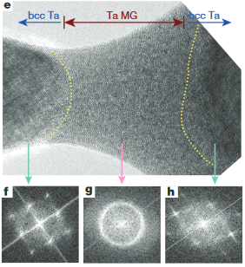
Extended List of “Phases”
Kinetically locked states
Glass
Li Zhong et al., Nature, 512, 177 (2014):
Monoatomic metallic glasses

Slide 6
Microscopic Definition of
“Non-Thermodynamical” Phases
Thermodynamics and statistical physics point of view:
  Stable states correspond to global minima of the thermodynamic potential
  Metastable states are local minima
  Glasses are non-ergodic states (do not exist in thermodynamics)
How can we tell those states by looking at atomic-scale structure and dynamics?

Slide 7
Outline
Overview of atomistic model
Glass transition criteria
Glass transition and shear stress autocorrelation functions (SACF)
Correlation of displacements and supercooling
Conclusions

Slide 8
Atomistic model

Slide 9
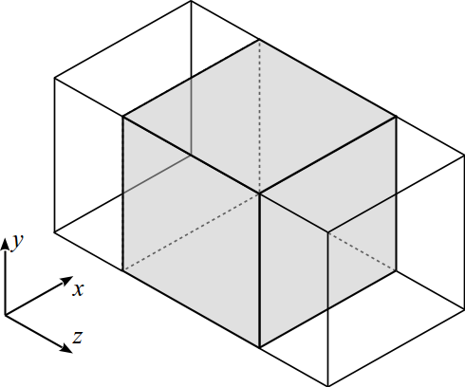
The Molecular Dynamics Model
Embedded atom method potential for Al (Foiles et al.,1998)
The initial conguration

Slide 10
Quasi-Isobaric Cooling Process
(rescaling of velocities)
T, K
1500
Measurements
|dT/dt| = const
Cooling
►
300
t

Slide 11
Glass Transition Criteria

Slide 12
INCREASE OF VISCOSITY (10¹² Pa·s)
Splitting of the second peak
of the pair correlation function (structural).
Formation of clusters
in the systems (structural).
Changes in heat capacity during cooling or heating (calorimetric).

Slide 13
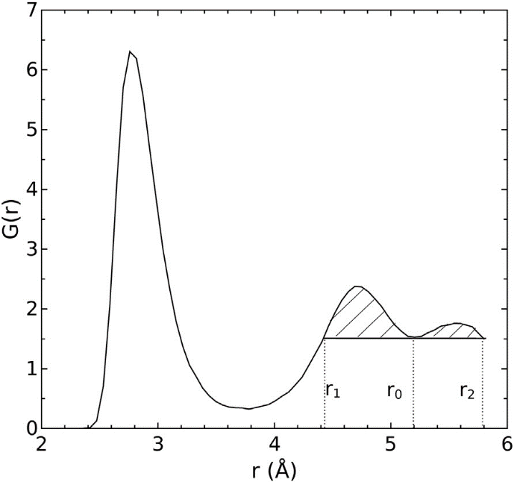
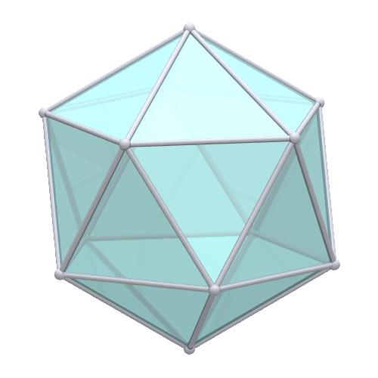
Structural Criteria
Splitting of the second peak
of the pair correlation function
Formation of
icosahedral clusters
Hypothesis: F. C. Frank, Proc. R. Soc. London A 215, 43 (1952)
Confirmation (Electron Nano-Diffraction):
A. C. Y. Liu, M. J. Neish, G. Stokol, G. A. Buckley, L. A. Smillie, M. D. de Jonge, R. T. Ott, M. J. Kramer, and L. Bourgeois, Phys. Rev. Lett. 110, 205505 (2013)

Slide 14
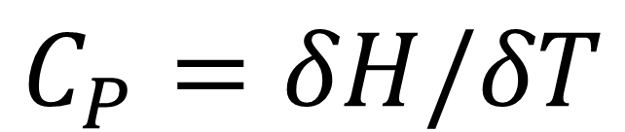
The Calorimetric Criterion
Changes in heat capacity
during cooling or heating
$$C_{P}=δH/δT$$
Enthalpy of the system H = U + PV ≈ U,
as Р ≈ 0
Н(Т) is averaged over 30 MD trajectories
with the same macroscopic state

Slide 15
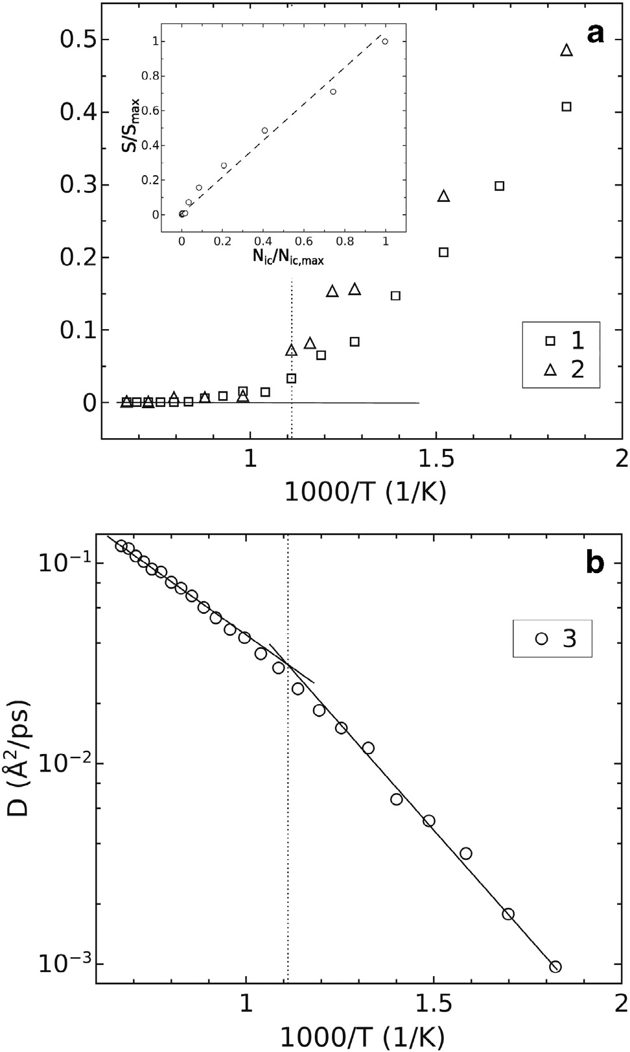
м
S/S_{max}
N_{ic}/ N_{ic,max}
1000 / T

Slide 16
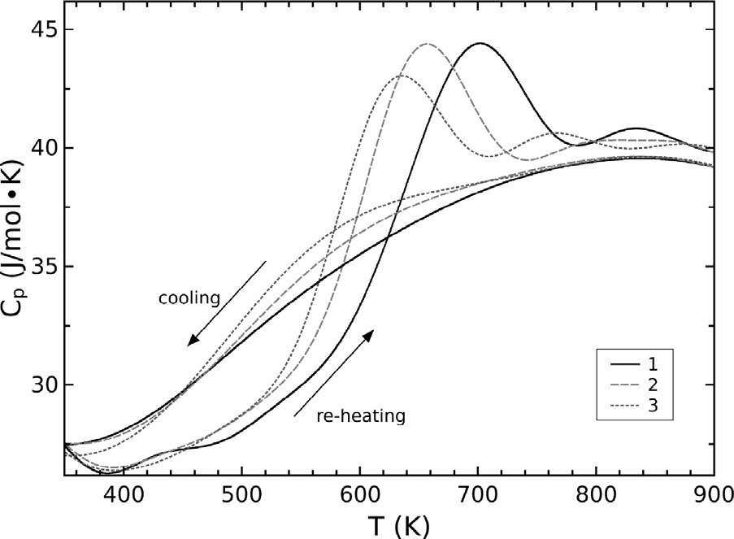
2·10¹² K/s
1.3·10¹² K/s
6·10¹¹ K/s

Slide 17
Shear Stress Autocorrelation Functions (SACF) in the
Glass Transition Region

Slide 18
Viscosity calculation:
Green-Kubo Relations
Shear viscosity coefficient
Where
denote ensemble-averaging
ηxy
ηxz
ηyz

Slide 19
The Stress Autocorrelation Functions
900 K
19

Slide 20
The Stress Autocorrelation Functions
700 K
20

Slide 21
The Stress Autocorrelation Functions
500 K
21

Slide 22
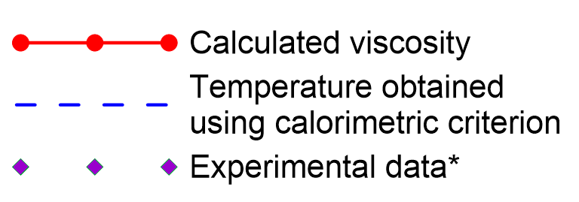
Viscosity Dependence on Temperature
|dT/dt| = 4∙10¹³ К/s
Calorimetric T_{g}
Kinematic viscosity (cm²/s)
*Ladyanov V I et al. Phys. Chem. Liquids 52 46 (2014)
T_{melt}
▼
22

Slide 23
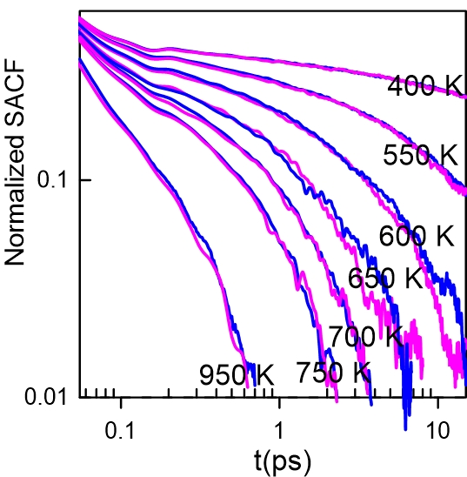
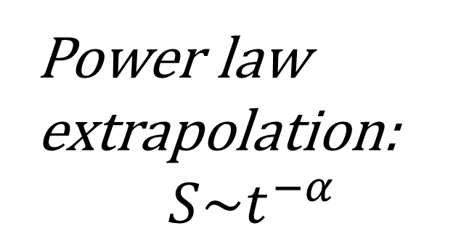
The Stress Autocorrelation Functions
Power law
extrapolation:
$$S\sim t^{−α}$$
23

Slide 24
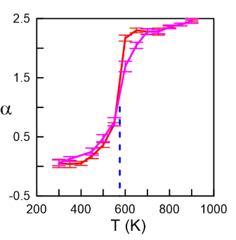
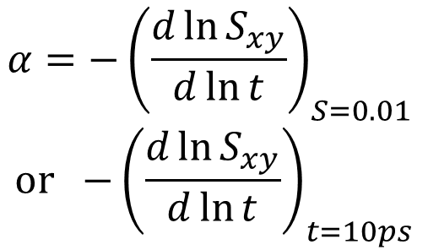
“Effective Exponent”
$$α={−\left(\frac{d\ln{S_{xy}}}{d\ln{t}}\right)}_{S=0.01}$$
$$or {−\left(\frac{d\ln{S_{xy}}}{d\ln{t}}\right)}_{t=10ps}$$
Red: ~10¹³ K/s
Magenta: ~10¹² K/s

Slide 25
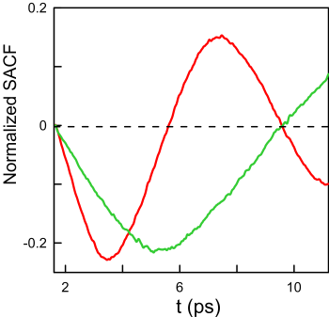
“Transverse” Stress Autocorrelation Functions (XZ, YZ)
Thickness = 82 Å
Thickness = 164 Å
25

Slide 26
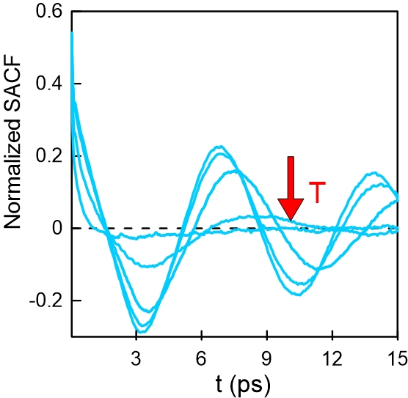

“Transverse” Stress Autocorrelation Functions (XZ, YZ)
$$δ=\frac{A_{1}}{A_{2}}$$
300 K
700 K
A₁
A₂
26

Slide 27
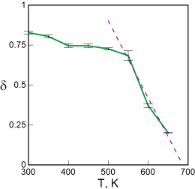



Damping Dependence on Temperature
$$1/δ$$
$$T_{g}≈690 K$$
$${calorimetric T}_{g}≈640 K$$
27

Slide 28
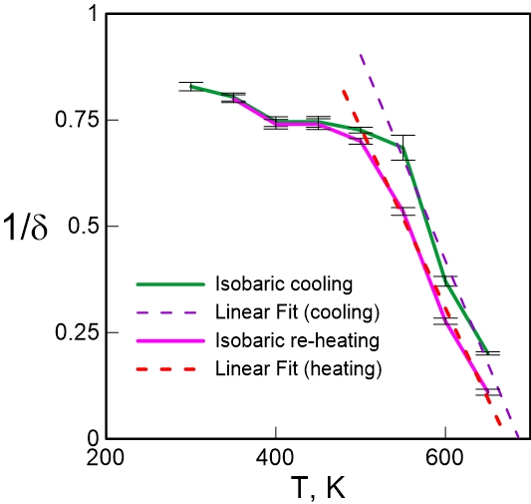
Damping Hysteresis
Stronger damping on re-heating, hence T_{glass-liq} < T_{liq-glass}
in accordance with calorimetric T_{f} < T_{g}
28

Slide 29
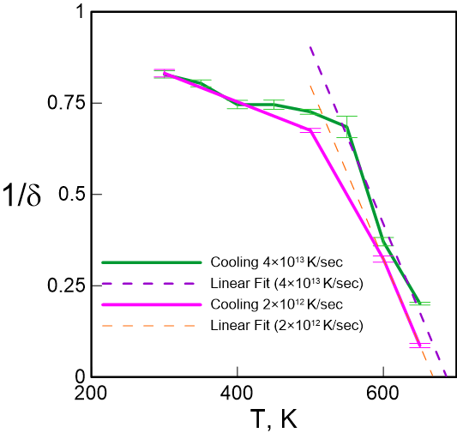
Cooling Rate Effect
T_{g} increases with cooling rate,
in accordance with other criteria and
relaxation glass transition models
29

Slide 30
Correlation of Displacements and Supercooling

Slide 31
Correlations in Microscopic Motion
Δr₁
r₀
Δr₂
$$CC\left(r_{0},t\right)={〈\cos\left(Δr_{1}\left(t\right),Δr_{2}\left(t\right)\right)〉}_{{|r}_{1}\left(0\right)−r_{2}\left(0\right)|=r_{0}}$$
31

Slide 32
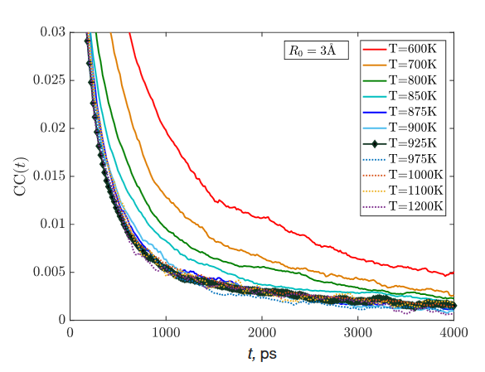
Correlations in Aluminum Melt
32

Slide 33
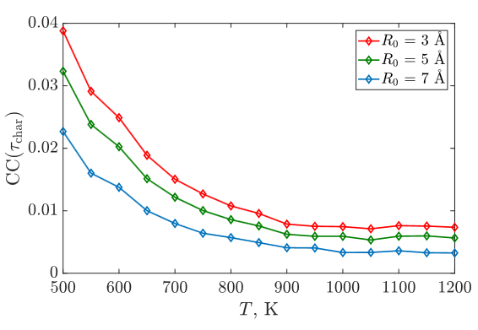
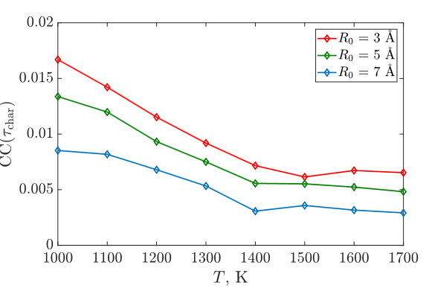
Correlations in Aluminum (T_{m}=925 K) and Copper (T_{m}= 1350 K) Melts
Al
Cu
CC (800 ps)
T_{melt}
T_{melt}
33

Slide 34
Conclusions
We have shown the differences in dynamics of stable liquids, supercooled liquids and glasses on the examples of metallic melts
Glass shows little shear stress relaxation and signs of transverse sound
Atoms in supercooled liquids have more correlated motion than in stable liquids
Correlation between atomic displacements is almost constant above the melting temperature and grows below the melting temperature

Slide 36
ACF time-averaging
t+T
t+2T
t
t+3T

Slide 37
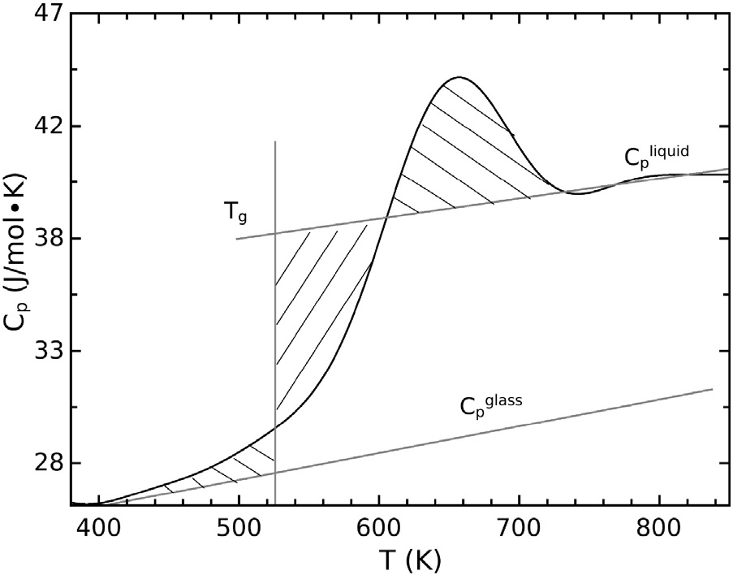
T_{f}

Slide 38
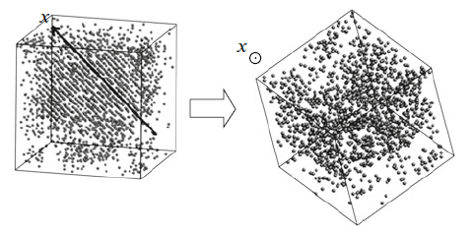
Partial crystallization (12 ·10¹⁰ K/s)
Only icosahedra-coordinated atoms are shown

Slide 39
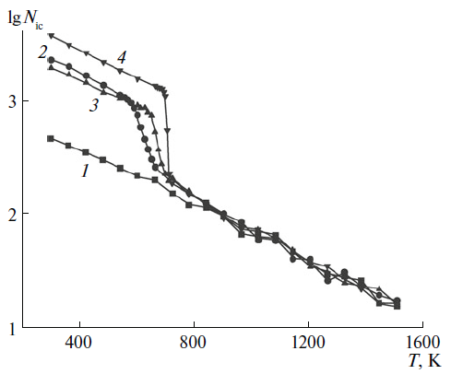
Partial crystallization
4. – 3 ·10¹⁰ К/s
2. – 12 ·10¹⁰ К/s
3. – 6 ·10¹⁰ К/s
1. – 4 ·10¹³ К/s

Slide 40
Публикации
L.N. Kolotova, G. E. Norman, and V V Pisarev.
Glass transition of aluminum melt. Molecular dynamics study
Journal of Non-Crystalline Solids 429 (2015) 98–103
E M Kirova and G E Norman.
Viscosity calculations at molecular dynamics simulations
J. Phys.: Conf. Ser. принято
Л.Н. Колотова, Г.Э. Норман, В.В. Писарев.
Стеклование переохлаждённого расплава алюминия.
Молекулярно-динамическое исследование.
Журнал физической химии. 2015. Т. 89. №5. С. 1578-1583

Slide 41
(time-averaged)

Slide 43
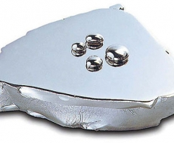

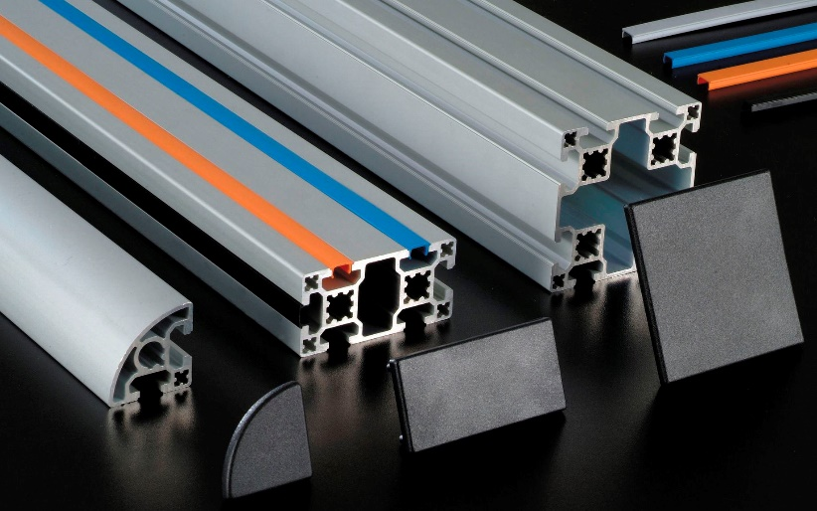
Practical use
Display manufacture
Constructing

Slide 44
The glass–liquid transition is a transition in amorphous materials from a hard and relatively brittle "glassy" state into a molten or rubber-like state,
as the temperature is increased.
The critical cooling rate is
the limiting rate of cooling
which is too fast for crystals to form
and the material is "locked" in a glassy state.

