Slide 1
Thermally activated delayed fluorescence in organic semiconductors: a quantum chemical study
A. Freidzon
In memory of Prof. V.G. Plotnikov

Slide 2
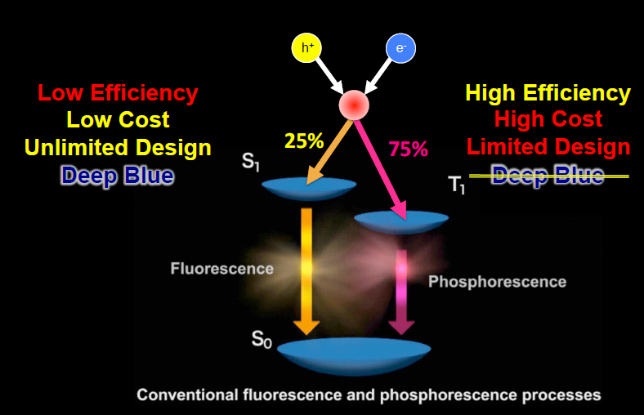
Electrogeneration of excitons in OLEDs
From C. Adachi, J. Adachi, High Performance TADF for OLEDs

Slide 3
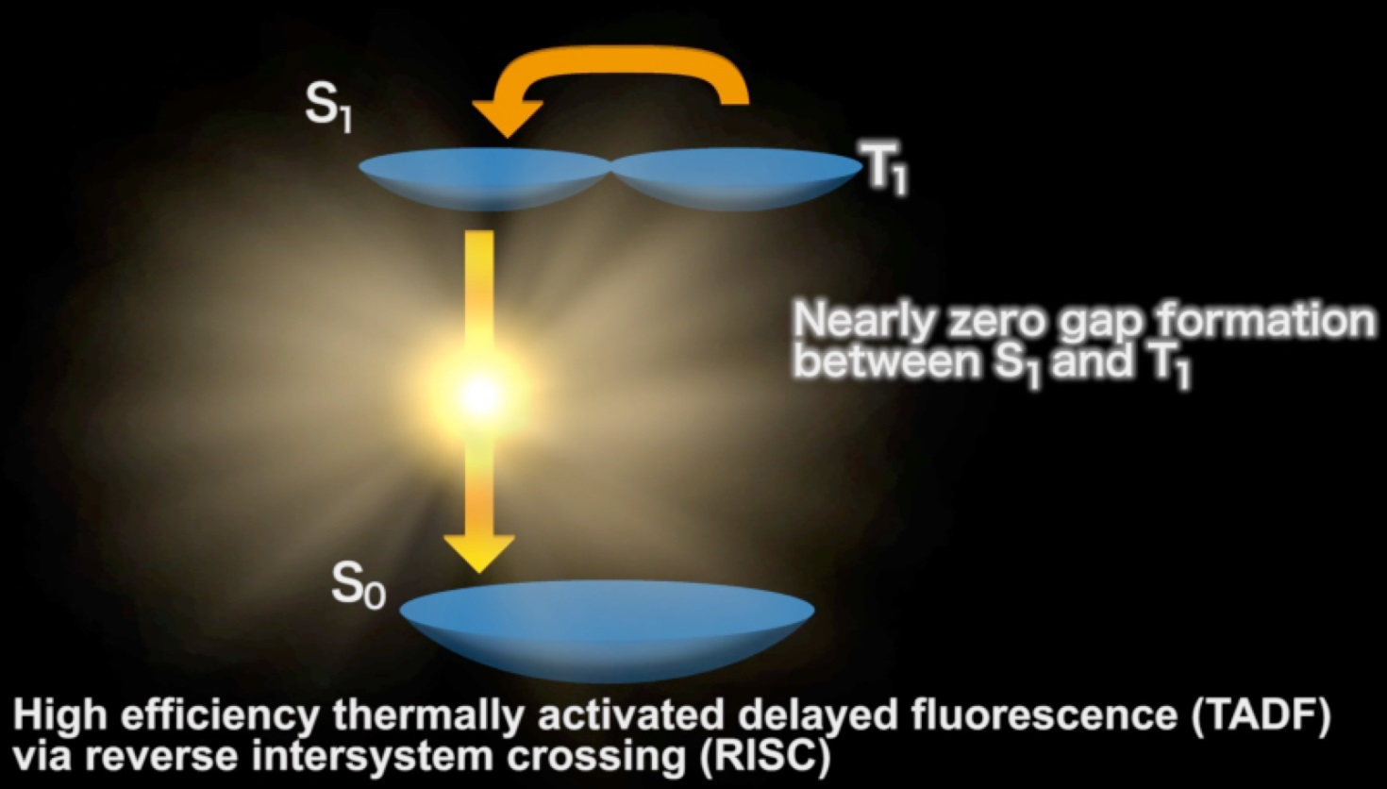
Thermally Activated Delayed Fluorescence
W = <S1|H_{SO}|T1>²/ΔE_{S1-T1}
From C. Adachi, J. Adachi, High Performance TADF for OLEDs

Slide 4
Thermally Activated Delayed Fluorescence

Slide 5
Thermally Activated Delayed Fluorescence
H_{SO}
W = <S1|H_{SO}|T1>²/ΔE_{S1-T1}
Profit

Slide 6
Life is more interesting though

Slide 7
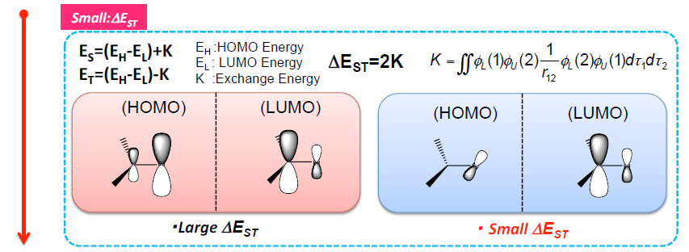
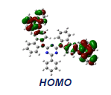
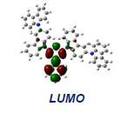
Molecular design of TADF emitters
It is argued that for small ΔE_{S1-T1} we need spatially separated HOMO and LUMO
From C. Adachi, J. Adachi, High Performance TADF for OLEDs

Slide 8
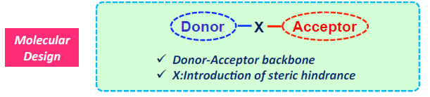
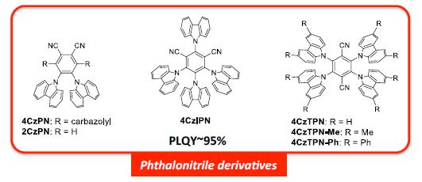
Molecular design of TADF emitters
However, spatially separated HOMO and LUMO lead to small transition dipole
μ = <φ_{L}|r|φ_{H}>
Donor–X–Acceptor molecules are proposed as TADF emitters
From C. Adachi, J. Adachi, High Performance TADF for OLEDs

Slide 9
Molecular design of TADF emitters
If both T1 and S1 are HOMO→LUMO excitations,
E(T1 )≤E(S1) over the entire PES (Hund’s rule)
H_{SO} is small (El-Sayed’s rule)
Nonzero W_{TS} only due to the small ΔE(S-T)
W_{TS} ≤ W_{ST}; to avoid back-transfer, S1 should be highly emissive
which is hardly possible when HOMO and LUMO are spatially separated
S1
~kT
T1
S0
Collision
A different model should be applied

Slide 10
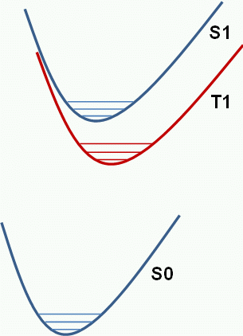
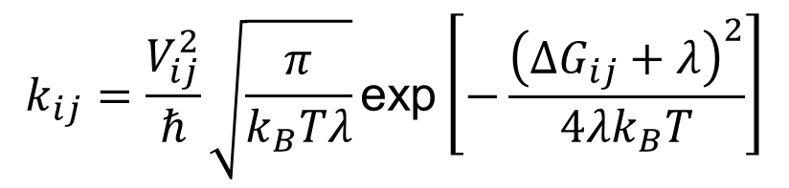
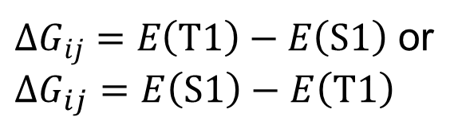

Molecular design of TADF emitters
Vibronic interactions are important
Using Marcus-like rate constant expression
V_{ij}
ISC
RISC
$$k_{ij}=\frac{V_{ij}^{2}}{ℏ}\sqrt{\frac{π}{k_{B}Tλ}}\text{exp}\left[−\frac{{\left(ΔG_{ij}+λ\right)}^{2}}{4λk_{B}T}\right]$$
ΔG_{ij}
$$V_{ij}=\left\langle S1 | H_{SO} | T1\right\rangle$$
$ΔG_{ij}=E\left(T1\right)−E\left(S1\right)$ or
$$ΔG_{ij}=E\left(S1\right)−E\left(T1\right)$$
λ is S-T reorganization energy
Nevertheless, the problem of low V_{ij} remains
Some other states should be involved

Slide 11

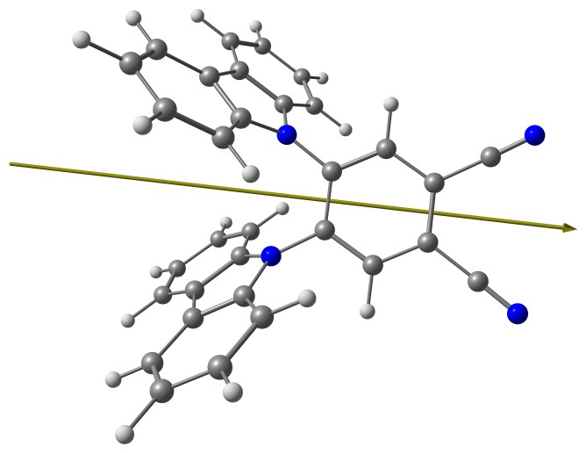
Let’s look at the typical TADF molecule
Bis-carbazolyl-phthalonitrile 2CzPN
Blue emitter (473 nm)
C₂ symmetry

Slide 12
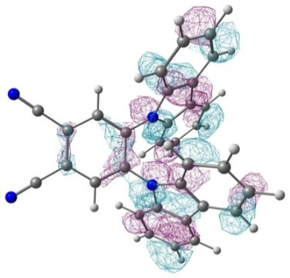
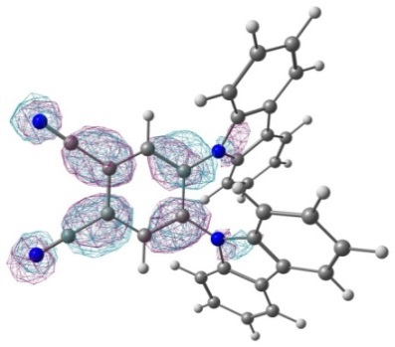
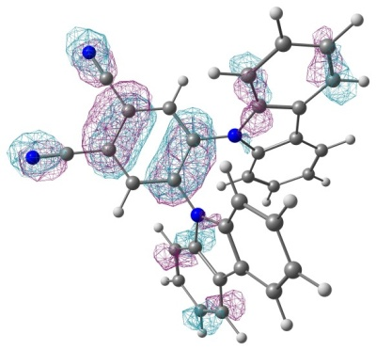
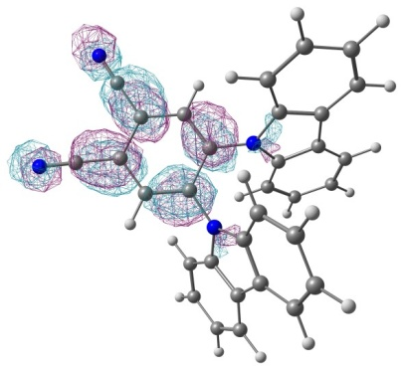
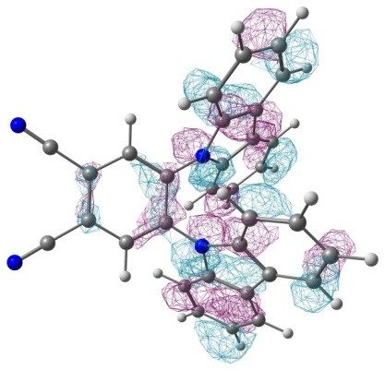

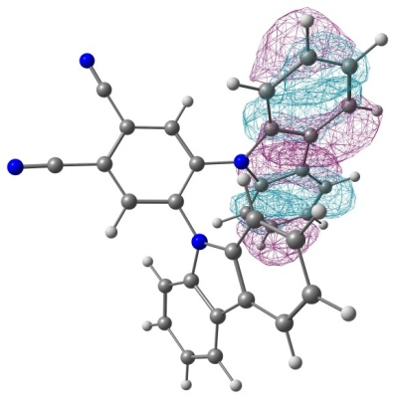
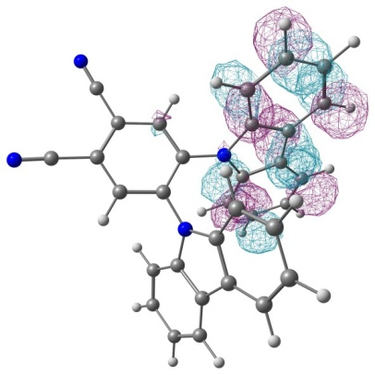
Possible low-lying excited states of 2CzPN
Triplets | Singlets
³ICT
³LE(PN)
¹ICT
³LE(Cz)
This work

Slide 13
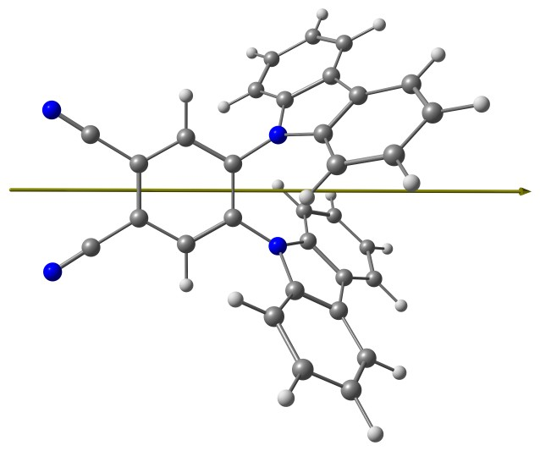
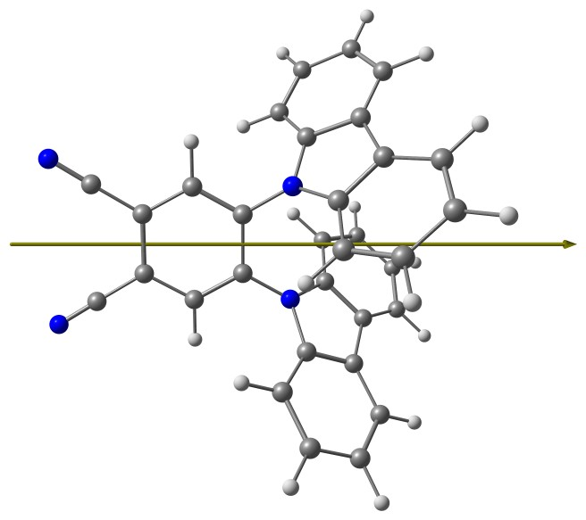
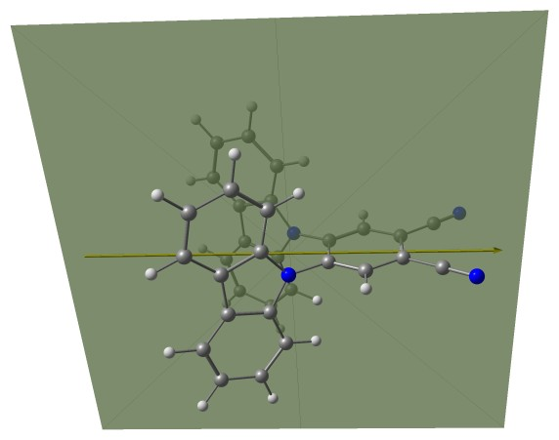
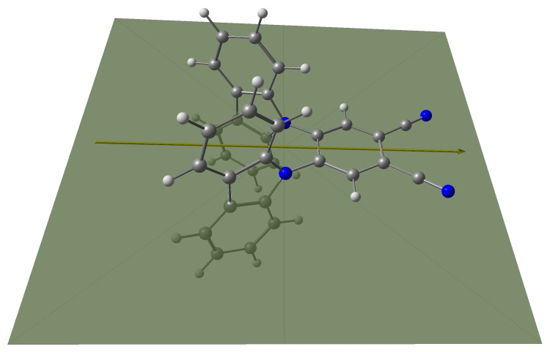
Possible low-lying excited states of 2CzPN
S0 (C₂)
T1 (C₂)
S1 (C_{2v})
This work

Slide 14
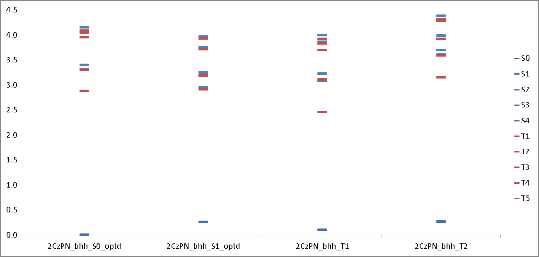
Energy levels of 2CzPN
XMCQDPT2/SA(10)-CASSCF(16,12)/6-31G(d,p)//BHHLYP/6-31G(d,p)
¹ICT
λ^{abs}(calc) = 374 nm
λ^{abs}(exp) = 369 nm
Note the high density of singlet and triplet states: high probability of nonadiabatic interactions

Slide 15
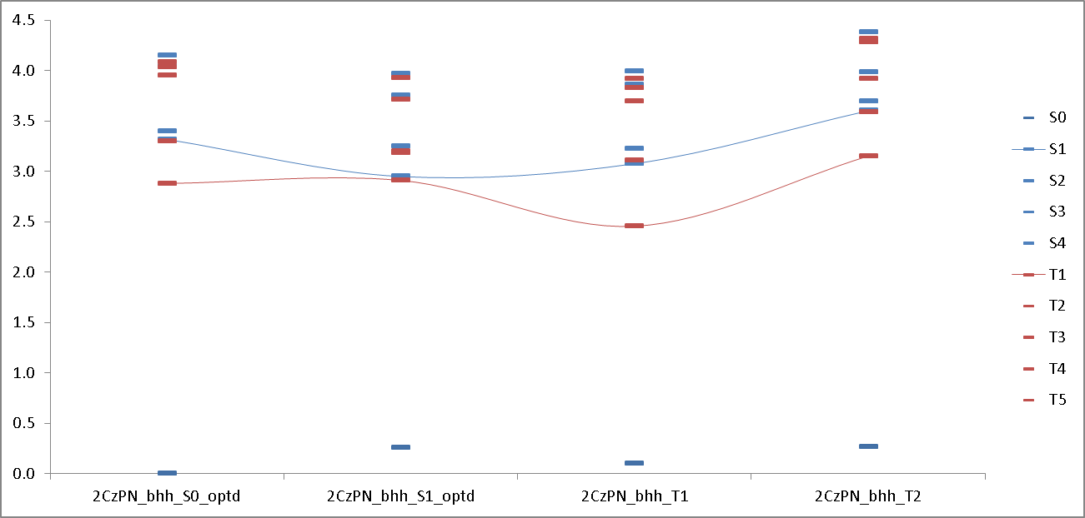
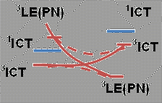
Energy levels of 2CzPN
XMCQDPT2/SA(10)-CASSCF(16,12)/6-31G(d,p)//BHHLYP/6-31G(d,p)
³LE(PN)
RISC
³ICT
³ICT
³LE(PN)
³LE(PN)
¹ICT
ISC
³LE(PN)
λ_{ph}(calc) = 526 nm
λ_{ph}(exp) = 532 nm
λ_{fl}(calc) = 460 nm
λ_{fl}(exp) = 473 nm
k_{fl} = 2.87E+04 s⁻¹
τ_{fl} = 3.48E-05 s
k_{ph} = 2.80 s⁻¹
τ_{ph} = 0.36 s
k_{RISC}(³ICT->¹ICT) = 2.78E-03 s⁻¹
τ_{RISC}(³ICT->¹ICT) = 359 s
k_{ISC}(¹ICT->³ICT) = 6.01E+05 s⁻¹
τ_{ISC}(¹ICT->³ICT) = 1.66E-06 s
k_{RISC}(³LE->¹ICT) = 8.98E+01 s⁻¹
τ_{RISC}(³LE->¹ICT) = 0.01 s
k_{ISC}(¹ICT->³LE) = 3.39E+07 s⁻¹
τ_{ISC}(¹ICT->³LE) = 2.95E-08 s
k_{fl} < k_{isc}. What makes 2CzPN fluorescent?

Slide 16
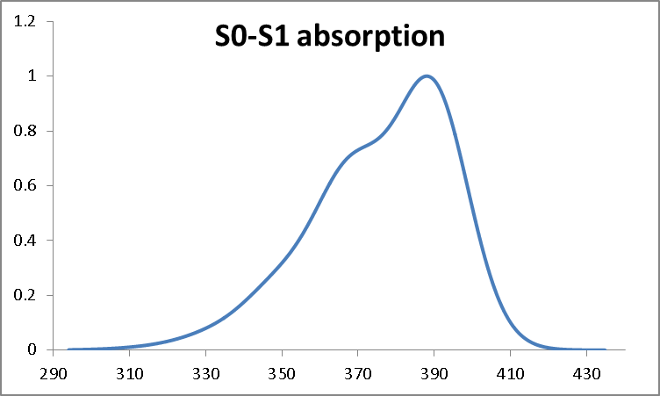
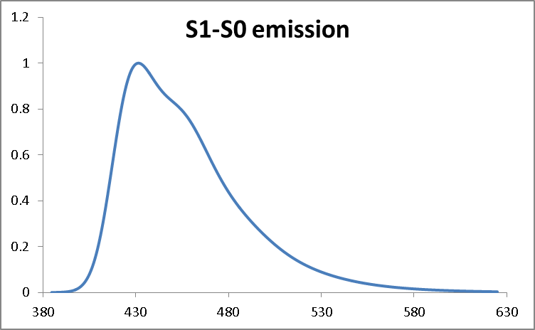
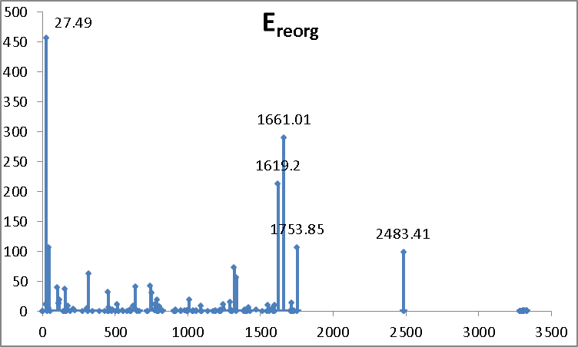
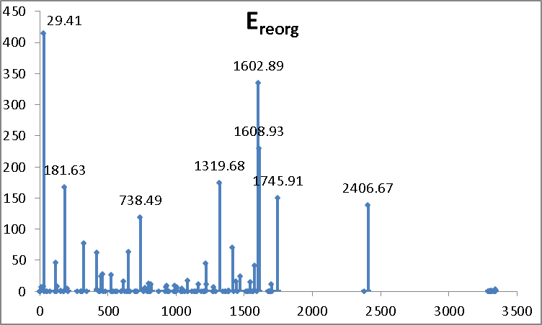
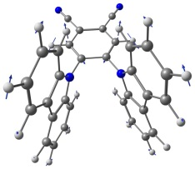
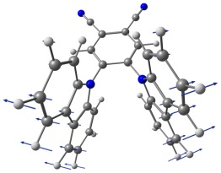
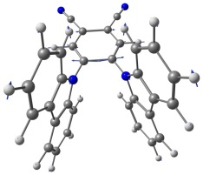
The role of vibrations
Lax’s model of absorption and emisson spectra
Franck—Condon Displaced Harmonic Oscillator model

Slide 17
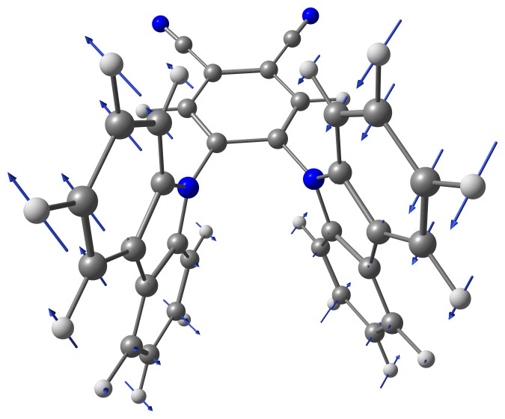
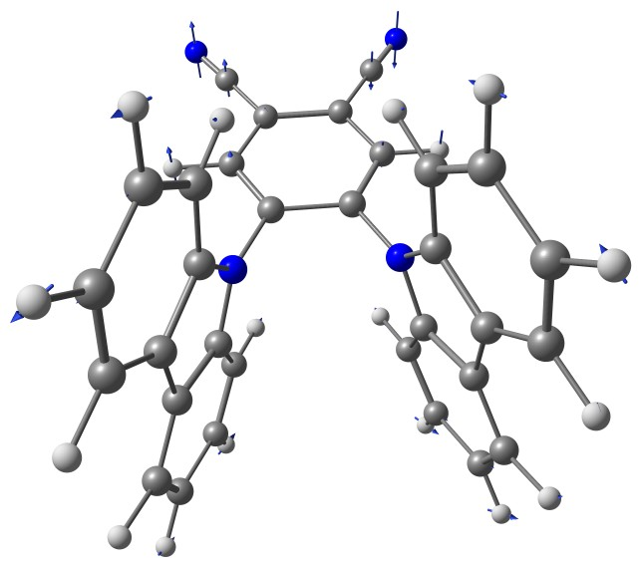
The role of vibrations
Non-condon effects
Mode 7 (12.38 cm⁻¹)
Mode 8 (28.32 cm⁻¹)
Antisymmetric vibrations transferring S1 to S0

Slide 18
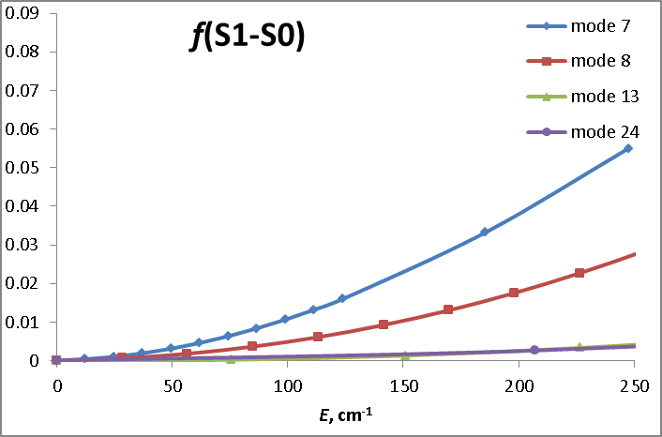
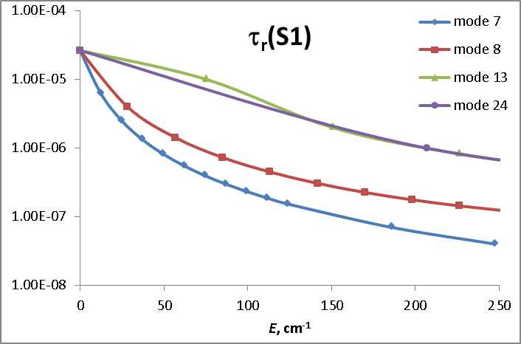
The role of vibrations
Non-Condon effects
Deforming the molecule along 1, 2, …, 20 quanta of
Modes 7, 8, 13, and 24
Deformations along Modes 7 and 8 result in 2 order of magnitude decrease in the radiative lifetime of S1 state!
The vibration periods of Modes 7 and 8 are 2.7 and 1.2 ps (much faster than all the above processes)

Slide 19
Proposed mechanism of TADF in 2CzPN
Electrogeneration of ³LE(PN) state
Route to singlet emission | Competing processes
RISC to ¹ICT surface with k_{RISC}(³LE->¹ICT) = 8.98E+01 s⁻¹ and τ_{RISC}(³LE->¹ICT) = 0.01 s | Phosphorescence with k_{ph} = 2.80 s⁻¹ and τ_{ph} = 0.36 s
Emission from ¹ICT minimum with k_{fl} = 2.87E+04 s⁻¹ and τ_{fl} = 3.48E-05 s | ISC to ³ICT with k_{ISC}(¹ICT->³ICT) = 6.01E+05 s⁻¹ and τ_{ISC}(¹ICT->³ICT) = 1.66E-06 s and to ³LE(PN) with k_{ISC}(¹ICT->³LE) = 3.39E+07 s⁻¹ and τ_{ISC}(¹ICT->³LE) = 2.95E-08 s
Vibrations with ν = 12.38 and 28.32 cm⁻¹ (~1-3E-12 s)
Emission from vibrationally deformed ¹ICT with at least 100-1000-fold rate

Slide 20
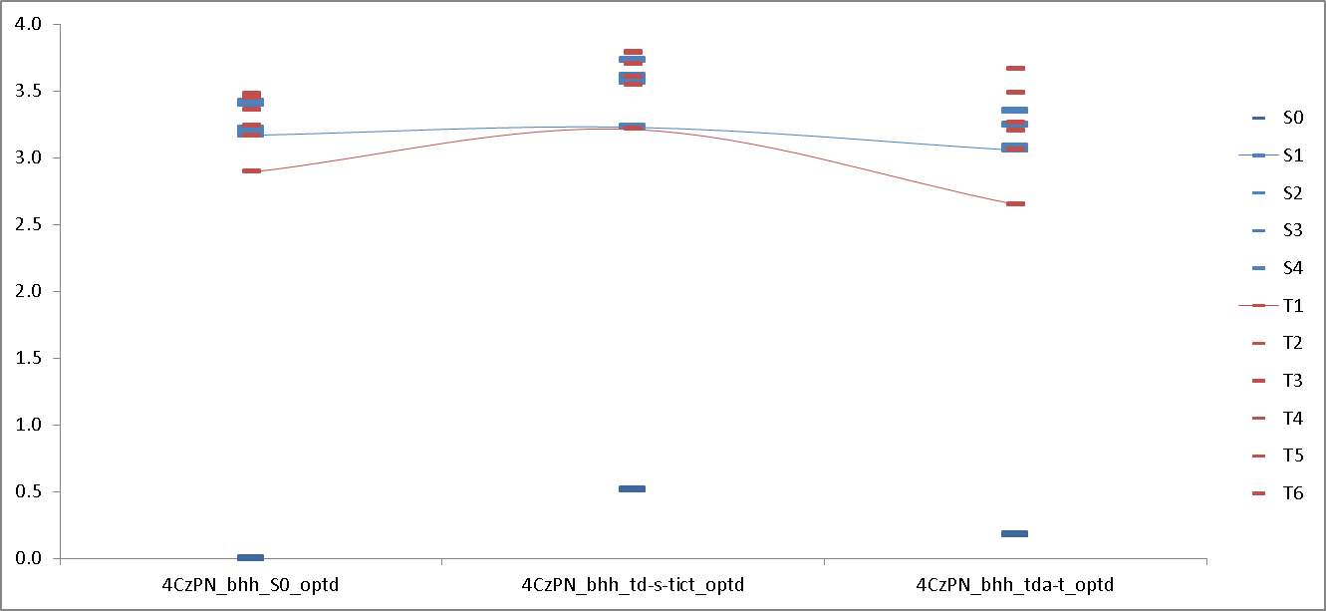

Slide 21
Density Functional vs. Multireference Methods
The problem of proper state ordering
S₃
T₄
S₃
T₄
k_{ST}
S₂
T₃
S₂
k_{ST}
T₃
S₁
T₂
S₁
T₂
T₁
T₁
Correct
Correct
Correct
Too low
k_{ST} is calculated for the wrong states!
Interacting states are correctly predicted
Why it is important?
Correct state ordering influences nonradiative constants and energy transfer pathways in the material

Slide 22
Thank you for your attention!

